Slide 1
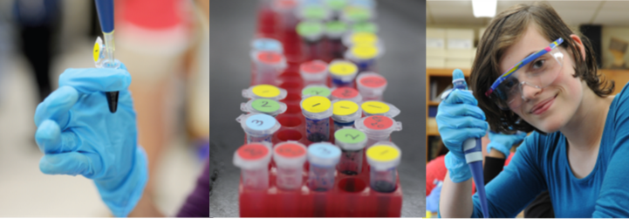


INTRODUCTION
Biotechnology for the classroom
21 July 2026

Slide 2

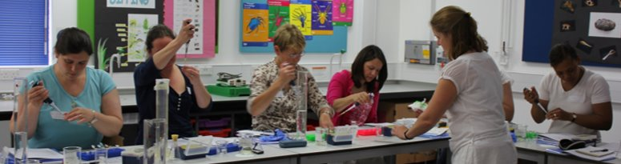
ABE Benefits
Training programme​ ​ Free equipment loan​ ​ Free consumables​ | Free written materials​ ​ Access to presentations​ ​ Support​

Slide 3
ABE “who’s who”
Phil Smith, ABE UK Science Coordinator and CPD Lead
phil.smith@nbi.ac.uk
Lee, Di, Keta, UH Tech team
amgentechsuh@herts.ac.uk
Eddie Orija, ABE UK Site Director
ABEUK@nbi.ac.uk
Philippa Mulberry, ABE UK
Programme Administrator
ABEUK@nbi.ac.uk
Shiree Gilday-Burns - Cambridge
Hub (CRC)
SGilday-Burns@camre.ac.uk
Mauro Rinaldi and Tyler Howell- Bray – Hull hub
M.Rinaldi@hull.ac.uk
Alison Ackroyd & Rachel Alexander – MidKent hub
Alison.Ackroyd@midkent.ac.uk

Slide 4
ABE UK ‘news’
Termly newsletter & online Network meeting
- Nov '24: PCR using MO & ISS
- May '25: Switch to TAE, rationale and examples
Social Media – visibility & news
- @TSNphil / @ABEProgOffice
#biotechexperience

Slide 5
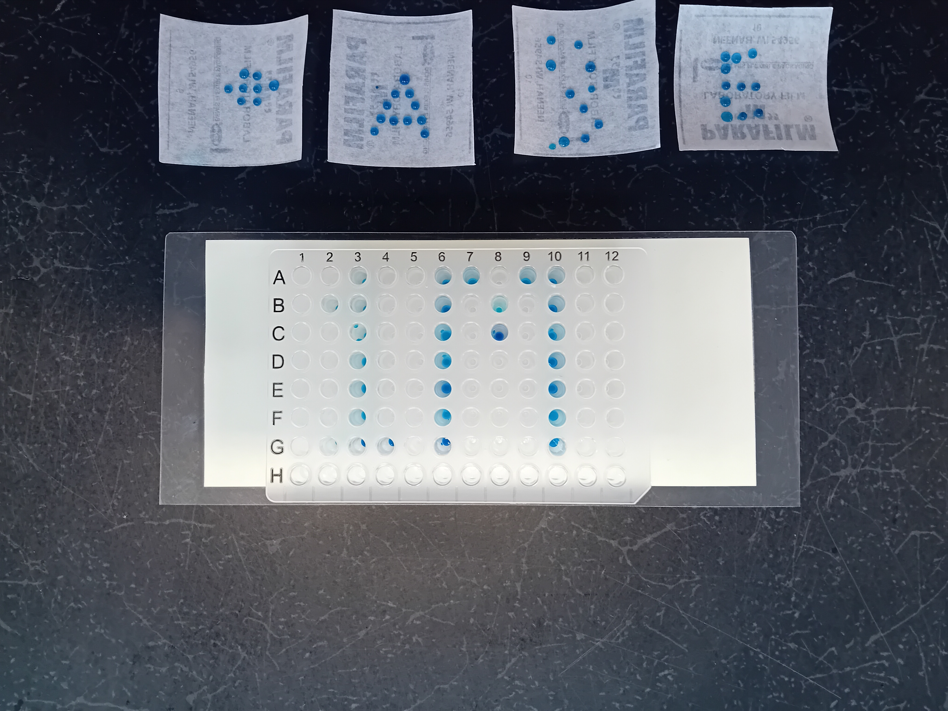

ABE Biotech update
34 yrs
???
2 flags
1 Million students
BBC news website (2 months)
May 2025

Slide 6
"DNA" in the ‘news’
Funeral for Air India crash victim after DNA match
Billion to one' DNA match in 60-year-old murder
New DNA discovered in baby remains investigation
DNA test led man to help family with tragic past
Police swab falcon chicks in trafficking crackdown
Sex offender caught by DNA in his PCSO application
DNA scheme on farm machinery cuts theft - report

Slide 7
Another Strand
“understand the science and check the small print. You were never customers; you were always the product”
Adam Rutherford, TV geneticist speaking about what?
7 million customers
https://www.theguardian.com/commentisfree/2025/mar/27/geneticist-mourn-23andme-useless-health-information
https://www.bbc.co.uk/news/articles/c4grggw4n56o

Slide 8


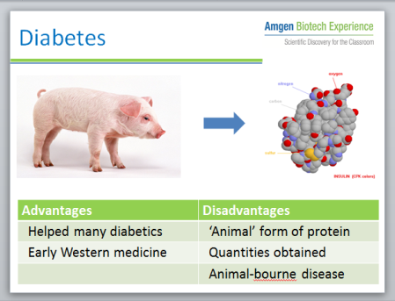
Resources
Student guide
Teacher and technician guide
Video resources
Powerpoints available

Slide 9

Teacher & technician guides
Overview
Preparation
Health and safety
Learning objectives
Prior knowledge and skills
Expected question responses
Additional resources

Slide 10
Student guides
Introduction
Learning objectives
Aims
Materials
Health and safety
Methods
Questions

Slide 11

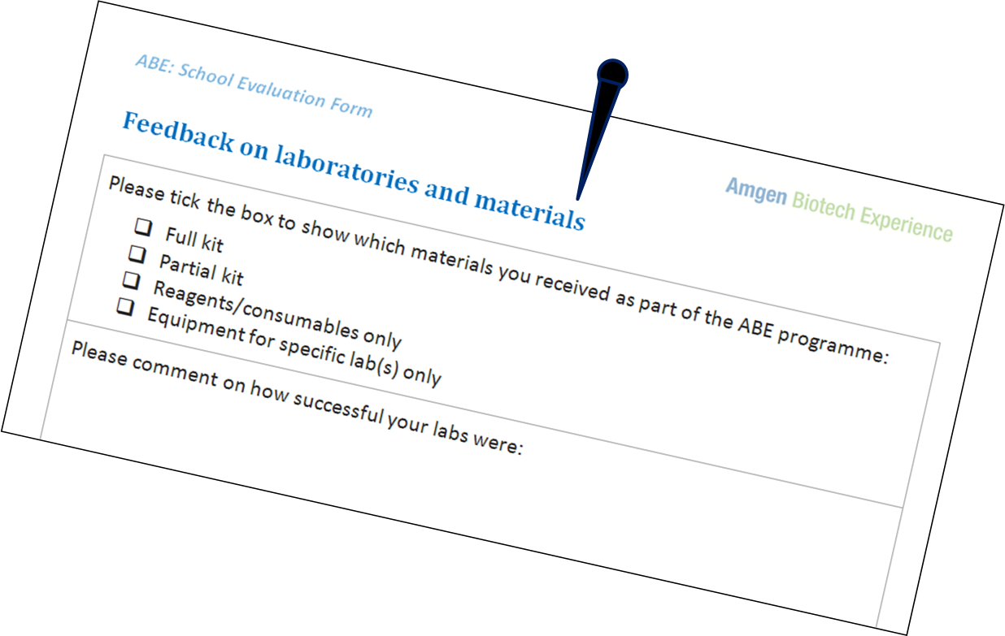
ABE requirements
On-line feedback form for CPD course
School contract
Survey Monkey for box evaluation
These must be completed!!

Slide 12
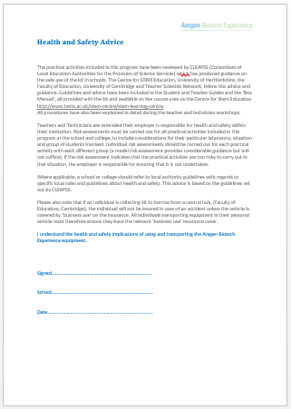
Health and safety
TAE buffer
Gel Red / Gel Green
Microorganisms

Slide 13
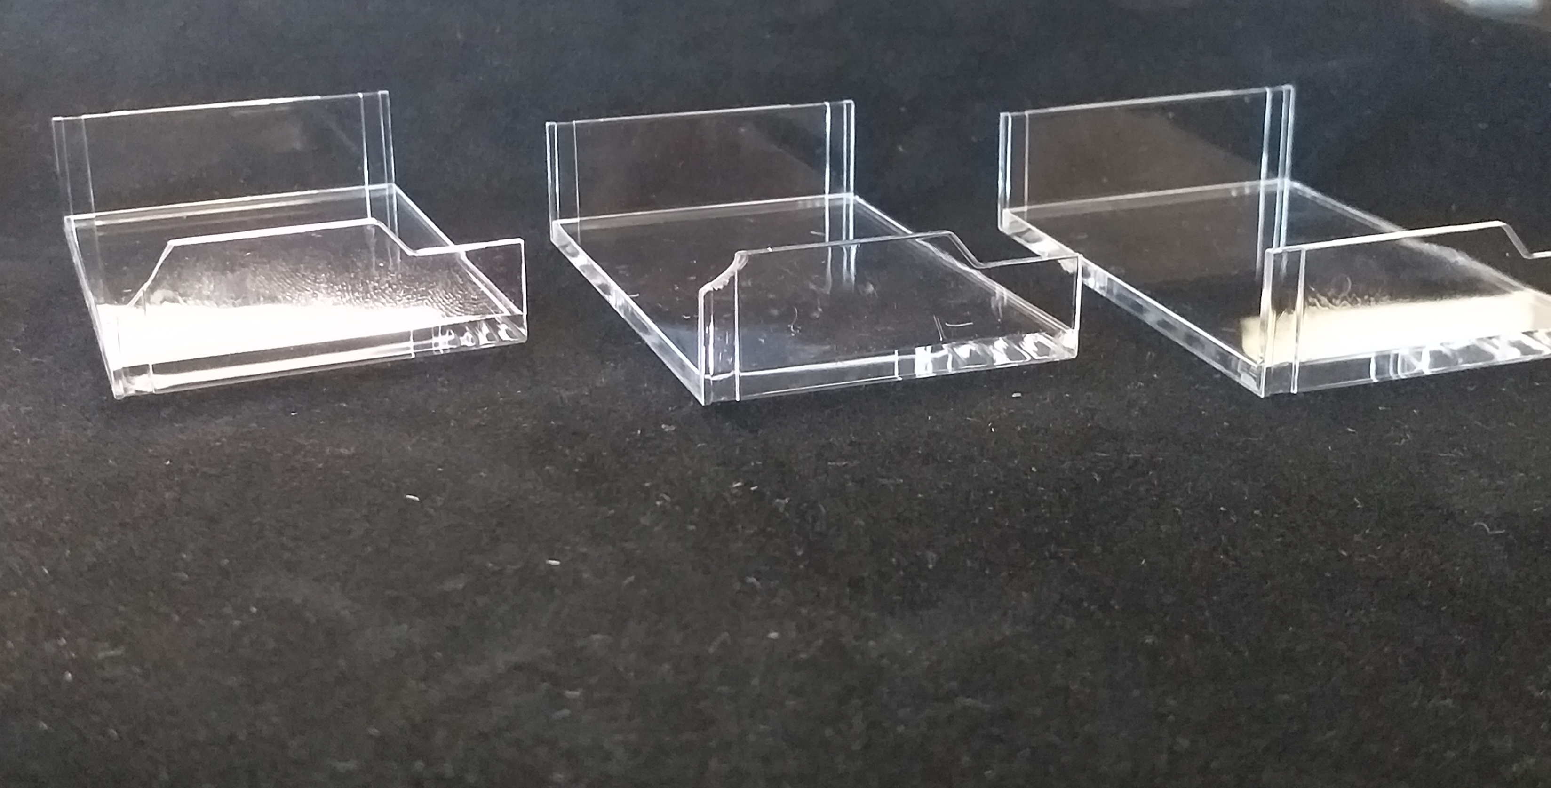
Mini-One, please handle with care!

Slide 14



ABE labs
Lab 2 Restriction digestion
Lab 3 Ligation
Lab 5 Electrophoresis

Slide 15
ABE (UK) Organisation
DNA profiling (lab 9)
Microvolumetrics and pipetting (lab 1)
Restriction digest: pARA and pKAN-R (lab 2)
Restriction digest: pARA-R (lab 2a)
Ligation (lab 3)
PCR (lab 4)
PCR (lab 4a)
Agarose gel electrophoresis:
verification product size(s) (lab 5)
Agarose gel electrophoresis:
verification product size(s) (lab 5a)
Transformation with ligation products (lab 6)
Transformation with pARA-R (lab 6a)
Colony PCR and gel electrophoresis (lab 7)
Colony PCR and gel electrophoresis (lab 7a)

