Slide 1
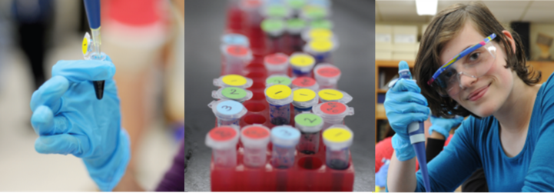


DNA manipulation in the classroom
Technician Day
2 June 2026
Notes:
There are 15 minutes introduction and 45 minutes on box unpacking and sample storage, so this whole section should last about 1 hour.

Slide 2

Programme
9:00 – 9:15 | Introduction: The vital link / reflection
9:15 – 10:30 | Unpacking boxes Sample storage
10:30 – 11:00 | Tea and coffee break
11:00 – 12:30 | Solution preparation Aliquoting reagents Agarose gel preparation
12:30 – 1:30 | Lunch
1:30 – 2:00 | Lab 1 Micropipetting
2:00 – 3:00 | Lab 1 An Introduction to Microvolumetrics and Pipetting
3:00 – 3:15 | Gel documentation
3:15 – 3:45 | Closing comments and feedback
Notes:
To try and give you as much support as we can with the new equipment and techniques that you will be using in school, this is the programme for today.
It’s deliberately not quite so packed full of sessions as yesterday, to give you more of a chance to imagine what it will be like completing the practical work, and to ask lots of questions, so please do stop me anytime to ask anything!

Slide 3

Hub
technician
Technicians
Teachers at school
Notes:
Welcome back, we’re especially glad to see you back for a second day, because we believe that for students to get a positive experience in their Biotechnology education, your role as technicians is vital.
You are the link for the teachers in your school. Based on one of last year’s participating schools, teachers can sometimes get carried away with enthusiasm and not think through the practicalities of getting vast numbers of students to do these practical experiments. They are also not always the most organised at sample storage! You will have more of an idea of how long the preparation of materials for these labs takes and may need to guide teachers in how much help you need from them to run these experiments in your school.
You are also the link with the hub technician. You will be in contact with (NAME) to confirm the number of pairs doing the practicals and the pick up and drop off times for the kit. If there are any problems with supplies or equipment, you will need to either call to sort it out, if it’s part way through the practical work, or bring it to the hub technician’s attention when the kit is returned, so we can sort it out for the next school borrowing the kit.
We have no doubt that you have far more experience in how to organise your time and teachers than we do, but we wanted to try and give you as much support as we can with the new equipment and techniques that you will be using in school.
For example, last year two village colleges quite close to each other, lent each other their technicians for a day when it was their turn to borrow the kit, so that their preparation work and experience could be shared. They found it worked really well and are doing the same again this year.
So before we start, since with the smaller numbers today we may have some chance of remembering everyone’s the names, could you just say again who you are and what school you are teaching at?

Slide 4
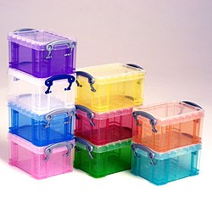
Box unpacking and sample storage
Notes:
Without further ado, let’s get on with box unpacking and sample storage.
Organise participants into 3 groups. Each group unpacks a box in front of the others onto a sheet of white flipchart paper and takes a photo to go on the website as a reminder of what it will look like when they get it. As they do this talk through:
The first thing to do when you get the kit is check that everything is there that should be! As well as the box lists laminated to the inside lids of the boxes, there will be an XL spreadsheet included, telling you the number of pairs of students you are performing the labs with and how much of the equipment and consumables you will need and have been given to do this (an example of this sheet is on the next overhead).
Sample storage on arrival – the colour coding system
The box lists laminated to the box lid with OHP pen to check off as repacking
Please return anything you don’t use
Please refill tip boxes before returning
Rinse gel electrophoresis chambers with water and air dry – the delicate wires inside are easily broken by hand-drying
Please leave your gel photos on the camera so we can see how you got on – we are continually aiming to improve results for you and seeing your results will help us to do this
DON’T FORGET the TEACHER AND TECHNICAIN EVALUATION forms. We both want to check that you are having a positive experience doing these practicals and need to show that we are evaluating the programme to get continued funding for it!

Slide 5
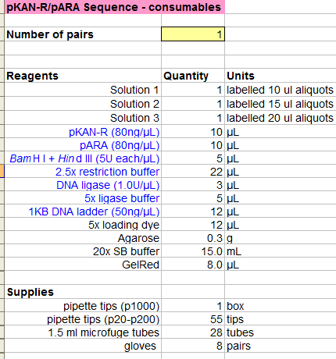
Blue = store @ -20°C (in freezer)
Black = store at room temperature
Notes:
An example of the XL spreadsheet showing the quantities of reagents you have in the boxes.

Slide 6
Notes:
After box unpacking it is tea break time – back at 10.30.
Then there are 1 ½ hours on Solution preparation, Aliquoting reagents, and Agarose gel preparation
In fact I would do this in a different order:
Aliquoting reagents
Solution preparation
Agarose gel preparation
If this doesn’t take all that long then continue to do ‘lab 1 micropipetting’ before lunch

Slide 7
IX. Aliquoting Guide
We have provided sufficient reagents for the number of students you indicated on the ‘School Application Form’, including a bit extra for pipetting errors.
Laboratory 1. An Introduction to Microvolumetrics and Pipetting
Size of tube | Label tube | Contents of tube | Aliquot | Actually used
1.5 mL | *Solution 1 | Blue and purple dye | 10μL | 4μL
1.5 mL | *Solution 2 | Blue, purple and yellow dye | 15μL | 8μL
1.5 mL | *Solution 3 | Purple dye | 20μL | 12μL
1.5 mL | **dH₂O | Distilled water | 1000 μL | Varies
*A class set (12 tubes) has been pre-aliquoted and can be found in one of the Boxes in a plastic microfuge tube box.
** dH₂O is used for several labs.
Laboratory 2. Restriction Analysis of pARA and pKAN-R
Size of tube | Label tube | Contents of tube | Aliquot | Actually used
1.5mL | pARA | pARA (80ng/ μL) | 10μL | 8μL
1.5mL | pKAN-R | pKAN-R (80 ng/ μL) | 10μL | 8μL
1.5mL | B/H | BamH I and Hind III | 5μL | 4μL
1.5mL | 2.5x buffer | 2.5x restriction buffer | 20μL | 16μL
1.5mL | *dH₂O | Distilled water | 1000μL | 4μL
* dH₂O is used for several labs.
Notes:
When the kit arrives, after you have checked and unpacked it, you will need to start to aliquot and prepare the reagents for the students. Don’t panic!
We give you enough reagents for all of the students and a bit extra for errors!
The ‘School Preparation Guide’, pages 5 – 9 in the box manual, tells you what needs to be done (i) as soon as you have time after the kit arrives, (ii) what to do before the lab starts, and (iii) after the lab has finished. I’ve deliberately used the politicians style of speech there, ‘needs to be done’, because I think there needs to be communication beforehand about who is going to do what and when.
Section 9 of the Teacher manual is the ‘Aliquoting Guide’, which gives you an overview of how much you aliquot of the different reagents, and how much the students then use.
When the kit arrives:
It will contain microfuge tubes of solutions 1, 2 and 3, already aliquoted for you
You will need to aliquot the other reagents
You will need to dilute the 20X SB buffer for use at a 1X concentration
You will need to either pour the agarose gels for students, or melt and leave in Falcon tubes in a 60oC waterbath so that they can pour their own (please return Falcon tubes for reuse
You will need to dilute the 10,000X GelRed DNA stain in water, for use at a 3X concentration
We will go through calculations for:
Diluting SB buffer
Preparing agarose gels
Diluting GelRed

Slide 8
C₁V₁ = C₂V₂
C₁= desired concentration
V₁= desired volume
C₂= stock solution concentration
V₂ = volume required
Notes:
Hints on solution preparation can be found in section VII of the Teacher Guide, ‘Preparation hints’, page 36.
So for yourselves today, working in pairs you need to prepare:
400 ml of 1X SB buffer from 20X SB buffer stock solution
100 ml of 10,000X GelRed DNA stain in dH2O to a final concentration of 3X GelRed
An 0.8% agarose minigel, which need to be 30 ml volume
Run through an example of how to use the formula. Then ask them, in pairs, to do the above calculations. Then check them, then get them to prepare the 20X SB buffer and agarose gel for use after lunch. Won’t make up GelRed again, as we’ll use the solution from yesterday.
(1) (1 x) (400) = (20 x) (V2)
400 = V2
20
20 = V2
So 20 ml of 20X SB buffer + 380 ml dH2O = 400 ml of 1X SB buffer
(2) (3 x) (100) = (10,000 x) (V2)
300 = V2
10,000
0.03 ml = V2
30 ul = V2
So 30 ul of 10,000X GelRed stain in 100 ml of dH2O = 100 ml of 3X GelRed staining solution
(3) A percentage (1%) weight by volume solution is 1 gram per 100 ml.
0.8 g x 30 ml = 0.24 g
100 ml
So weigh 0.24 grams of agarose into a 100 ml glass flask, add 30 ml of 1X SB buffer and melt.
TIPS: don’t swirl excessively as agarose gets stuck on sides of flask. Do remember to use a heatproof glove! Do remember to prepare the trays!
POINTS: You can pour melt and pour multiple gels at the time – only limited by the number of gel trays and combs that you have
you need to decide with the teachers if you or the students will dilute the 20X SB buffer to go in the electrophoresis tanks!

Slide 9
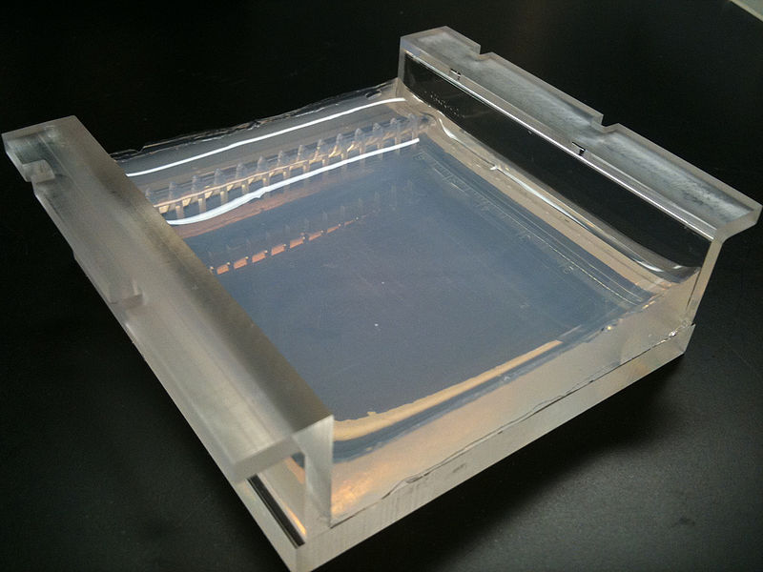
Notes:
Check calculations
Make SB buffer
Make agarose gels – this one is a right whopper, yours will be much thinner!!

Slide 10
Notes:
After Solution preparation, Aliquoting reagents, and Agarose gel preparation it is lunchtime – back by 1:00.
The next session on micropipetting is set to last 30 minutes

Slide 11

Laboratory 1: micropipetting
1 Twist dial to desired volume
Add disposable pipette tip
Press plunger to first stop
Insert pipette tip into solution to be
transferred
Slowly release plunger to retrieve liquid
Move pipette tip into desired tube
Press plunger past first stop to second stop
to transfer liquid, keep the plunger down
as you remove it from the tube.
8 Eject tip
Notes:
As the ones who will probably end up using these beautiful pieces of equipment a fair amount, you are a valuable resource for teachers for your expertise.
In 2 schools last year I know that technicians went in to help students using their micropipettes, so this section is both for you and for teaching methods that you, or your teachers could adopt (we couldn’t fit everything into one day, so theses bits you will need to feed back!).
So a reminder of how it’s used

Slide 12
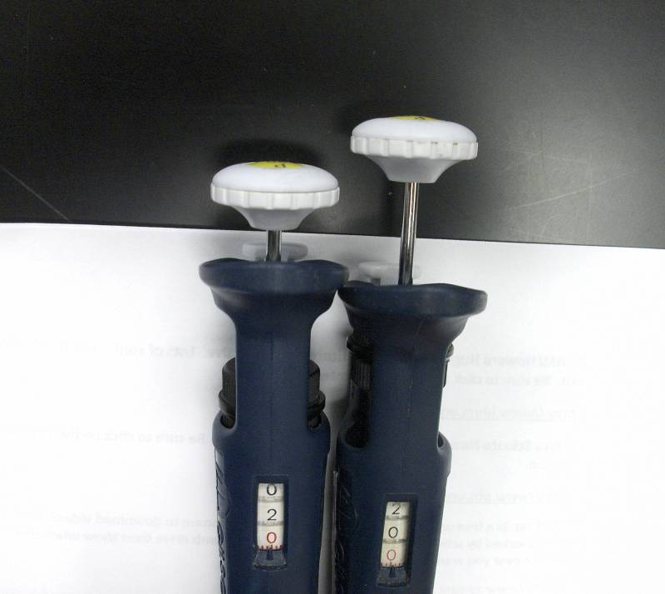
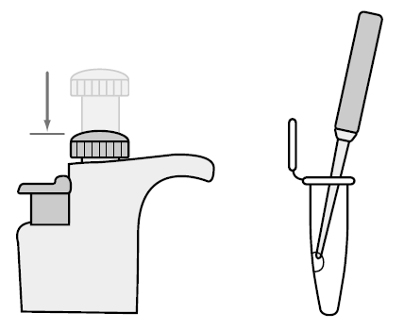
Laboratory 1: micropipetting
Notes:
12
You can tell that the pipette on the left is set to 2 ul and the pipette on the right is set to 20 ul. The distance that the plunger depresses will feel very small when you are dispensing such small quantities, but don’t be tempted to go to the second stop when aspirating.
When dispensing such small quantities do it on the side of the tube, so you can see it, there is a microfuge available to pool reagents at the bottom of tubes.
Now I’m going to suggest and you get to try 3 different ways of getting students used to dispensing such small quantities of liquids:
1 – using filter paper
2 – using laminated sheets
3 – using lab 1 from the manual

Slide 13
Laboratory 1: micropipetting
University of Leicester video on using a micropipette

Slide 14
Laboratory 1: micropipetting
2 μl
5 μl
10 μl
20 μl
Notes:
You can use filter paper and food dye

Slide 15
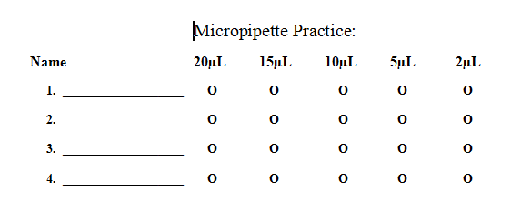
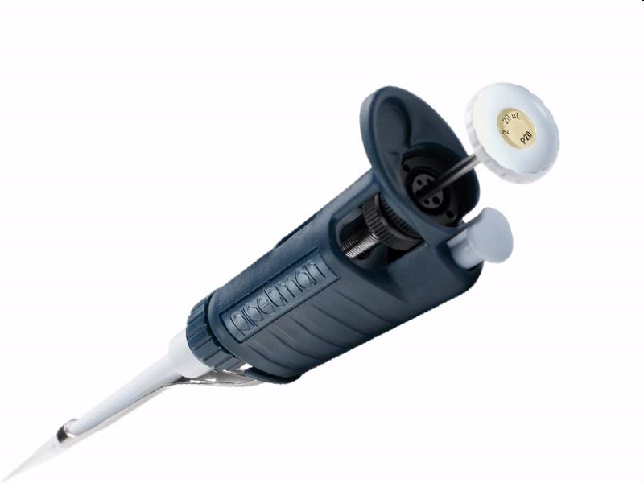
Laboratory 1: micropipetting
Notes:
15
You can use laminated sheets with food dye

Slide 16
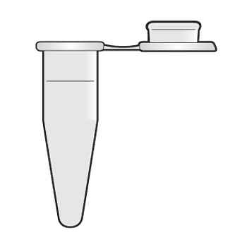
Laboratory 1: micropipetting
Pipetting Exercise 2, LAB 1, page 1.4 student guide
Keep and load …
Notes:
You can use the ‘Pipetting exercise 2’ from Lab 1 (page 1.4)
Have a go at all 3 and see what you think!
Keep hold of the tubes from Pipetting exercise 2 for use later.

Slide 17
Notes:
After micropipetting is ‘Lab 1 An Introduction to Microvolumetrics and Pipetting’ set to last for 1 ½ hours. These 2 flow together quite nicely, so do blur the boundaries of timing. Gel electrophoresis needs to be started at latest by 1.45 so that the ligation reactions have time to separate (45 minutes run time takes us up to 2:30 for gel staining and gel documentation at 3:00).
Prepare gel in electrophoresis tanks and load Lab 1 samples. Then talk through agarose gel electrophoresis whilst they progress.

Slide 18
Laboratory 1: micropipetting
University of Leicester video on gel electrophoresis

Slide 19
Laboratory 1: micropipetting
Tube L:-
LIG 5ul
H2O 3ul
Dye 2ul
Ligation reaction
DNA marker
Solution A
Solution B
Solution C
K+
A+
Notes:
Loading 5 lanes today, not just the 3 for lab 1, because we will also load DNA ladder and ligation reaction to see if any bands are visible from yesterday’s reaction.
Need to:
Remove tape
Remove comb
Prepare ligation reaction
Load 5 samples

Slide 20
Laboratory 1: micropipetting
Marker
LIG - 1
LIG - 2
LIG – 3
LIG - 4
LIG - 5
A +
K +
Notes:
Loading 5 lanes today, not just the 3 for lab 1, because we will also load DNA ladder and ligation reaction to see if any bands are visible from yesterday’s reaction.
Need to:
Remove tape
Remove comb
Prepare ligation reaction
Load 5 samples

Slide 21
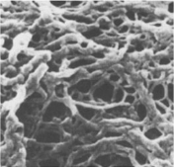
Laboratory 1: micropipetting
Magnified image of Agarose Matrix
Notes:
Once all the gels are running talk through what is (ad will happen):
So molecules are separating through agarose gel matrix – larger molecules go faster.

Slide 22
Laboratory 1: micropipetting
Notes:
These are the 3 coloured molecules loaded in solutions 1, 2 and 3.
Looking at their molecular weights which would you expect to migrate:
the furthest?
the shortest distance?

Slide 23
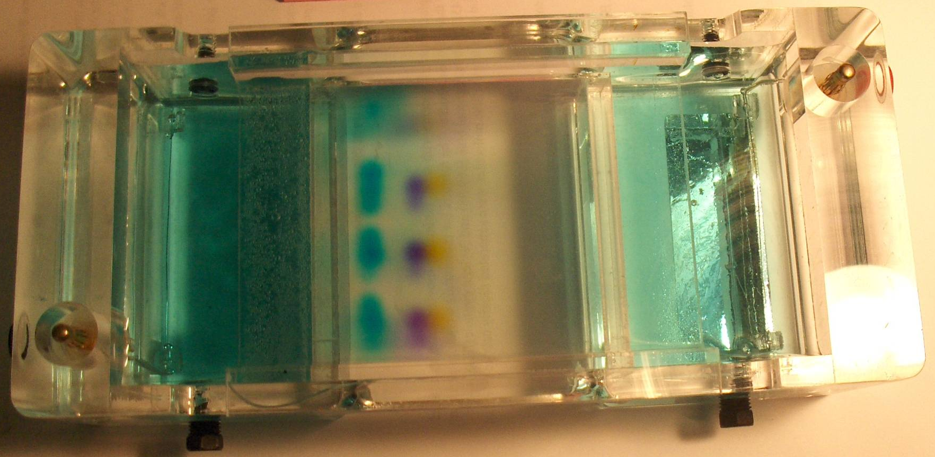
Laboratory 1: micropipetting
Xylene cyanol
Bromophenol blue
Orange
G
Notes:
You should find in this lab that the dyes don’t come out in the order that you would predict by size alone. Any ideas what else could be a factor in the rate of dye migration through the agarose gel matrix?
- Shape
- Electronegativity
Also play a role.
Bromophenol blue has greater electronegativity than xylene cyanol.
Once you’ve talked through this then get the participants to set up the GelRed gel staining trays and Fotodyne system, ready for gel imaging.

Slide 24
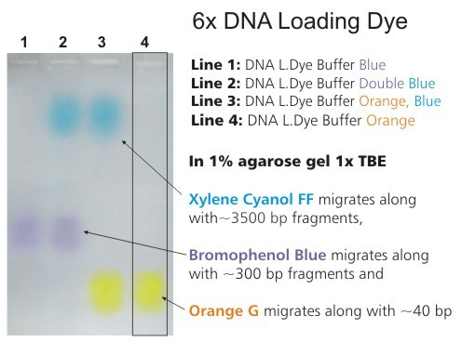
Laboratory 4 : Gel electrophoresis
Notes:
24
Some of your gels will have been stopped for you, just before the dye Orange G reached the end of the gel. Some are just completing electrophoresis. When you look at your gel you should see that the 3 dyes have separated considerably. The exact size of DNA fragment that they co-migrate with will depend on the percentage of the gel and the type of loading buffer used.
You won’t see any DNA yet, you need to stain the gels and then look at them on a UV transilluminator, to get a picture of them using the special camera hood and filter.
2 gels will fit in 1 gel staining tray and reduce the amount of the very expensive DNA stain, GelRed, that is needed to cover the gel for staining. 100 ml of GelRed will be enough to stain 2 minigels. GelRed, whilst a safer alternative to the mutagenic and carcinogenic ethidium bromide, is still a DNA stain, which intercalcates in DNA, of which we have plenty, so you need to wear gloves, eye protection and as it stains, I would recommend a lab coat whilst using it.
So in groups of 4 pairs (working with the others from your electrophoresis station) you need to:
measure out 100 ml of distilled water in a measuring cylinder
Pour a little water into a gel staining tray
Add 30 ul of GelRed 10,000 x concentrate, using 2 x 15 ul, measured using a Gilson p20 pipette
Add the rest of the water on top – this helps to mix the GelRed into the water
Slide the 2 gels into the gel staining tray (taking care not to rip or drop them!) and label the ends of the tray with tape, so you know which gel belongs to whom.
Stain for 30 minutes agitating occassionally to aid diffusion of GelRed into the gel.
Once you’ve got the gels staining then we’ll look at the predicted results and then be able to see your results on the UV transilluminator and photograph them.
Get gels into GelRed stain

Slide 26
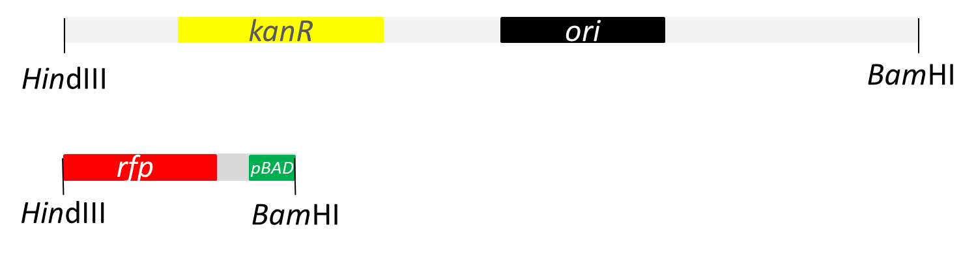
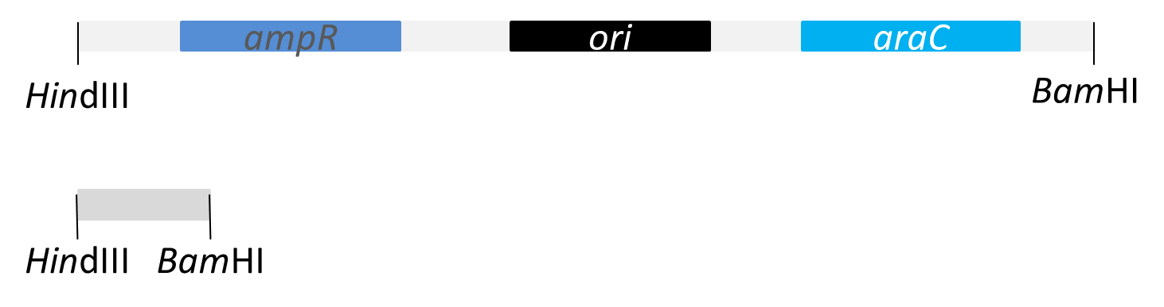
Lab 2: restriction digestion
4,705 bp
pKAN-R
807 bp
4,495 bp
pARA
377 bp
Notes:
These are the fragments produced from the restriction digests in linear form.
The 4705 bp fragment from pKAN-R with the gene for kanamycin resistance, kanr.
The 807 bp fragment from pKAN-R with the pBAD promoter and rfp gene.
The 4495 bp fragment from pARA with the ampicillin resistant gene, ampr and araC gene.
The 377 bp fragment from pARA.
If you use this information to look ahead to what the agarose gel will look like with theses samples loaded onto it…

Slide 27
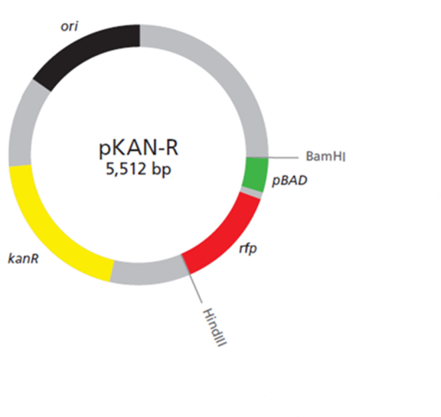
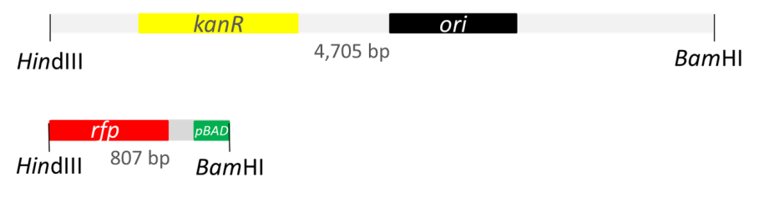
Lab 2: restriction digestion
1 Kb
K +
A-
A+
K-
10.0
8.0
6.0
5.0
4.0
3.0
2.0
1.5
1.0
0.5
Notes:
pKAN-R is 5,512 bp. Expect a single band at this size.
After digestion expect bands of 4,705 and 807 bp. 2 bands.

Slide 28
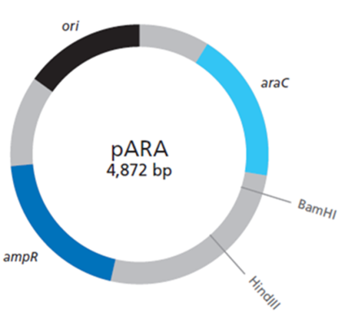
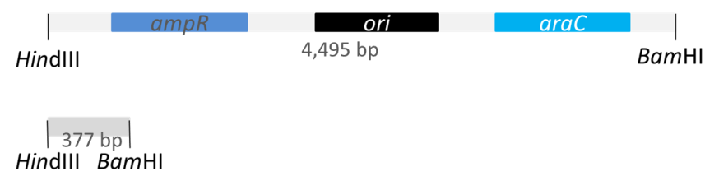
Lab 2: restriction digestion
1 Kb
K +
A-
A+
K-
10.0
8.0
6.0
5.0
4.0
3.0
2.0
1.5
1.0
0.5
Notes:
pARA is 4,872 bp. Expect a single band.
Expect 2 restriction fragments; 4,495 and 377 bp.

Slide 29
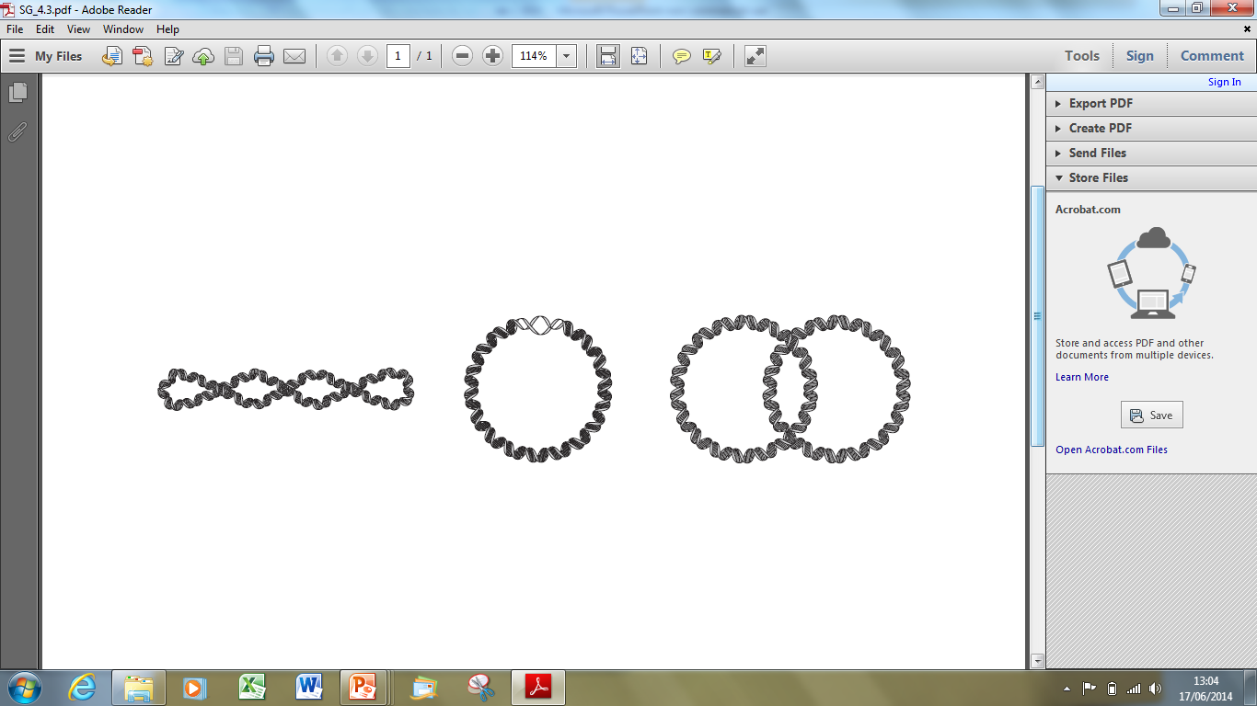
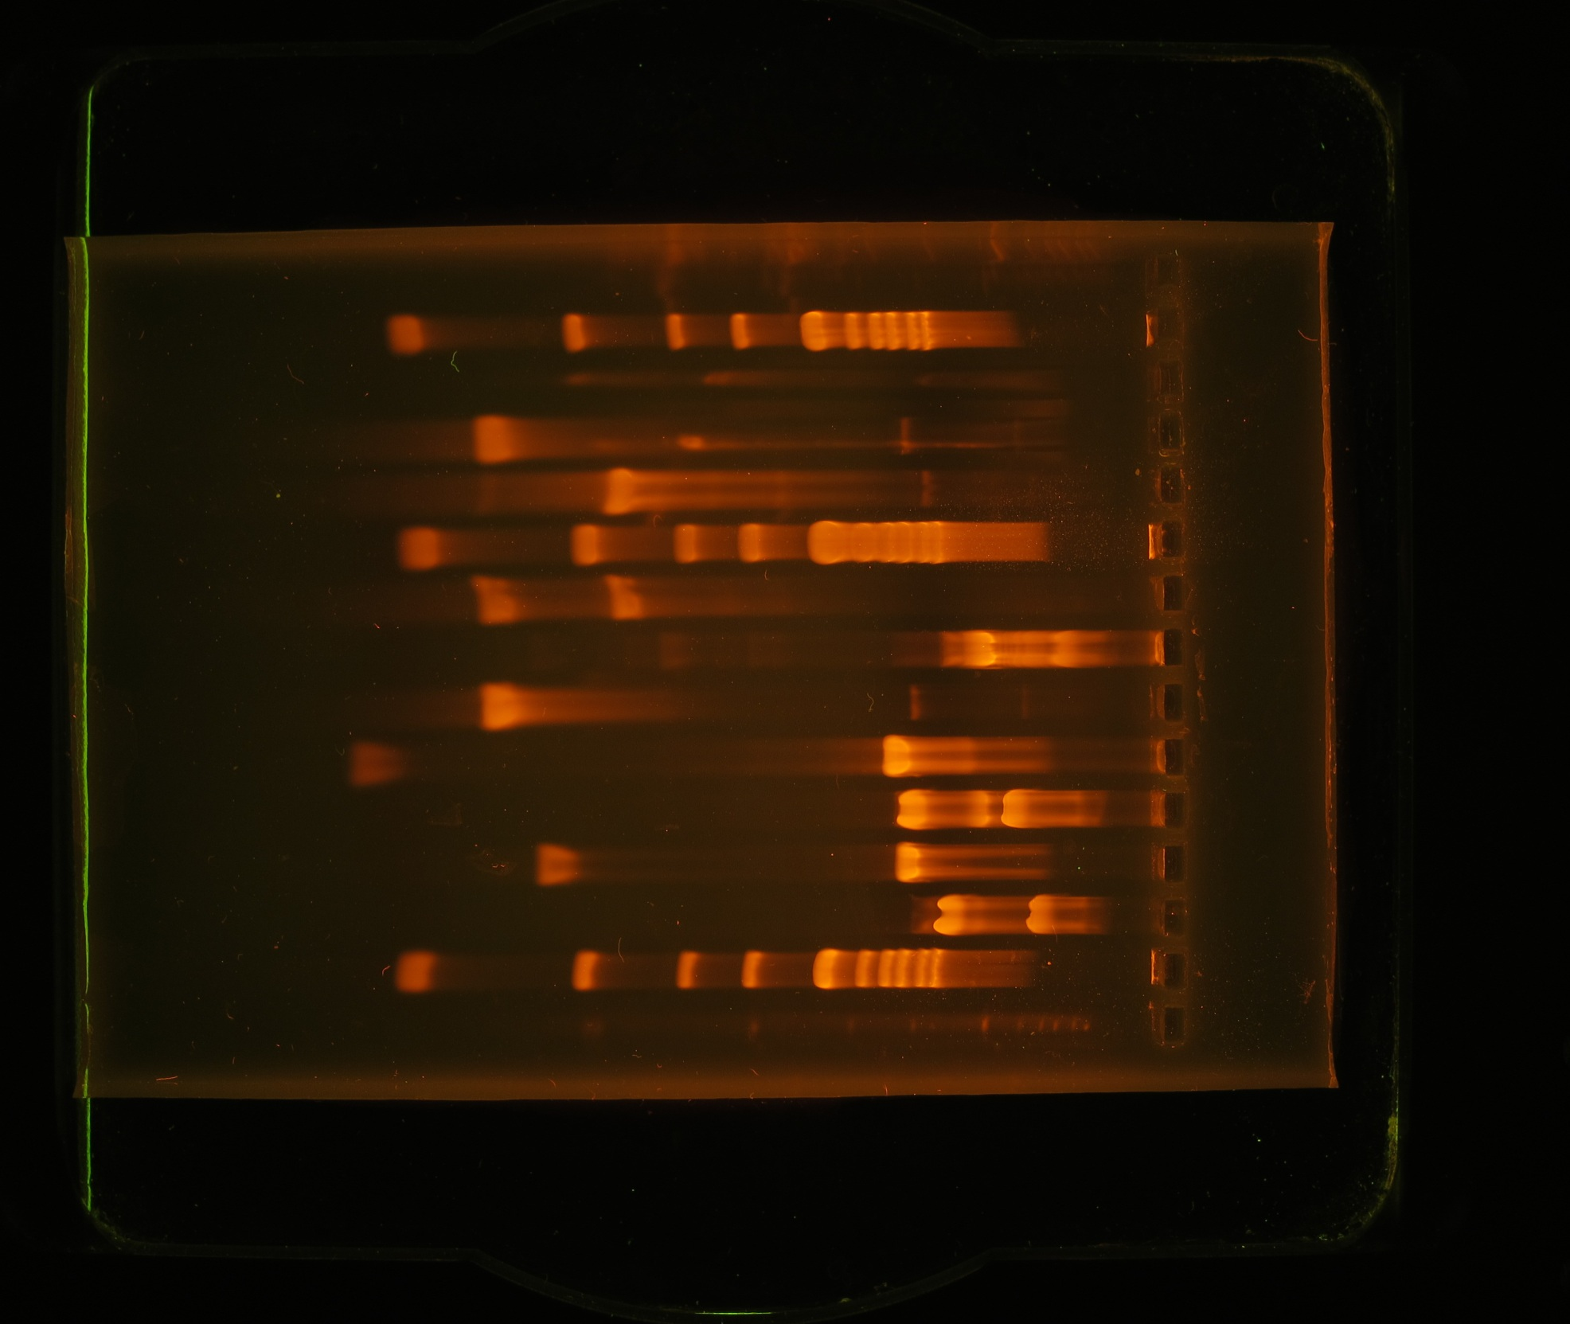
Lab 2: restriction digestion
1 Kb
K +
A-
A+
1 Kb
K+
K-
K-
A-
A+
multimer
10.0
10.0
8.0
8.0
6.0
6.0
5.0
5.0
4.0
4.0
3.0
3.0
Nicked circle
2.0
2.0
1.5
1.5
1.0
1.0
supercoiled
0.5
0.5
Notes:
So this is what you’d predict to see.
It will match well in the lanes where restriction digests were loaded, but not in the lanes containing undigested plasmid.
This is because plasmids come in different forms.
You will see at least 2 bands, probably supercoiled and nicked circle, you may also see mulitmers.

Slide 30
Lab 2: restriction digestion
High Resolution – Scanning Electron Microscope imaging of the three-dimensional surface topology of (a) supercoiled plasmid pUC21, (c and d) open-circular DNA molecules of pBR322 plasmid.
Taken from; YAFFEE, M, WALTER, P., RICHTER, C. and MULLER, M. (1996) Direct observation of iron-induced conformational changes of mitochondrial DNA by high-resolution field-emission in-lens scanning electron microscopy (DNA unwinding/iron colloid formation/backscattered electron detection). Proceedings of the National Academy of Sciences of the USA 93; pp. 5341-5346.
Notes:
And here are what I think are some rather lovely pictures of supercoiled and ‘open-circular’ or relaxed circle plasmids.

Slide 31
Notes:
Hopefully today I’ve taken you through:
What the kit will look like when you get it
What needs to be done with the different bits of it
Some ideas to share at school about micropipetting
Results from the ligation reactions

Slide 33
Science and technical support/supplies:
PHIL SMITH
phil.smith@nbi.ac.uk
01603 450304 / 07388 115080
Notes:
For more information on course: Kate
For more information on the Science / teaching: Karen
If you become part of the programme, the most important person is Kusum, who co-ordinates all the equipment and consumables, from here at Harrow College.

