Slide 1
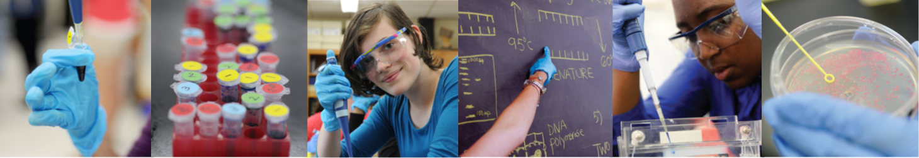
Biotechnology in the classroom (Course 2)
> DATE <
#biotechexperience

Slide 2

Objectives
By the end of this course you will:
Feel confident preparing for labs 4/4a, 5, 6/6a, 7/7a
Feel confident carrying out labs 4/4a, 5, 6/6a, 7/7a
Be aware of Health and Safety requirements
Know where to access resources
Know who to contact for support

Slide 3
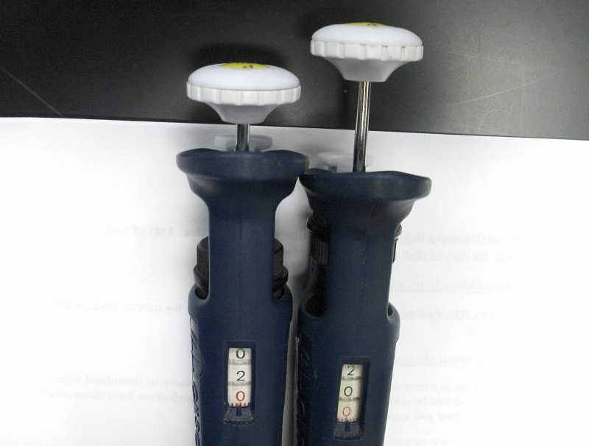
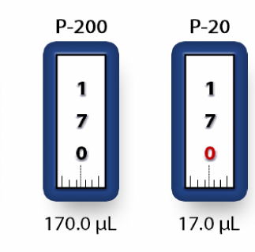
Micro-pipetting
P20 – used in Y1 – max. volume 20ul
P200 – used with P20 in Y2 – for vols between 20 and 200ul

Slide 4
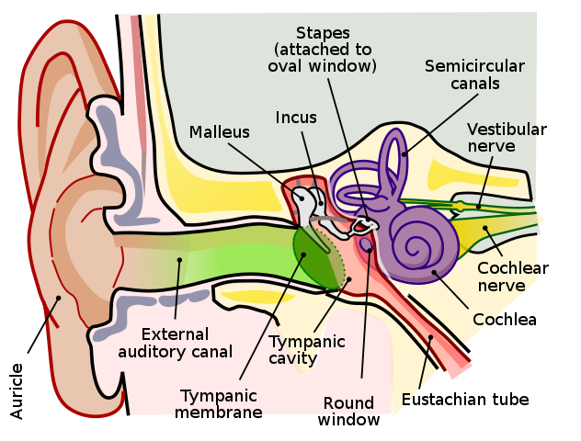
Introducing PCR
PCR
1 – Who invented PCR?
2 – What are the 3 stages of PCR?
3 – How many uses of PCR can you hear?

Slide 5
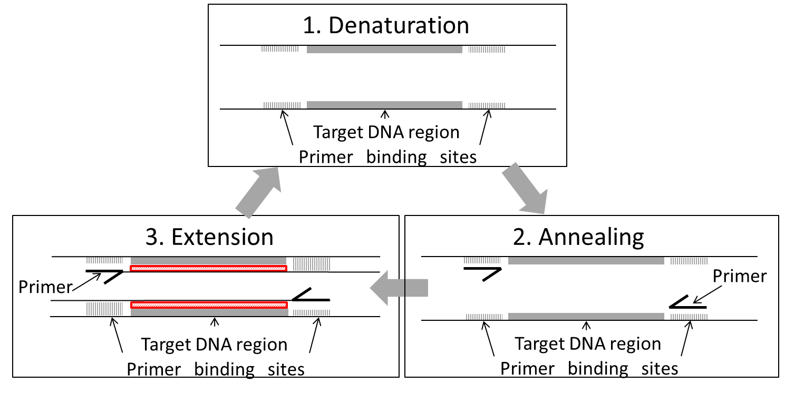
Introducing PCR

Slide 6
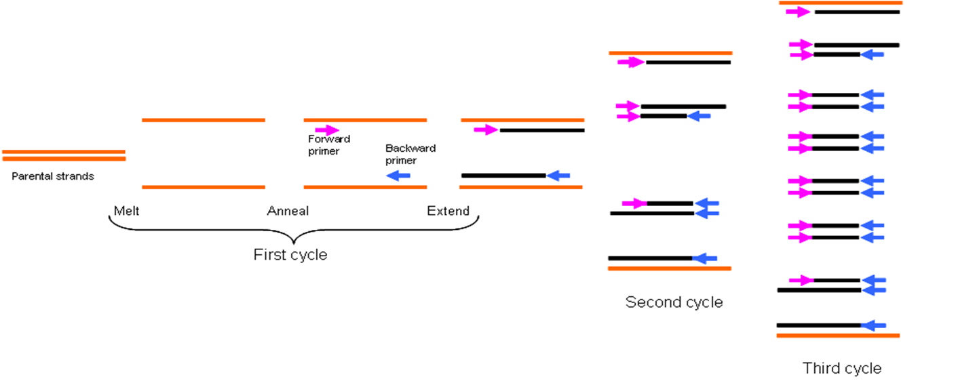
Introducing PCR

Slide 7
Introducing PCR
Number of PCR cycles | Lengths of dsDNA
1 | 2
2 | 4
5 | 32
10 | 1,024
20 | 1,048,576
35 | 34,359,738,368

Slide 8
Introducing PCR
Gene function
Detect mutations
Recombination
PCR
Diagnosis of hereditary disease
Sequencing
Diagnosis of infectious disease
Phylogenetic research
Paternity testing
Forensic analysis

Slide 9
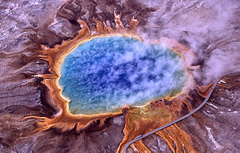
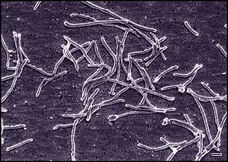
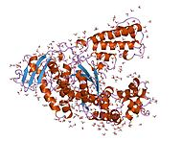
Introducing PCR

Slide 10
Introducing PCR
DNA template
Primers (forward and reverse)
Nucleosides (dATP, dCTP, dGTP, dTTP) = dNTPs
Magnesium chloride
Buffer
DNA polymerase from a thermophilic bacteria

Slide 11
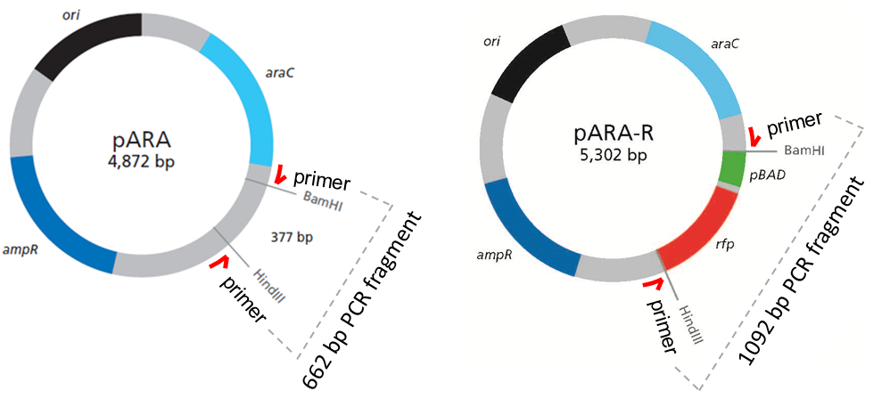
Template DNA

Slide 12
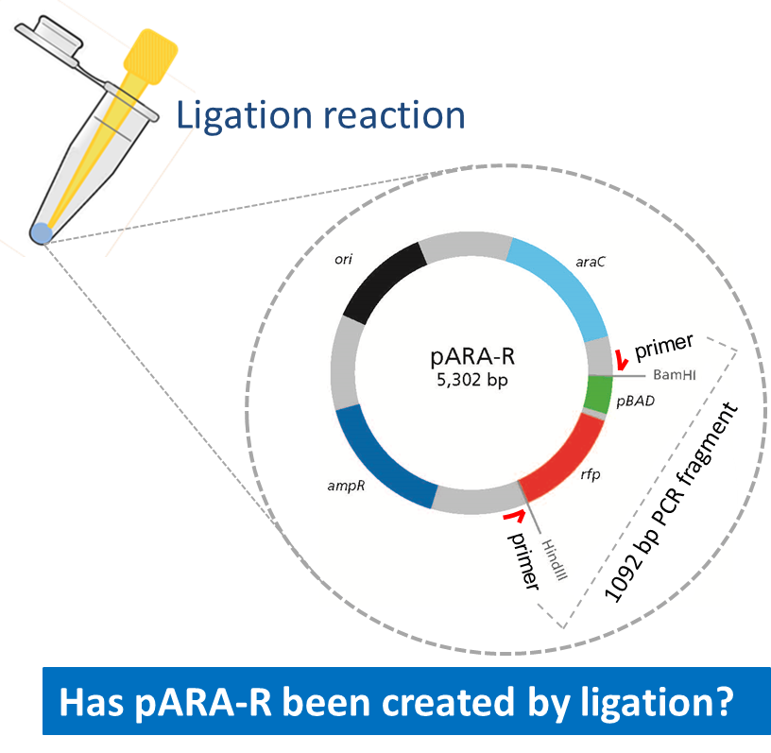
Template DNA

Slide 13
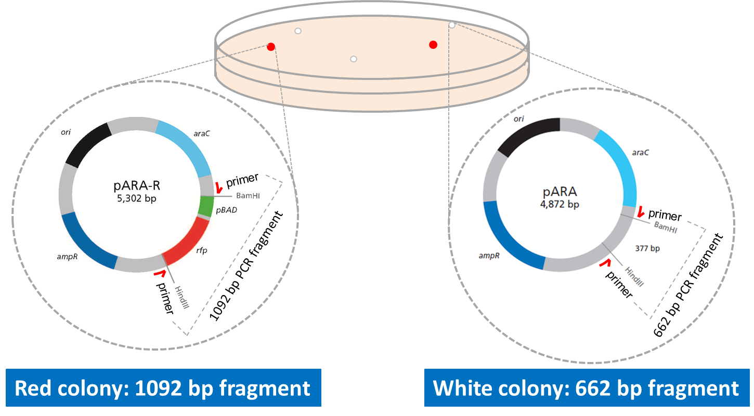
Template DNA

Slide 14
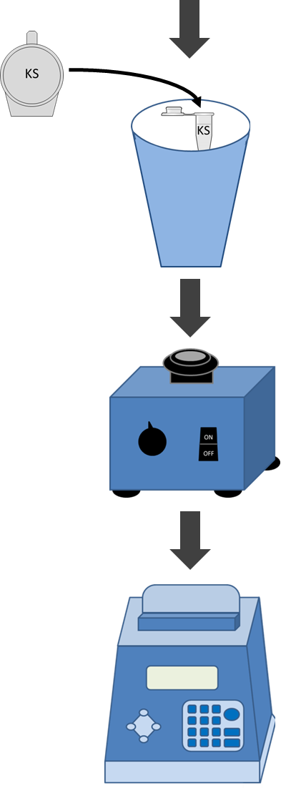
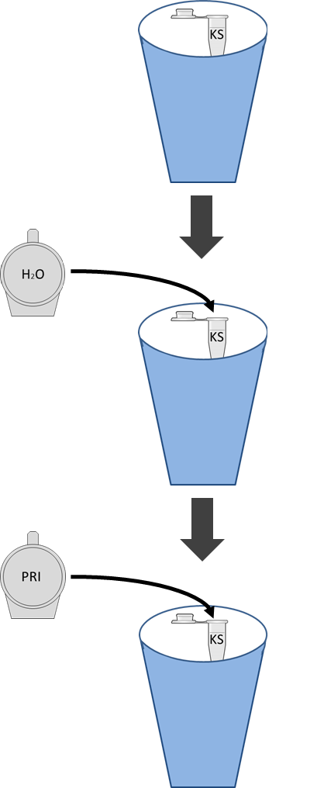
PCR Set-Up
1. Using small PCR tubes, find one labelled PRI
PRI
DNA
4. Add template DNA
2. Add water
H2O
5. Mix with tip
3. Add MM
6. Run thermal cycler
MM

Slide 15
Setting up PCRs
Reagent | NEG PCR | pARA PCR | pARA-R PCR | Ligation PCR | Colony PCR (s)
Combined primers (PRI) * | 2.0 μl | 2.0 μl | 2.0 μl | 2.0 μl | 2.0 μl
Nuclease-free water (H₂O) | 10.5 μl | 8.5 μl | 8.5 μl | 5.5 μl | 9.5 μl
Master Mix (MM) | 12.5 μl | 12.5 μl | 12.5 μl | 12.5 μl | 12.5 μl
pARA plasmid (A) |  | 2.0 μl
pARA-R plasmid (R) |  |  | 2.0 μl
Ligation (LIG) |  |  |  | 5.0 μL
Colony |  |  |  |  | ~1 μl
* Combined primers are already aliquoted into mini-tubes. Total vol for all reactions, 25.0 μl

Slide 16
Running PCRs
Reagent | Temp. (°C) | Time (sec)
Initial denaturation | 95 | 200
Denaturation 30 cycles of Annealing Extension | 95 53 68 | 30 30 30
Final extension | 68 | 300
Hold | 4 | Indefinite

Slide 19
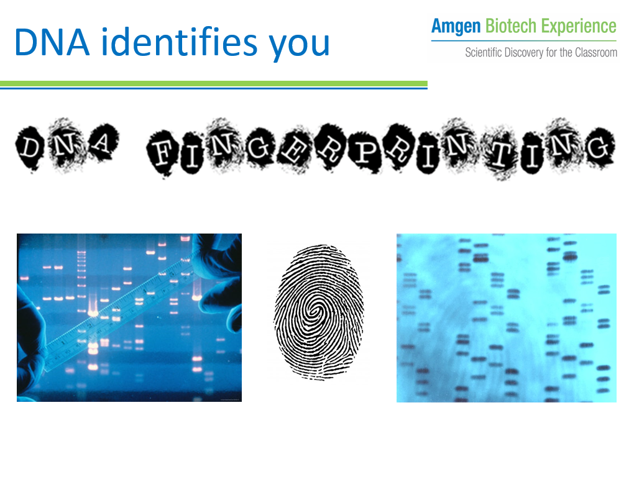
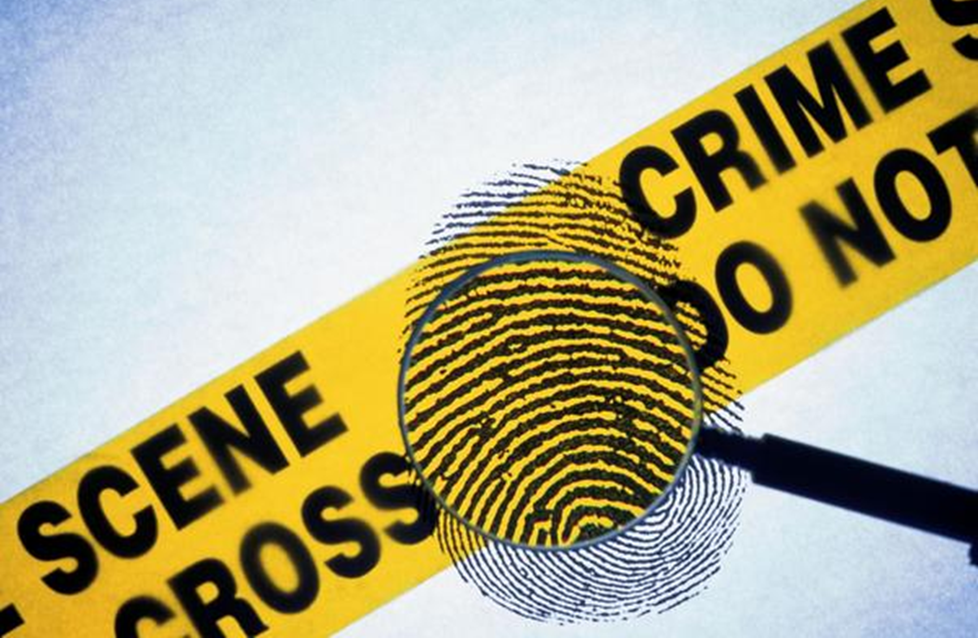
Assembly resource
AVAILABLE:
Introductory pictures
Assembly slides with notes
AIM:
Increase profile of Science
Introduce students to Molecular Biology
Link to ABE program in your school – increasing awareness among staff and students

Slide 20

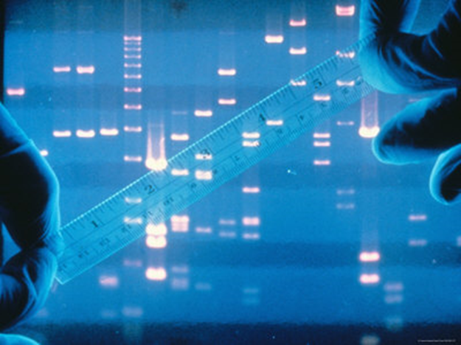
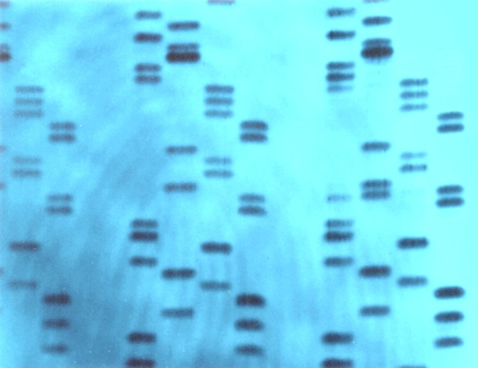
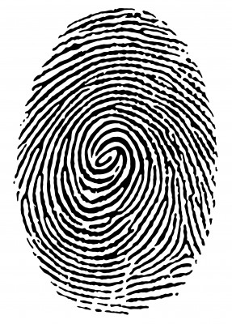
DNA identifies you

Slide 21
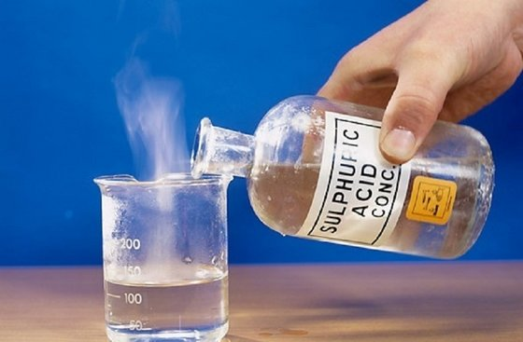
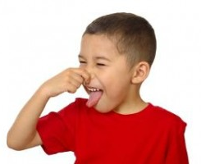
Alec Jeffreys

Slide 22

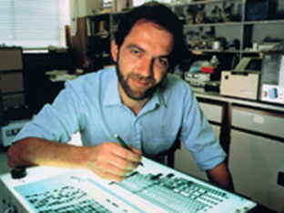
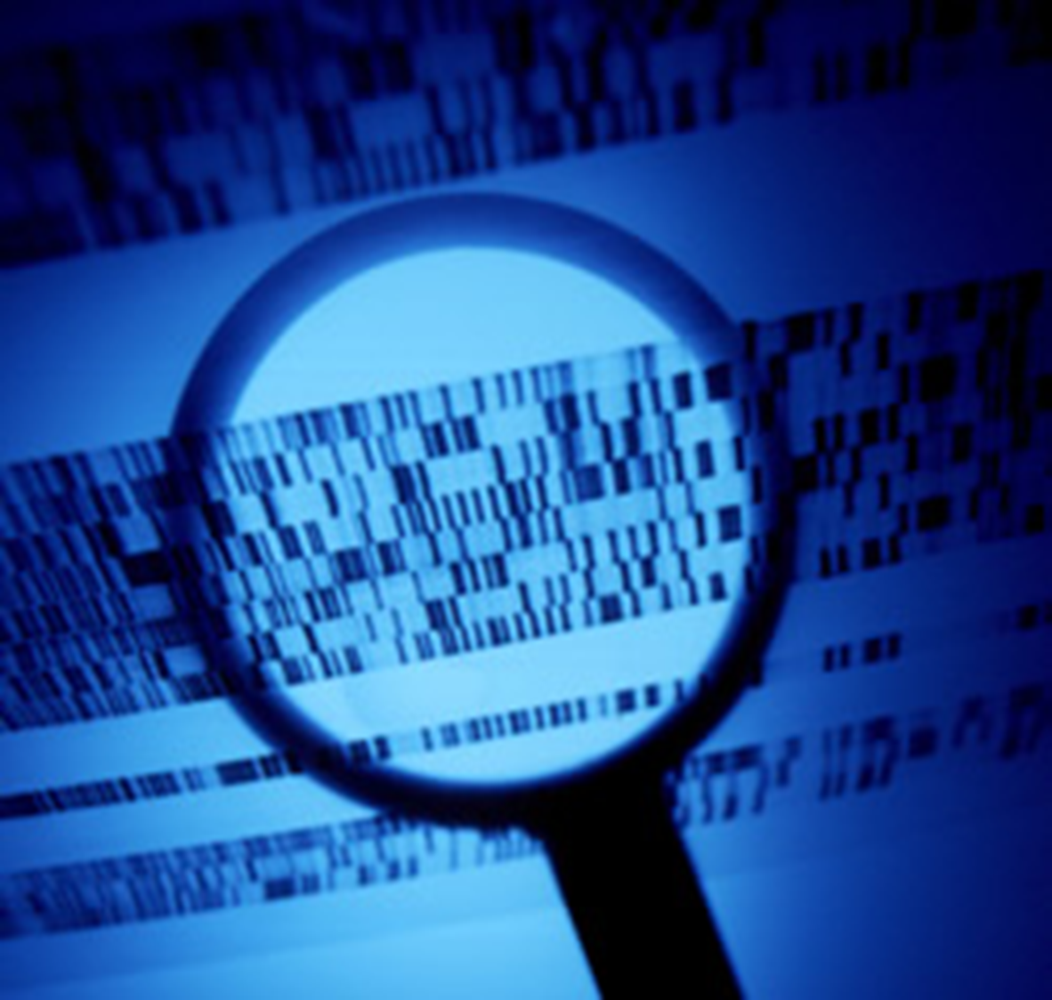
Alec Jeffreys
DNA fingerprinting

Slide 23
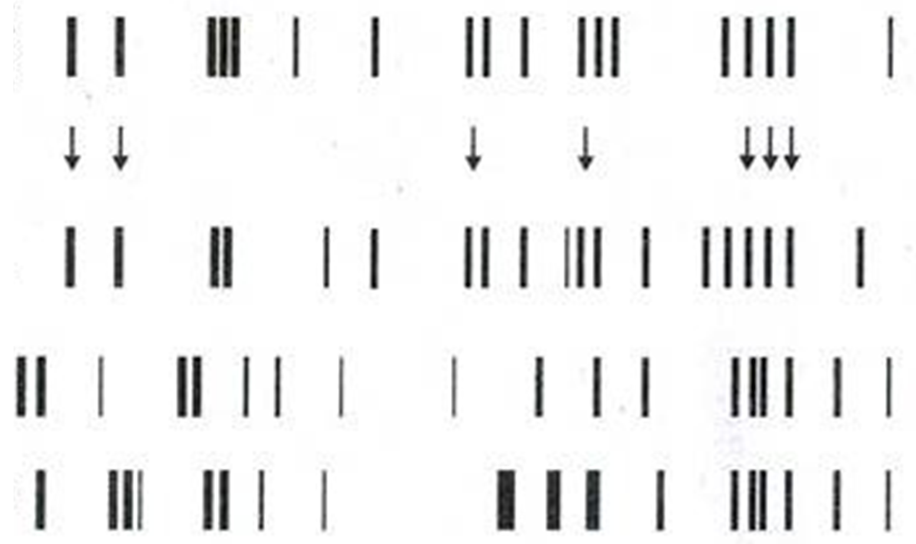
DNA fingerprinting
Scene of
Crime DNA
Suspect 1
Suspect 2
Suspect 3

Slide 24
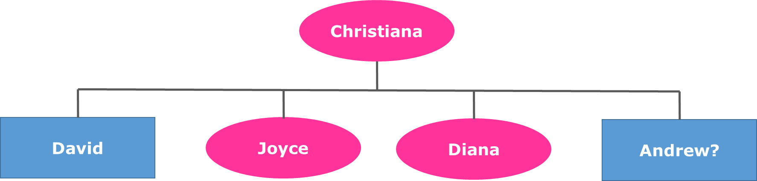

DNA fingerprinting
Reuniting families

Slide 25
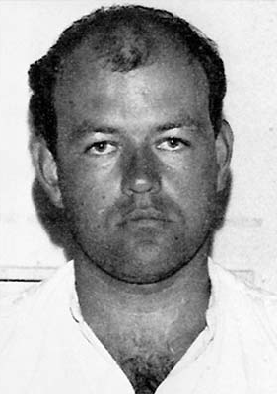
DNA fingerprinting
Colin Pitchfork
1st Murder conviction

Slide 26
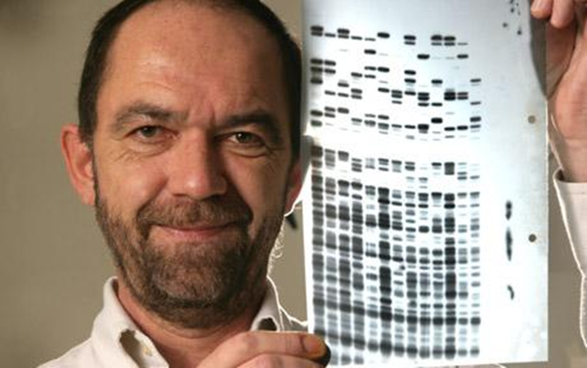
DNA fingerprinting
Alec Jeffreys: identifying through DNA

Slide 27

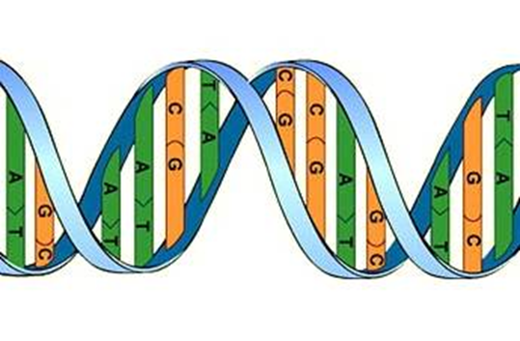
DNA fingerprinting
DNA identifies you.
Your actions define you.

Slide 29
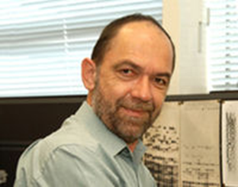
DNA profiling
Variable Number Tandem Repeats
(VNTRs)

Slide 30
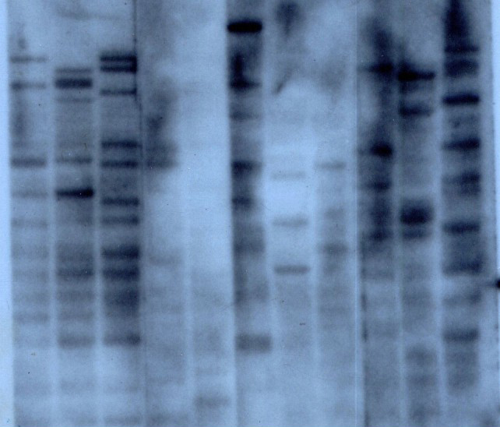
DNA profiling

Slide 31
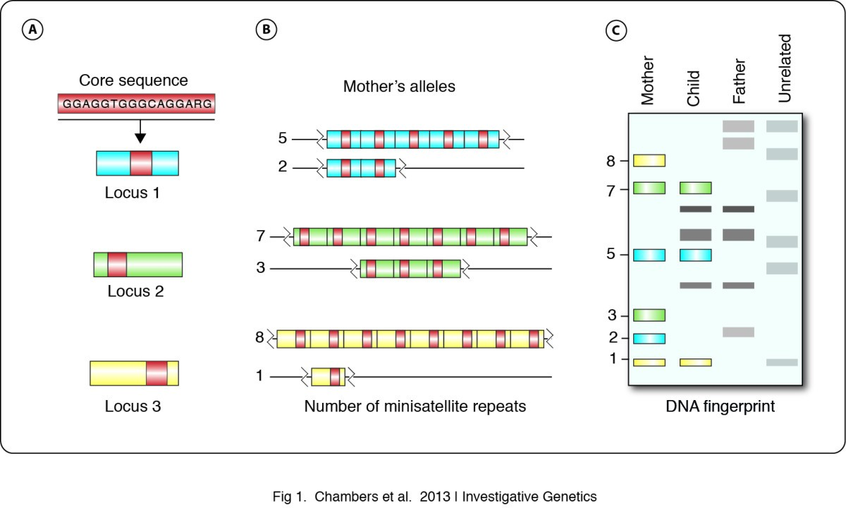
DNA profiling
DNA fingerprinting in zoology: past, present, future | Investigative Genetics | Full Text (biomedcentral.com)

Slide 32
DNA profiling - 1


Chromosome 3 from father


Chromosome 3 from mother

Slide 33
DNA profiling
Chromosome 3 from father
Chromosome 3 from mother

Slide 34
DNA profiling - 2
DNA ladder
CS sample
Suspect 1
Suspect 2
Suspect 3

Slide 35
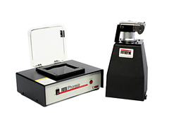
DNA profiling - 3

Slide 36
DNA profiling
Cut the DNA either side of a VNTR region using restriction enzymes
Separate the DNA fragments containing the VNTR sequence using gel electrophoresis
Visualise the DNA using a special stain, UV transilluminator and digital camera
Identify the cake thief!

Slide 37
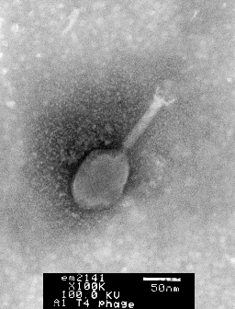
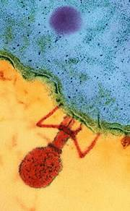
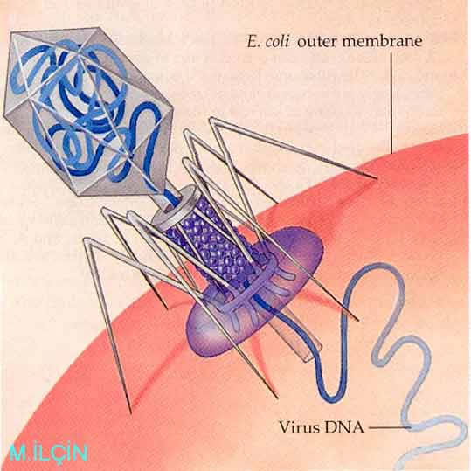
Restriction enzymes
1
2
3

Slide 38
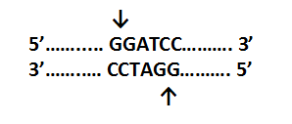
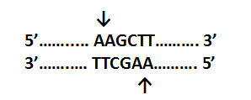
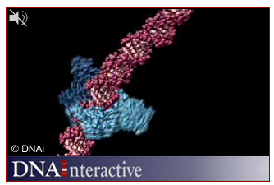
Restriction enzymes
BamHI
Bacillus amyloliquefaciens
HindIII
Haemophilus influenza

Slide 39
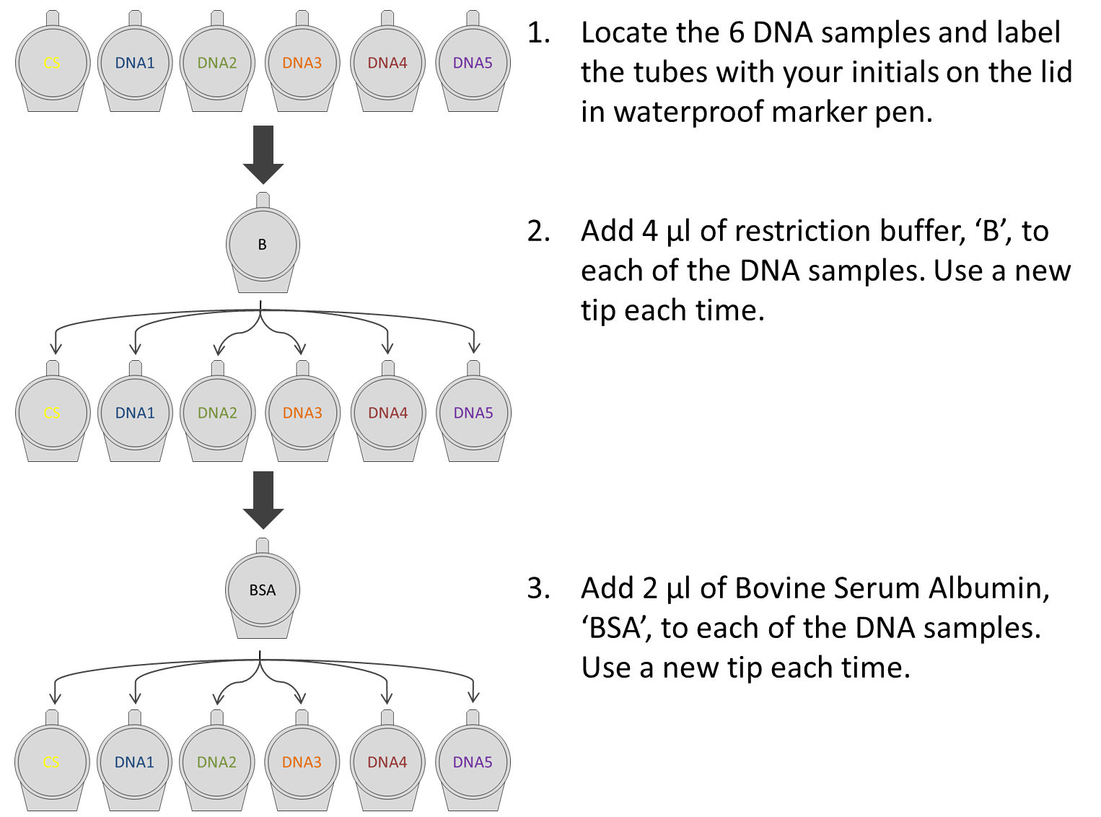
DNA profiling
BF
Add 4 ul restriction buffer, ‘BF’ to each DNA sample. Use a new tip every time.
3. Mix each sample gently, swirling with the pipette tip.

Slide 40
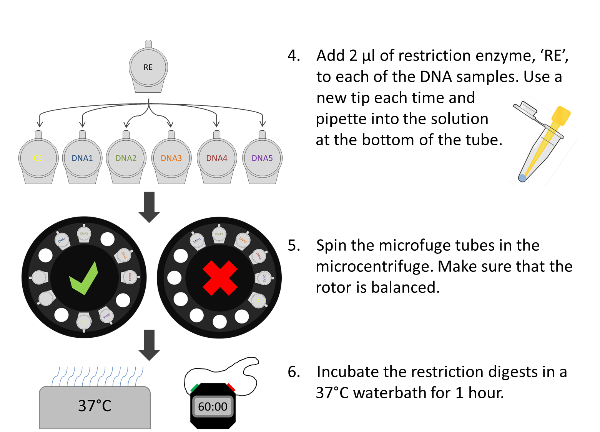
DNA profiling
Add 2 ul of restriction enzyme, ‘ENZ’ to each of the DNA samples. Use a new tip everytime and pipette into the solution at the bottom of the tube
ENZ

Slide 41

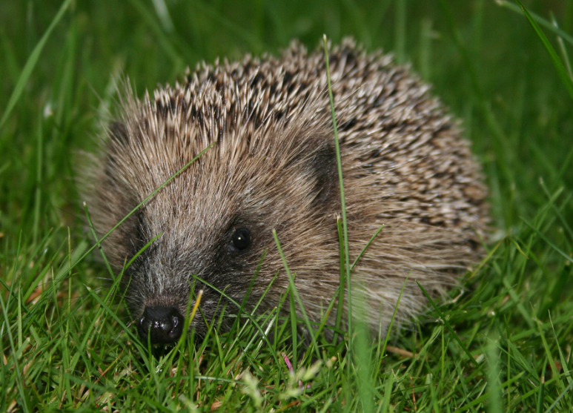

DNA profiling
DNA Fingerprinting / DNA profiling
Schootland yard

Slide 42
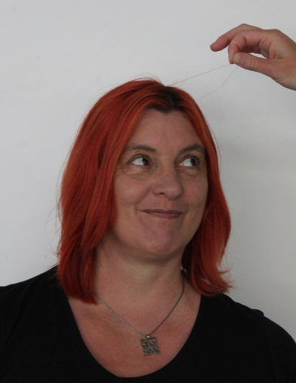
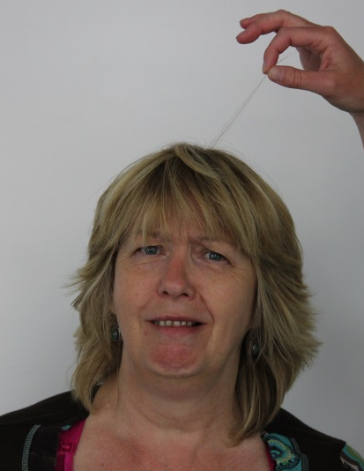
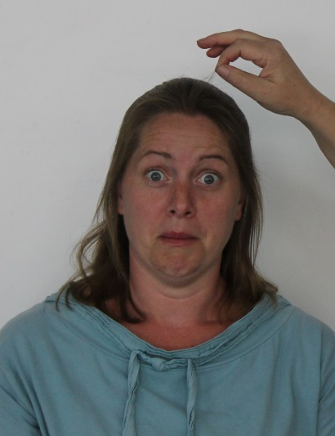
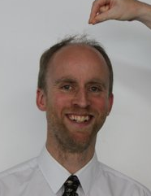
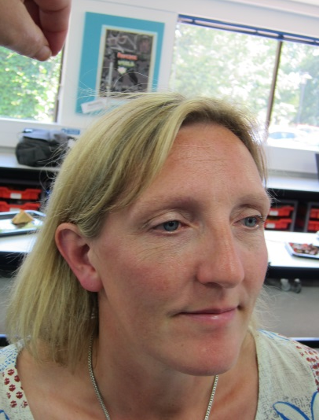
Schootland yard
1
2
3
4
5

Slide 43
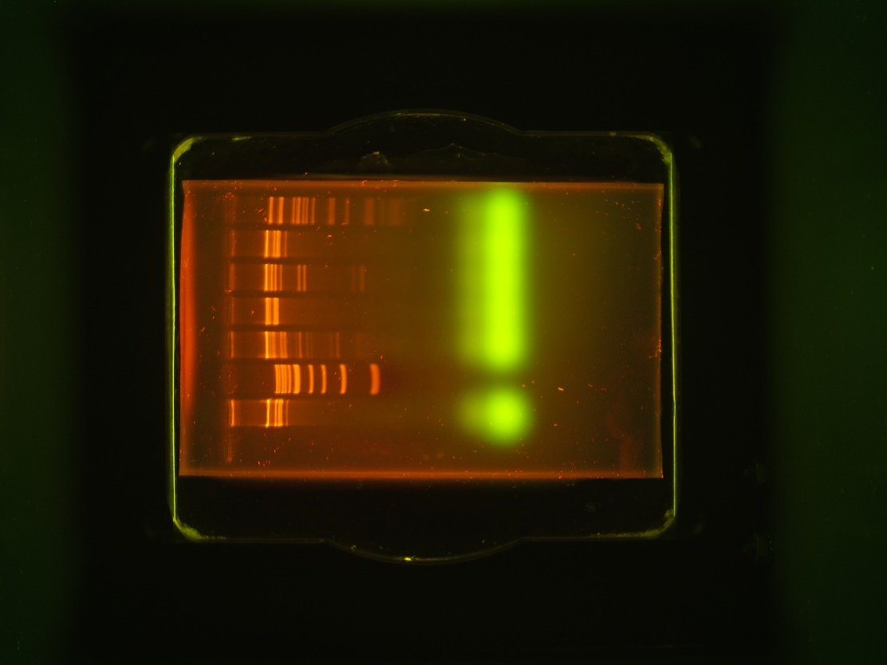
DNA Profiling
– model gel
Ref
1 kb
DNA 1
DNA 2
DNA 3
DNA 4
DNA 5

Slide 45
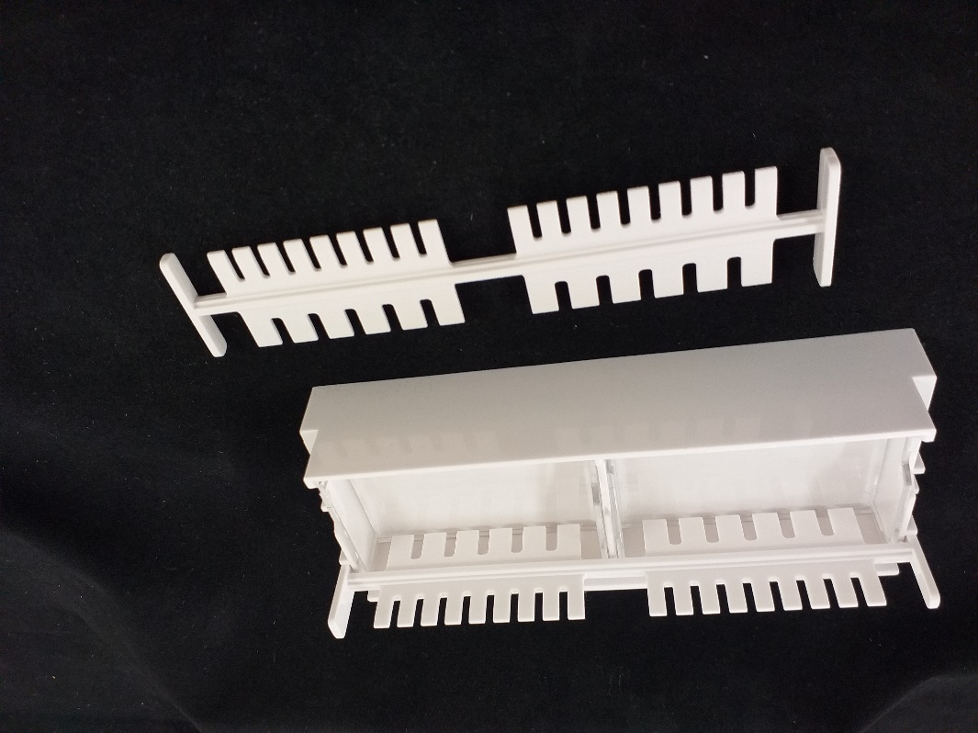
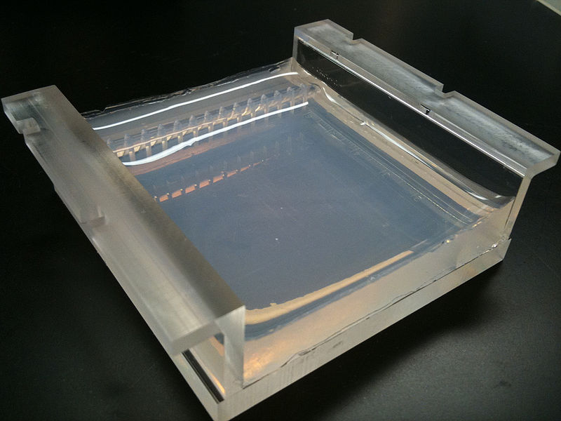

Electrophoresis prep.
400 ml 1 x TAE buffer from 50 x concentrate
8 ml of 50 x TAE buffer + 392 ml of distilled water
0.8% agarose gel, 35 ml in volume
0.28 g agarose + 35 ml 1 x TAE buffer
Remember gloves and goggles when handling TAE buffer

Slide 46
Electrophoresis prep.
Number of samples will dictate which comb you use
DNA Fingerprinting – Ref + 5 suspects + marker = 7
PCR of ‘rfp’ – some/all of
A-plasmid
R-plasmid
H2O (-ive ct)
Red colony
White colony

Slide 47
Gel layout - suggestion
Group 1
Group 2
12.5 µl CS sample
12.5 µl CS sample
10 µl DNA ladder
10 µl DNA ladder
12.5 µl DNA1
12.5 µl DNA2
12.5 µl DNA3
12.5 µl DNA4
12.5 µl DNA5
12.5 µl DNA1
12.5 µl DNA2
12.5 µl DNA3
12.5 µl DNA4
12.5 µl DNA5
Agarose gel with 15 wells

Slide 48
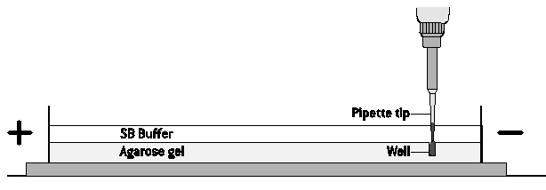
Gel electrophoresis
Pipette tip
SB buffer
Well
Agarose gel

Slide 49

Gel electrophoresis

Slide 50

Lab 5: gel electrophoresis
Xylene cyanol ~ 4,000 bp
Bromophenol blue ~ 500 bp
Orange G ~ 50 bp

Slide 51
Lab 9: DNA profiling
CS / DNA Ref
1 kb marker
DNA 1
DNA 2
DNA 3
DNA 4
DNA 5
So who dunnit?

Slide 52


Electrophoresis – 2 ways
Tanks & transilluminator (TT)
Mini-One (MO)
Electrical Hazards – clear up spills immediately. Keep power packs raised above lab bench surface

Slide 53


Lab 5: gel tank assembly

Slide 54

Lab 5: Mini-One assembly

Slide 55
Electrophoresis – 2 ways
Tanks & transilluminator (TT)
Mini-One (MO)
0.8% gel, 1 x TAE buffer
30-35 ml agarose for each gel
200-300 ml buffer needed
8 or 15 teeth (samples) per gel
Add LD to samples
LD – regular
Load / black card below tank
Run time: 30-45 min
Post-stain: 30 min / Gel Red
Download gel images and share results
0.8% gel, 1 x TAE buffer
11 ml agarose for each gel
135 ml buffer needed
6 or 9 teeth (samples) per gel
Add LD to samples
Ensure LD contains Gel Green
Load under blue light
Run ‘live’ : 20-30 min
No post-stain required
Result recorded directly by students on smartphone

Slide 56


Current DNA Stains
Gel Red (used in TT)
Gel Green (used in MO)
GelRed® is an ultra sensitive, extremely stable and environmentally safe fluorescent nucleic acid dye designed to replace the highly toxic ethidium bromide (EtBr) for staining dsDNA, ssDNA or RNA in agarose gels or polyacrylamide gels.
Safer than EtBr: non-mutagenic and non-hazardous for disposal
Much more sensitive than EtBr and SYBR® Safe
Stable at room temperature and microwavable
Simple precast or post-electrophoresis gel staining, no destaining
GelGreen® is a highly sensitive, stable and environmentally safe, green fluorescent nucleic acid stain
• Non-mutagenic - at concentrations relevant to nucleic acid gel staining
• Non-cytotoxic - at concentrations relevant to nucleic acid gel staining
• Cell membrane impermeability for true safety
• Impenetrable to latex gloves
• Very photostable - use under normal room light
• Hydrolytically stable
• Microwaveable
Remember gloves and goggles when using the stains

Slide 57

Current DNA Stains
Gel Red (used in TT)
Gel Green (used in MO)
Image c/o VWR - https://uk.vwr.com/store/product/826590/gelredtm-and-gelgreentm-nucleic-acid-gel-stains

Slide 58
Before Loading
Remove the masking tape from the ends of your gel tray
Place the gel, and its casting tray, into the electrophoresis tank. The wells should be at the black (negative end), as DNA is negatively charged and will run towards the red (positive) end.
Make sure that the open end of the wells is facing upwards to receive the samples
Submerge the gel in 1X TAE buffer (this contains the ions needed for electrophoresis). There needs to be 1-2 mm of buffer over the top of the gel. Too much and the current will go through the buffer and not the gel! Pour buffer onto the gel until just after the well dimples disappear.
Remove the comb from your agarose gel by lifting it directly upwards. The comb will create some suction, so it needs a gentle, but consistent upwards pressure.
Place a black sheet under the wells to make them more visible
Remove the comb from your agarose gel by lifting it directly upwards.
Place the gel, and its casting tray into the electrophoresis tank (only fits one way!). Remember the black supporting platform and make sure the wells are aligned with the marks on the platform on the negative end
Make sure that the open end of the wells is facing upwards to receive the samples
Cover gel with 1 x TAE buffer (135 ml recommended) by filling one side of the gel tray and watching the liquid force air out from under the gel. Then fill the other side until the gel is just covered.
Place photo hood onto unit and check green power light is solid before loading samples
Don’t forget gloves and eye protection when handling the TAE buffer

Slide 59
PCRs onto Gel
Each PCR sample, needs to be prepared for loading onto gel – either a MiniOne gel or the traditional format. Add 4μl loading dye DIRECT TO PCR samples, mix, and LOAD into 10μl into gel
Reagent | NEG gel | A gel | R gel | LIG gel | C gel
Loading Dye | 2.0 μL | 2.0 μL | 2.0 μL | 2.0 μL | 2.0 μL
Nuclease-free water (H₂O) | 6.0 μL | 6.0 μL | 6.0 μL | 6.0 μL | 6.0 μL
Neg PCR (water only) | 2.0 μL
pARA plasmid (A) - PCR |  | 2.0 μL
pARA-R plasmid (R) - PCR |  |  | 2.0 μL
Ligation (LIG) - PCR |  |  |  | 2.0 μL
Colony PCR |  |  |  |  | 2.0 μL

Slide 60
Biotechnology for the classroom
Bacterial Transformation

Slide 61
Horizontal Gene Transfer
Horizontal gene transfer (HGT) is the movement of genetic information between organisms, a process that includes the spread of antibiotic resistance genes among bacteria

Slide 62



Horizontal Gene Transfer
Conjugation Transduction Transformation

Slide 63






Lab 6a: transformation
Competent Cells
pARA-R
Recombinant Plasmids

Slide 64

Lab 6a: transformation
Lipid bilayer
(inner)
Adhesion zone
Peptidoglycan
layer
Lipid bilayer
(outer)
Calcium ions

Slide 65

Lab 6a: transformation
Lipid bilayer
(inner)
Adhesion zone
Peptidoglycan
layer
Lipid bilayer
(outer)
Calcium ions
pARA-R

Slide 66

Lab 6a: transformation
Lab 6a: transformation
Transformation Theory

Slide 67



Lab 6a: transformation
Spread don’t
gauge agar
Keep cells cold
Heat shock at exactly 42°C

Slide 68

Lab 6a: transformation
Follow good aseptic technique. Gloves do not need to be worn. All tips & tubes into Virkon (or equivalent)

Slide 70



Lab 6a: transformation
P- plates
No growth
LB
LB/amp
P+ plates
LB
LB/amp
LB/amp/ara

Slide 71
Lab 6a: transformation
Supercoiled plasmid
Relaxed circle plasmid
LB/amp/ara
Taken from; YAFFEE, M, WALTER, P., RICHTER, C. and MULLER, M. (1996) PNAS of the USA 93; pp. 5341-5346.

Slide 72

Lab 6a: transformation
colony
satellite colonies

Slide 73




Lab 6a: transformation
Colony isolation and culture
LB/amp/ara
broth

Slide 74

Lab 6a: transformation

Slide 75




















Lab 6a: transformation
Overnight
culture
Cell pellet
with RFP
Lysed
cells
Pellet
cell debris
RFP with
binding buffer

Slide 76

Lab 6a: transformation

Slide 77

Making protein therapeutics
chromosome

gene of interest
plasmids
E. coli
plasmid
digest plasmid
recombinant plasmid
protein purified
protein produced
E. coli with recomb-inant plasmid

Slide 78
Objectives
By the end of this course you will:
Feel confident preparing for labs 4/4a, 5, 6/6a, 7/7a
Feel confident carrying out labs 4/4a, 5, 6/6a, 7/7a
Be aware of Health and Safety requirements
Know where to access resources
Know who to contact for support

Slide 80

Lab 6/6a ’
ONLINE FOLLOW-UP - RESULTS

Slide 81

Lab 4/7 – Finding ‘rfp’
A-plasmid
R-plasmid
Red
Ligation
Water
White
1 kb

Slide 82


PCR: lab 4a
MMpARA-R
MMRed
1 Kb
1 Kb
1 Kb
R -
R +
10.0
10.0
8.0
8.0
6.0
6.0
5.0
5.0
4.0
4.0
3.0
3.0
2.0
2.0
1.5
1.5
1.0
1.0
0.5
0.5

Slide 83

PCR: lab 7a
MMpARA-R
MMRed
1 Kb
1 Kb
1 Kb
R -
R +
10.0
10.0
8.0
8.0
6.0
6.0
5.0
5.0
4.0
4.0
3.0
3.0
2.0
2.0
1.5
1.5
1.0
1.0
0.5
0.5

Slide 84


PCR: lab 4a and 7a
MMpARA-R
MMpARA-R
MMRed
MMRed
1 Kb
1 Kb
1 Kb
1 Kb
1 Kb
1 Kb
R -
R +
R -
R +
10.0
10.0
10.0
10.0
8.0
8.0
8.0
8.0
6.0
6.0
6.0
6.0
5.0
5.0
5.0
5.0
4.0
4.0
4.0
4.0
3.0
3.0
3.0
3.0
2.0
2.0
2.0
2.0
1.5
1.5
1.5
1.5
1.0
1.0
1.0
1.0
0.5
0.5
0.5
0.5

Slide 85


PCR: lab 4
MMpARA
MMpARA-R
Ligation
1 Kb
MMLIG
K +
A+
1 Kb
K-
A-
10.0
8.0
6.0
5.0
4.0
3.0
2.0
1.5
1.0
0.5

Slide 86


PCR: lab 4
MMpARA
MMpARA-R
Ligation
1 Kb
MMLIG
K +
A+
1 Kb
K-
A-
10.0
8.0
6.0
5.0
4.0
3.0
2.0
1.5
1.0
0.5

Slide 87



PCR: lab 4
MMpARA
MMpARA-R
Ligation
1 Kb
MMLIG
pARA PCR
K +
A+
1 Kb
K-
A-
Ligation reaction
10.0
8.0
6.0
5.0
4.0
3.0
2.0
1.5
Ligation PCR
1.0
0.5
pARA-R PCR

Slide 88

PCR: lab 4
MMpARA
MMpARA-R
MMpARA
MMpARA-R
Ligation
Ligation
1 Kb
MMLIG
MMLIG
K +
A+
1 Kb
1 Kb
K +
A+
1 Kb
K-
A-
K-
A-
10.0
10.0
8.0
8.0
6.0
6.0
5.0
5.0
4.0
4.0
3.0
3.0
2.0
2.0
1.5
1.5
1.0
1.0
0.5
0.5

Slide 89
PCR: lab 4
MMpARA
MMpARA-R
MMpARA
MMpARA-R
Ligation
Ligation
1 Kb
MMLIG
MMLIG
K +
A+
1 Kb
1 Kb
K +
A+
1 Kb
K-
A-
K-
A-
10.0
10.0
8.0
8.0
6.0
6.0
5.0
5.0
4.0
4.0
3.0
3.0
2.0
2.0
1.5
1.5
1.0
1.0
0.5
0.5

Slide 90
PCR: lab 7
MMpARA-R
MMWhite
MMWhite
MMRed
MMWhite
1 Kb
1 Kb
10.0
10.0
8.0
8.0
6.0
6.0
5.0
5.0
4.0
4.0
3.0
3.0
2.0
2.0
pARA-R PCR
1.5
1.5
1.0
1.0
0.5
0.5

Slide 91


PCR: lab 7
MMpARA-R
MMWhite
MMWhite
MMRed
MMWhite
1 Kb
1 Kb
primer
1092 bp PCR fragment
primer
10.0
10.0
8.0
8.0
6.0
6.0
5.0
5.0
4.0
4.0
3.0
3.0
LB/amp/ara
2.0
2.0
1.5
1.5
primer
1.0
1.0
662 bp PCR fragment
primer
0.5
0.5

Slide 92
PCR: lab 7
MMpARA-R
MMWhite
MMWhite
MMRed
MMWhite
1 Kb
1 Kb
primer
1092 bp PCR fragment
primer
10.0
10.0
8.0
8.0
6.0
6.0
5.0
5.0
4.0
4.0
3.0
3.0
LB/amp
2.0
2.0
1.5
1.5
primer
1.0
1.0
662 bp PCR fragment
primer
0.5
0.5

Slide 93
PCR: lab 7
MMpARA-R
MMpARA-R
MMWhite
MMWhite
MMWhite
MMWhite
MMWhite
MMRed
MMRed
MMWhite
1 Kb
1 Kb
1 Kb
1 Kb
10.0
10.0
10.0
8.0
8.0
8.0
6.0
6.0
6.0
5.0
5.0
5.0
4.0
4.0
4.0
3.0
3.0
3.0
2.0
2.0
2.0
1.5
1.5
1.5
1.0
1.0
1.0
0.5
0.5
0.5

Slide 94


Plasmids from ligation

Slide 95
Plasmids in white colonies
662 bp fragment by PCR
136 bp from BamHI site
149 bp from HindIII site
377 bp restriction fragment
4780 bp fragment by PCR
136 bp from BamHI site
149 bp from HindIII site
4495 bp restriction fragment
4990 bp fragment by PCR
136 bp from BamHI site
149 bp from HindIII site
4705 bp restriction fragment

Slide 96
Thank you !

