Slide 1
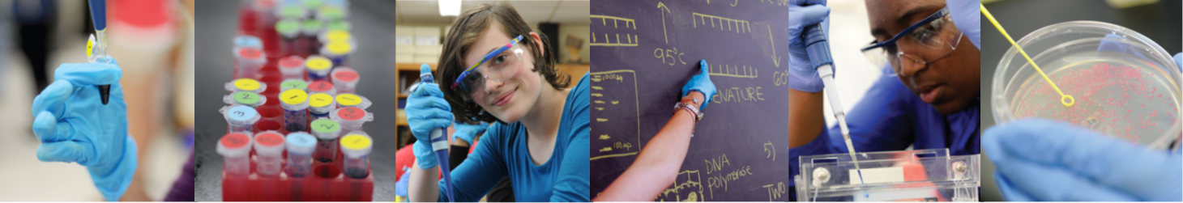


Biotechnology for the classroom
2 June 2026

Slide 2

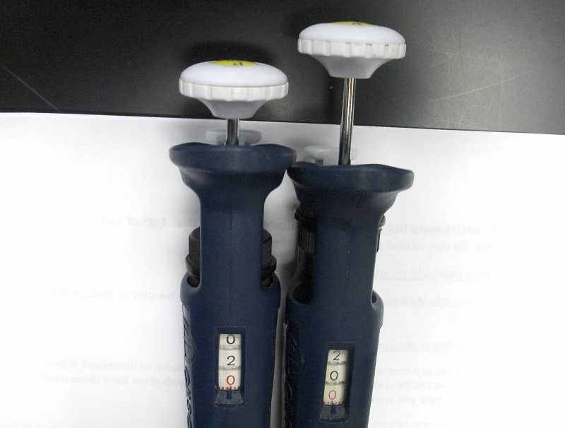
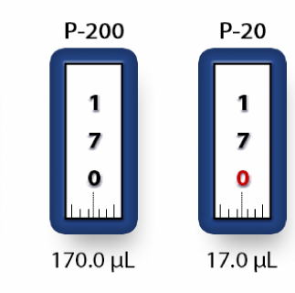
Micro-pipetting
P20 – used in Y1 – max. volume 20ul
P200 – used with P20 in Y2 – for vols between 20 and 200ul

Slide 3
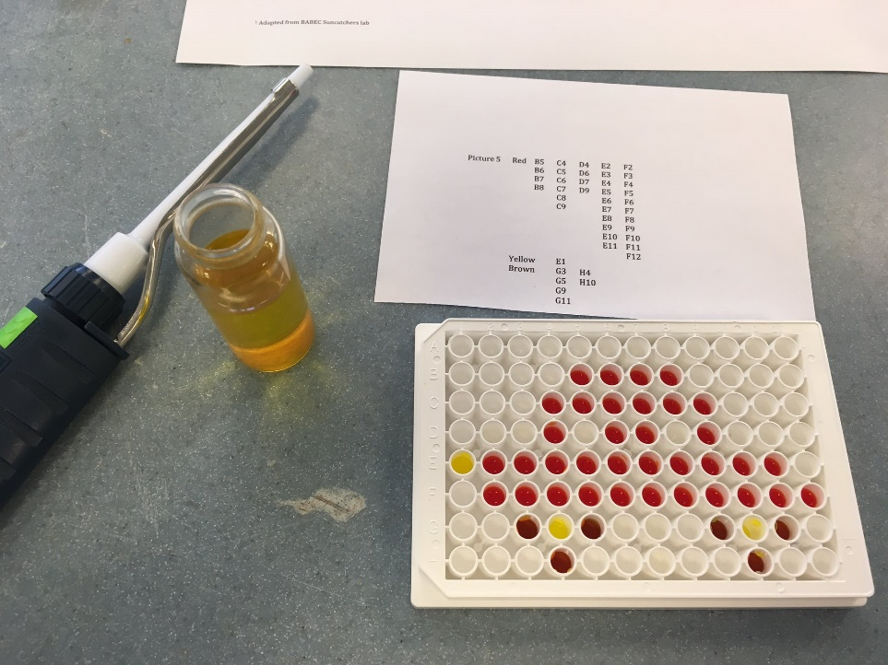
Micro-pipetting
Suncatcher activity using P200’s … scientific battleships!
Notes:
Often easier to demonstrate these key differences with the actual kit, as opposed to slides

Slide 4
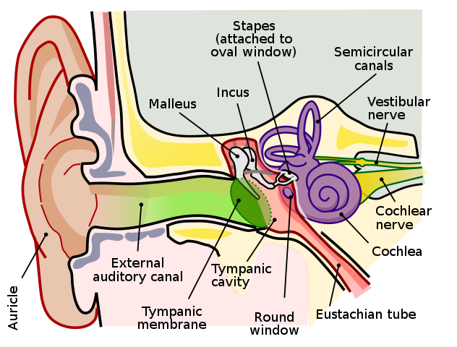
Introducing PCR
PCR
1 – Who invented PCR?
2 – What are the 3 stages of PCR?
3 – How many uses of PCR can you hear?
Notes:
HERE IS ONE WAY TO INTRODUCE PCR …
What better way to start than with a song? Get it from: http://www.youtube.com/watch?v=x5yPkxCLads
This is 2 minutes 14 seconds long. Test your listening skills are see if you can spot the following information…
1 - The person that created PCR was ‘a guy named Dr Kary Mullis’
2 – The 3 stages of PCR are; ‘denaturing, annealing and extending’
3 – The 4 uses of PCR (which they do say amplifies DNA in vitro) given in the song are:
- detect mutations (which can be used as predictors of disease development)
- recombine (a method that can be used for creating protein therapeutics to help those with genetic disease)
- find out who the Daddy is (paternity testing)
- solve a crime (forensic analysis)
Kary Mullis – “bombastic biochemist” invented PCR and did receive Nobel Prize for chemistry (1995) for this invention. Interesting FoI request linked to COVID testing - Freedom of Information request about PCR Swab Test Accuracy SARS-CoV-2 Parts 1 & 2 (FOI-21-153) - GOV.UK (www.gov.uk)

Slide 5
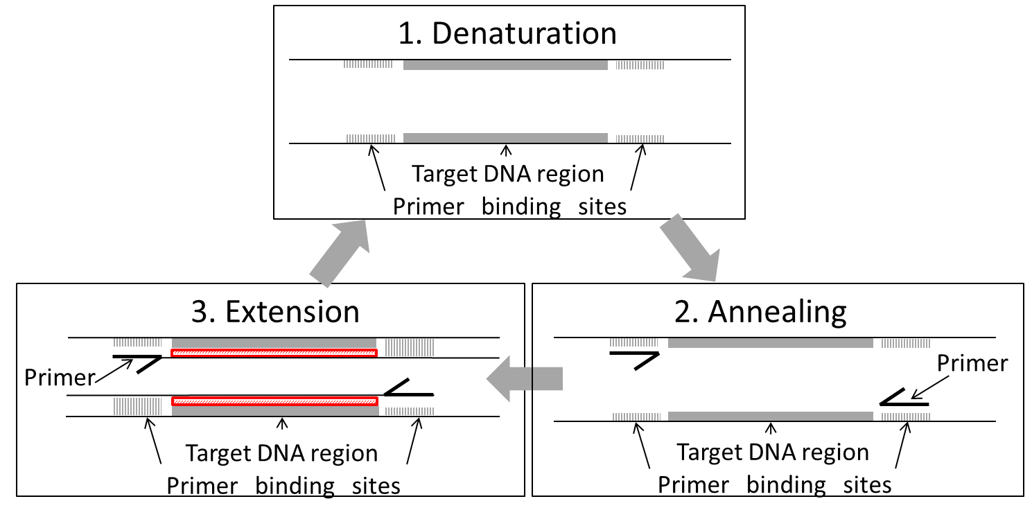
Introducing PCR
Notes:
How does PCR work?
The 3 stages of the PCR are shown on this slide
Denaturation - occurs at a high temperature 94 - 98 °C
- separates the double-stranded DNA by breaking the hydrogen bonds holding the bases together
Annealing – at a temperature of 50 - 65 °C.
- allows sequence specific primers to bind to complementary bases either side of the region to be amplified
Extension – usually performed at 72 °C
- DNA polymerase extends the short double-stranded region (created by primer binding to the template DNA)
A nice overview of how the temperature cycling causes the DNA to behave, has been produced by the DNA Learning Center In New York:
http://www.youtube.com/watch?v=2KoLnIwoZKU

Slide 6
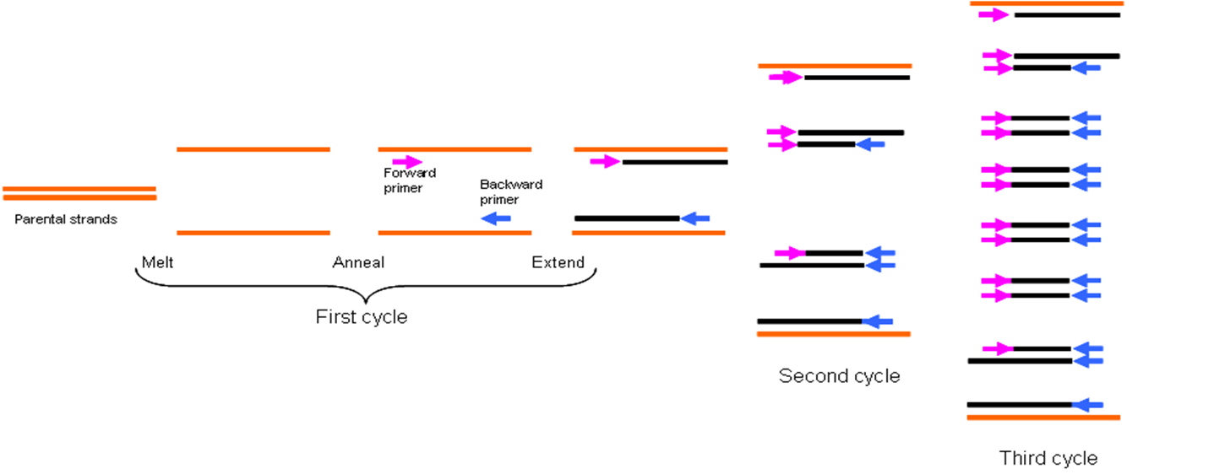
Introducing PCR
Notes:
How many copies of DNA are amplified in the first PCR cycles?

Slide 7
Introducing PCR
Number of PCR cycles | Lengths of dsDNA
1 | 2
2 | 4
5 | 32
10 | 1,024
20 | 1,048,576
35 | 34,359,738,368
Notes:
How many copies of DNA are amplified in the entire PCR?
The number of double-stranded DNA molecules of the region being amplified that can be created is enormous.

Slide 8
Introducing PCR
Gene function
Detect mutations
Recombination
PCR
Diagnosis of hereditary disease
Sequencing
Diagnosis of infectious disease
Phylogenetic research
Paternity testing
Forensic analysis
Notes:
What is PCR used for?
PCR is used to amplify DNA for a huge number of applications. It has become one of the cornerstones of Molecular Biology, allowing easy amplification of large quantities of DNA in vitro.
Some examples of the uses of DNA amplified by PCR are given…

Slide 9
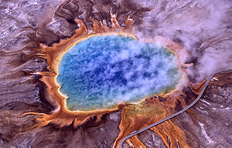
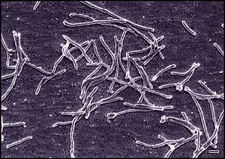
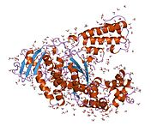
Introducing PCR
Notes:
Where does DNA polymerase come from?
- The thermophilic bacteria from which DNA polymerase was extracted were found in hot springs, like this one in Yellowstone National Park, USA.
Used to living in temperatures of over 100oC these organisms have evolved enzymes with higher optimum temperatures at which they operate.
Initially the DNA polymerase enzyme used most commonly in PCR was extracted from a bacteria named Thermus aquaticus.
This enzyme is now manufactured on a large scale for molecular biology applications using recombinant technology. (This means that gene for DNA polymerase from Thermus aquaticus has been cloned into a plasmid, transformed into a bacteria and millions of bacteria are grown, which manufacture the thermostable DNA polymerase.)
This diagram shows the 3-D structure of DNA polymerase.

Slide 10
Introducing PCR
DNA template
Primers (forward and reverse)
Nucleosides (dATP, dCTP, dGTP, dTTP) = dNTPs
Magnesium chloride
Buffer
DNA polymerase from a thermophilic bacteria
Notes:
What is needed in a PCR mixture?
- The DNA template you will can be sourced from a number of different places – more on that in a moment.
Primers are short sequences that bind uniquely to the DNA sequence flanking your DNA sequence of interest. Sequence on page 7.7.
Nucleosides are the ‘building blocks’ of the new DNA, each consisting of a sugar, phosphate group and base. Nucleoside triphosphates are used, and energy from the removal of the extra phosphate groups is used to build up the new strand of DNA. The abbreviations for the nucleoside triphosphates are eg; deoxyadenosine triphosphate, deoxycytosine triphosphate, deoxyguanine triphosphate, and, deoxythymine triphosphate.
You will add magnesium chloride as magnesium is required as an enzyme cofactor for DNA polymerase.
The buffer contains salt and maintains a pH suitable for DNA polymerase activity.
DNA polymerase is the enzyme that elongates short double-stranded regions of DNA by synthesising a complementary strand to the existing single-strand of DNA in a 5’ to 3’ direction. If the DNA polymerase enzyme from the majority of bacteria were used it would need to be added after each time the temperature was raised to denature the DNA, as the enzyme would also be denatured. So DNA polymerase from a thermophilic bacteria is used.

Slide 11
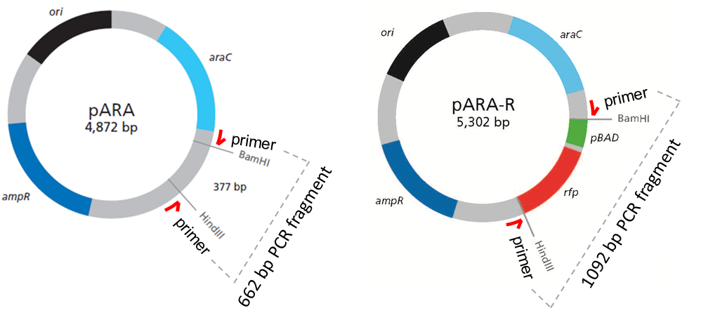
Template DNA

Slide 12
Template DNA
Notes:
Note priming sites for PCR sit outside the restriction sites.
R-plasmid is based on the A-plasmid (same backbone) so a product is produced with both A and R but of different size – because of the inserted rfp gene

Slide 13
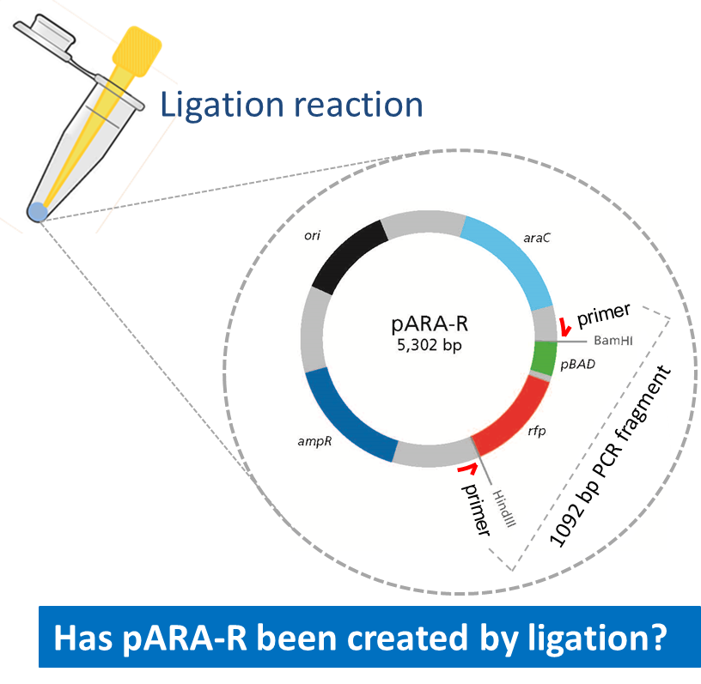
Template DNA
Notes:
Is rfp detectable in the ligation reaction?
Using the PCR after ligation, then running the products on an agarose gel, allows students to identify whether the ligation reaction has successfully created pARA-R, because if pARA-R is in the DNA used as template for the PCR, then a 1092 bp fragment will result.
This is the basis of LAB 4

Slide 14
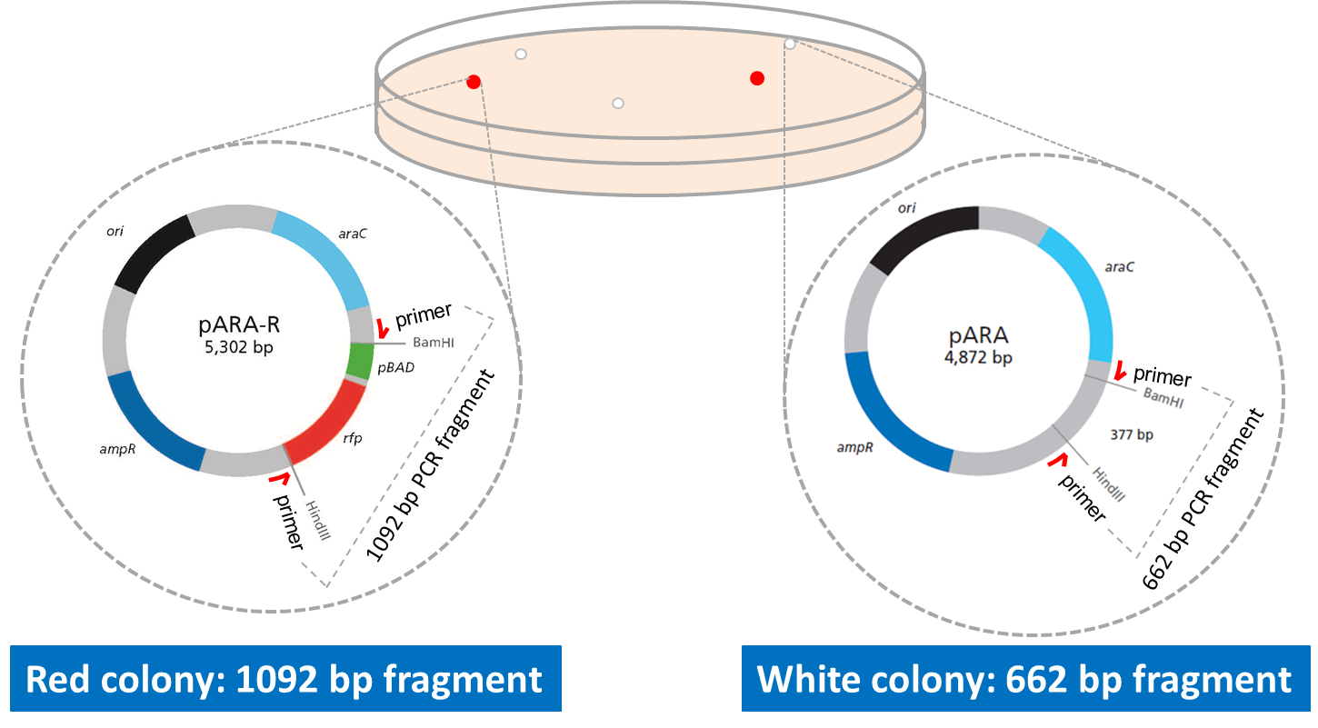
Template DNA
Notes:
Using the PCR after transformation, then running the products on an agarose gel, is even more exciting for me, because it allows correlation between phenotype and genotype.
Red colonies should produce a 1092 bp band visible after colony PCR by agarose gel electrophoresis.
White colonies should produce a 662 bp band visible after colony PCR by agarose gel electrophoresis (because white colonies contain A plasmid and not R).
This is the basis of LAB 7

Slide 15
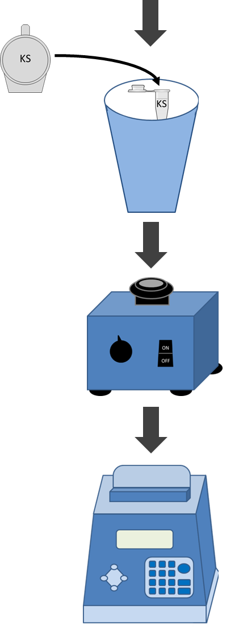
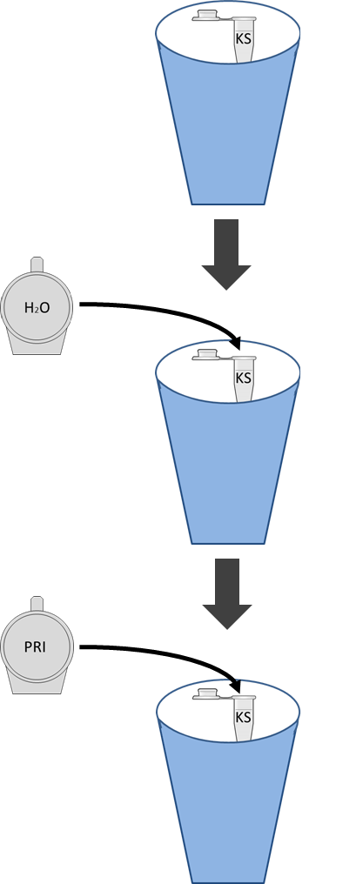
PCR Set-Up
1. Using small PCR tubes, find one labelled PRI
PRI
DNA
4. Add template DNA
2. Add water
H2O
5. Mix with tip
3. Add MM
6. Run thermal cycler
MM
Notes:
Step 2: setting up the PCR
Master mix contains buffer, magnesium chloride, nucleosides and DNA polymerase. Keep on ice to preserve maximum enzyme activity of DNA polymerase.
Remember:
Use fresh tips for each new component you add
Keep on ice
Label tubes on the side – with personal identifier - as labels on top rub off easily in thermal cycler
PCR machine will take about 2 hours to run.

Slide 16
Setting up PCRs
Reagent | NEG PCR | pARA PCR | pARA-R PCR | Ligation PCR | Colony PCR (s)
Combined primers (PRI) * | 2.0 μl | 2.0 μl | 2.0 μl | 2.0 μl | 2.0 μl
Nuclease-free water (H₂O) | 10.5 μl | 8.5 μl | 8.5 μl | 5.5 μl | 9.5 μl
Master Mix (MM) | 12.5 μl | 12.5 μl | 12.5 μl | 12.5 μl | 12.5 μl
pARA plasmid (A) |  | 2.0 μl
pARA-R plasmid (R) |  |  | 2.0 μl
Ligation (LIG) |  |  |  | 5.0 μL
Colony |  |  |  |  | ~1 μl
* Combined primers are already aliquoted into mini-tubes. Total vol for all reactions, 25.0 μl
Notes:
Talk through set-up, emphasise we (you!!) will have already aliquoted the Primers, and everything added to them.
Also remind this training session is combining investigations that form both LAB 4 and LAB 7 (with controls)

Slide 17
Running PCRs
Reagent | Temp. (°C) | Time (sec)
Initial denaturation | 95 | 200
Denaturation 30 cycles of Annealing Extension | 95 53 68 | 30 30 30
Final extension | 68 | 300
Hold | 4 | Indefinite
Notes:
Total time in PCR machine is approx. 1.5 - 2 hours. Machine acts like fridge at end, so samples can remain in PCR machine overnight or over weekend (assuming it is left switched-on)

Slide 18
Timing of PCRs
Lab | Activity | Time (min)
4 | PCR of recombinant plasmids | 15-30
 | Wait time (PCR) | 90
7.1 | Colony PCR | 15-30
 | Wait time (PCR) | 90
7.2 | Gel loading | 15-30
 | Wait time (electrophoresis) | 45
 | Gel staining | 5
 | Wait time (staining) | 30
 | Gel visualisation | 30
Timings refer to the traditional use of electrophoresis followed by staining.
MiniOne does make this process quicker
Notes:
More about ‘Timings’ in the Intro Pages of the T&T guide - Page i.6
MiniOne is an electrophoresis system that enables you to ‘see DNA move thru gel - ‘as live’ thereby making it quicker to get results (by removing the need to stain gels). The agarose gels themselves are smaller, again speeding up the process

Slide 20
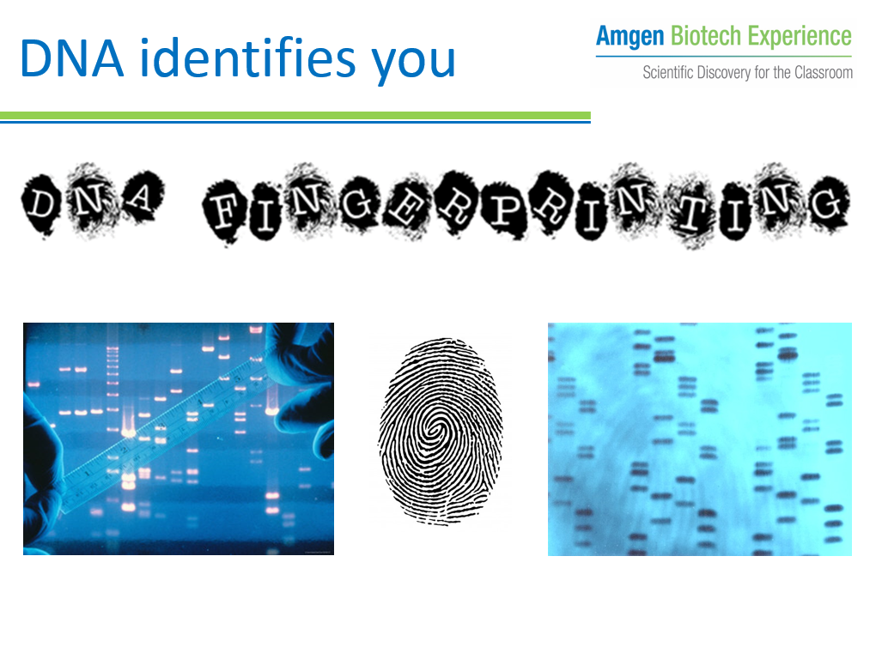
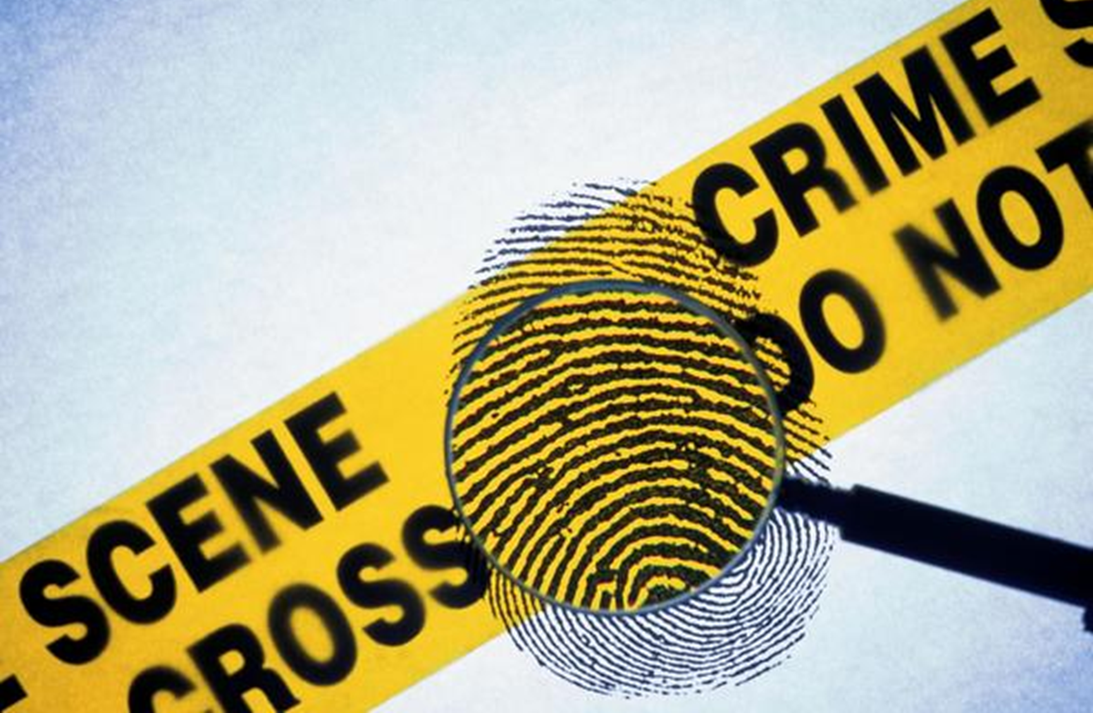
Assembly resource
AVAILABLE:
Introductory pictures
Assembly slides with notes
AIM:
Increase profile of Science
Introduce students to Molecular Biology
Link to ABE program in your school – increasing awareness among staff and students
Notes:
Looking to raise the profile of science in your school – possibly while you are loaning the ABE kit ? – here is a resource to support you - geared towards an assembly scenario. Get the ABE message out beyond those students doing the labs …

Slide 21
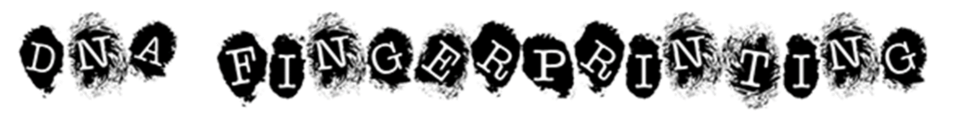
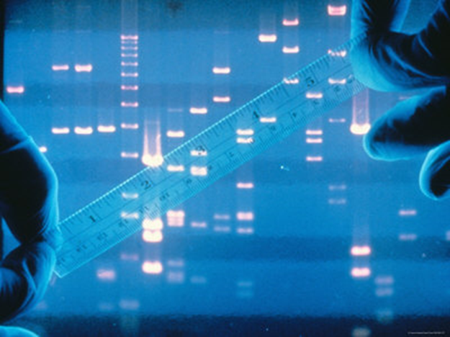
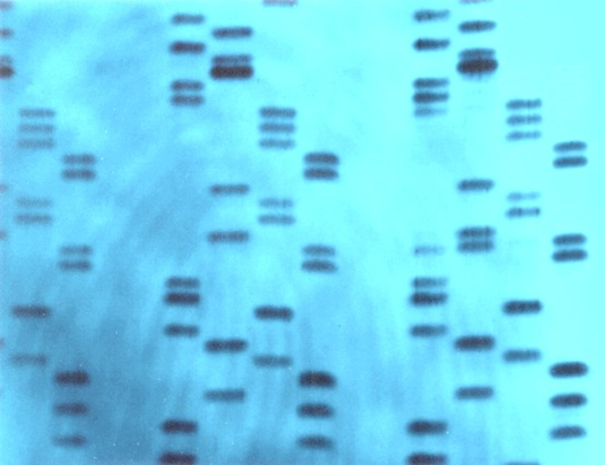
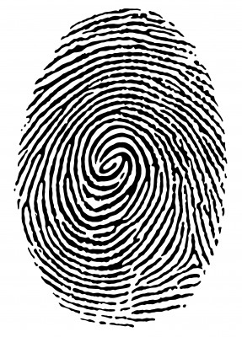
DNA identifies you
Notes:
Crime Scene Analysis uses a range of techniques. Uniformed officers secure the area and dogs sniff for clues. Another technique ‘DNA fingerprinting’ is now common too – scientists in biohazard suits to prevent contamination, analysing every little detail for DNA evidence that can point to a suspect and, hopefully, close the case.
The method of DNA fingerprinting, stems largely from the work of one man – Professor Sir Alec Jeffreys. It was he who developed techniques to use DNA to identify people.
This morning I’d like to spend a few minutes telling you a little bit about him…

Slide 22
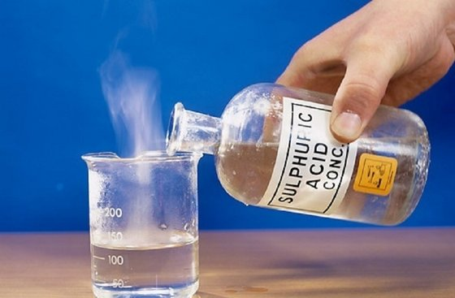
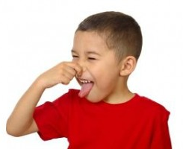
Alec Jeffreys
Notes:
Alec was born, and spent the first 6 years of his life in Oxford, before moving with his family to Luton.
When he was 8, his father gave him a Chemistry set. He loved it and tried lots of reactions, as well as buying other chemicals to add to it, like the sulphuric acid, which splashed out during one of his more explosive reactions and gave him a small scar on his chin.
However, his curiosity and inventiveness were undaunted. His father bought him a much-loved microscope and he saved up for a dissecting kit. He was encouraged in his hobby of insect dissection, although when he found a dead cat and brought it home in his bag and dissected it on the dining room table, stinking out the house when he ruptured its intestines, he recalls his parents were not best pleased!
His interest in and love of Science, led him back to Oxford to study at University, and later to work at the University of Leicester.

Slide 23

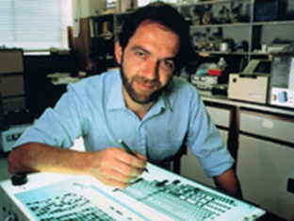
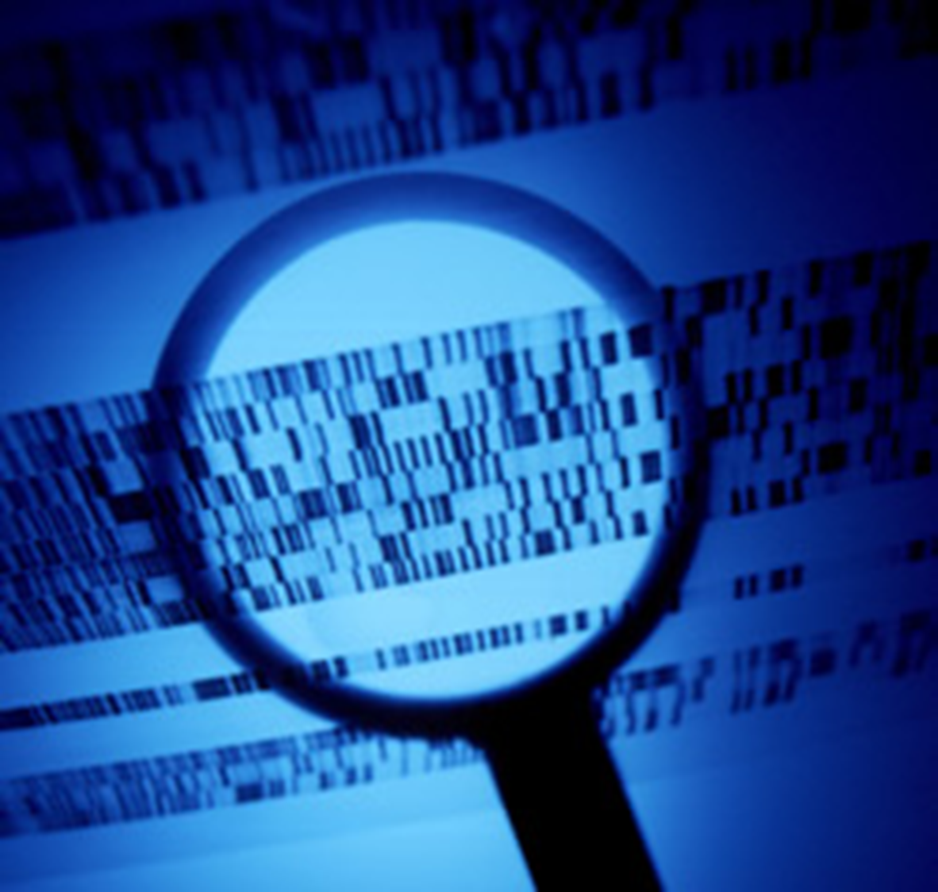
Alec Jeffreys
DNA fingerprinting
Notes:
In 1984, whilst at Leicester, Alec worked in the field of genetics – a very new science in those days.
One day, during an experiment, he found that there were similarities and differences between the DNA of a lab technician's family. Further experiments led him to realize that differences in an individual's DNA could be used to identify them – DNA fingerprinting had been invented.

Slide 24
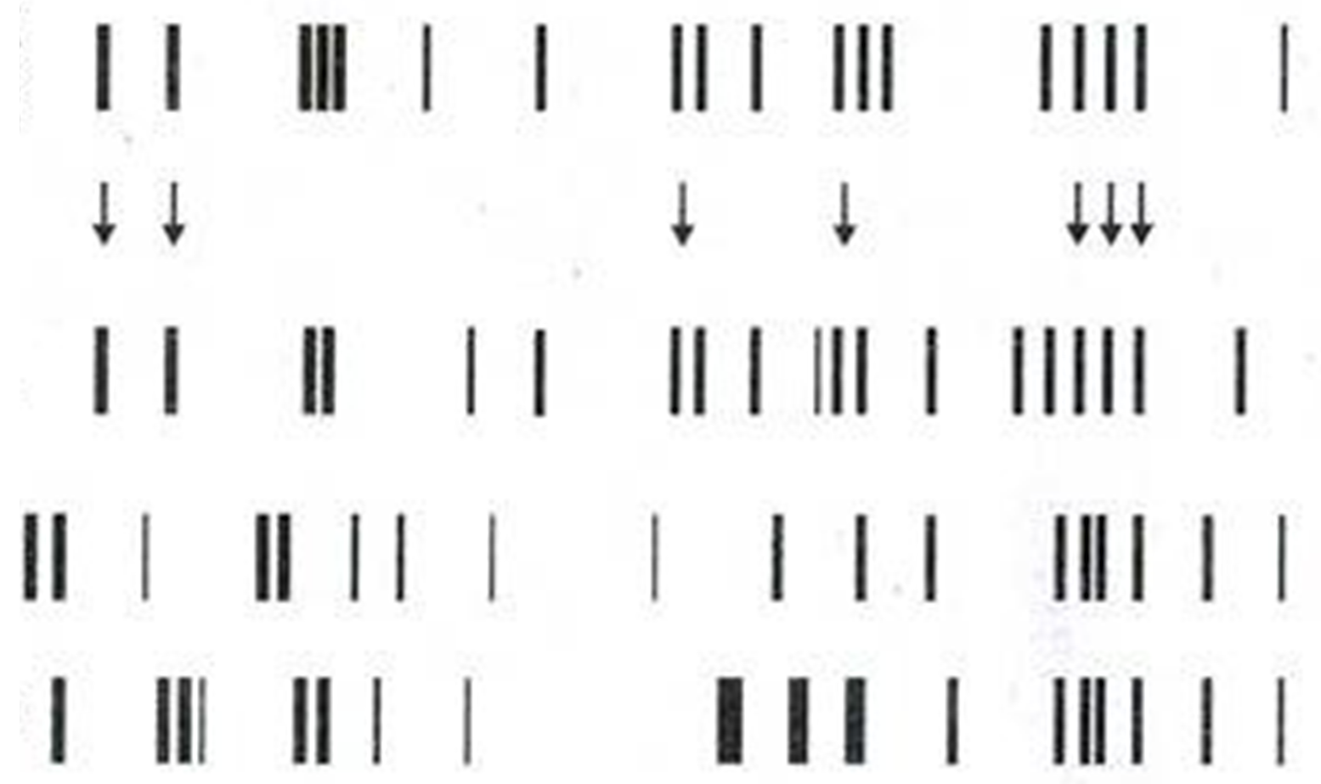
DNA fingerprinting
Scene of
Crime DNA
Suspect 1
Suspect 2
Suspect 3
Notes:
The method of DNA fingerprinting involves:
Taking DNA from a sample
Cutting it up
Separating the pieces of DNA by size
Comparing the ‘DNA fingerprints’
A reasonably simple technique the DNA fingerprint would look like this.
This is a DNA fingerprint from a Crime Scene.
The Scene of Crime DNA is at the top of the image: big bits close to the writing and small bits further away.
DNA from suspects 1, 2 and 3 are shown lower down the image.
Can anyone see which of the suspects DNA fingerprint matched that at the Scene of Crime? (1)

Slide 25
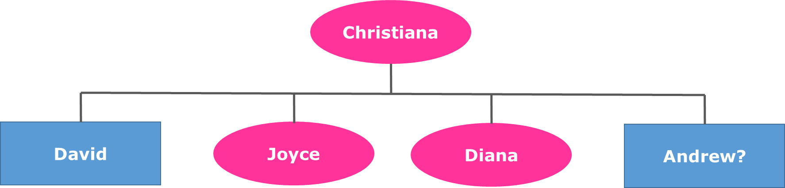

DNA fingerprinting
Reuniting families
Notes:
The new technique had to prove its usefulness though. The first practical application of ‘DNA fingerprinting’ was not at a crime scene, but in a case of immigration.
Christiana, mother to David, Joyce and Diana, lived in England. Her estranged husband lived in Ghana. In 1985, a 13 year old boy called Andrew was sent from Ghana by his father to be reunited with his mother – Christiana.
Immigration officials held Andrew at Heathrow airport, claiming his passport was forged and he did not have the right to remain in the UK. While awaiting deportation The Law Centre representing Andrew read about ‘DNA fingerprinting’, contacted Alec Jeffreys and asked him to help. By comparing the DNA of Andrew to Christiana, David, Joyce and Diana Alec Jeffreys found the odds of Christiana being the mother were 600,000 to 1 for.
After DNA identified him Andrew was not deported but remained in the UK reunited with his mother.

Slide 26
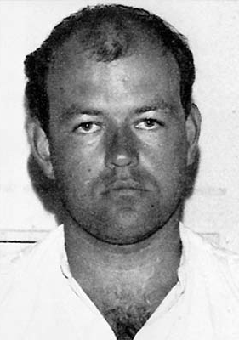
DNA fingerprinting
Colin Pitchfork
1st Murder conviction
Notes:
It wasn’t until 3 years later, in 1988, that the first murder conviction was made based on DNA fingerprinting.
2 schoolgirls had been assaulted and murdered. A local man had been arrested and charged. Asked to help, Alec Jeffreys found that the local man’s DNA did not match that found on the schoolgirl’s bodies. The local man was exonerated – released with apologies.
4,000 blood and saliva samples were taken from men in the surrounding villages, who did not have an alibi for the time of the murders.
Then by chance a woman overheard her colleague gloating that he had earnt some money providing samples for a friend: Colin Pitchfork. She informed the Police, who arrested and took samples from him. The samples matched the DNA fingerprint found at the crime scenes. In 1988 Colin Pitchfork was sentenced to life imprisonment for the murders.

Slide 27
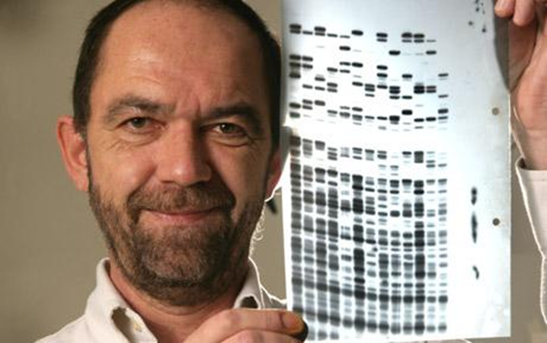
DNA fingerprinting
Alec Jeffreys: identifying through DNA
Notes:
Nowadays, Alec Jeffreys’ method of DNA fingerprinting is frequently used worldwide to:
Identify parents and children
Identify criminals
Many countries, including the UK and USA have National DNA databases of people’s DNA fingerprints.

Slide 28

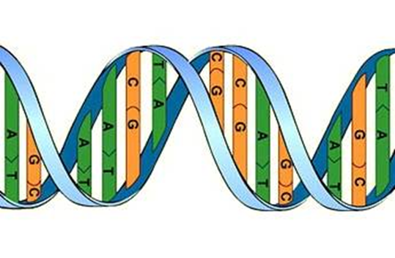
DNA fingerprinting
DNA identifies you.
Your actions define you.
Notes:
The Science of genetics, allows us to be identified by our DNA. However, DNA is a string of chemicals and there is always more to a person than just a series of chemicals. Our DNA can identify us, but our actions define us.
We are born with a DNA profile, but it is up to us to use the abilities and talent that we are born with well – hopefully for the greater good. Alec Jeffreys applied himself to an area he felt passionately about (Science) and used his abilities to help develop our knowledge and use of genetics.
I’ll leave you with these thoughts ….
If DNA can identify you, but your actions define you…
What do your actions say about you?
What are your talents and abilities?
How could you use these for the greater good of humanity?

Slide 29
Notes:
Welcome back!

Slide 30
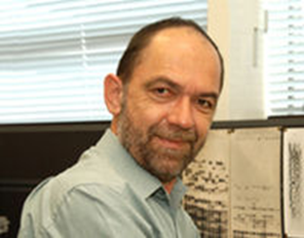
DNA profiling
Variable Number Tandem Repeats
(VNTRs)
Notes:
In 1984, this man, a scientist called Alec Jeffreys, reported a DNA profiling technique while working at the University of Leicester.
DNA profiling (also known as DNA fingerprinting or genetic fingerprinting) uses areas of the genome known as variable number tandem repeats (VNTRs)
What are VNTRs?
Although humans share the vast majority of their DNA sequence (>99.9%), there are regions of DNA sequence that are highly variable.
These DNA regions are known as mini-satellites, or variable number tandem repeat (VNTR) sequences.
VNTR sequences appear in the same place in the DNA of different individuals, but are so different in length that they allow individuals to be distinguished (typically 11-60 bp).
The technique requires relatively large quantities of high-quality DNA and further specialised lab techniques (Southern blotting) and radioactive labelling
Other examples of Repetitive Genetic Elements have since been developed as technologies have improved
Micro-satellites – STR’s – short tandem repeats (typically 2-6 bases repeated), which takes advantage of the development of the PCR technique and doesn’t require radioactive labelling
Nice description available here on the yourgenome.org website from WT Sanger - https://www.yourgenome.org/facts/what-is-a-dna-fingerprint

Slide 31
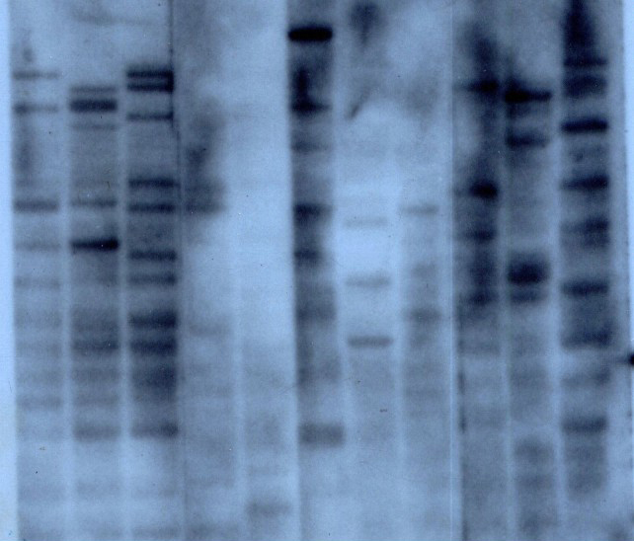
DNA profiling
Notes:
The original ‘autoradiograph’ from Alec Jeffreys experiments
Radioactively labelled fragments of DNA exposed against photographic film. Some of the samples were lab members and their family, others animal samples
You can see that being certain of some differences is quite tricky, particularly if you want to rely on this technique to solve crimes !

Slide 32
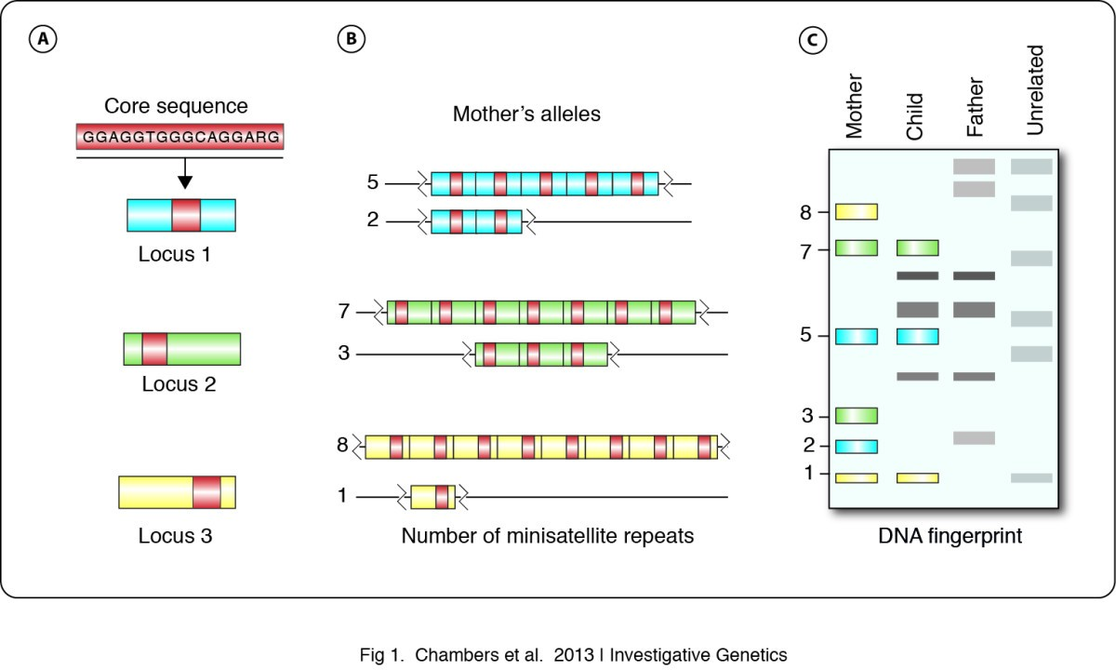
DNA profiling
DNA fingerprinting in zoology: past, present, future | Investigative Genetics | Full Text (biomedcentral.com)
Notes:
Here is a more detailed description of the technique (that you can read freely within the link for further details and examples from zoology and conservation)
Minisatellite repeat units are characterized by an approximate 16 bp core sequence in humans and other animals. (A) A core minisatellite repeat is present at three loci. (B) The number of minisatellite repeats at these loci are shown for one individual (the mother) who is heterozygous at each of the three loci. Locus 1 genotype: 5, 2; locus 2 genotype: 7, 3; and locus 3 genotype: 8, 1. (C) Representation of an autoradiograph showing restriction fragment profiles of four individuals at these three loci. At each locus in the child’s profile, one allele is shared with the mother and the other is shared with the father, as would be expected when maternity and paternity have been correctly identified. Note that the unrelated individual shares only a small number of bands with the individuals from this family.

Slide 33
DNA profiling - 1


Chromosome 3 from father


Chromosome 3 from mother
Notes:
So how can we use VNTRs to create a DNA profile?
… simplified for our purposes
This picture shows 2 chromosomes from 1 person (remember in each of your cells, except for eggs or sperm, you carry 2 copies of each chromosome, one form your father and one from your mother). They have inherited different length VNTR sequences from each parent. Each individual has 2 different length copies of each VNTR sequence.
You will use 3 Molecular Biology techniques to create a DNA profile.
1 – Cut the DNA either side of a VNTR region using restriction enzymes. Restriction enzymes are like molecular scissors, they can be used to cut DNA at a particular sequence. Reactions using restriction enzymes to cut DNA are called restriction digests.

Slide 34
DNA profiling
Chromosome 3 from father
Chromosome 3 from mother
Notes:
At the end of the restriction digest, 2 DNA fragments containing the same VNTR sequence will have been removed.

Slide 35
DNA profiling - 2
DNA ladder
CS sample
Suspect 1
Suspect 2
Suspect 3
Notes:
How can we use VNTRs to create a DNA profile?
2 – Separate the DNA fragments containing the VNTR sequence using gel electrophoresis.
This picture shows an agarose gel. It is made by pouring warm agarose (which is very much like jelly) into a small gel try and then sticking a comb in it to make holes called wells. Once the agarose gel has set the comb is removed and DNA can be loaded into the holes for electrophoresis. Electrophoresis is the separation of molecules by size (and shape and charge) through an electrical field. A marker called a DNA ladder is loaded into one of the wells to give an indication of the size of the other DNA bands. DNA is negatively charged because of the phosphate groups in the sugar-phosphate backbone of the molecule and will move from the negative to the positive electrode. Alongside the DNA ladder the sample from the crime scene and other suspects will be loaded and run. For each VNTR, DNA fragments of 2 different sizes will be detected (one inherited from mother and one inherited from father).
So if a gel was produced like this, which suspect would have DNA that matched that at the crime scene?
At this stage in a real experiment the DNA is small and colourless and invisible, so you need a third step that allows you to visualise (see) the DNA.

Slide 36
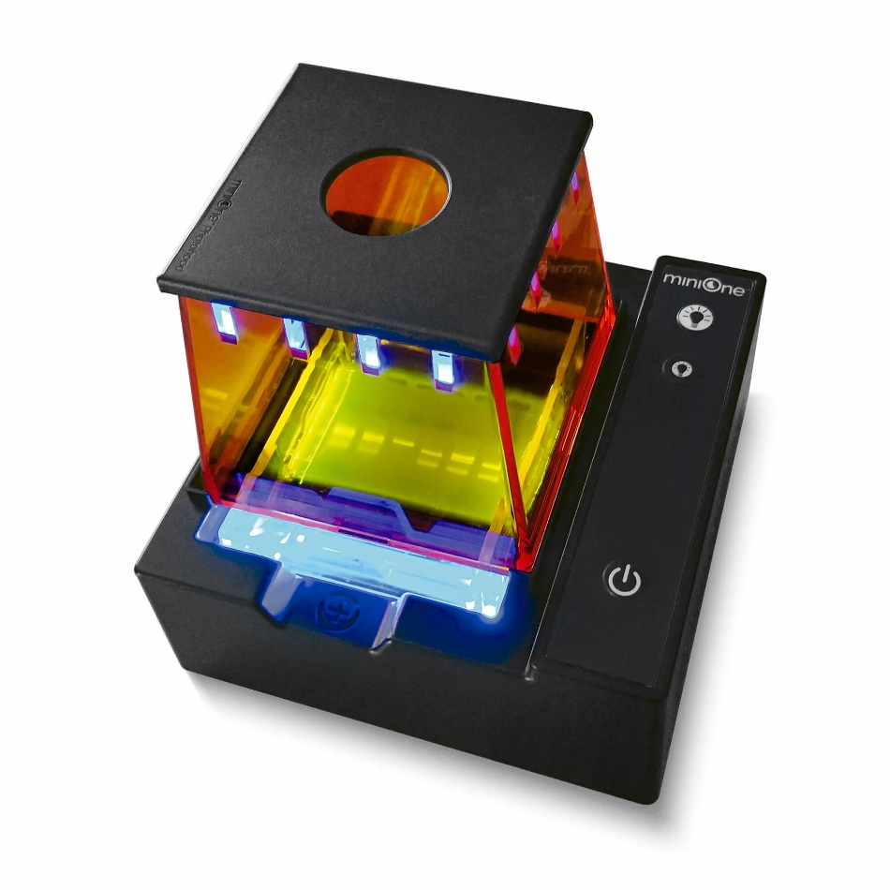
DNA profiling - 3
Notes:
How can we use VNTRs to create a DNA profile?
3 – Visualising the DNA using a special stain, UV transilluminator and digital camera.
In order to see the DNA that has been separated by size during agarose gel electrophoresis a special stain that binds to DNA is used. The gel is placed in this stain for half-an-hour, then put onto a UV transilluminator (Ultra-violet light box), which makes the DNA stain fluoresce so that you can see it. A camera programmed to take optimum pictures of gels backlit by ultra-violet light is used to take a photo of your results so that you can interpret them.
Ultra-violet light is bad for your eyes so the UV transilluminator has a built-in switch that won’t allow the bulbs to work unless the safety screen is in place.
In our experiments, we will often see multiple DNA bands and you are trying to ‘pattern match’ the DNA from the Crime Scene (for example) with a collection of ‘suspects’

Slide 37
DNA profiling
Cut the DNA either side of a VNTR region using restriction enzymes
Separate the DNA fragments containing the VNTR sequence using gel electrophoresis
Visualise the DNA using a special stain, UV transilluminator and digital camera
Identify the cake thief!
Notes:
How can we use VNTRs to create a DNA profile?
1 – Cut the DNA either side of a VNTR region using restriction enzymes.
2 – Separate the DNA fragments containing the VNTR sequence using gel electrophoresis.
3 – Visualising the DNA using a special stain, UV transilluminator and digital camera.
This is summarised nicely in this video clip:
How does DNA fingerprinting work? – YouTube
If you perform all 3 stages correctly you will be able to match the DNA profile from the crime scene to one of the suspects and be able to identify the cake thief!

Slide 38
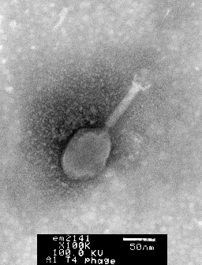
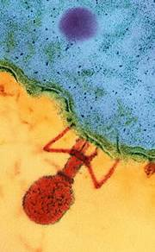
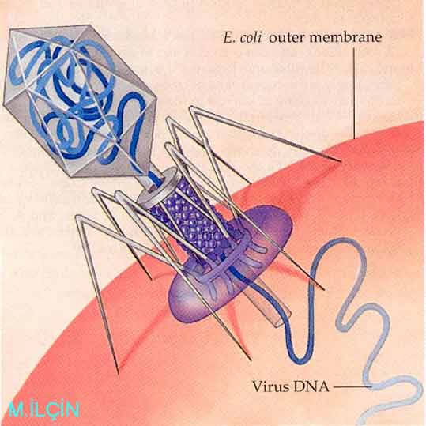
Restriction enzymes
1
2
3
Notes:
Where do restriction enzymes come from?
To give you a bit of background restriction enzymes were first observed as part of a bacterium’s ‘immune system’, preventing bacteriophage infection.
In the 1970s, Hamilton Smith and Daniel Nathans were the first to purify these primitive ‘immune agents’, which turned out to be some enzymes that bacteria produced and used to cut-up the viral DNA into fragments, as it was injected into its cell, restricting the growth of the virus.
Hamilton Smith and Daniel Nathans, along with Werner Arbor, received the Nobel Prize for their discovery and characterization of these important molecules.
Above are:
1 - transmission electron microscope images of T4phage, a bacteriophage that infects Escherichia coli bacteria from microscopist Louisa Howard, at the
Dartford college electron microscope facility
2 – falsely coloured transmission electron microscope image of T4phage injecting DNA into an E. coli bacterium
3 – a schematic diagram of the same process

Slide 39
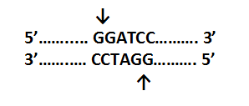
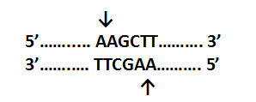
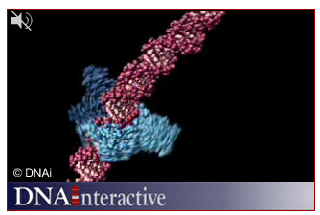
Restriction enzymes
BamHI
Bacillus amyloliquefaciens
HindIII
Haemophilus influenza
Notes:
How do restriction enzymes cut DNA?
All restriction enyzmes will:
bind to DNA at recognition sequences. Recognition sequences are palindromes.
only cut DNA at specific restriction sites. Restriction sites can be within the recognition sequence or nearby.
2 examples of enzymes are shown with their recognition sequences and restriction sites (arrows).
Restriction enzymes work by ‘reading’ the DNA base sequence until they find their recognition sequence and then cut or cleave the DNA at a specific restriction site.
In this short video clip there is an animation of DNA (coloured pink), being ‘read’ by a restriction enzyme (in blue) and cleaved at the restriction site.
http://www.dnalc.org/view/15488-Restriction-digest-3D-animation-with-no-audio.html
You will use a mix of restriction enzymes today to cut DNA either side of selected VNTRs.

Slide 40
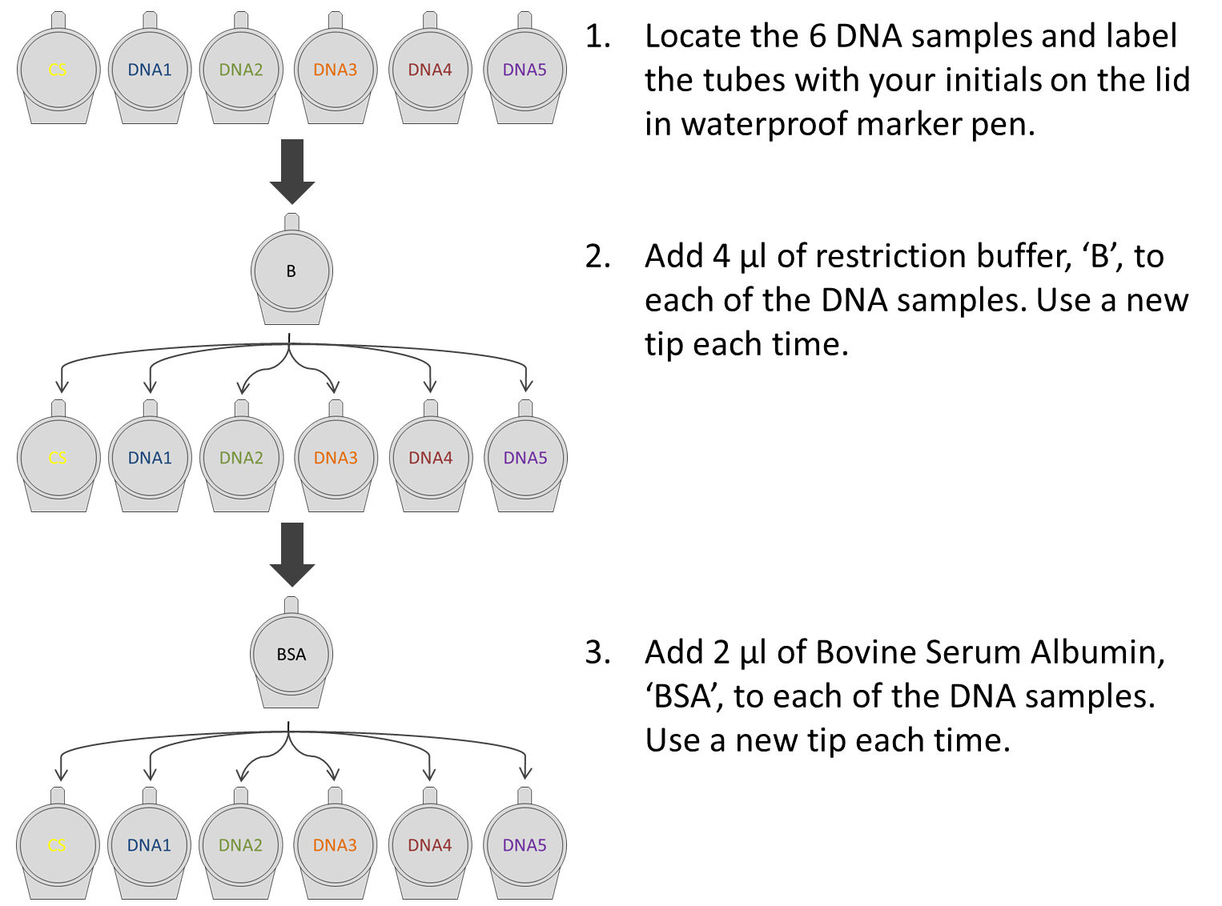
DNA profiling
BF
Add 4 ul restriction buffer, ‘BF’ to each DNA sample. Use a new tip every time.
3. Mix each sample gently, swirling with the pipette tip.
Notes:
How will we set up the restriction digests?
You will need to use small writing for labelling the tubes on their lids.
DO label on their lids, the waterproof markers are not very waterproof if actually submerged in water!
I would suggest ticking off each reagent as you add it so you don’t do the same thing twice or forget a reaction.
DON’T forget to change tips between each addition or you will contaminate the DNA samples.

Slide 41
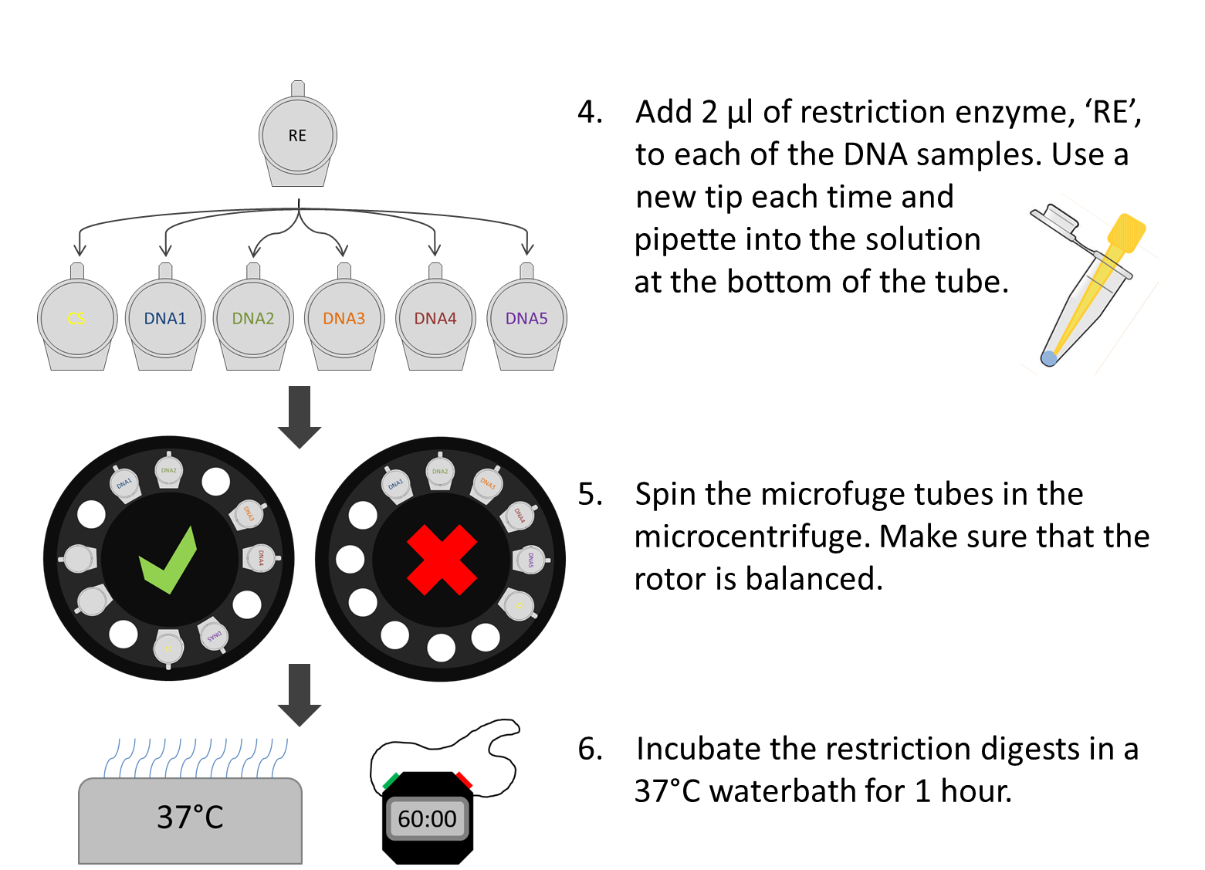
DNA profiling
Add 2 ul of restriction enzyme, ‘ENZ’ to each of the DNA samples. Use a new tip everytime and pipette into the solution at the bottom of the tube
ENZ
Notes:
How will we set up the restriction digests?
You are using small quantities of transparent reagents. It is a good idea to collect them at the bottom of the tube together by briefly centrifuging before incubating in the waterbath.
DO make sure that you balance the rotor before starting the microcentrifuge – it goes very fast 13,000 revolutions per minute and it is easy to bend the spindle.

Slide 42
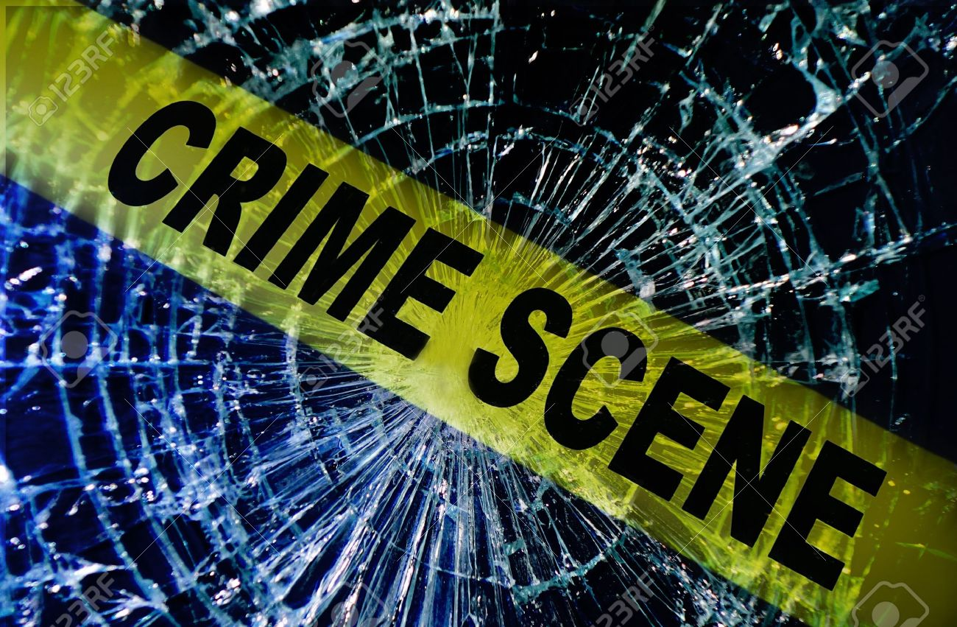
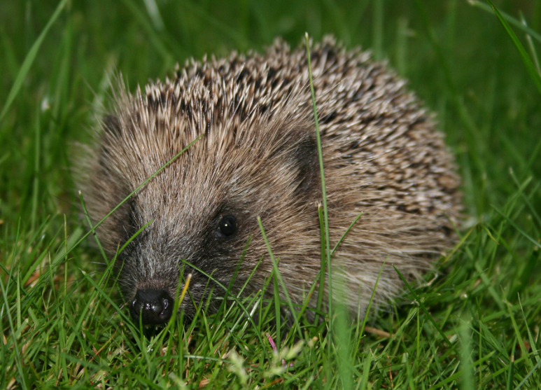

DNA profiling
DNA Fingerprinting / DNA profiling
Schootland yard
Notes:
the same practical activity can be used with a different focus. It might be a way to run ABE labs such as this one, when you are covering ecology–related topics for example.
Our ABE website, hosted by UH STEM Centre, has a collection of alternative Fingerprinting scenarios (originally produced by SAPS and the Scottish Institute for Biotechnology Education / SIBE (which is no longer). We have been given permission to reproduce their work on our website (which is password protected).
It includes the following scenarios
FairOak Project
Hedgehog Recolonisation
How many otters crossed the river?
Orchid conservation
Invasion of Japanese Knotweed

Slide 43
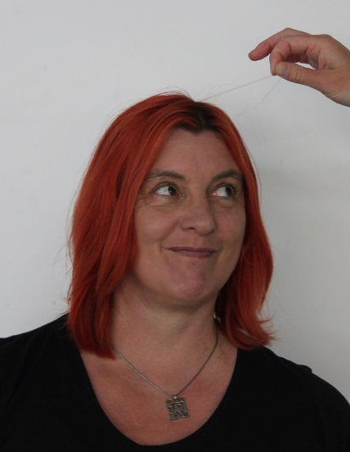
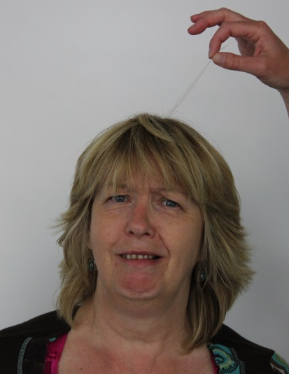
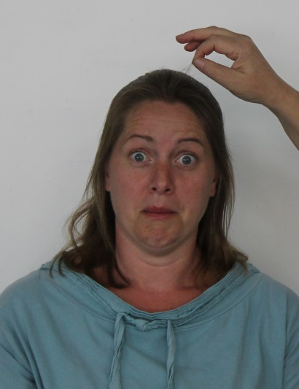
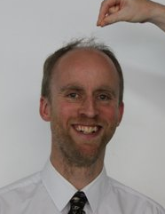
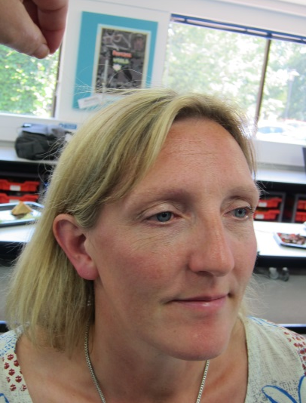
Schootland yard
1
2
3
4
5
Notes:
Or you can recreate your own fun or serious crime-scene as long as colleagues in the department are prepared to donate their DNA samples!! ☺
Holli took a hair from each suspect…
… and isolated and amplified the DNA from it.

Slide 44
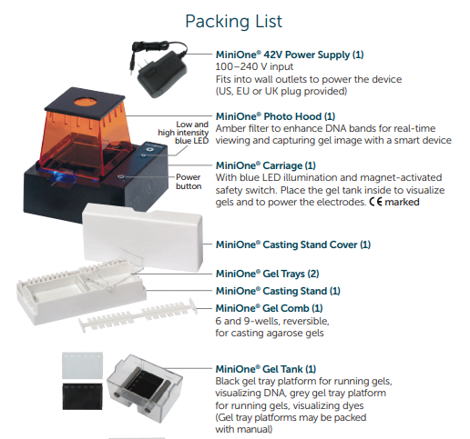
Lab 5: Mini-One assembly
Notes:
Mini-One – highlight how it is impossible to set-up the wrong way because of incompatibilities and markings.

Slide 45
Mini-One Set-up
0.8% gel, 1 x TAE buffer
11 ml agarose for each gel
135 ml buffer needed
6 or 9 teeth (samples) per gel
Add LD to samples
Ensure LD contains Gel Green
Load under blue light
Run ‘live’ : 20-30 min
No post-stain required
Result recorded directly by students on smartphone

Slide 46


Gel Green DNA Stain
GelGreen® is a highly sensitive, stable and environmentally safe, green fluorescent nucleic acid stain
• Non-mutagenic - at concentrations relevant to nucleic acid gel staining
• Non-cytotoxic - at concentrations relevant to nucleic acid gel staining
• Cell membrane impermeability for true safety
• Impenetrable to latex gloves
• Very photostable - use under normal room light
• Hydrolytically stable
• Microwaveable
Remember gloves and goggles when using the stains
Notes:
Both systems use less cytotoxic DNA stains than the traditional Ethidium bromide systems that those of you who have worked in research may remember. STILL EXERT CARE, THEY ARE DNA STAINS and we don’t want your DNA being stained

Slide 47


Electrophoresis prep.
400 ml 1 x TAE buffer from 50 x concentrate
8 ml of 50 x TAE buffer + 392 ml of distilled water
0.8% agarose gel, 35 ml volume (3 gels!)
0.28 g agarose + 35 ml 1 x TAE buffer
Remember gloves and goggles when handling TAE buffer
Notes:
Remember microwaving SB buffer + agarose creates a super-heated liquid, so take care when making molten agarose

Slide 48
Electrophoresis prep.
Number of samples will dictate which comb you use
DNA Fingerprinting – Ref + 5 suspects + marker = 7
PCR of ‘rfp’ – some/all of
A-plasmid
R-plasmid
H2O (-ive ct)
Red colony
White colony
Notes:
Think about the number of samples you will have, and comb size for the gel

Slide 49

Gel electrophoresis
Pipette tip
SB buffer
Well
Agarose gel
Notes:
Loading your sample onto the agarose gel
With the low-intensity blue light switched-on it is very easy to load Mini-One gels

Slide 50

Gel electrophoresis
Notes:
Although take care not to jab through the bottom or sides of the wells. Allow the loading dye to help samples “SINK” into the wells

Slide 51
PCRs onto Gel
Each PCR sample, needs to be prepared for loading onto gel – either a MiniOne gel or the traditional format. Add 4μl loading dye DIRECT TO PCR samples, mix, and LOAD into 10μl into gel
Reagent | NEG gel | A gel | R gel | LIG gel | C gel
Loading Dye | 2.0 μL | 2.0 μL | 2.0 μL | 2.0 μL | 2.0 μL
Nuclease-free water (H₂O) | 6.0 μL | 6.0 μL | 6.0 μL | 6.0 μL | 6.0 μL
Neg PCR (water only) | 2.0 μL
pARA plasmid (A) - PCR |  | 2.0 μL
pARA-R plasmid (R) - PCR |  |  | 2.0 μL
Ligation (LIG) - PCR |  |  |  | 2.0 μL
Colony PCR |  |  |  |  | 2.0 μL
Notes:
Different to manual –
Text Box = approach that we will follow in training, will save quite a bit of plastic and is part of our measures to make ABE less impactful in terms of single-use plastics . Can be used in class as well
TABLE – reproduces the manual - which may well be reprinted next year with further improvements – suggests taking PCR samples out of tube and preparing a fresh tube

Slide 53

Lab 5: gel electrophoresis
Xylene cyanol ~ 4,000 bp
Bromophenol blue ~ 500 bp
Orange G ~ 50 bp
Notes:
In a 1% agarose gel; Orange G dye co-migrates with linear DNA of about 50 bp, bromophenol blue co-migrates with linear DNA of about 500 bp, and xylene cyanol co-migrates with linear DNA of about 4,000 bp.
When in the gel tank with blue light switched-on, the DNA fragments should be visible

Slide 54

Lab 9: DNA profiling
CS / DNA Ref
1 kb marker
DNA 1
DNA 2
DNA 3
DNA 4
DNA 5
So who dunnit?
Notes:
This slide shows the expected result, so you need to decide when you wish to share this participants.
No need to worry about sizes – you are looking to ‘pattern match’
Separating ‘suspect samples’ from DNA Ref with the marker helps ‘read’ the gel
Assuming no pipetting or labelling errors you should find Suspect 4 matches the Crime Scene

Slide 55
200 bp
200 bp
160 bp
160 bp
120 bp
120 bp
100 bp
100 bp
80 bp
80 bp
60 bp
60 bp
40 bp
40 bp
30 bp
30 bp
20 bp
20 bp
Notes:
See back of Teacher and Technician guide for this ‘paper & pen’ version of DNA fingerprinting

Slide 56
1
2
3
4
5
6
200 bp
200 bp
160 bp
160 bp
120 bp
120 bp
100 bp
100 bp
80 bp
80 bp
60 bp
60 bp
40 bp
40 bp
30 bp
30 bp
20 bp
20 bp

Slide 57
200 bp
200 bp
160 bp
160 bp
120 bp
120 bp
Crime scene DNA analysed for 4 VNTR regions
(FGA, VWA, D18S51, D19S433)
100 bp
100 bp
80 bp
80 bp
60 bp
60 bp
40 bp
40 bp
30 bp
30 bp
20 bp
20 bp

Slide 59
Biotechnology for the classroom
Bacterial Transformation

Slide 60
Horizontal Gene Transfer
Horizontal gene transfer (HGT) is the movement of genetic information between organisms, a process that includes the spread of antibiotic resistance genes among bacteria

Slide 61



Horizontal Gene Transfer
Conjugation Transduction Transformation
Notes:
What is transformation? Transformation refers to the changing of an organisms genetic material
Transformation is one of the methods by which the DNA of a cell can be altered, to express exogenous (foreign) DNA. Other methods of horizontal gene transfer include bacterial conjugation and bacterial transduction.
In bacterial conjugation a cell to cell contact is made through a ‘pilus’ and genetic material, often in the form of a plasmid or transposon is introduced to another bacterium.
In bacterial transduction, genetic material is transferred from one to another bacterium by a virus.
In bacterial transformation, cells are made ‘competent’ using either an electric current (electroporation, using an electric field of 10-20 kV/cm which is thought to create holes in the cell membrane through which the plasmid DNA may enter. After the electric shock the holes are rapidly closed by the cell's membrane-repair mechanisms) or chemical methods (commonly calcium chloride), under cold conditions, then a sudden ‘heat shock’ causing DNA to enter through the bacterial cell membrane.

Slide 62






Lab 6a: transformation
Competent Cells
pARA-R
Recombinant Plasmids
Notes:
The cells have been made competent for you using calcium chloride. In this experiment you will add the recombinant plasmid, pARA-R, to the bacterial cells and HEAT SHOCK them in the hope that the plasmid will be incorporated into a bacterial host cell, which will then transcribe, translate and express the proteins encoded.

Slide 63

Lab 6a: transformation
Lipid bilayer
(inner)
Adhesion zone
Peptidoglycan
layer
Lipid bilayer
(outer)
Calcium ions
Notes:
The mechanism by which bacterial cells made competent using chemical methods ‘take up’ DNA is unclear.
Both DNA and the cell membrane surrounding bacterial cells are negatively charged due to phosphate groups (and lipopolysaccharides on the bacterial cell surface). Like charges repel each other and so it is thought that the calcium from the calcium chloride may shield the negative charges of the cell surface, allowing DNA molecules to adhere. Performing this chemical process in cold conditions is thought to change or weaken the cell surface structure of the cells making it more permeable to DNA.
The heat shock in the presence of plasmid DNA is thought to create a pressure gradient from outside the cell to inside the cell. This pressure gradient helps to move the plasmid DNA from the outside to the inside of the bacterial cell either through cell pores, or through the damaged cell wall.
Almost needless to say, this is not a very pleasant experience for the bacterium and afterwards they need a bit of TLC to recover, before being spread onto agar plates to grow.

Slide 64

Lab 6a: transformation
Lipid bilayer
(inner)
Adhesion zone
Peptidoglycan
layer
Lipid bilayer
(outer)
Calcium ions
pARA-R

Slide 65

Lab 6a: transformation
Lab 6a: transformation
Transformation Theory

Slide 66



Lab 6a: transformation
Spread don’t
gauge agar
Keep cells cold
Heat shock at exactly 42°C

Slide 67

Lab 6a: transformation
Follow good aseptic technique. Gloves do not need to be worn. All tips & tubes into Virkon (or equivalent)

Slide 68
Notes:
Any questions so far?

Slide 69



Lab 6a: transformation
P- plates
No growth
LB
LB/amp
P+ plates
LB
LB/amp
LB/amp/ara
Notes:
You will pour 3 plates and divide 2 in half, rather than pour 5 plates for each pair.
Once the experiment is complete and you plate the competent cell control (P-) and competent cells transformed with recombinant plasmids (P+) onto Luria-Bertani (LB) agar plates you will find out whether the experiment has been successful and created a recombinant plasmid that expresses RFP inside an E. coli bacterium, making it glow red!

Slide 70
Lab 6a: transformation
Supercoiled plasmid
Relaxed circle plasmid
LB/amp/ara
Taken from; YAFFEE, M, WALTER, P., RICHTER, C. and MULLER, M. (1996) PNAS of the USA 93; pp. 5341-5346.
Notes:
This slide is to illustrate the difference between the transformation efficiency doing lab 5a, with recombinant plasmid that has been purified from bacteria and is mostly in supercoiled form and doing lab 5, in which the recombinant plasmid has been engineered by the students and is primarily in relaxed circle form.
Firstly here are what I think are some lovely High Resolution – Scanning Electron Microscope images of the three-dimensional surface topology of (a) supercoiled plasmid pUC21, (c and d) open-circular DNA molecules of pBR322 plasmid.
When the supercoiled form of plasmid is used in transformation, not only should every bacterial colony produce RFP protein, but each pair of students performing the experiment should get multiple colonies.
When the relaxed circle plasmid, constructed by the students in labs 2, 3 and 4 is used there will be some bacteria transformed with constructs other than the recombinant pARA-R which we wanted. This shows a really exceptionally successful transformation, in most classes of 12 pairs there will single numbers of colonies altogether that have been successfully transformed with recombinant pARA-R and are expressing the rfp gene.

Slide 71

Lab 6a: transformation
colony
satellite colonies
Notes:
The other thing that you may come across are ‘satellite colonies’ on the LB + amp or LB + amp + ara plates
These are not necessarily transformed with the recombinant plasmid carrying ampicillin resistance, but can grow in the area around a colony as "freeloaders" and survive because other cells are doing the work of destroying the antibiotic in their immediate vicinity on the plate. They only develop when antibiotic resistance is due to a compound secreted outside of the cell, like with the antibiotic ampicillin, which is destroyed by the enzyme beta lactamase outside of the cell.
When do you get satellite colonies? When:
The ampicillin plate is old (meaning that the antibiotic is partially degraded)
The transformed cells are plated at very high density (meaning that the plate is covered with huge number of cells)
The copy number of the plasmid in the cells is so high that beta lactamase is secreted at high levels, or
The colonies grow on the plate for several days (allowing more time for degradation of ampicillin).
They’re not a problem, provide an interesting discussion point and wouldn’t survive if you were to progress to lab 6, because the transformed bacteria are grown overnight in medium containing ampicillin, which would be sufficient to kill them.

Slide 72




Lab 6a: transformation
Colony isolation and culture
LB/amp/ara
broth
Notes:
The next steps in the US sequence of labs is to grow an overnight culture and purify the protein from that culture. Briefly, here is the procedure

Slide 73

Lab 6a: transformation

Slide 74




















Lab 6a: transformation
Overnight
culture
Cell pellet
with RFP
Lysed
cells
Pellet
cell debris
RFP with
binding buffer

Slide 75

Lab 6a: transformation

Slide 76

Making protein therapeutics
chromosome

gene of interest
plasmids
E. coli
plasmid
digest plasmid
recombinant plasmid
protein purified
protein produced
E. coli with recomb-inant plasmid

Slide 77
Notes:
Final chance for any questions ….

Slide 78

Lab 6/6a ’
ONLINE FOLLOW-UP - RESULTS

Slide 79

Lab 4/7 – Finding ‘rfp’
A-plasmid
R-plasmid
Red
Ligation
Water
White
1 kb
Notes:
Smallest 2 fragments in 1 kb ladder are 500 and 1000 bp. This helps us size all other bands
The faint smear in water track is primer-dimer
A-plasmid amplifies the 662 bp band (that sits between 500 and 1000)
R-plasmid amplifies the 1092 bp band (that is > 100 bp on ladder)
Ligation gives multiple fragments inc. 662 and 1092 (which predominate)
White colony contain A-plasmid (so 662 bp band)
Red colony contain R-plasmid (so 1092 bp band)

Slide 80


PCR: lab 4a
MMpARA-R
MMRed
1 Kb
1 Kb
1 Kb
R -
R +
10.0
10.0
8.0
8.0
6.0
6.0
5.0
5.0
4.0
4.0
3.0
3.0
2.0
2.0
1.5
1.5
1.0
1.0
0.5
0.5

Slide 81

PCR: lab 7a
MMpARA-R
MMRed
1 Kb
1 Kb
1 Kb
R -
R +
10.0
10.0
8.0
8.0
6.0
6.0
5.0
5.0
4.0
4.0
3.0
3.0
2.0
2.0
1.5
1.5
1.0
1.0
0.5
0.5

Slide 82


PCR: lab 4a and 7a
MMpARA-R
MMpARA-R
MMRed
MMRed
1 Kb
1 Kb
1 Kb
1 Kb
1 Kb
1 Kb
R -
R +
R -
R +
10.0
10.0
10.0
10.0
8.0
8.0
8.0
8.0
6.0
6.0
6.0
6.0
5.0
5.0
5.0
5.0
4.0
4.0
4.0
4.0
3.0
3.0
3.0
3.0
2.0
2.0
2.0
2.0
1.5
1.5
1.5
1.5
1.0
1.0
1.0
1.0
0.5
0.5
0.5
0.5

Slide 83


PCR: lab 4
MMpARA
MMpARA-R
Ligation
1 Kb
MMLIG
K +
A+
1 Kb
K-
A-
10.0
8.0
6.0
5.0
4.0
3.0
2.0
1.5
1.0
0.5
Notes:
Main series expected (left) and observed (right) results
pKAN-R- : restriction digest control. Expected size 5512 bp.
pKAN-R+ : restriction digest with BamHI and HindIII. Expected size 4705 bp + 807 bp.
pARA- : restriction digest control. Expected size 4872 bp.
pARA+ : restriction digest with BamHI and HindIII. Expected size 4495 bp + 377 bp.
pARA PCR : PCR of plasmid using primers outside BamHI and HindIII cutting sites. Expected size 662 bp. (See slide, ‘pARA : PCR product’.)
Ligation : ligation of pARA+ and pKAN-R. Expected size – different-sized fragments, will probably show as a smear.
Ligation PCR : PCR of the ligation reaction. Expected size – should be 662 bp (re-ligated pARA) and 1092 bp (created, desired pARA-R), likely to be others, but may be too large to amplify by PCR with extension time used (shown as a smear).
pARA-R PCR : PCR of plasmid using primers outside BamHI and HindIII cutting sites. Expected size 1092 bp. (See slide, ‘pARA-R : PCR product’.)
Red colony PCR : ‘colony pick’ PCR of E. coli LMG194 transformed with ligation reaction, plated on LB/amp/ara. Expected size 1092 bp.
White colony PCR 1 : ‘colony pick’ PCR of E. coli LMG194 transformed with ligation reaction, plated on LB/amp/ara. Expected size 662 bp.
White colony PCR 2 and 3 : ‘colony pick’ PCR of E. coli LMG194 transformed with ligation reaction, plated on LB/amp. Expected size 662 bp (re-ligated pARA) and 1092 bp (created, desired pARA-R), may be others too.
The wells loaded with PCRs corresponding to the different stages on the ‘Using the new PCR’ slide are labelled with the same green numbers used on the ‘Using the new PCR’ slide.

Slide 84


PCR: lab 4
MMpARA
MMpARA-R
Ligation
1 Kb
MMLIG
K +
A+
1 Kb
K-
A-
10.0
8.0
6.0
5.0
4.0
3.0
2.0
1.5
1.0
0.5
Notes:
Main series expected (left) and observed (right) results
pKAN-R- : restriction digest control. Expected size 5512 bp.
pKAN-R+ : restriction digest with BamHI and HindIII. Expected size 4705 bp + 807 bp.
pARA- : restriction digest control. Expected size 4872 bp.
pARA+ : restriction digest with BamHI and HindIII. Expected size 4495 bp + 377 bp.
pARA PCR : PCR of plasmid using primers outside BamHI and HindIII cutting sites. Expected size 662 bp. (See slide, ‘pARA : PCR product’.)
Ligation : ligation of pARA+ and pKAN-R. Expected size – different-sized fragments, will probably show as a smear.
Ligation PCR : PCR of the ligation reaction. Expected size – should be 662 bp (re-ligated pARA) and 1092 bp (created, desired pARA-R), likely to be others, but may be too large to amplify by PCR with extension time used (shown as a smear).
pARA-R PCR : PCR of plasmid using primers outside BamHI and HindIII cutting sites. Expected size 1092 bp. (See slide, ‘pARA-R : PCR product’.)
Red colony PCR : ‘colony pick’ PCR of E. coli LMG194 transformed with ligation reaction, plated on LB/amp/ara. Expected size 1092 bp.
White colony PCR 1 : ‘colony pick’ PCR of E. coli LMG194 transformed with ligation reaction, plated on LB/amp/ara. Expected size 662 bp.
White colony PCR 2 and 3 : ‘colony pick’ PCR of E. coli LMG194 transformed with ligation reaction, plated on LB/amp. Expected size 662 bp (re-ligated pARA) and 1092 bp (created, desired pARA-R), may be others too.
The wells loaded with PCRs corresponding to the different stages on the ‘Using the new PCR’ slide are labelled with the same green numbers used on the ‘Using the new PCR’ slide.

Slide 85



PCR: lab 4
MMpARA
MMpARA-R
Ligation
1 Kb
MMLIG
pARA PCR
K +
A+
1 Kb
K-
A-
Ligation reaction
10.0
8.0
6.0
5.0
4.0
3.0
2.0
1.5
Ligation PCR
1.0
0.5
pARA-R PCR
Notes:
Main series expected (left) and observed (right) results
pKAN-R- : restriction digest control. Expected size 5512 bp.
pKAN-R+ : restriction digest with BamHI and HindIII. Expected size 4705 bp + 807 bp.
pARA- : restriction digest control. Expected size 4872 bp.
pARA+ : restriction digest with BamHI and HindIII. Expected size 4495 bp + 377 bp.
pARA PCR : PCR of plasmid using primers outside BamHI and HindIII cutting sites. Expected size 662 bp. (See slide, ‘pARA : PCR product’.)
Ligation : ligation of pARA+ and pKAN-R. Expected size – different-sized fragments, will probably show as a smear.
Ligation PCR : PCR of the ligation reaction. Expected size – should be 662 bp (re-ligated pARA) and 1092 bp (created, desired pARA-R), likely to be others, but may be too large to amplify by PCR with extension time used (shown as a smear).
pARA-R PCR : PCR of plasmid using primers outside BamHI and HindIII cutting sites. Expected size 1092 bp. (See slide, ‘pARA-R : PCR product’.)
Red colony PCR : ‘colony pick’ PCR of E. coli LMG194 transformed with ligation reaction, plated on LB/amp/ara. Expected size 1092 bp.
White colony PCR 1 : ‘colony pick’ PCR of E. coli LMG194 transformed with ligation reaction, plated on LB/amp/ara. Expected size 662 bp.
White colony PCR 2 and 3 : ‘colony pick’ PCR of E. coli LMG194 transformed with ligation reaction, plated on LB/amp. Expected size 662 bp (re-ligated pARA) and 1092 bp (created, desired pARA-R), may be others too.
The wells loaded with PCRs corresponding to the different stages on the ‘Using the new PCR’ slide are labelled with the same green numbers used on the ‘Using the new PCR’ slide.

Slide 86

PCR: lab 4
MMpARA
MMpARA-R
MMpARA
MMpARA-R
Ligation
Ligation
1 Kb
MMLIG
MMLIG
K +
A+
1 Kb
1 Kb
K +
A+
1 Kb
K-
A-
K-
A-
10.0
10.0
8.0
8.0
6.0
6.0
5.0
5.0
4.0
4.0
3.0
3.0
2.0
2.0
1.5
1.5
1.0
1.0
0.5
0.5
Notes:
Main series expected (left) and observed (right) results
pKAN-R- : restriction digest control. Expected size 5512 bp.
pKAN-R+ : restriction digest with BamHI and HindIII. Expected size 4705 bp + 807 bp.
pARA- : restriction digest control. Expected size 4872 bp.
pARA+ : restriction digest with BamHI and HindIII. Expected size 4495 bp + 377 bp.
pARA PCR : PCR of plasmid using primers outside BamHI and HindIII cutting sites. Expected size 662 bp. (See slide, ‘pARA : PCR product’.)
Ligation : ligation of pARA+ and pKAN-R. Expected size – different-sized fragments, will probably show as a smear.
Ligation PCR : PCR of the ligation reaction. Expected size – should be 662 bp (re-ligated pARA) and 1092 bp (created, desired pARA-R), likely to be others, but may be too large to amplify by PCR with extension time used (shown as a smear).
pARA-R PCR : PCR of plasmid using primers outside BamHI and HindIII cutting sites. Expected size 1092 bp. (See slide, ‘pARA-R : PCR product’.)
Red colony PCR : ‘colony pick’ PCR of E. coli LMG194 transformed with ligation reaction, plated on LB/amp/ara. Expected size 1092 bp.
White colony PCR 1 : ‘colony pick’ PCR of E. coli LMG194 transformed with ligation reaction, plated on LB/amp/ara. Expected size 662 bp.
White colony PCR 2 and 3 : ‘colony pick’ PCR of E. coli LMG194 transformed with ligation reaction, plated on LB/amp. Expected size 662 bp (re-ligated pARA) and 1092 bp (created, desired pARA-R), may be others too.
The wells loaded with PCRs corresponding to the different stages on the ‘Using the new PCR’ slide are labelled with the same green numbers used on the ‘Using the new PCR’ slide.

Slide 87
PCR: lab 4
MMpARA
MMpARA-R
MMpARA
MMpARA-R
Ligation
Ligation
1 Kb
MMLIG
MMLIG
K +
A+
1 Kb
1 Kb
K +
A+
1 Kb
K-
A-
K-
A-
10.0
10.0
8.0
8.0
6.0
6.0
5.0
5.0
4.0
4.0
3.0
3.0
2.0
2.0
1.5
1.5
1.0
1.0
0.5
0.5
Notes:
Main series expected (left) and observed (right) results
pKAN-R- : restriction digest control. Expected size 5512 bp.
pKAN-R+ : restriction digest with BamHI and HindIII. Expected size 4705 bp + 807 bp.
pARA- : restriction digest control. Expected size 4872 bp.
pARA+ : restriction digest with BamHI and HindIII. Expected size 4495 bp + 377 bp.
pARA PCR : PCR of plasmid using primers outside BamHI and HindIII cutting sites. Expected size 662 bp. (See slide, ‘pARA : PCR product’.)
Ligation : ligation of pARA+ and pKAN-R. Expected size – different-sized fragments, will probably show as a smear.
Ligation PCR : PCR of the ligation reaction. Expected size – should be 662 bp (re-ligated pARA) and 1092 bp (created, desired pARA-R), likely to be others, but may be too large to amplify by PCR with extension time used (shown as a smear).
pARA-R PCR : PCR of plasmid using primers outside BamHI and HindIII cutting sites. Expected size 1092 bp. (See slide, ‘pARA-R : PCR product’.)
Red colony PCR : ‘colony pick’ PCR of E. coli LMG194 transformed with ligation reaction, plated on LB/amp/ara. Expected size 1092 bp.
White colony PCR 1 : ‘colony pick’ PCR of E. coli LMG194 transformed with ligation reaction, plated on LB/amp/ara. Expected size 662 bp.
White colony PCR 2 and 3 : ‘colony pick’ PCR of E. coli LMG194 transformed with ligation reaction, plated on LB/amp. Expected size 662 bp (re-ligated pARA) and 1092 bp (created, desired pARA-R), may be others too.
The wells loaded with PCRs corresponding to the different stages on the ‘Using the new PCR’ slide are labelled with the same green numbers used on the ‘Using the new PCR’ slide.

Slide 88
PCR: lab 7
MMpARA-R
MMWhite
MMWhite
MMRed
MMWhite
1 Kb
1 Kb
10.0
10.0
8.0
8.0
6.0
6.0
5.0
5.0
4.0
4.0
3.0
3.0
2.0
2.0
pARA-R PCR
1.5
1.5
1.0
1.0
0.5
0.5
Notes:
Main series expected (left) and observed (right) results
pKAN-R- : restriction digest control. Expected size 5512 bp.
pKAN-R+ : restriction digest with BamHI and HindIII. Expected size 4705 bp + 807 bp.
pARA- : restriction digest control. Expected size 4872 bp.
pARA+ : restriction digest with BamHI and HindIII. Expected size 4495 bp + 377 bp.
pARA PCR : PCR of plasmid using primers outside BamHI and HindIII cutting sites. Expected size 662 bp. (See slide, ‘pARA : PCR product’.)
Ligation : ligation of pARA+ and pKAN-R. Expected size – different-sized fragments, will probably show as a smear.
Ligation PCR : PCR of the ligation reaction. Expected size – should be 662 bp (re-ligated pARA) and 1092 bp (created, desired pARA-R), likely to be others, but may be too large to amplify by PCR with extension time used (shown as a smear).
pARA-R PCR : PCR of plasmid using primers outside BamHI and HindIII cutting sites. Expected size 1092 bp. (See slide, ‘pARA-R : PCR product’.)
Red colony PCR : ‘colony pick’ PCR of E. coli LMG194 transformed with ligation reaction, plated on LB/amp/ara. Expected size 1092 bp.
White colony PCR 1 : ‘colony pick’ PCR of E. coli LMG194 transformed with ligation reaction, plated on LB/amp/ara. Expected size 662 bp.
White colony PCR 2 and 3 : ‘colony pick’ PCR of E. coli LMG194 transformed with ligation reaction, plated on LB/amp. Expected size 662 bp (re-ligated pARA) and 1092 bp (created, desired pARA-R), may be others too.
The wells loaded with PCRs corresponding to the different stages on the ‘Using the new PCR’ slide are labelled with the same green numbers used on the ‘Using the new PCR’ slide.

Slide 89


PCR: lab 7
MMpARA-R
MMWhite
MMWhite
MMRed
MMWhite
1 Kb
1 Kb
primer
1092 bp PCR fragment
primer
10.0
10.0
8.0
8.0
6.0
6.0
5.0
5.0
4.0
4.0
3.0
3.0
LB/amp/ara
2.0
2.0
1.5
1.5
primer
1.0
1.0
662 bp PCR fragment
primer
0.5
0.5
Notes:
Main series expected (left) and observed (right) results
pKAN-R- : restriction digest control. Expected size 5512 bp.
pKAN-R+ : restriction digest with BamHI and HindIII. Expected size 4705 bp + 807 bp.
pARA- : restriction digest control. Expected size 4872 bp.
pARA+ : restriction digest with BamHI and HindIII. Expected size 4495 bp + 377 bp.
pARA PCR : PCR of plasmid using primers outside BamHI and HindIII cutting sites. Expected size 662 bp. (See slide, ‘pARA : PCR product’.)
Ligation : ligation of pARA+ and pKAN-R. Expected size – different-sized fragments, will probably show as a smear.
Ligation PCR : PCR of the ligation reaction. Expected size – should be 662 bp (re-ligated pARA) and 1092 bp (created, desired pARA-R), likely to be others, but may be too large to amplify by PCR with extension time used (shown as a smear).
pARA-R PCR : PCR of plasmid using primers outside BamHI and HindIII cutting sites. Expected size 1092 bp. (See slide, ‘pARA-R : PCR product’.)
Red colony PCR : ‘colony pick’ PCR of E. coli LMG194 transformed with ligation reaction, plated on LB/amp/ara. Expected size 1092 bp.
White colony PCR 1 : ‘colony pick’ PCR of E. coli LMG194 transformed with ligation reaction, plated on LB/amp/ara. Expected size 662 bp.
White colony PCR 2 and 3 : ‘colony pick’ PCR of E. coli LMG194 transformed with ligation reaction, plated on LB/amp. Expected size 662 bp (re-ligated pARA) and 1092 bp (created, desired pARA-R), may be others too.
The wells loaded with PCRs corresponding to the different stages on the ‘Using the new PCR’ slide are labelled with the same green numbers used on the ‘Using the new PCR’ slide.

Slide 90
PCR: lab 7
MMpARA-R
MMWhite
MMWhite
MMRed
MMWhite
1 Kb
1 Kb
primer
1092 bp PCR fragment
primer
10.0
10.0
8.0
8.0
6.0
6.0
5.0
5.0
4.0
4.0
3.0
3.0
LB/amp
2.0
2.0
1.5
1.5
primer
1.0
1.0
662 bp PCR fragment
primer
0.5
0.5
Notes:
Main series expected (left) and observed (right) results
pKAN-R- : restriction digest control. Expected size 5512 bp.
pKAN-R+ : restriction digest with BamHI and HindIII. Expected size 4705 bp + 807 bp.
pARA- : restriction digest control. Expected size 4872 bp.
pARA+ : restriction digest with BamHI and HindIII. Expected size 4495 bp + 377 bp.
pARA PCR : PCR of plasmid using primers outside BamHI and HindIII cutting sites. Expected size 662 bp. (See slide, ‘pARA : PCR product’.)
Ligation : ligation of pARA+ and pKAN-R. Expected size – different-sized fragments, will probably show as a smear.
Ligation PCR : PCR of the ligation reaction. Expected size – should be 662 bp (re-ligated pARA) and 1092 bp (created, desired pARA-R), likely to be others, but may be too large to amplify by PCR with extension time used (shown as a smear).
pARA-R PCR : PCR of plasmid using primers outside BamHI and HindIII cutting sites. Expected size 1092 bp. (See slide, ‘pARA-R : PCR product’.)
Red colony PCR : ‘colony pick’ PCR of E. coli LMG194 transformed with ligation reaction, plated on LB/amp/ara. Expected size 1092 bp.
White colony PCR 1 : ‘colony pick’ PCR of E. coli LMG194 transformed with ligation reaction, plated on LB/amp/ara. Expected size 662 bp.
White colony PCR 2 and 3 : ‘colony pick’ PCR of E. coli LMG194 transformed with ligation reaction, plated on LB/amp. Expected size 662 bp (re-ligated pARA) and 1092 bp (created, desired pARA-R), may be others too.
The wells loaded with PCRs corresponding to the different stages on the ‘Using the new PCR’ slide are labelled with the same green numbers used on the ‘Using the new PCR’ slide.

Slide 91
PCR: lab 7
MMpARA-R
MMpARA-R
MMWhite
MMWhite
MMWhite
MMWhite
MMWhite
MMRed
MMRed
MMWhite
1 Kb
1 Kb
1 Kb
1 Kb
10.0
10.0
10.0
8.0
8.0
8.0
6.0
6.0
6.0
5.0
5.0
5.0
4.0
4.0
4.0
3.0
3.0
3.0
2.0
2.0
2.0
1.5
1.5
1.5
1.0
1.0
1.0
0.5
0.5
0.5
Notes:
Main series expected (left) and observed (right) results
pKAN-R- : restriction digest control. Expected size 5512 bp.
pKAN-R+ : restriction digest with BamHI and HindIII. Expected size 4705 bp + 807 bp.
pARA- : restriction digest control. Expected size 4872 bp.
pARA+ : restriction digest with BamHI and HindIII. Expected size 4495 bp + 377 bp.
pARA PCR : PCR of plasmid using primers outside BamHI and HindIII cutting sites. Expected size 662 bp. (See slide, ‘pARA : PCR product’.)
Ligation : ligation of pARA+ and pKAN-R. Expected size – different-sized fragments, will probably show as a smear.
Ligation PCR : PCR of the ligation reaction. Expected size – should be 662 bp (re-ligated pARA) and 1092 bp (created, desired pARA-R), likely to be others, but may be too large to amplify by PCR with extension time used (shown as a smear).
pARA-R PCR : PCR of plasmid using primers outside BamHI and HindIII cutting sites. Expected size 1092 bp. (See slide, ‘pARA-R : PCR product’.)
Red colony PCR : ‘colony pick’ PCR of E. coli LMG194 transformed with ligation reaction, plated on LB/amp/ara. Expected size 1092 bp.
White colony PCR 1 : ‘colony pick’ PCR of E. coli LMG194 transformed with ligation reaction, plated on LB/amp/ara. Expected size 662 bp.
White colony PCR 2 and 3 : ‘colony pick’ PCR of E. coli LMG194 transformed with ligation reaction, plated on LB/amp. Expected size 662 bp (re-ligated pARA) and 1092 bp (created, desired pARA-R), may be others too.
The wells loaded with PCRs corresponding to the different stages on the ‘Using the new PCR’ slide are labelled with the same green numbers used on the ‘Using the new PCR’ slide.

Slide 92


Plasmids from ligation
Notes:
Ten possible two-fragment plasmids can be made from the four fragments present in the restriction digest.
The possible 10 plasmids appear in figure 3.1 on page 3.4 of the teacher and technician guide.

Slide 93
Plasmids in white colonies
662 bp fragment by PCR
136 bp from BamHI site
149 bp from HindIII site
377 bp restriction fragment
4780 bp fragment by PCR
136 bp from BamHI site
149 bp from HindIII site
4495 bp restriction fragment
4990 bp fragment by PCR
136 bp from BamHI site
149 bp from HindIII site
4705 bp restriction fragment
Notes:
pARA most likely to be encountered because of size that can be replicated in PCR and because of primers binding to both pARA fragments in 4780 bp plasmid can cause disruption of replication.

Slide 94
Thank you !

