Slide 1
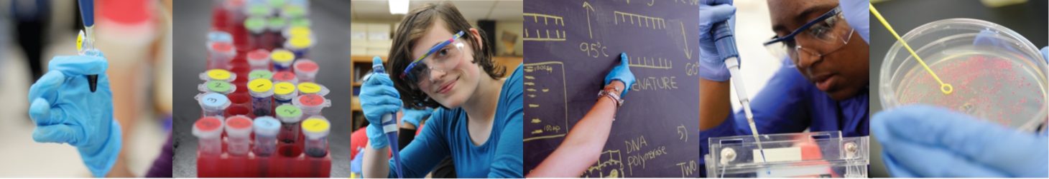


INTRODUCTION
DNA manipulation in the classroom
2 June 2026

Slide 2

Objectives
By the end of this course you will:
Feel confident preparing for labs 1, 2, 3 & 5
Feel confident carrying out labs 1, 2, 3 & 5
Be aware of Health and Safety requirements
Know where to access resources
Know who to contact for support

Slide 3
A sense of scale:
1 litre = 1000 ml
5 ml = 1.tsp
500 μl
500 ml
1 ml = 1000 μl
20 / 10 / 5 / 2 μl
1 μl is 1 millionth of a litre (1000 ml in 1 litre / 1000 μl in 1ml – 1000 x 1000)

Slide 4

Lab 1: micropipetting
1 Twist dial to desired volume
2 Add disposable pipette tip
3 Press plunger to first stop
4 Insert pipette tip into solution to be
transferred
5 Slowly release plunger to retrieve liquid
6 Move pipette tip into desired tube
7 Press plunger past first stop to second stop
to transfer liquid, keep the plunger down
as you remove it from the tube.
8 Eject tip

Slide 5
Lab 1: micropipetting
2 μl
5 μl
10 μl
20 μl

Slide 6
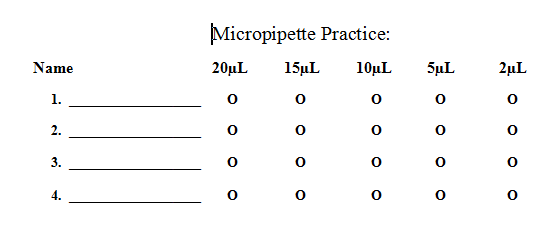
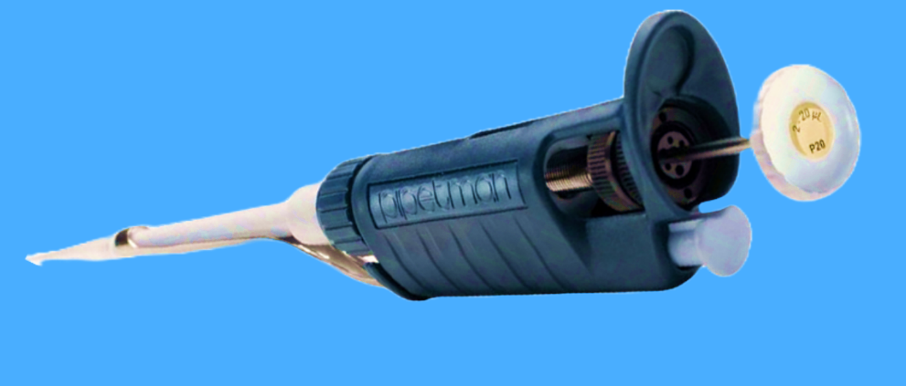
Lab 1: micropipetting

Slide 7
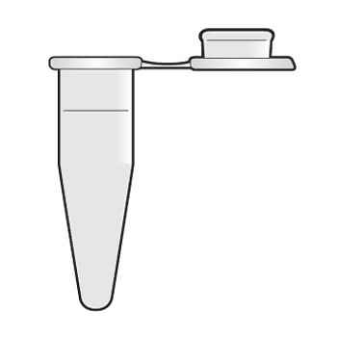
Lab 1: micropipetting

Slide 8
Lab 1: micropipetting
1 Twist dial to desired volume
2 Add disposable pipette tip
3 Press plunger to first stop
4 Insert pipette tip into solution to be
transferred
5 Slowly release plunger to retrieve liquid
6 Move pipette tip into desired tube
7 Press plunger past first stop to second stop
to transfer liquid, keep the plunger down
as you remove it from the tube.
8 Eject tip

Slide 10
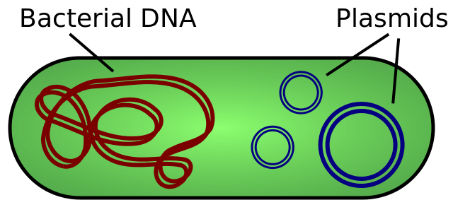
Working with Plasmids
Plasmids 101: What is a plasmid? (addgene.org)
Image taken from Wikimedia Commons

Slide 11
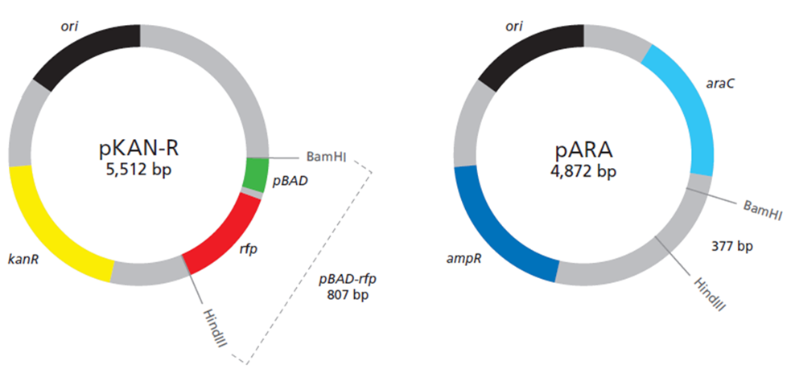
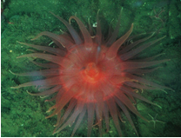
Lab 2: restriction digestion

Slide 12
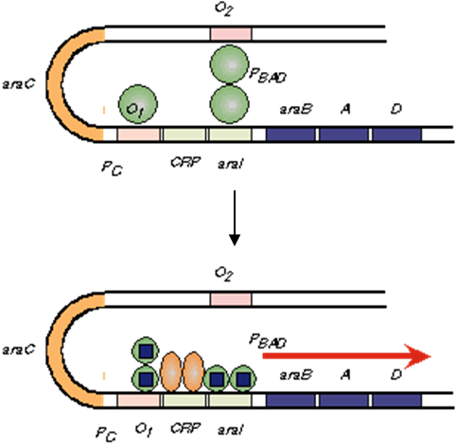
Lab 2: restriction digestion

Slide 13
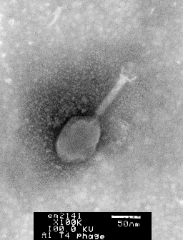
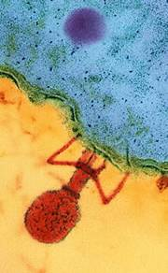
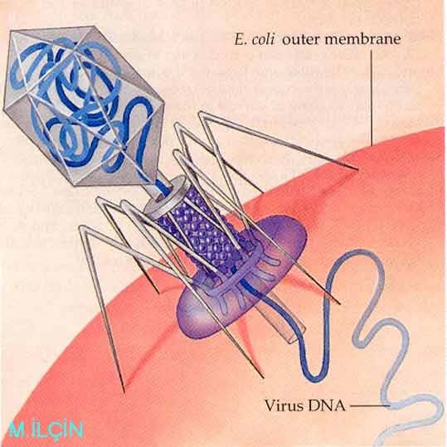
Lab 2: restriction digestion
1
2
3

Slide 14
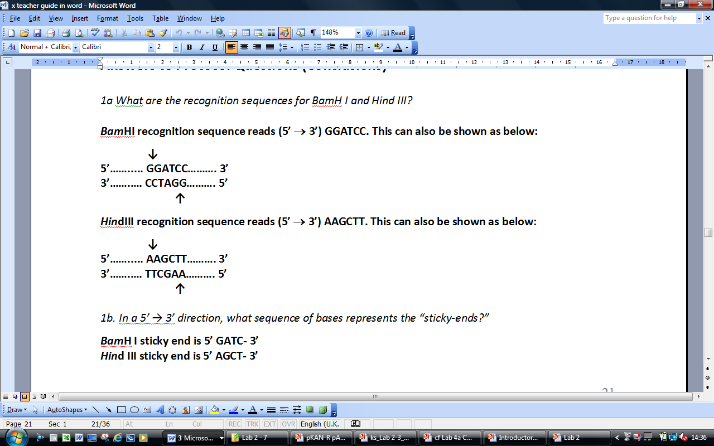
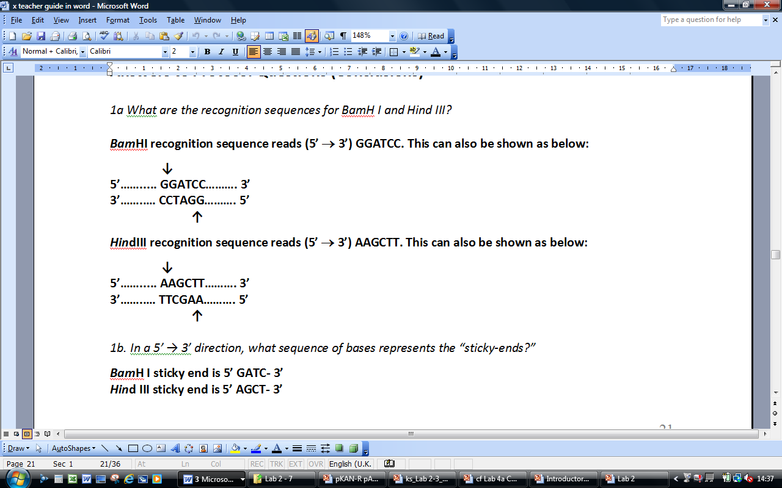
Lab 2: restriction digestion
BamHI
Bacillus amyloliquefaciens
HindIII
Haemophilus influenza

Slide 15





Lab 2: restriction digestion
pBAD
rfp

Slide 16
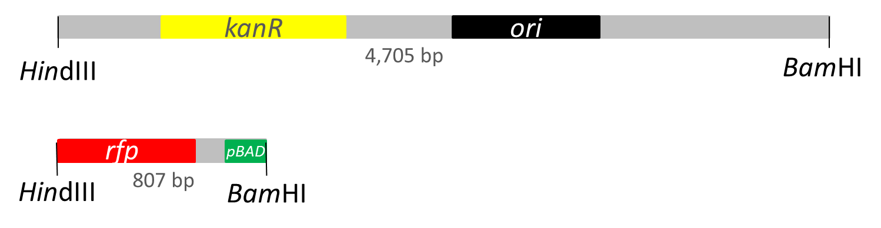
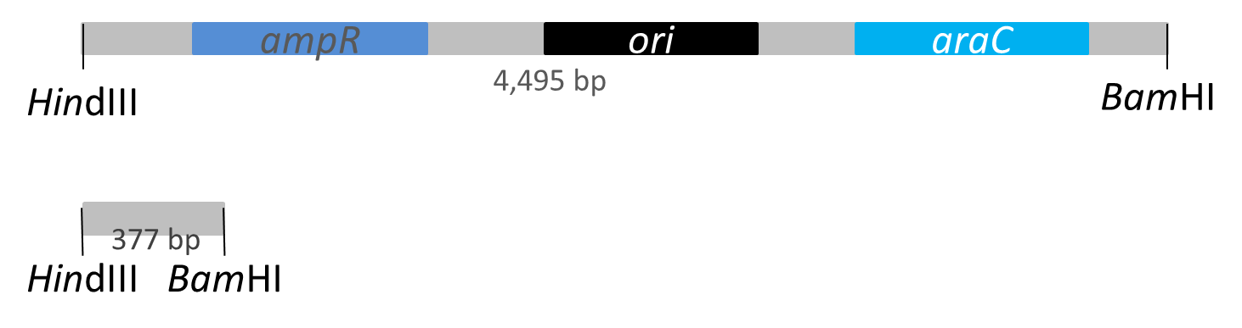
Lab 2: restriction digestion
pKAN-R
pARA

Slide 17
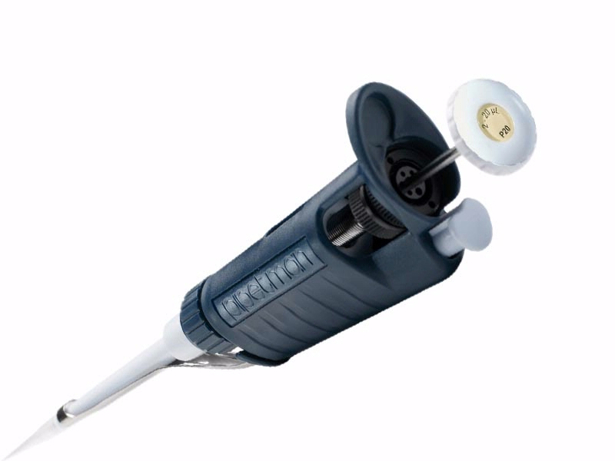
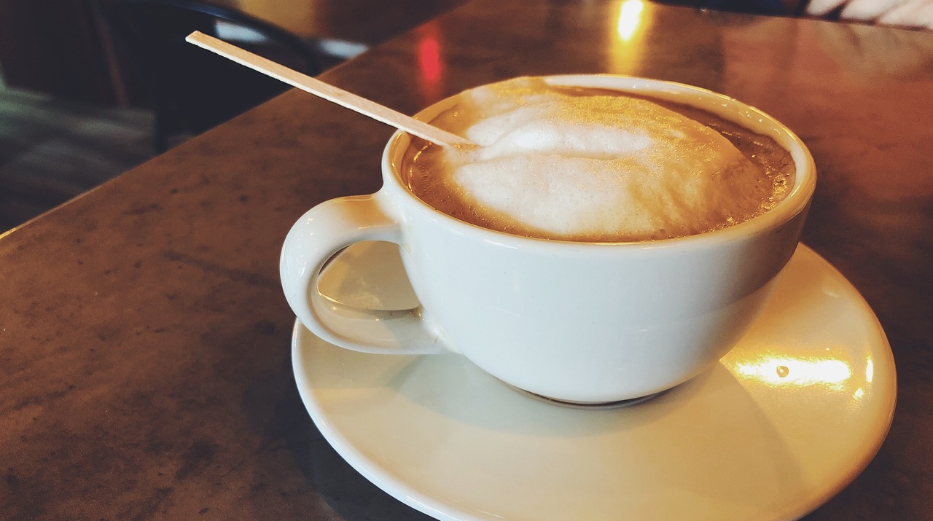
Lab 2: restriction digestion

Slide 19
Lab 5: preparation
400 ml 1 x TAE buffer from 50 x concentrate
0.8% agarose gel, 11 ml per gel (make bulk)
With the Mini-One gel system, DNA stain added with LD

Slide 20
Lab 5: TAE buffer
C₁V₁ = C₂V₂
C₁= desired concentration
V₁= desired volume
C₂= stock solution concentration
V₂ = volume required

Slide 21
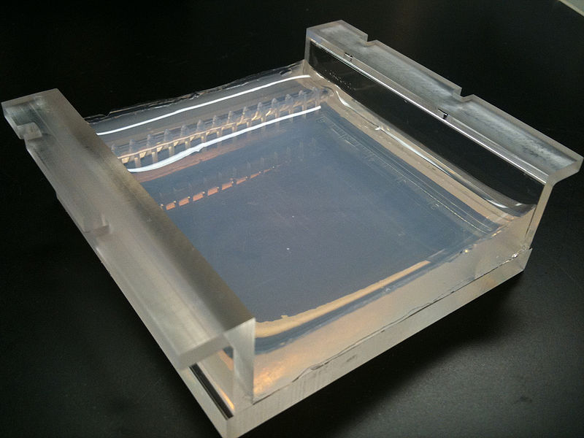
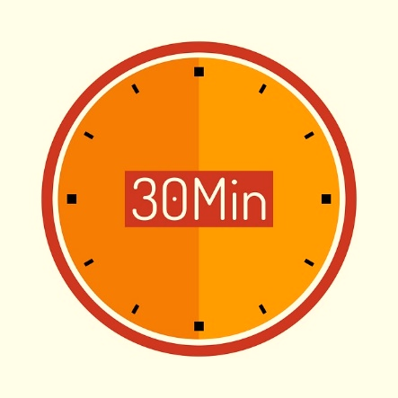
Lab 5: agarose gel

Slide 22
Lab 5: Ligation
But first – HEAT INACTIVATION .. 70 C for 20 min
DNA ligation is the joining of 2 DNA molecules by the enzyme, DNA ligase.
DNA ligase catalyzes the formation of two covalent phosphodiester bonds between the 3’ hydroxyl group of one nucleotides and the 5’ phosphate group of another in an ATP dependent reaction.
In molecular cloning the ligation reaction follows the digestion of the gene insert and the target vector.

Slide 23
Lab 2: restriction digestion
pBAD
rfp

Slide 24
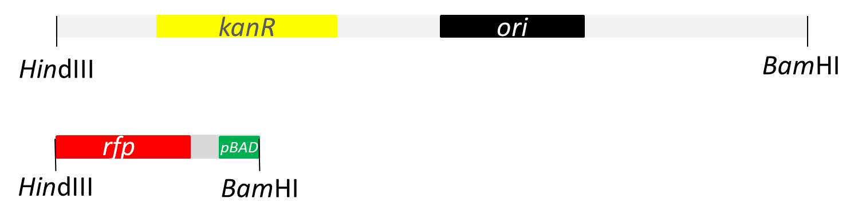
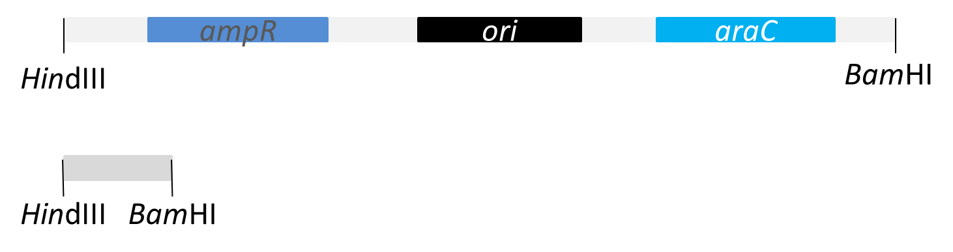
Lab 2: restriction digestion
4,705 bp
pKAN-R
807 bp
4,495 bp
pARA
377 bp

Slide 25
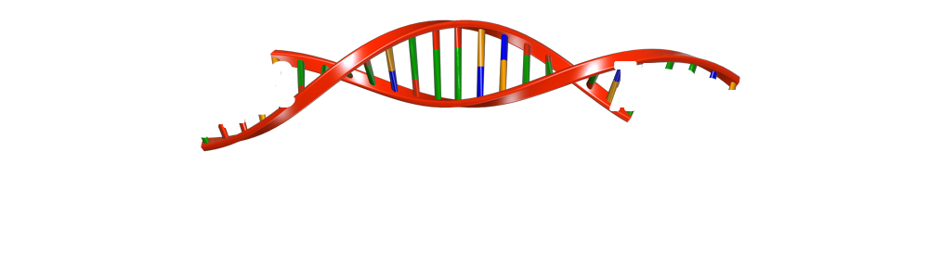


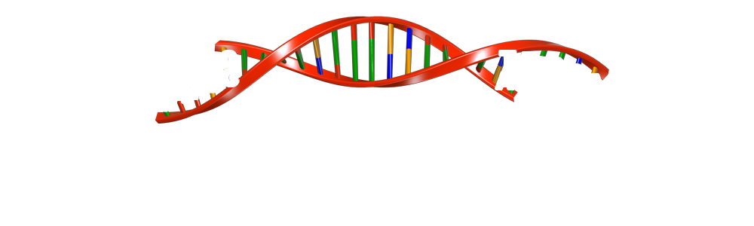
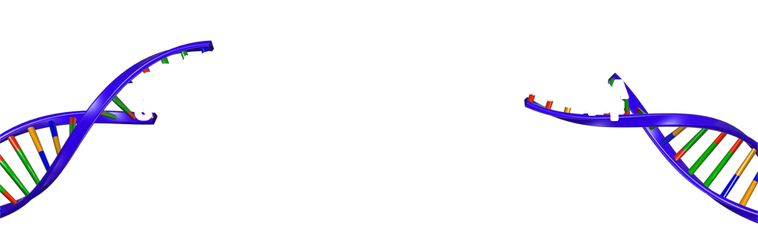
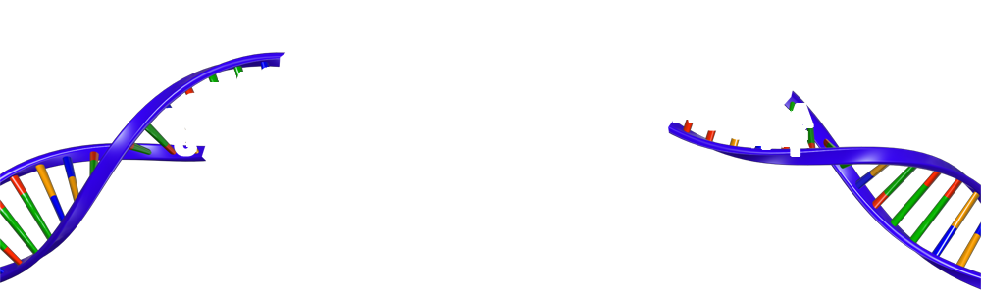


Lab 3: Ligation
BamH I
sticky end
3’
G
T
T
C
C
C
A
G
5’
G
A
T
A
3’
Hind III
5’
sticky end
Hind III
5’
sticky end
T
A
G
3’
C
C
A
A
G
C
G
BamH I
5’
T
T
5’
3’
sticky end
3’
3’
5’

Slide 26
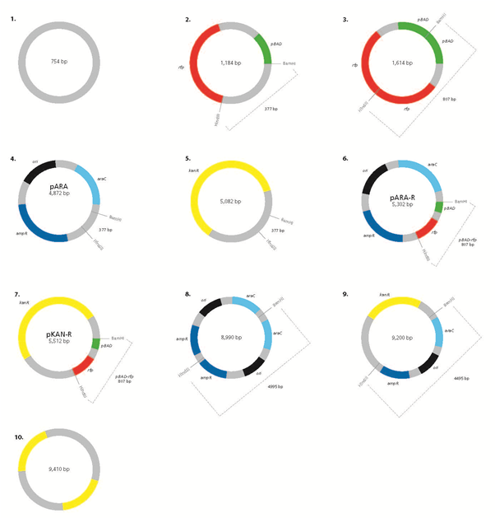

Lab 3: Ligation

Slide 27
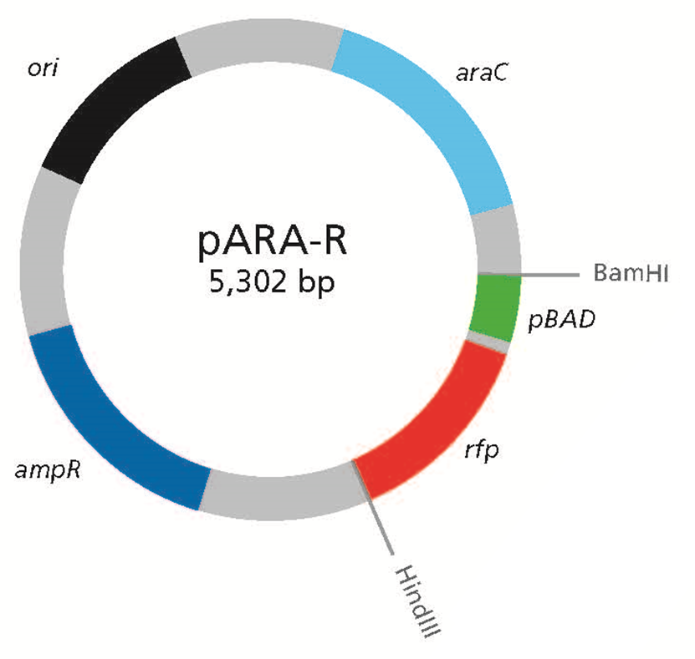
Lab 3: Ligation

Slide 28
Lab 3: Ligation (page 3.3)
Collect K+ and A+ from 70 C water-bath
Place on ICE. Wait 5 min
Locate LIG tube containing 2.5 μl Ligase enzyme
Add 4 μl Lig Buffer (LB) and 2.0 μl H₂0 to LIG tube
Add 6 μl K+ and 6 μl A+ to LIG tube
This tube now contains 20.5 μl
This tube stays on the bench, at room temp, o/n for the reaction to happen

Slide 30
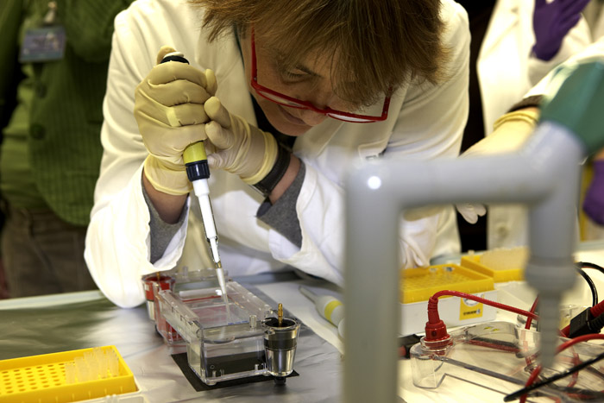
Lab 5: Gel Electrophoresis

Slide 31
Lab 5: gel electrophoresis

Slide 32
Lab 5: gel red staining

Slide 33
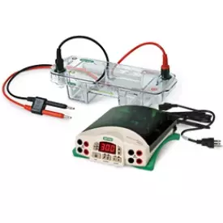
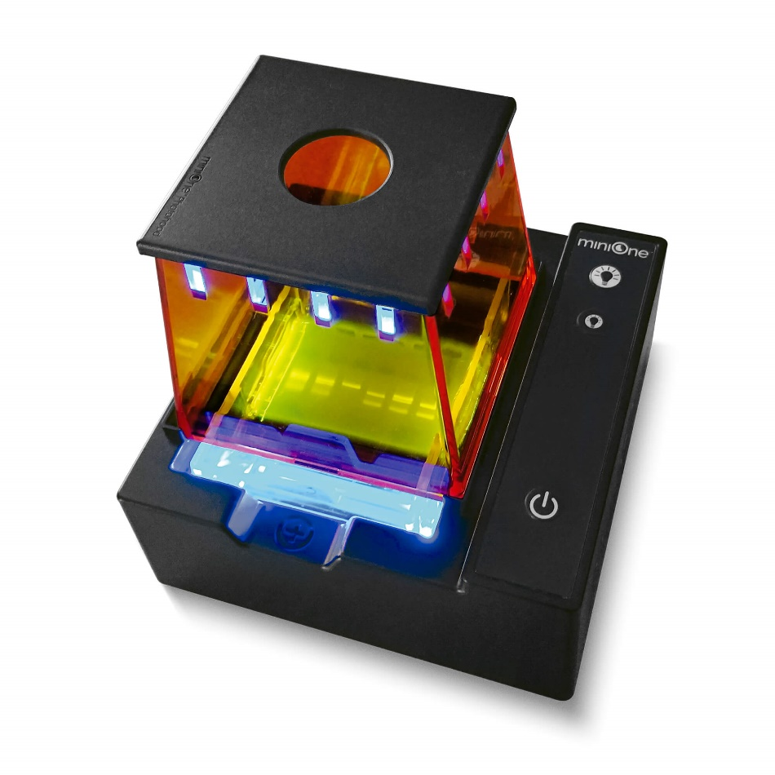
Electrophoresis – 2 ways
Tanks & transilluminator (TT)
Mini-One (MO)

Slide 34
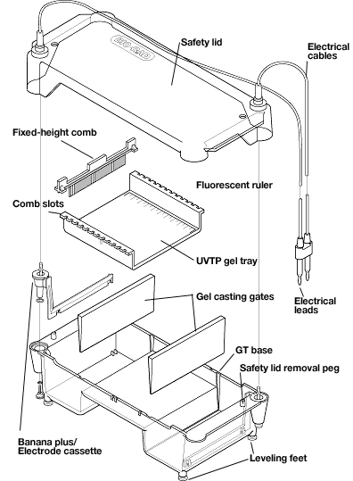
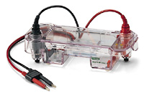
Lab 5: gel tank assembly

Slide 35
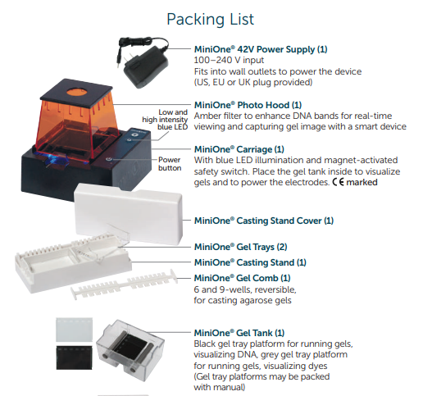
Lab 5: Mini-One assembly

Slide 36
Electrophoresis – 2 ways
Tanks & transilluminator (TT)
Mini-One (MO)
0.8% gel, 1 x TAE buffer
30-35 ml agarose for each gel
200-300 ml buffer needed
8 or 15 teeth (samples) per gel
Add LD to samples
LD – regular
Load / black card below tank
Run time: 30-45 min
Post-stain: 30 min / Gel Red
Download gel images and share results
0.8% gel, 1 x TAE buffer
11 ml agarose for each gel
135 ml buffer needed
6 or 9 teeth (samples) per gel
Add LD to samples
Ensure LD contains Gel Green
Load under blue light
Run ‘live’ : 20-30 min
No post-stain required
Result recorded directly by students on smartphone

Slide 37
Before Loading
Remove the masking tape from the ends of your gel tray
Place the gel, and its casting tray, into the electrophoresis tank. The wells should be at the black (negative end), as DNA is negatively charged and will run towards the red (positive) end.
Make sure that the open end of the wells is facing upwards to receive the samples
Submerge the gel in 1X TAE buffer (this contains the ions needed for electrophoresis). There needs to be 1-2 mm of buffer over the top of the gel. Too much and the current will go through the buffer and not the gel! Pour buffer onto the gel until just after the well dimples disappear.
Remove the comb from your agarose gel by lifting it directly upwards. The comb will create some suction, so it needs a gentle, but consistent upwards pressure.
Place a black sheet under the wells to make them more visible
Remove the comb from your agarose gel by lifting it directly upwards.
Place the gel, and its casting tray into the electrophoresis tank (only fits one way!). Remember the black supporting platform and make sure the wells are aligned with the marks on the platform on the negative end
Make sure that the open end of the wells is facing upwards to receive the samples
Cover gel with 1 x TAE buffer (135 ml recommended) by filling one side of the gel tray, and watching the liquid force air out from under the gel. Then fill the other side until the gel is just covered.
Place photo hood onto unit and check green power light is solid before loading samples
Don’t forget gloves and eye protection when handling the TAE buffer

Slide 38
Lab 5: gel loading tips …
Spread the electrophoresis tanks out as much as possible around the room before loading. Do not move once loaded
Everyone gets hand-wobble, especially when doing a new lab procedure, so support your hand or wrist to help keep steady
Try not to jab through the bottom or sides of the well, allow the dense loading dye to help the sample sink into well
When you dispense your sample into the well push to the second stop on the pipette and hold there while removing the pipette from the buffer to avoid sucking the sample back up again!
Use a new tip for each sample to avoid contamination
We are usually loading 10 ul per well

Slide 39
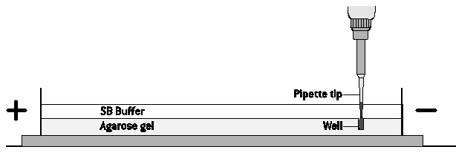
Gel electrophoresis
Pipette tip
TAE buffer
Well
Agarose gel

Slide 40
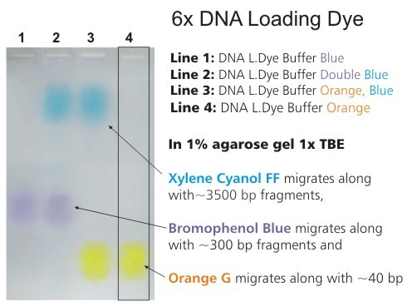
Gel electrophoresis (TT)
Xylene cyanol ~ 4,000 bp
Bromophenol blue ~ 500 bp
Orange G ~ 50 bp

Slide 41
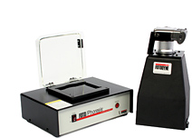
Gel electrophoresis (TT)
P is programme, use with macro mode, flash off
C is custom
No zoom improves quality
Focus before taking

Slide 42
RESULTS
FROM DIGESTS AND LIGATION

Slide 43
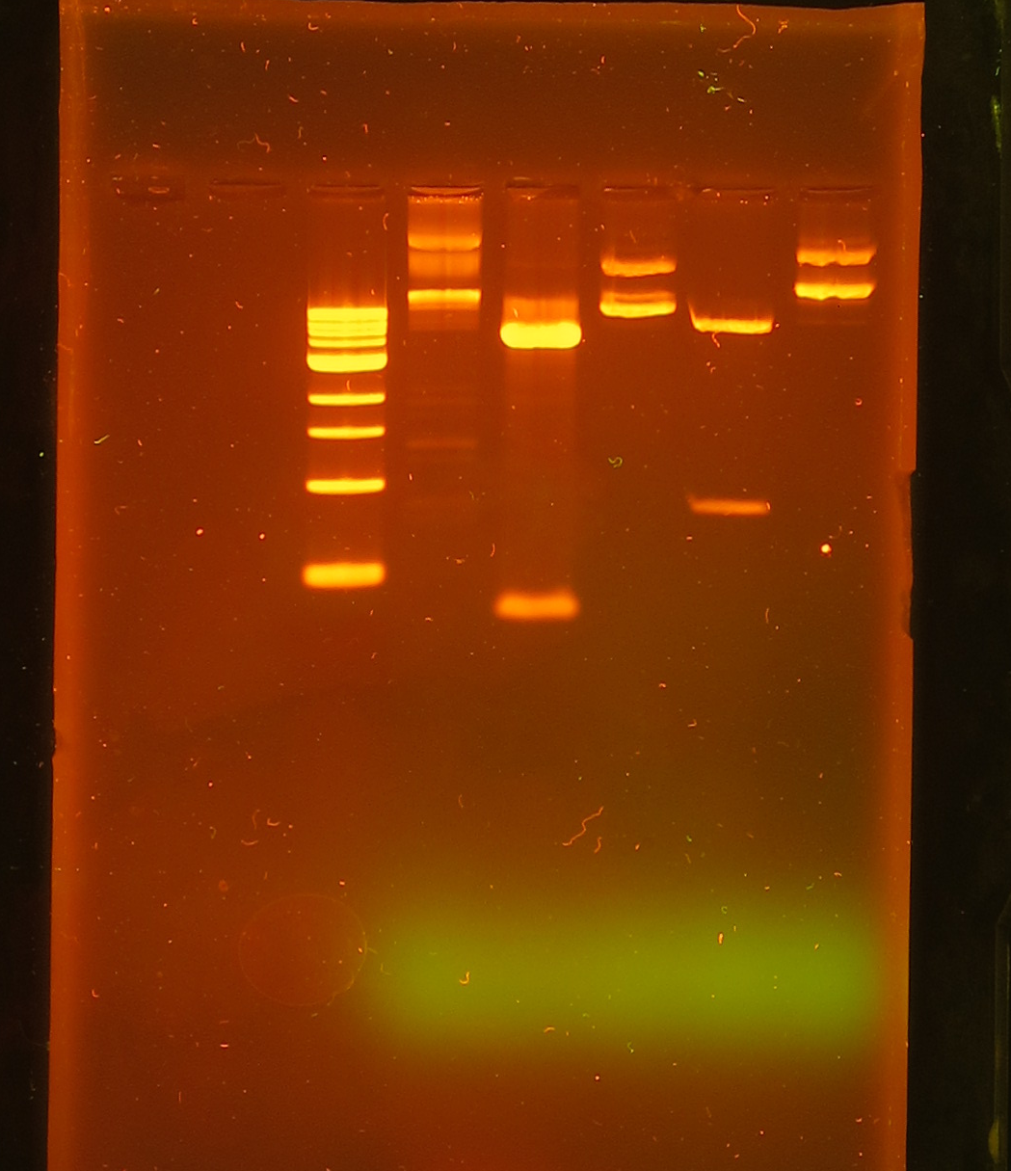
Plasmid Digest & Ligation
K-
K+
A-
A+
Lig
1 kb
3000 >
1000 >
500 >

Slide 44
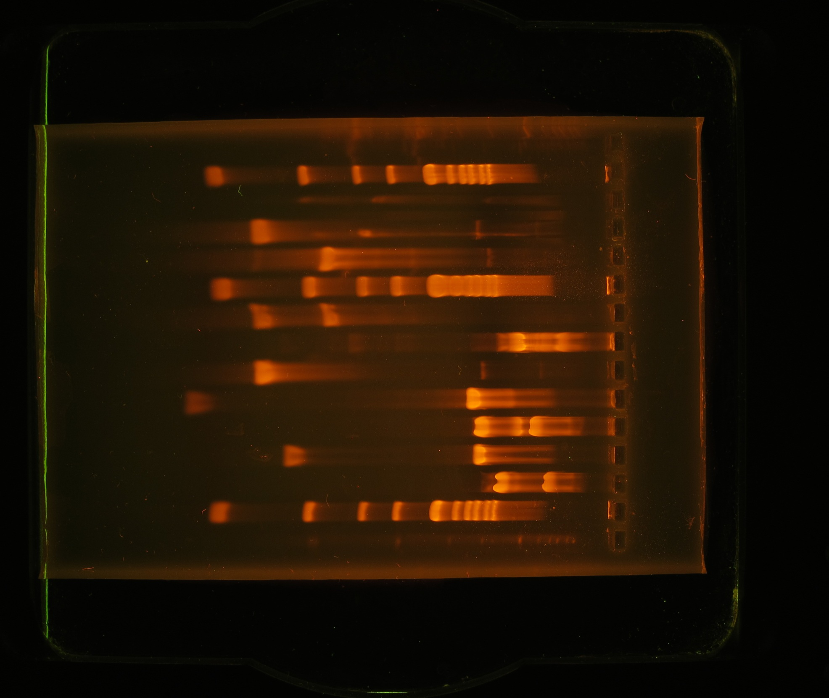

Lab 5: gel electrophoresis
1 Kb
K +
A-
A+
LIG
1 Kb
K+
LIG
K-
K-
A-
A+
10.0
10.0
8.0
8.0
6.0
6.0
5.0
5.0
4.0
4.0
3.0
3.0
2.0
2.0
1.5
1.5
1.0
1.0
0.5
0.5

Slide 45
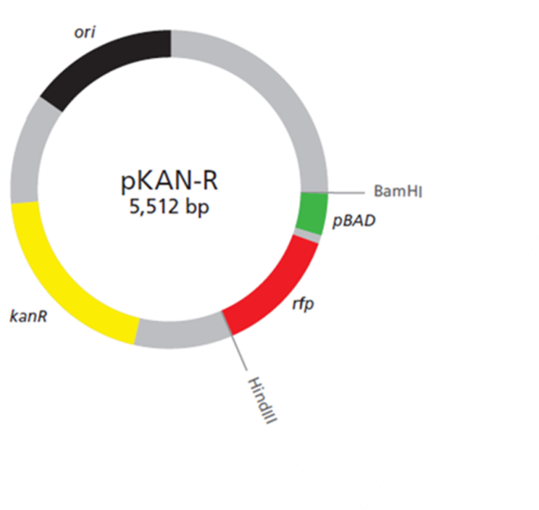
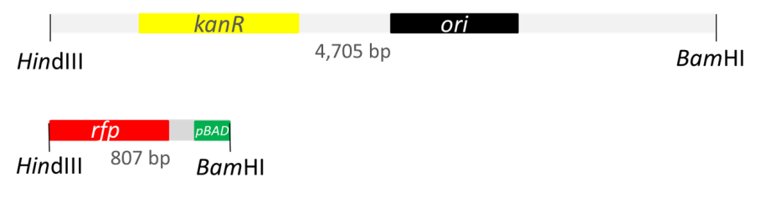
Lab 2: restriction digestion
1 Kb
K +
A-
A+
K-
10.0
8.0
6.0
5.0
4.0
3.0
2.0
1.5
1.0
0.5

Slide 46
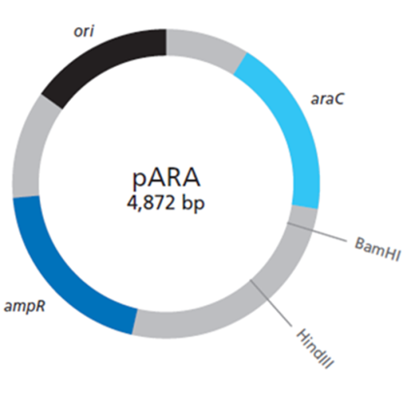

Lab 2: restriction digestion
1 Kb
K +
A-
A+
K-
10.0
8.0
6.0
5.0
4.0
3.0
2.0
1.5
1.0
0.5

Slide 47
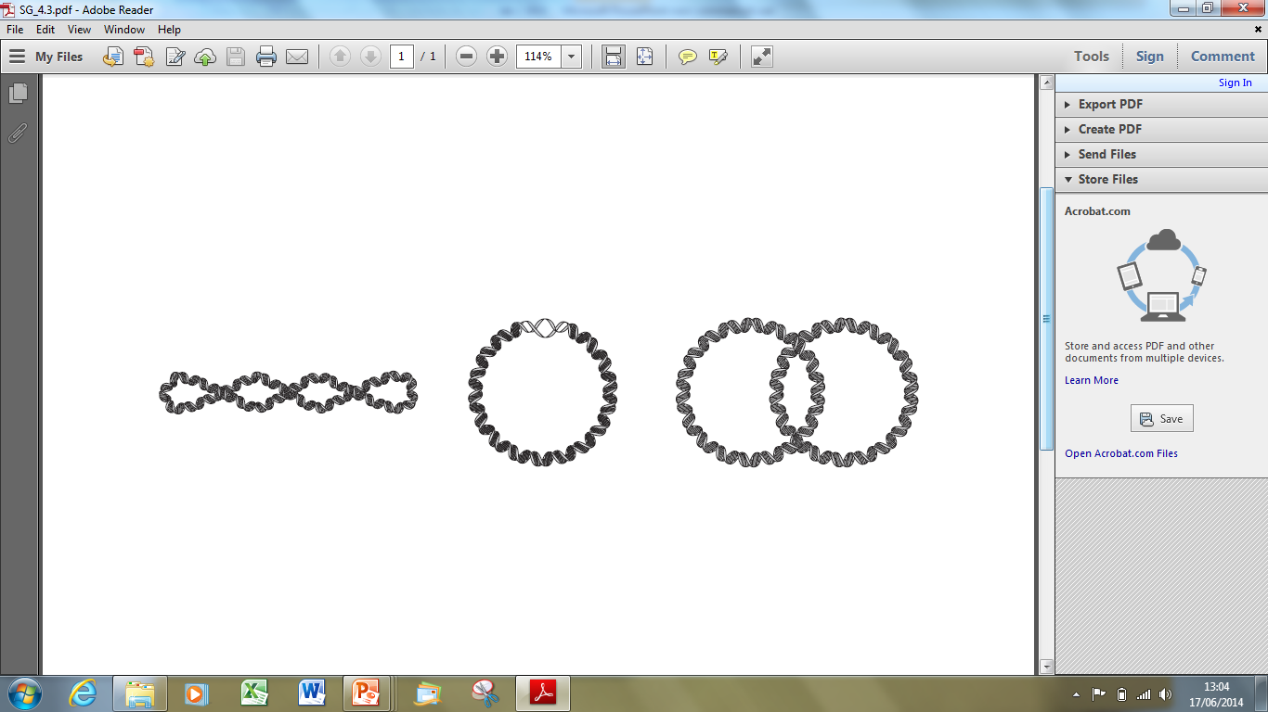
Lab 2: restriction digestion
1 Kb
K +
A-
A+
1 Kb
K+
A+
K-
K-
A-
multimer
10.0
10.0
8.0
8.0
6.0
6.0
5.0
5.0
4.0
4.0
3.0
3.0
Nicked circle
2.0
2.0
1.5
1.5
1.0
1.0
supercoiled
0.5
0.5

Slide 48
Lab 2: restriction digestion
High Resolution – Scanning Electron Microscope imaging of the three-dimensional surface topology of (a) supercoiled plasmid pUC21, (c and d) open-circular DNA molecules of pBR322 plasmid.
Taken from; YAFFEE, M, WALTER, P., RICHTER, C. and MULLER, M. (1996) Direct observation of iron-induced conformational changes of mitochondrial DNA by high-resolution field-emission in-lens scanning electron microscopy (DNA unwinding/iron colloid formation/backscattered electron detection). Proceedings of the National Academy of Sciences of the USA 93; pp. 5341-5346.

Slide 49


Clone that gene
Restriction enzyme | Recognition site
BamHI | GGATCC CCTAGG
EcoRI | GAATTC CTTAAG
HindIII | AAGCTT TTCGAA

Slide 50
Objectives
By the end of this course you will:
Feel confident preparing for labs 1, 2 , 3 & 5
Feel confident carrying out labs 1, 2 , 3 & 5
Be aware of Health and Safety requirements
Know where to access resources
Know who to contact for support

