Slide 1
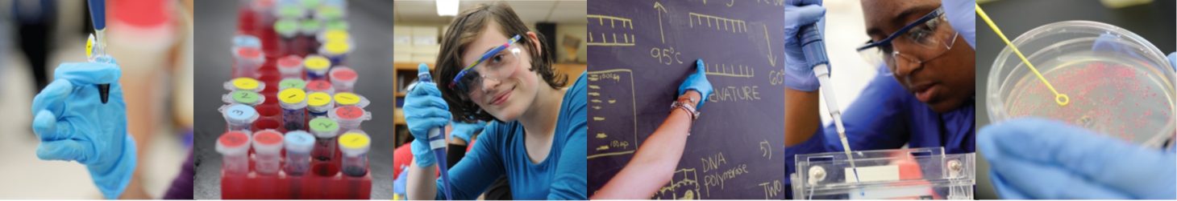
DNA manipulation in the classroom
> DATE <
#biotechexperience
Notes:
Provided by the Advanced Molecular Genetics (AMGen) company to further biotechnology education
In this introduction I’ll tell you a bit about this practical Biotechnology programme, specifically:
The benefits to your school.
The development of the programme and how it is being introduced in the UK
The organisation of running the Biotechnology practicals in your school.
Before moving on to talk about how this series of practical experiments links to industrial applications and start the practical work.

Slide 2


DNA manipulation in the classroom
2 June 2026

Slide 3

A sense of scale:
1 litre = 1000 ml
5 ml = 1.tsp
500 μl
500 ml
1 ml = 1000 μl
20 / 10 / 5 / 2 μl
1 μl is 1 millionth of a litre (1000 ml in 1 litre / 1000 μl in 1ml – 1000 x 1000)

Slide 4

Lab 1: micropipetting
1 Twist dial to desired volume
2 Add disposable pipette tip
3 Press plunger to first stop
4 Insert pipette tip into solution to be
transferred
5 Slowly release plunger to retrieve liquid
6 Move pipette tip into desired tube
7 Press plunger past first stop to second stop
to transfer liquid, keep the plunger down
as you remove it from the tube.
8 Eject tip
Notes:
Using these beautiful pieces of equipment is a skill and one in high demand in multiple fields of scientific research, analysis and development.
So a reminder of how it’s used … demonstrate use and talk thru 1st stop, 2nd stop, supporting arm etc.

Slide 5
Lab 1: micropipetting
2 μl
5 μl
10 μl
20 μl
Notes:
You can use filter paper and food dye – artistic students

Slide 6
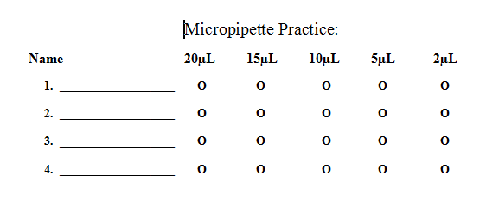
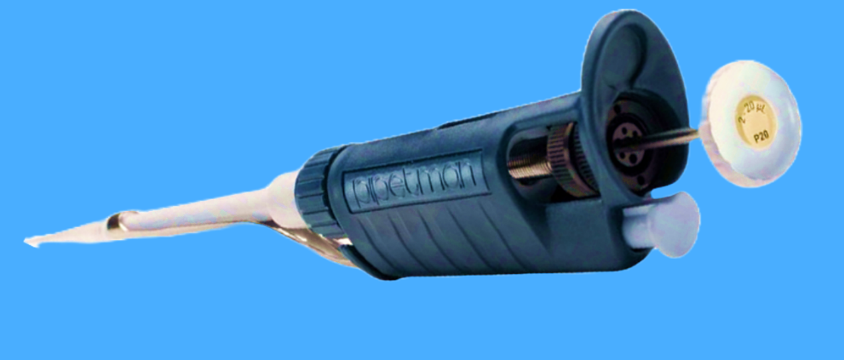
Lab 1: micropipetting
Notes:
You can use laminated sheets with food dye

Slide 7
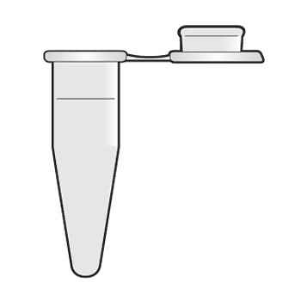
Lab 1: micropipetting
Notes:
Or provide students with an exact volume in a microfuge tube and get them to dispense exact volumes from it. Eg 20 ul into 4 x 5 ul.
Try out these 3 methods of use and see what you think
x

Slide 8
Lab 1: micropipetting
1 Twist dial to desired volume
2 Add disposable pipette tip
3 Press plunger to first stop
4 Insert pipette tip into solution to be
transferred
5 Slowly release plunger to retrieve liquid
6 Move pipette tip into desired tube
7 Press plunger past first stop to second stop
to transfer liquid, keep the plunger down
as you remove it from the tube.
8 Eject tip

Slide 9
Notes:
Any questions so far?

Slide 10
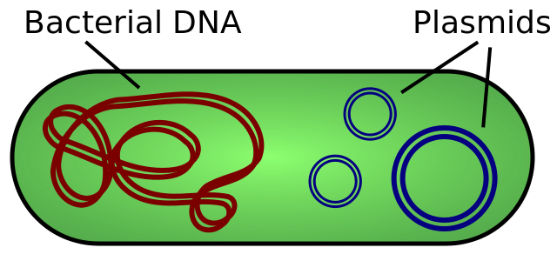
Working with Plasmids
Plasmids 101: What is a plasmid? (addgene.org)
Image taken from Wikimedia Commons
Notes:
sign-post to plasmid / plasmids | Learn Science at Scitable (nature.com) – nice background

Slide 11
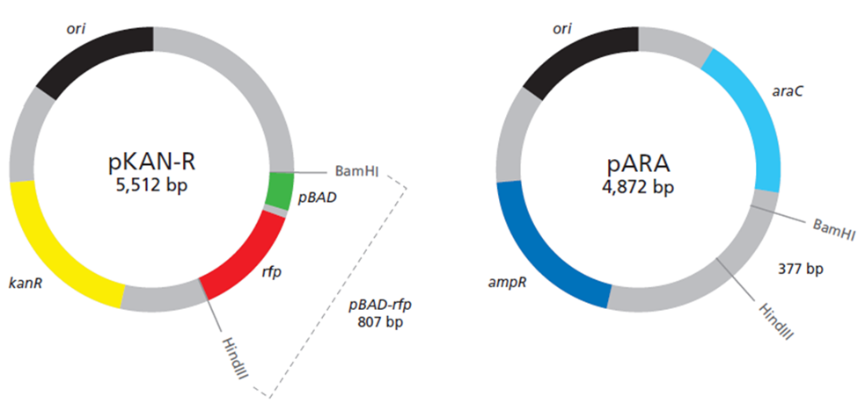
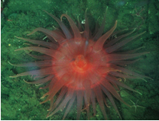
Lab 2: restriction digestion
Notes:
As you can see plasmids are small, circular pieces of DNA. They can enter bacteria carrying genes and the bacteria will express those genes.
(1) One group of scientists has cloned the gene for Red Fluorescent Protein (rfp) into a plasmid with a kanamycin resistance gene. This is known as pKAN-R (the little p means plasmid, the KAN refers to the antibiotic resistance gene and the R is the recombinant rfp gene.)
Kanamycin is an antibiotic that kills bacteria by preventing them from making proteins. Kanamycin was isolated from Streptomyces kanamyceticus. It interacts with the 30S subunit of prokaryotic ribosomes, causing substantial mistranslation and indirectly inhibits translocation during protein synthesis. If a cell cannot synthesize proteins, it will die. So bacteria that do not contain this plasmid will not survive on agar plates containing kanamycin.
The kanamycin resistant gene, kanr, encodes a phosphotransferase, an enzyme that transfers a phosphate group to the kanamycin molecule destroying its antibiotic effects by preventing it from interacting with the 30S subunit of prokaryotic ribosomes. Bacteria that have taken up the plasmid with the kanr gene can therefore survive on agar plates containing kanamycin.
The red fluorescent protein gene was originally isolated from Discosoma sp, a type of soft coral (also referred to as a sea anemone) found in the Indo-Pacific Ocean. The wild-type gene has been mutated, through a process called directed evolution, to produce colours that are several times brighter than the wild-type protein. The term “wild type” refers to the original gene, the one that you would find in nature. The rfp gene has been engineered into the plasmid pKAN-R. Note that the rfp gene for RFP has both BamH I and Hind III restriction sites on either side.

Slide 12
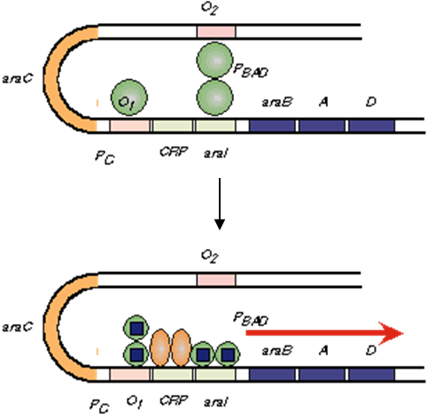
Lab 2: restriction digestion
Notes:
Another group of scientists has created an expression vector with an ampicillin resistance gene and an arabinose-inducible promoter. This plasmid is called pARA (again the little p means plasmid, the ARA refers to the arabinose gene and pARA also carries a selectable antibiotic resistance gene ampr).
Ampicillin is a beta lactam antibiotic. Ampicillin acts as a competitive inhibitor of the enzyme transpeptidase, which is needed by bacteria to make their cell walls. It inhibits the final stage of bacterial cell wall synthesis during binary fission, which ultimately leads to cell lysis. So bacteria that do not have an ampicillin resistance gene will not survive on plates containing ampicillin.
The ampicillin resistance gene, ampr, encodes the protein beta lactamase, an enzyme that catalyses the destruction of the antibiotic ampicillin. Bacteria that have taken up the plasmid with the ampr gene can therefore survive on agar plates containing kanamycin.
* As an aside it is quite interesting to take a minute to compare the different mechanisms of antibiotic action with students; kanamycin ‘getting in the way’ of the 30S ribosome during protein synthesis, causing mis-translation, and; ampicillin inhibiting the action of an enzyme needed to make cell walls so cell walls are incomplete and bacteria ‘burst’.
pARA carries a gene for the AraC protein, which is expressed to make the AraC protein. The region of pARA labelled pBAD, in the plasmid map, indicates the site where RNA polymerase needs to bind to initiate transcription of an gene inserted between the BamHI and HindII sites. When there is no arabinose present a dimer of the AraC protein binds near the pBAD promoter, preventing RNA polymerase binding to initiate transcription. When arabinose is present, arabinose binds to the AraC protein and initiates transcription. This means that any gene inserted downstream of the pBAD promoter, between the BamHI and HindIII sites, will be transcribed and expressed in the presence of arabinose. That is why pARA is called an expression plasmid. A gene, even a foreign one, can be expressed if it is inserted into a specific location in this plasmid.
Note: whilst the lac operon is included in most A level syllabi, it is uncommon to find other operons until beyond A level. The arabinose operon provides an excellent opportunity for students to be extended to explore another, well-characterised, system for the control of gene expression. In the mini diagram here the AraC protein is the green circle, arabinose is the blue square and another protein CRP (catabolite regulation protein), which can also be involved in regulation of the arabinose operon is shown as elongated orange circles.)

Slide 13
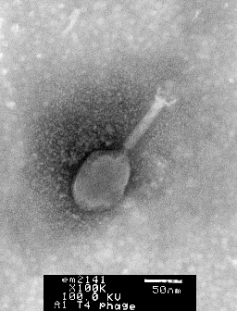
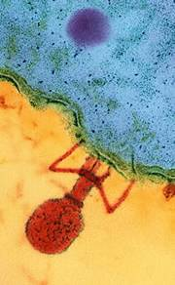
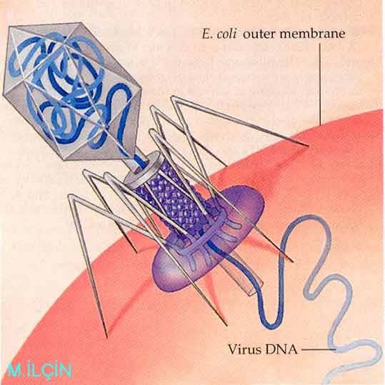
Lab 2: restriction digestion
1
2
3
Notes:
There are restriction enzyme sites on each pARA and pKAN-R that will be use to cut the plasmids.
To give you a bit of background restriction enzymes were first observed as part of a bacterium’s ‘immune system’, preventing bacteriophage infection. In the 1970s, Hamilton Smith and Daniel Nathans were the first to purify these primitive ‘immune agents’, which turned out to be some enzymes that bacteria produced and used to cut-up the viral DNA into fragments, as it was injected into its cell, restricting the growth of the virus. Hamilton Smith and Daniel Nathans, along with Werner Arbor, received the Nobel Prize for their discovery and characterization of these important molecules.
Above are:
1 - transmission electron microscope images of T4phage, a bacteriophage that infects Escherichia coli bacteria from microscopist Louisa Howard, at the
Dartford college electron microscope facility
2 – falsely coloured transmission electron microscope image of T4phage injecting DNA into an E. coli bacterium
3 – a schematic diagram of the same process

Slide 14
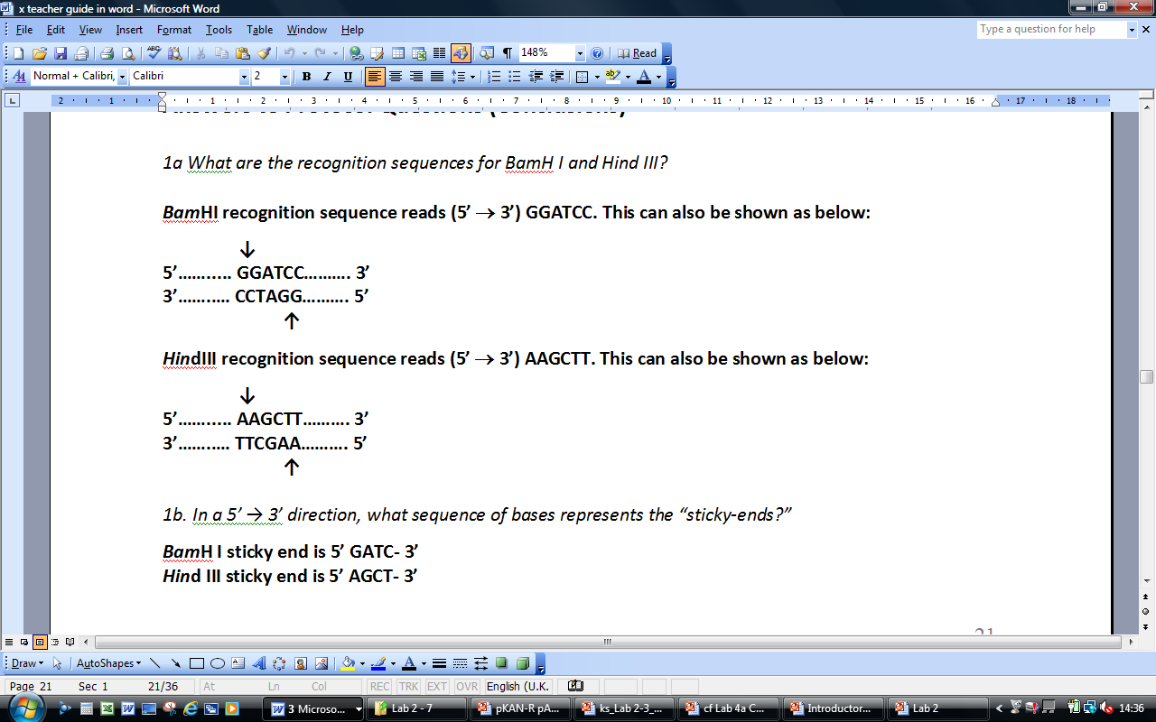
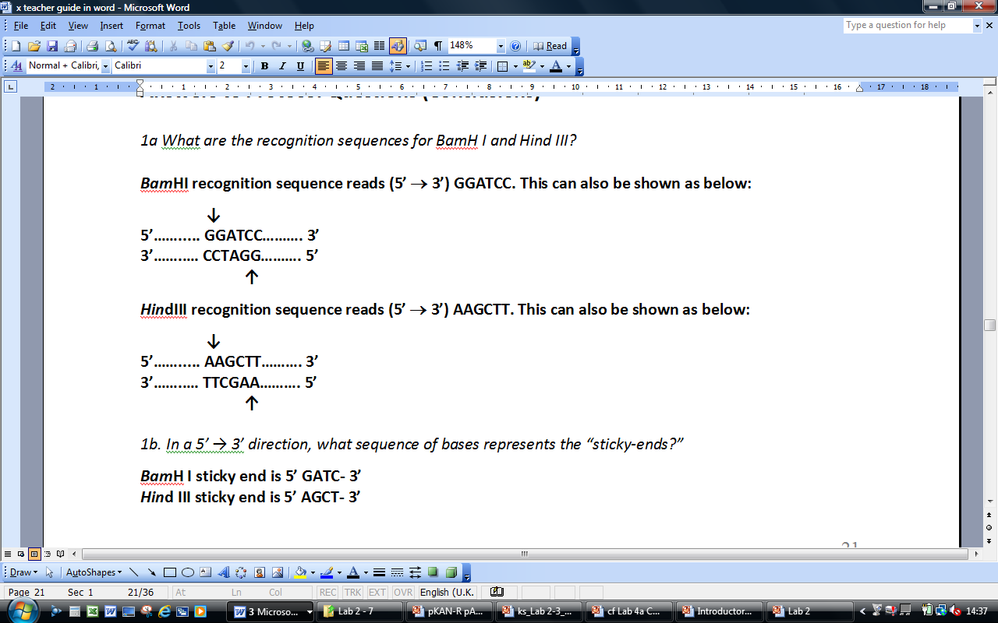
Lab 2: restriction digestion
BamHI
Bacillus amyloliquefaciens
HindIII
Haemophilus influenza
Notes:
There are many types of restriction enzyme, both exonucleases, which cut DNA molecules from their ends, and endonucleases, which cut the DNA molecule internally. The most used in Molecular Biology are the specific endonucleases, which cut at a consistent, specific nucleotide base sequence, known as the recognition sequence. The recognition sequences are palindromes (eg; “radar,” “Madam, I’m Adam,” and “a nut for a jar of tuna”). Some restriction endonucleases will make a “blunt cut,” leaving no overhanging bases. Other enzymes, like BamH I and Hind III, will leave overhanging bases creating “sticky ends.” These enzymes are particularly useful; since sticky ends make recombining DNA fragments a fairly simple procedure. The “stickiness” is the result of the extraordinary affinity of complimentary nucleotides to form hydrogen bonds between them.
BamHI came from Bacillus amyloliquefaciens (Bam), strain H, and was the first restriction enzyme isolated from this species.
HindIII came from Haemophilus influenza (Hin), strain d, and was the third restriction enzyme isolated from this species.
A “restriction site” marks the specific location where an enzyme will cut the DNA plasmid. So on this slide the recognition sequence is shown with arrows pointing to the restriction site.
BamHI will leave a four-base, 5’ overhang as a sticky end. This overhang, reading from 5’ to 3’, is G-A-T-C-, available for hydrogen bonding with fragments with a complementary 5’ overhang, -C-T-A-G.
Hind III will leave a four-base, 5’ overhang as a sticky end. The overhang, reading 5’ to 3’, is A-G-C-T-, available for hydrogen bonding with fragments with a complementary 5’ overhang, -T-C-G-A.

Slide 15





Lab 2: restriction digestion
pBAD
rfp
Notes:
If pKAN-R is digested with BamH I and Hind III, you will get 2 restriction fragments. The smaller fragment of 807 bp will be the pBAD promoter and rfp gene. The other fragment will be be 4,705 base pairs and will carry the gene for kanamycin resistance, kanr.
If pARA is digested with BamH I and Hind III, you will also get 2 restriction fragments, the smaller of which will be 377 bp, and the larger of which will be approximately 4,495 bp and will carry the ampicillin resistant gene, ampr and the araC gene.
During this laboratory you will remove the pBAD promoter and rfp gene from pKAN-R and remove the small 377 bp fragment from the pARA plasmid using the same enzymes. During the next laboratory, you will use the complementary sticky ends of these fragments to insert the rfp gene into pARA producing a recombinant DNA molecule.
It really is very much like the clone a gene exercise, but much, much smaller!

Slide 16
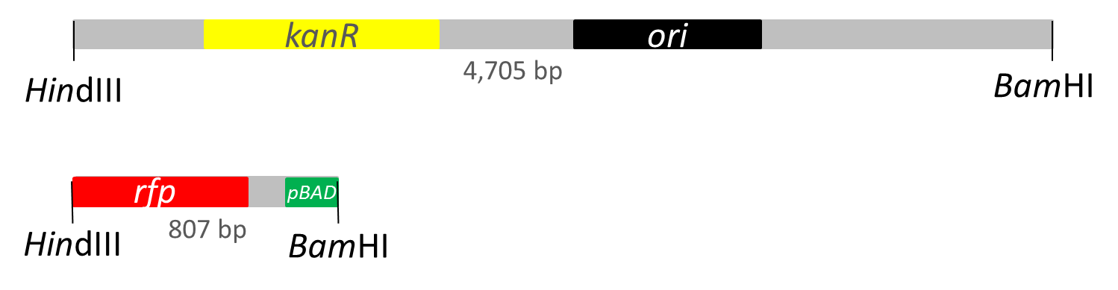
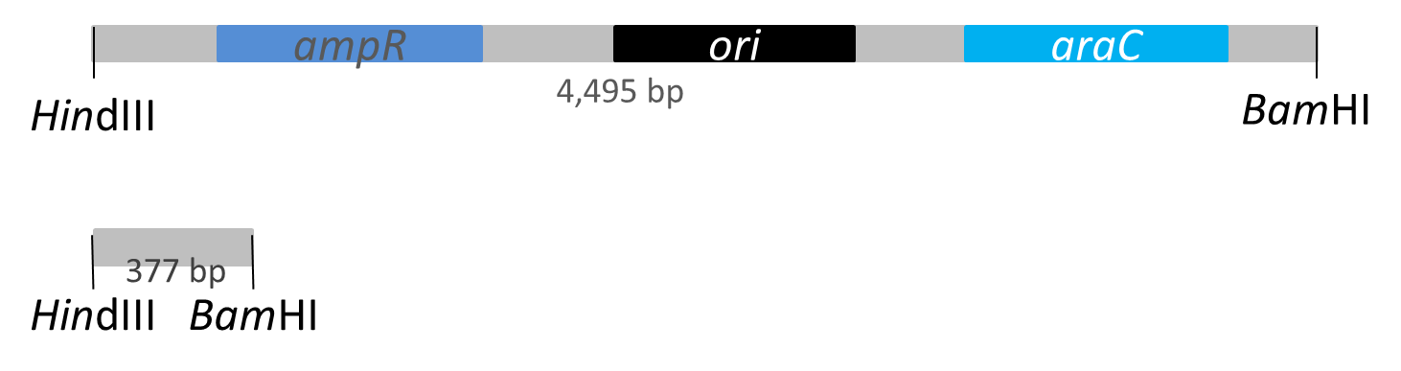
Lab 2: restriction digestion
pKAN-R
pARA
Notes:
These are the fragments produced from the restriction digests in linear form.
The 4705 bp fragment from pKAN-R with the gene for kanamycin resistance, kanr.
The 807 bp fragment from pKAN-R with the pBAD promoter and rfp gene.
The 4495 bp fragment from pARA with the ampicillin resistant gene, ampr and araC gene.
The 377 bp fragment from pARA.
If you use this information to look ahead to what the agarose gel will look like with theses samples loaded onto it…

Slide 17
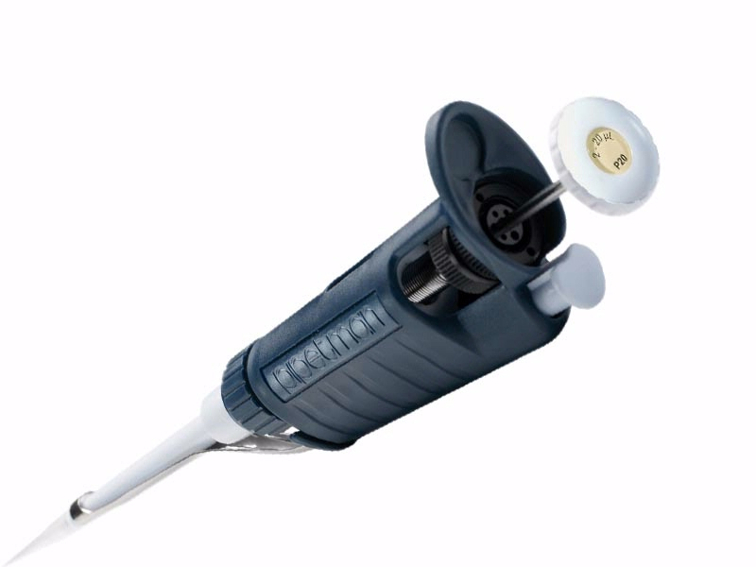

Lab 2: restriction digestion
Notes:
So let’s get working on the practical laboratory.
Now set up reactions for Lab 2 (see page 2.3) don’t forget:
Put your identifier on the tubes to prevent getting mixed up with other groups, write on the top of the tube so it doesn’t come off in the waterbath – the permanent, waterproof marker pens are only permanent and waterproof for a given value of these terms!
You can pipette each reagent in a little drop on the side of the tube to check that they are all there, then use the microcentrifuge to pool the liquid at the bottom before incubating in the 37oC waterbath
Do check which waterbath you put your samples in – you want this 37oC waterbath (the 70oC / 42oC waterbaths may be out too)
As you finish do look through the student’s questions on page 2.4 / 2.5

Slide 19
Lab 5: preparation
400 ml 1 x TAE buffer from 50 x concentrate
0.8% agarose gel, 11 ml per gel (make bulk)
With the Mini-One gel system, DNA stain added with LD

Slide 20
Lab 5: TAE buffer preparation
C₁V₁ = C₂V₂
C₁= desired concentration
V₁= desired volume
C₂= stock solution concentration
V₂ = volume required
Notes:
CARE!! - THIS SLIDE AND EQUATION HAS CONFUSED A FEW IN THE PAST. If they have a way that works for them there is no need to follow this (although it is great)
(1) (1 x) (400) = (50 x) (V2)
400 = V2
50
8 = V2
So 8 ml of 50X TAE buffer + 392 ml dH2O = 400 ml of 1X TAE buffer
(2) (1.5 x) (100) = (10,000 x) (V2)
150 = V2
10,000
0.015 ml = V2
15 ul = V2
So 15 ul of 10,000X GelRed stain in 100 ml of dH2O = 100 ml of 1.5X GelRed staining solution

Slide 21
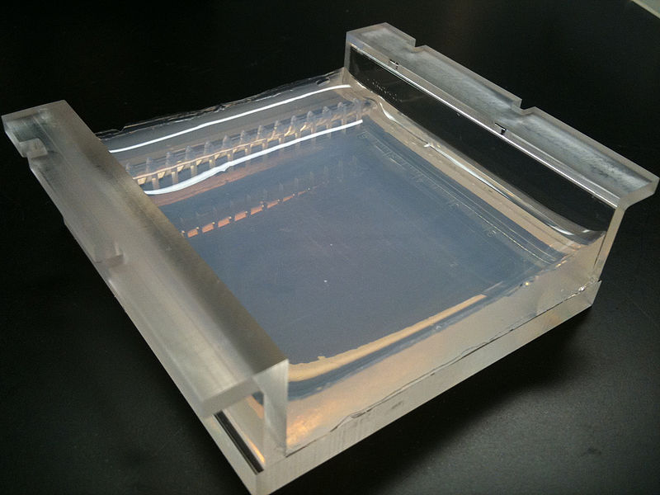
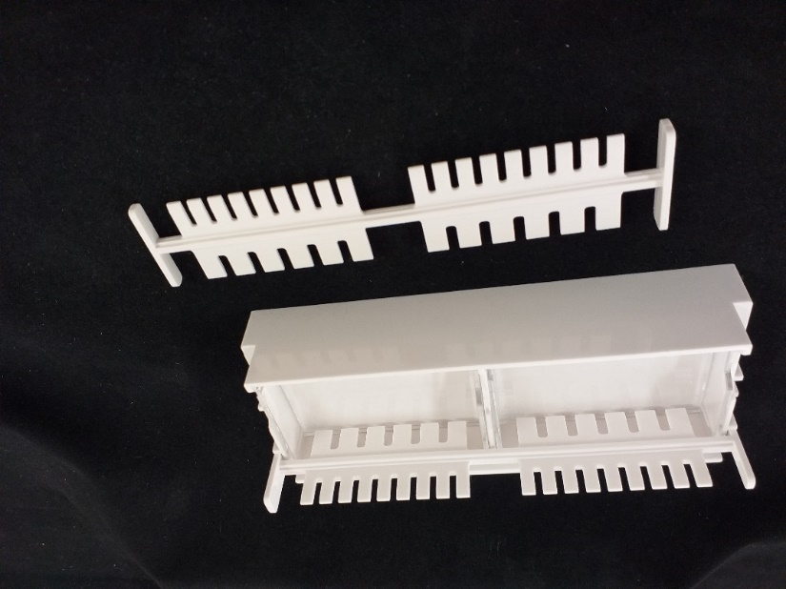
Lab 5: agarose gel

Slide 22
Lab 5: Ligation
But first – HEAT INACTIVATION .. 70 C for 20 min
DNA ligation is the joining of 2 DNA molecules by the enzyme, DNA ligase.
DNA ligase catalyzes the formation of two covalent phosphodiester bonds between the 3’ hydroxyl group of one nucleotides and the 5’ phosphate group of another in an ATP dependent reaction.
In molecular cloning the ligation reaction follows the digestion of the gene insert and the target vector.

Slide 23
Lab 2: restriction digestion
pBAD
rfp
Notes:
If pKAN-R is digested with BamH I and Hind III, you will get 2 restriction fragments. The smaller fragment of 807 bp will be the pBAD promoter and rfp gene. The other fragment will be be 4,705 base pairs and will carry the gene for kanamycin resistance, kanr.
If pARA is digested with BamH I and Hind III, you will also get 2 restriction fragments, the smaller of which will be 377 bp, and the larger of which will be approximately 4,495 bp and will carry the ampicillin resistant gene, ampr and the araC gene.
During this laboratory you will remove the pBAD promoter and rfp gene from pKAN-R and remove the small 377 bp fragment from the pARA plasmid using the same enzymes. During the next laboratory, you will use the complementary sticky ends of these fragments to insert the rfp gene into pARA producing a recombinant DNA molecule.
It really is very much like the clone a gene exercise, but much, much smaller!

Slide 24
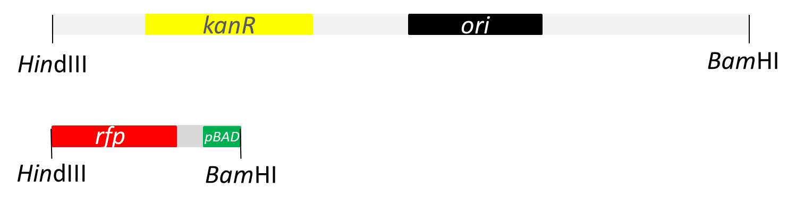
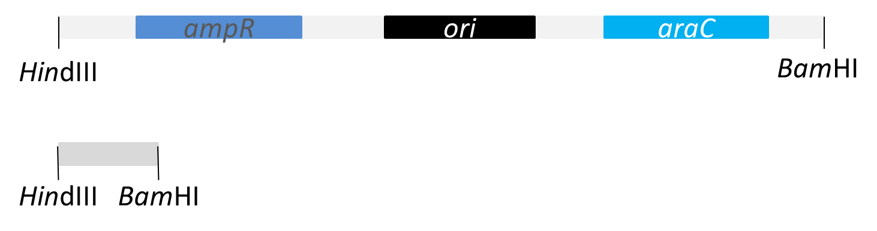
Lab 2: restriction digestion
4,705 bp
pKAN-R
807 bp
4,495 bp
pARA
377 bp
Notes:
These are the fragments produced from the restriction digests in linear form.
The 4705 bp fragment from pKAN-R with the gene for kanamycin resistance, kanr.
The 807 bp fragment from pKAN-R with the pBAD promoter and rfp gene.
The 4495 bp fragment from pARA with the ampicillin resistant gene, ampr and araC gene.
The 377 bp fragment from pARA.
If you use this information to look ahead to what the agarose gel will look like with theses samples loaded onto it…

Slide 25
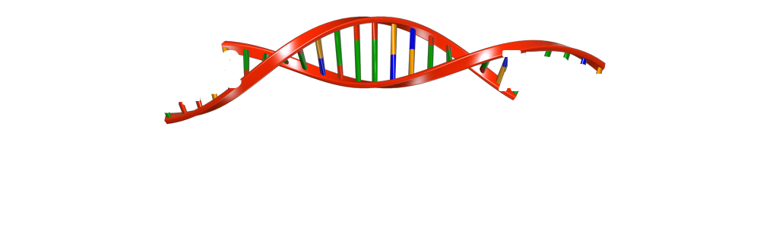


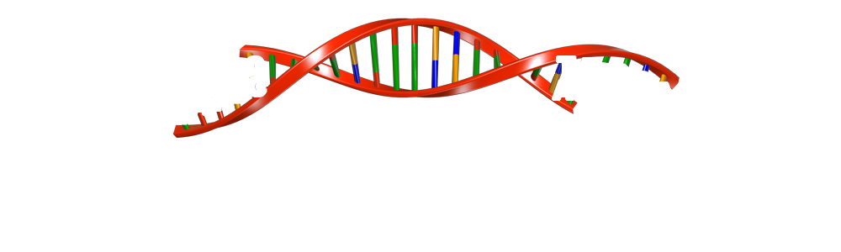
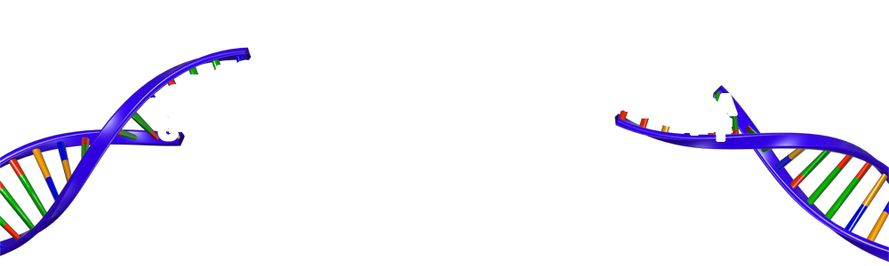
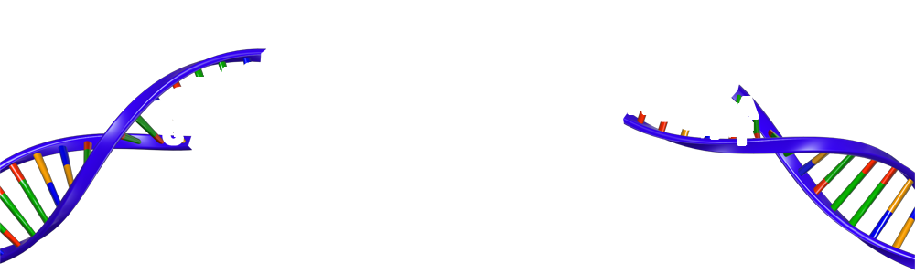


Lab 3: Ligation
BamH I
sticky end
3’
G
T
T
C
C
C
A
G
5’
G
A
T
A
3’
Hind III
5’
sticky end
Hind III
5’
sticky end
T
A
G
3’
C
C
A
A
G
C
G
BamH I
5’
T
T
5’
3’
sticky end
3’
3’
5’
Notes:
Now we need to ‘stick’ the fragments together. This is known as ligation.
A very important intermediate step is the one you’ve just started – inactivating the restriction enzymes. What would happen if you didn’t do this before trying to ligate the molecules together? (The restriction enzymes would cut up the newly liagted molecules at about the same rate as they form, meaning that no successfully ligated product would be formed.)
Now the reason for using specific endonucleases that produce fragments with ‘sticky ends’ becomes clear. The 4 base pair overhangs from the restriction sites of BamHI and HindIII find complementary overhangs / sticky ends hydrogen bonds form between the complementary base pairs. However, hydrogen bonds are weak chemical bonds, and they are inadequate to hold the sticky ends together permanently. The enzyme DNA ligase, with energy supplied by ATP, will form covalent bonds between the sugar and phosphate groups of the DNA backbone, where the sticky ends are holding it together. When the covalent bonds are formed, they complete the phosphodiester linkage between the two sugars and the phosphate group on each strand. The covalent bonds are a relatively strong bond.

Slide 26
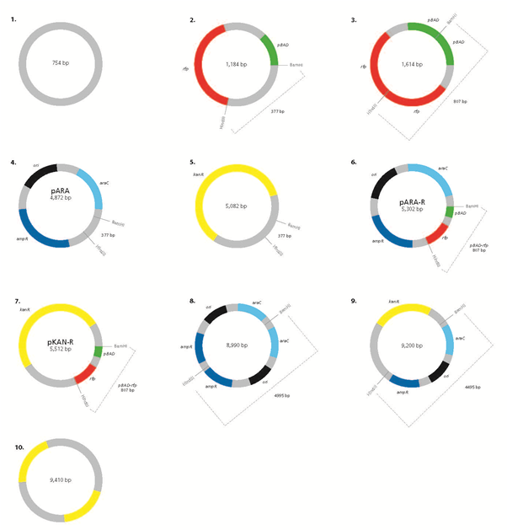

Lab 3: Ligation
Notes:
Ten possible two-fragment plasmids can be made from the four fragments present in the restriction digest.
The possible 10 plasmids appear in figure 3.1 on page 3.4 of the teacher and technician guide.

Slide 27
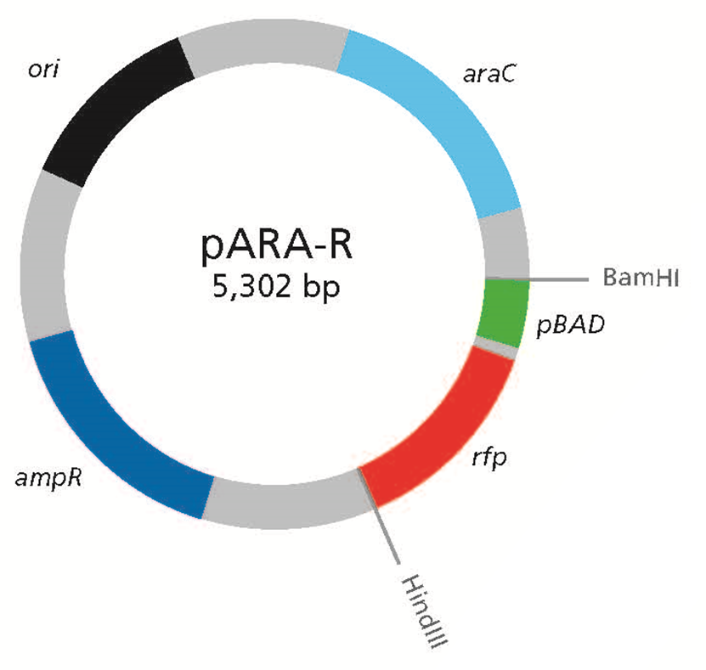
Lab 3: Ligation
Notes:
There will be different recombinant plasmids forming in the ligation reaction. Since each of the 4 linear fragments has sticky ends with complementary base pairs, just about any combination is possible. The only constraint is that recircularised DNA will contain an even number of fragments.
B ---------- H H-------------- B will recircularise.
B------------H H-------------- B B---------------H will nor circularise.
The recombinant DNA above is the one that we would like to form: a combination of the 4495 bp fragment from pARA and the 807 bp gene of interest from pKAN-R. This new recombinant molecule is called pARA-R (p for plasmid, ARA for arabinose-inducible expression system, -R for the recombinant rfp gene).
You are going to set up the ligation reaction, following the instructions in the student manual. The ligation reaction needs incubation overnight at room temperature. We obviously don’t have that long before today’s electrophoresis, so we will keep your ligations overnight and the technicians will run them on an agarose gel tomorrow and bring the results back to school with them. Meanwhile we will supply you with pre-prepared ligation reactions for use on your agarose gel today.

Slide 28
Lab 3: Ligation (page 3.3)
Collect K+ and A+ from 70 C water-bath
Place on ICE. Wait 5 min
Locate LIG tube containing 2.5 μl Ligase enzyme
Add 4 μl Lig Buffer (LB) and 2.5 μl H₂0 to LIG tube
Add 6 μl K+ and 6 μl A+ to LIG tube
This tube now contains 21.0 μl
This tube stays on the bench, at room temp, o/n for the reaction to happen

Slide 30
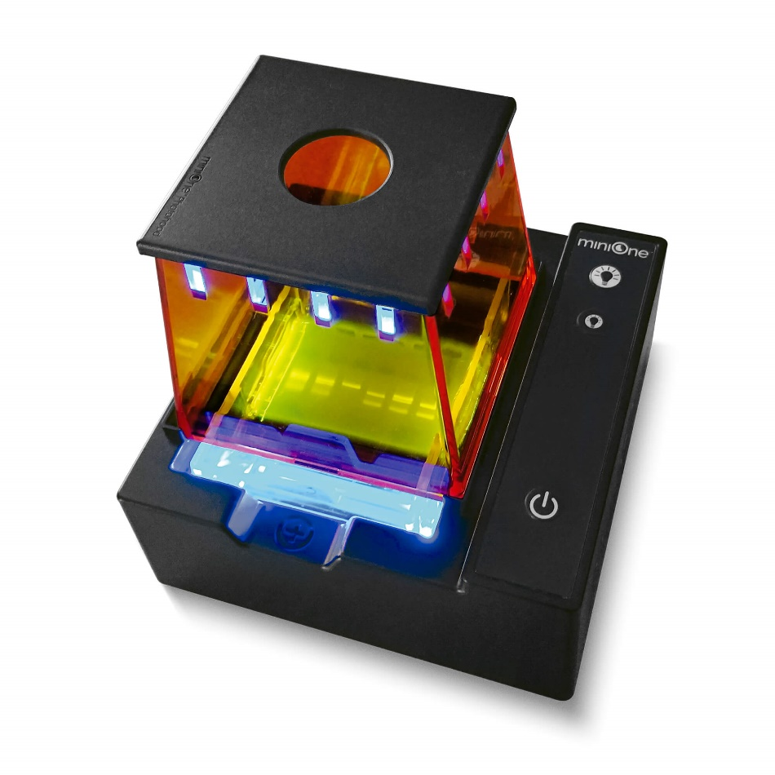
Lab 5: Gel Electrophoresis
Notes:
Mini-One makes this part of the day quicker

Slide 31
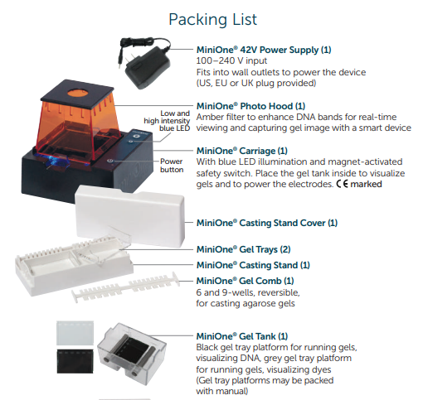
Lab 5: Mini-One assembly
Notes:
Highlight how it is impossible to set-up the wrong way because of incompatibilities and markings.

Slide 32
Mini-One Set-up
0.8% gel, 1 x TAE buffer
11 ml agarose for each gel
135 ml buffer needed
6 or 9 teeth (samples) per gel
Add LD to samples
Ensure LD contains Gel Green

Slide 33

Gel Green DNA Stain
GelGreen® is a highly sensitive, stable and environmentally safe, green fluorescent nucleic acid stain
• Non-mutagenic - at concentrations relevant to nucleic acid gel staining
• Non-cytotoxic - at concentrations relevant to nucleic acid gel staining
• Cell membrane impermeability for true safety
• Impenetrable to latex gloves
• Very photostable - use under normal room light
• Hydrolytically stable
• Microwaveable
Remember gloves and goggles when using the stains
Notes:
Both systems use less cytotoxic DNA stains than the traditional Ethidium bromide systems that those of you who have worked in research may remember. STILL EXERT CARE, THEY ARE DNA STAINS and we don’t want your DNA being stained

Slide 34

Gel prep.
Number of samples will dictate which comb you use
Lab 2 Digest (A+ / A- / K+ / K-) + Lab 3 + Marker (=6)
Sample 5 ul
LD* 2 ul
H20 3 ul
Total 10 ul
Notes:
Gel loading – students should note order of their sample loading. It can be different to the manual but they need to know!

Slide 35
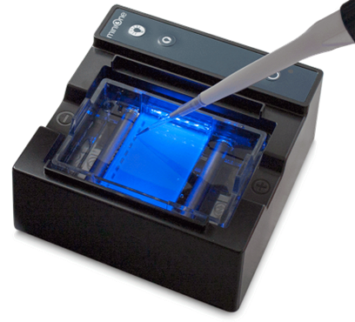
Gel Loading
● Load under blue light
● Run ‘live’ : 20-30 min
● No post-stain required
● Result recorded directly by students on smartphone

Slide 36
Lab 5: gel electrophoresis

Slide 37
Electrophoresis
As the gel runs, the DNA separates according to size (moving through the agarose matrix), and the Gel Green bound to DNA fragments, reacts with the blue light.

Slide 38
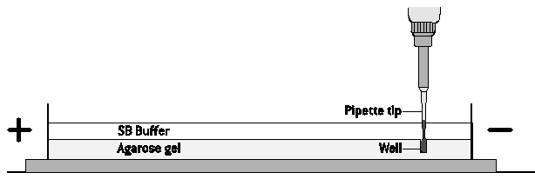
Gel electrophoresis
Pipette tip
SB buffer
Well
Agarose gel
Notes:
Loading your sample onto the agarose gel
When you see the see-through gel, in the see-through buffer, in the see-through tank, you will see how this can be a bit tricky!
Your students will have had the opportunity to practice this in lab 1.
Another thing you can do is to prepare some agar-agar blocks with wells made by the combs, so that students can practice and complete and gouging, as they will, on this much cheaper slightly more coloured product.
When it comes to loading your samples into the wells they will be mixed with blue loading dye, which will make them a bit more visible as well as helping them to sink.
Some people also find it helpful to put a strip of black tape underneath the wells, on the bottom of the electrophoresis tank, to help them to see the wells for loading. There is some black tape on the front desk if you would like to try it.

Slide 39
Lab 5: gel loading tips …
Spread the electrophoresis tanks out as much as possible around the room before loading. Do not move once loaded
Everyone gets hand-wobble, especially when doing a new lab procedure, so support your hand or wrist to help keep steady
Try not to jab through the bottom or sides of the well, allow the dense loading dye to help the sample sink into well
When you dispense your sample into the well push to the second stop on the pipette and hold there while removing the pipette from the buffer to avoid sucking the sample back up again!
Use a new tip for each sample to avoid contamination
We are usually loading 10 ul per well

Slide 40
RESULTS
FROM DIGESTS AND LIGATION

Slide 41
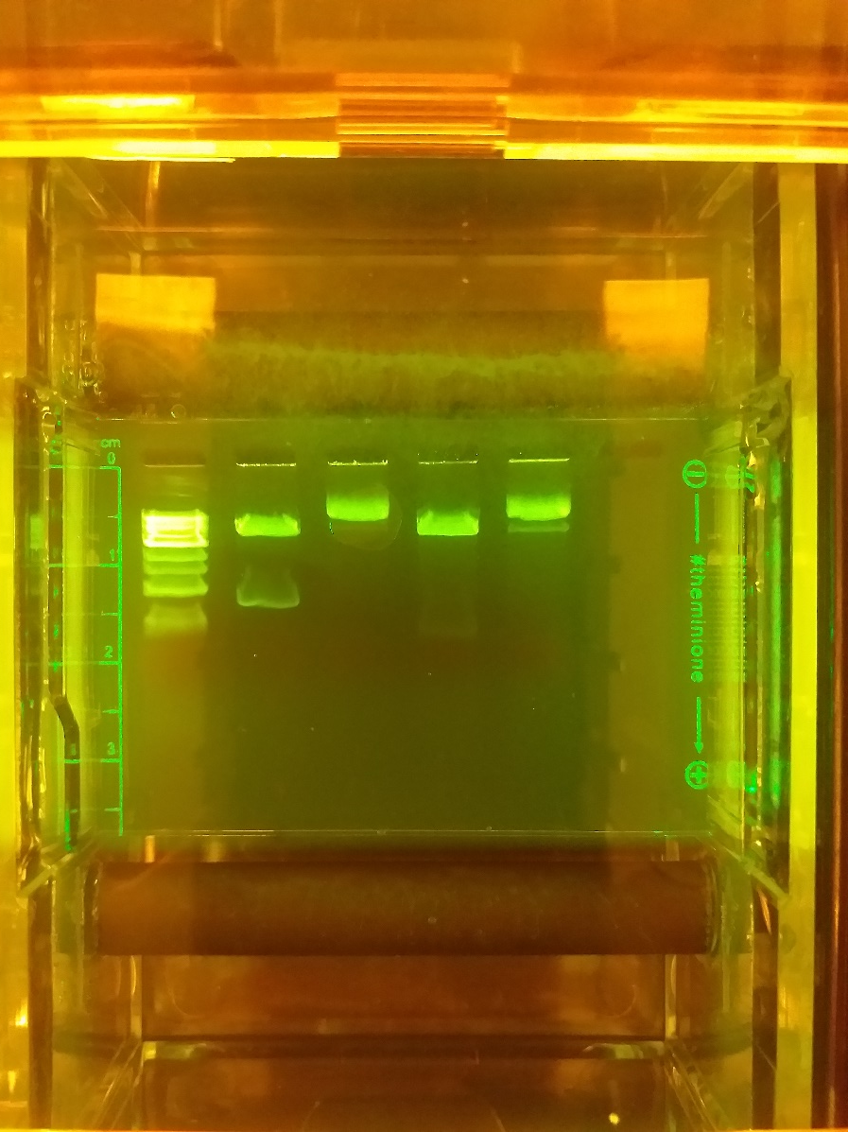
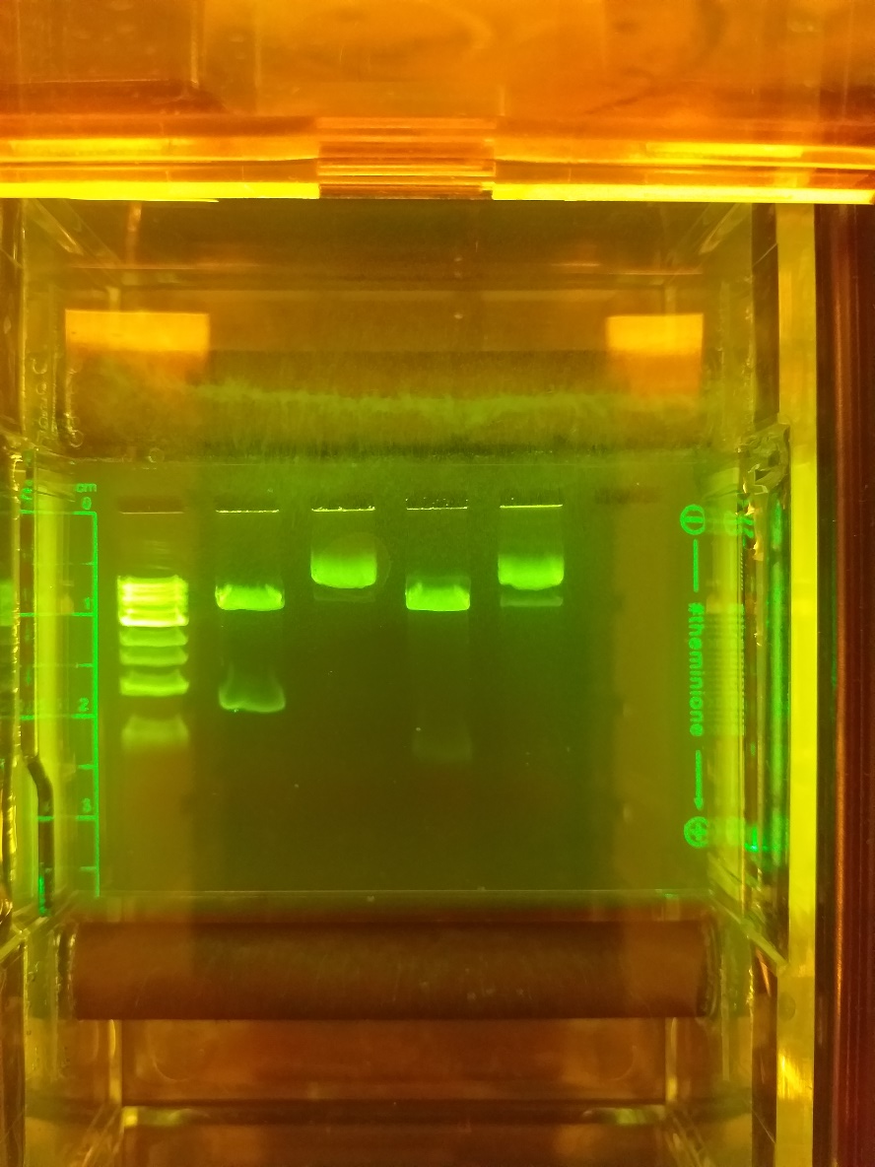
Plasmid Digest
A-
A+
K-
K+
1 kb
3000 >
1000 >
500 >
Notes:
Things to note:
Uncut plasmids (A-, K-), have 1 or 2 large bands, near wells
Smaller fragment in A+ compared K+ (377 c/w 807)
Larger fragment in K+ is larger than the equivalent in A+ (4705 c/w 4495)
NB. If you can’t spot the 377 and 807 bp fragments in the digest wells, look to see if the larger fragments are single and high (and maybe possible to size) if gel run far enough
(Sizes for 1 kb can be found in Student Guide, p 5.8)

Slide 42
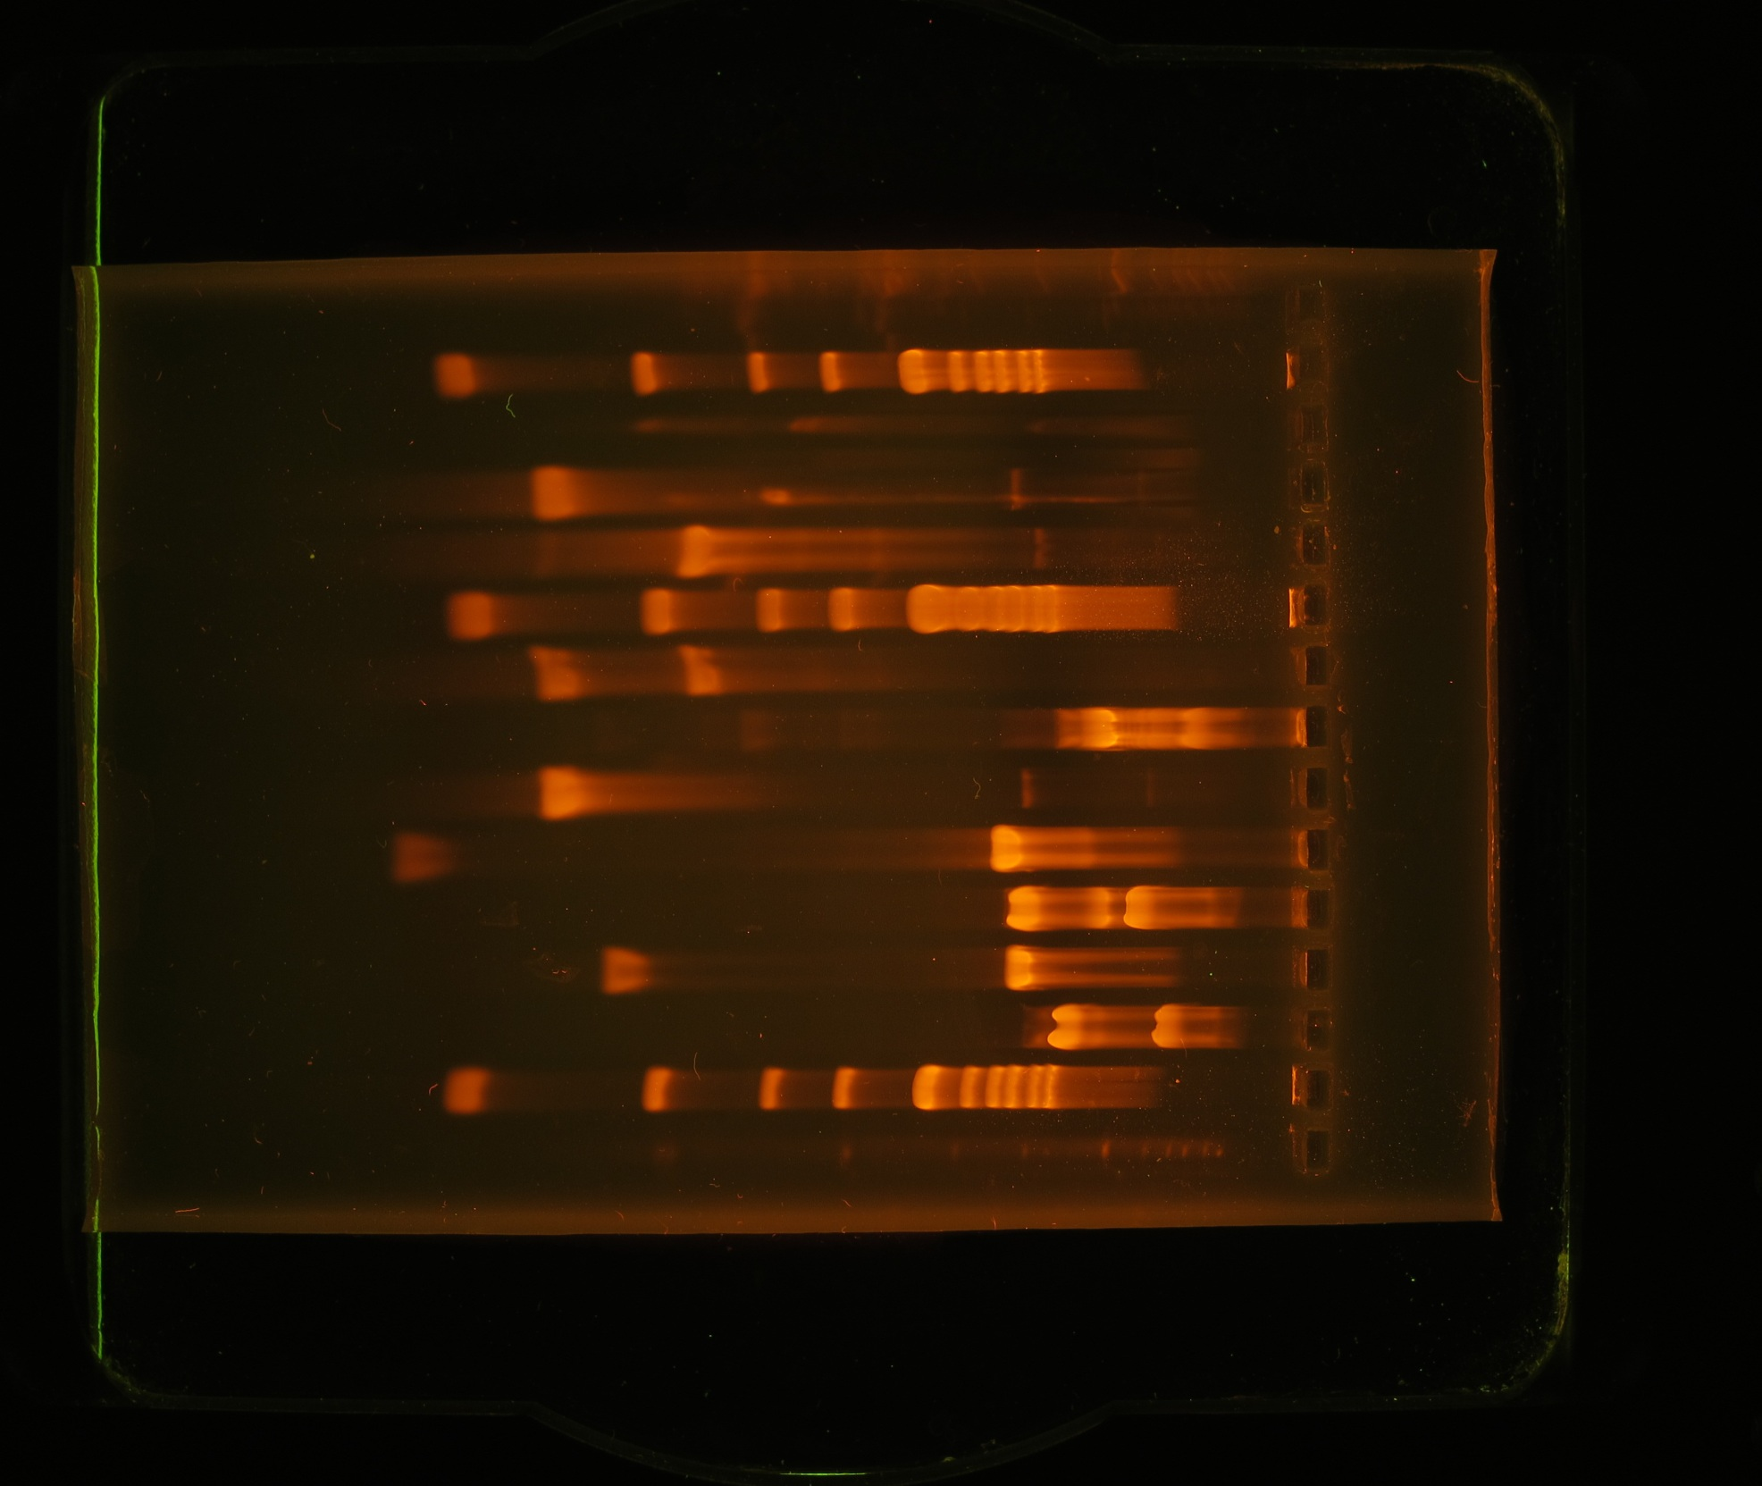

Lab 5: gel electrophoresis
1 Kb
K +
A-
A+
LIG
1 Kb
K+
LIG
K-
K-
A-
A+
10.0
10.0
8.0
8.0
6.0
6.0
5.0
5.0
4.0
4.0
3.0
3.0
2.0
2.0
1.5
1.5
1.0
1.0
0.5
0.5
Notes:
Now is the test to see whether we achieved all this, by looking at the size of the DNA fragments produced by gel electrophoresis. So, what do you think will show up in the 5 lanes that you loaded?
What size would you expect in the K- lane (undigested pKAN-R)? 5,512 bp, multiple plasmid configurations
What size would you expect in the K+ lane (digested pKAN-R)? 4,705 bp and 807 bp
A 4705 bp fragment with the gene for kanamycin resistance, and a 807 bp fragment with the pBAD promoter and rfp gene.
*It doesn’t matter how many times I run this series of experiments, I still get a thrill when I actually see the band for the rfp gene. In this practical sequence it is a red fluorescent protein marker, but in another lab it could be a gene for a new protein therapeutic for any of the many protein misfolding diseases and that is incredibly exciting and amazing.
What size would you expect in the A- lane (undigested pARA)? 4,872 bp, multiple plasmid configurations
What size would you expect in the A+ lane (digested pARA)? 4,495 bp and 377 bp
A 4495 bp fragment with the ampicillin resistant gene and araC gene.
What size would you expect in the LIG (ligation reaction) lane?
Bands of many different sizes from many different constructs made (including the 10, 2-fragment plasmids we looked at before). The bands in this lane are often indistinct as there are so many possible constructs that no single one may be present in sufficient quantity to show up with the DNA stain (which has limited sensitivity).
We would hope to see a band at 5,302 bp, representing the pARA-R recombinant plasmid that we would like to have made.

Slide 43
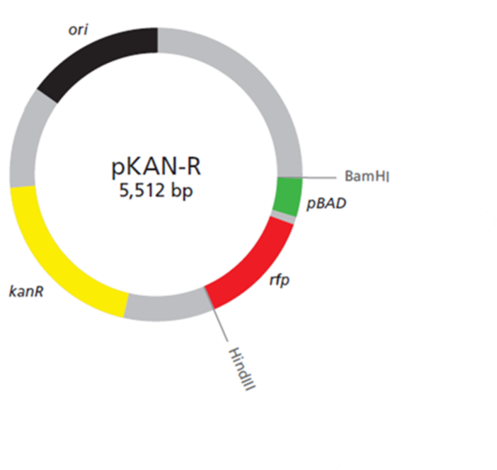
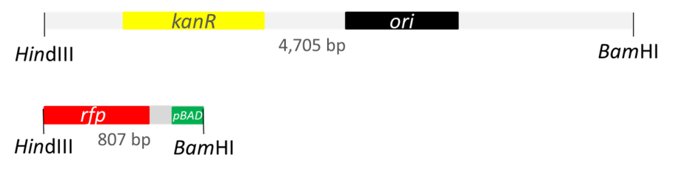
Lab 2: restriction digestion
1 Kb
K +
A-
A+
K-
10.0
8.0
6.0
5.0
4.0
3.0
2.0
1.5
1.0
0.5
Notes:
pKAN-R is 5,512 bp. Expect a single band at this size.
After digestion expect bands of 4,705 and 807 bp. 2 bands.

Slide 44
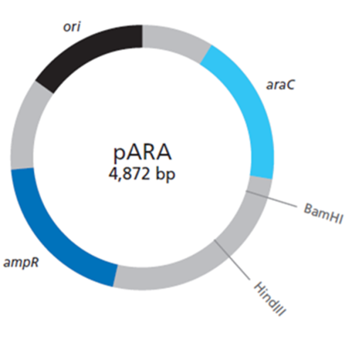

Lab 2: restriction digestion
1 Kb
K +
A-
A+
K-
10.0
8.0
6.0
5.0
4.0
3.0
2.0
1.5
1.0
0.5
Notes:
pARA is 4,872 bp. Expect a single band.
Expect 2 restriction fragments; 4,495 and 377 bp.

Slide 45
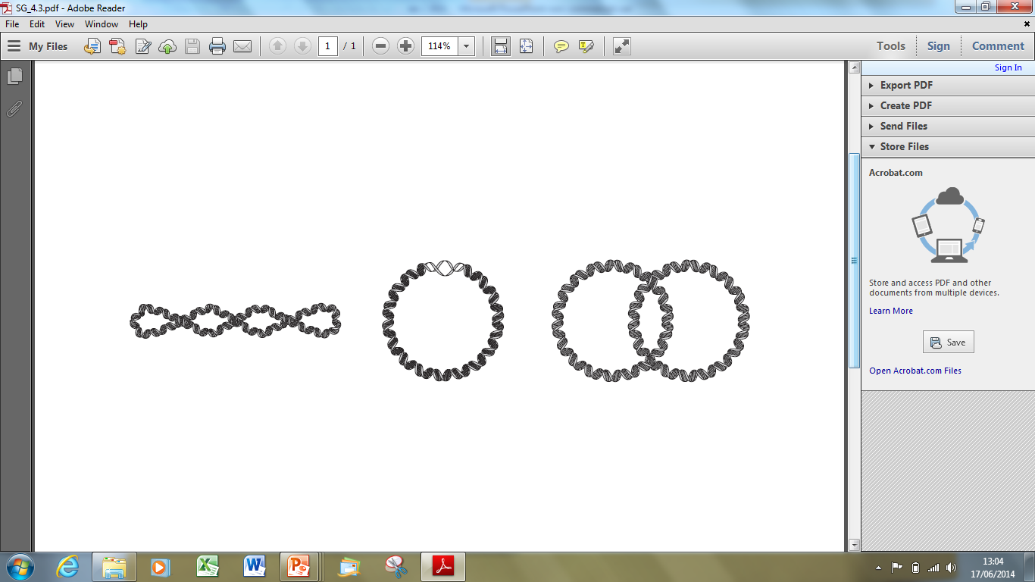
Lab 2: restriction digestion
1 Kb
K +
A-
A+
1 Kb
K+
K-
K-
A-
A+
multimer
10.0
10.0
8.0
8.0
6.0
6.0
5.0
5.0
4.0
4.0
3.0
3.0
Nicked circle
2.0
2.0
1.5
1.5
1.0
1.0
supercoiled
0.5
0.5
Notes:
So this is what you’d predict to see.
It will match well in the lanes where restriction digests were loaded, but not in the lanes containing undigested plasmid.
This is because plasmids come in different forms.
You will see at least 2 bands, probably supercoiled and nicked circle, you may also see mulitmers.

Slide 46
Lab 2: restriction digestion
High Resolution – Scanning Electron Microscope imaging of the three-dimensional surface topology of (a) supercoiled plasmid pUC21, (c and d) open-circular DNA molecules of pBR322 plasmid.
Taken from; YAFFEE, M, WALTER, P., RICHTER, C. and MULLER, M. (1996) Direct observation of iron-induced conformational changes of mitochondrial DNA by high-resolution field-emission in-lens scanning electron microscopy (DNA unwinding/iron colloid formation/backscattered electron detection). Proceedings of the National Academy of Sciences of the USA 93; pp. 5341-5346.
Notes:
And here are what I think are some rather lovely pictures of supercoiled and ‘open-circular’ or relaxed circle plasmids.

Slide 47


Clone that gene
Restriction enzyme | Recognition site
BamHI | GGATCC CCTAGG
EcoRI | GAATTC CTTAAG
HindIII | AAGCTT TTCGAA
Notes:
There is good ‘paper & pen’ exercise in the back of the Teacher Guide to re-inforce / model the gene cloning exercise

Slide 48
Objectives
By the end of this course you will:
Feel confident preparing for labs 1, 2, 3 & 5
Feel confident carrying out labs 1, 2, 3 & 5
Be aware of Health and Safety requirements
Know where to access resources
Know who to contact for support

Slide 49
Notes:
Any questions so far?

