Slide 1
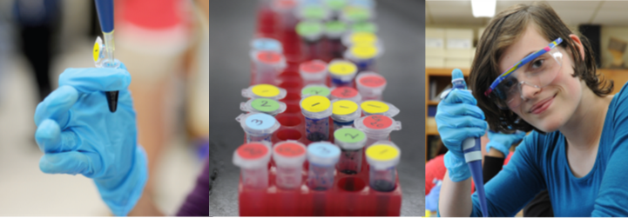


INTRODUCTION
DNA manipulation in the classroom
2 June 2026

Slide 2

Objectives
By the end of this course you will:
Feel confident preparing for labs 1, 2, 3 and 5
Feel confident carrying out labs 1, 2, 3 and 5
Be aware of Health and Safety requirements
Understand how ABE relates to ‘real world’ Biology
Know where to access resources
Know who to contact for support

Slide 3
ABE: introduction
➢ ABE ‘who’s who’
Benefits to the school
Development of the ABE programme
ABE (UK) currently
What do we mean by ‘kit’
Sample Storage
Relevance to the GCSE and A level specifications
Organisation of the ABE (UK) programme
Resources
ABE requirements

Slide 4
ABE “who’s who”
Phil Smith, UK CPD lead
phil.smith@nbi.ac.uk
Lee, Di, Kita, UH Tech team
amgentechsuh@herts.ac.uk
Shiree Gilday-Burns - Cambridge
Hub (CRC)
SGilday-Burns@camre.ac.uk
Mauro Rinaldi and Tyler Howell- Bray
M.Rinaldi@hull.ac.uk
Alison Ackroyd & Rachel Alexander
Alison.Ackroyd@midkent.ac.uk
Eddie Orija, Director of Centre for STEM Education, UH
e.orija@herts.ac.uk
Philippa Mulberry,
programme administrator
stem@herts.ac.uk
Sumudu Cruz-Dabrera,
programme administrator
stem@herts.ac.uk

Slide 5
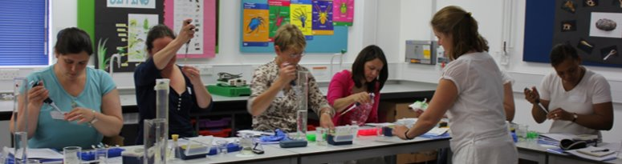
ABE Benefits
Training programme​ ​ Free equipment loan​ ​ Free consumables​ | Free written materials​ ​ Access to presentations​ ​ Support​
Notes:
The first thing I wanted to tell you about were the benefits to your school.
As a UK Biology teacher there are a number of features of this particular Biotechnology education programme that interest me…(from slide)
The yearly training is an important part of this programme, offering CPD for Science teachers and technicians. Not only does it allow us to hear school’s experiences and try to improve the series of practical experiments offered, but it also helps us to make sure that teachers feel confident in what they’re doing, and research here and abroad has shown that students get much more from experimental work when the teacher delivering it is confident in what they are doing.
Another advantage is that teachers don’t have time to spend preparing Biotechnology practicals from scratch. I think that this provides a pretty comprehensive (and free) package to help get Biotechnology into schools and inspire our students.
On your desk are 1 copy of the teacher manual, 1 copy of the student manual and 1 part of the technician manual for each school. These are yours to keep. (Copies are also available in electronic format from the SLC EE website – we’ll tell you how to get to them later.) You will need to use them today and tomorrow, so please keep them with you for the duration of the course.

Slide 6
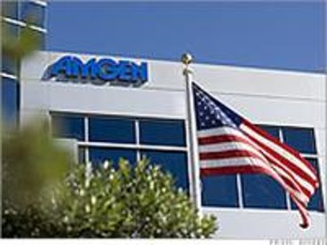
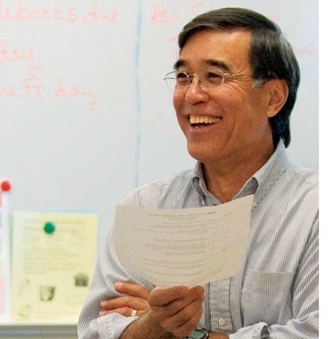
ABE programme
34 years ago ...
Notes:
The second thing I wanted to tell you about was the development of the programme and how it is being introduced in the UK.
So, I’ll start by taking you back to California in the late 1980s, where Bruce Wallace was one of the first molecular biologists employed to work for AMGen. When he started work his children were going through High School and he saw that they didn’t get to do the type of experiments that he did every day. About that time the National Research Council identified a gap between the practical biotechnology done in schools and research laboratories and a correlating difficulty in getting students interested and excited about Biotechnology.
Bruce Wallace began putting together practical experiments for High School students. These experiments were conducted in High schools located in the vicinity of the big Amgen labs, and a lot of the reagents were donated through the backdoor, by scientists working in the labs who believed in the value of Science education. Eventually, the key players at Amgen who had been quietly donating old kit and giving consumables were leaving and they informed their superiors of the education programme, of some considerable size, which was running. As you can imagine this led to quite an internal hoo-ha about gifting of unauthorised materials, but the sound principles and success of the programme were seen as an undeniable asset and so the Biotechnology programme was formalised into part of the Amgen Foundation’s work (the Amgen Foundation is the charitable arm of the Amgen company).
So in the 1990s the official Biotechnology experiments put together by Bruce Wallace for use in High Schools were collated. They aimed to;
Motivate students by getting them to perform current biotechnology experiments
Use industry standard equipment and reagents, and
Interest students by linking the techniques they performed to real examples from industry
Bruce Wallace very unfortunately met an untimely end in a paragliding accident not long after, but the programme was named after his pioneering work and the man shown above – Marty Ikkanda – succeeded him and has gone on to develop both the content of the Biotechnology education programme and the geographical area to which it extends. The Amgen-Bruce Wallace programme now reaches right across the USA and last year, for the first time began in the UK, in Cambridge. Marty himself, was with us last year presenting the labs, along with his senior lab technician Karin Steinhauer, and this is the first year after the pilot phase that the Amgen Biotechnology programme is running in the UK.

Slide 7
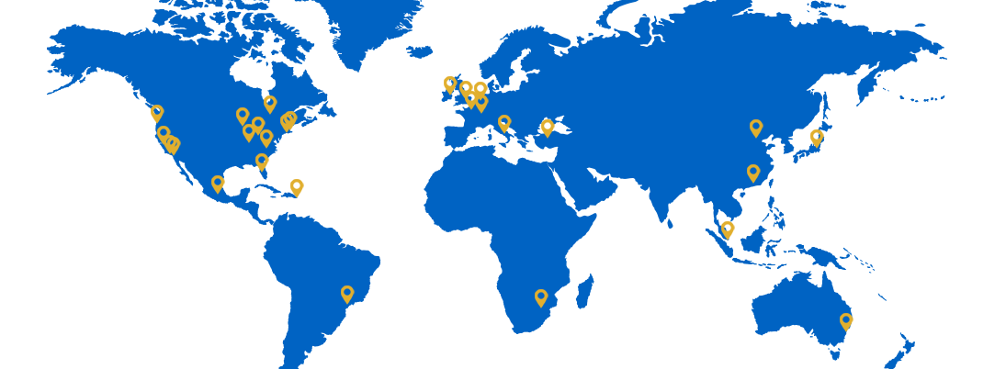
ABE Development
ABE reaches approximately 90,000 STUDENTS in a typical year.
Since 1990, the program has reached >1 Million students and has expanded to 27 LOCATIONS across the globe in 16 countries.
Nearly 3,500 TEACHERS have implemented ABE in their classrooms.
More than 1,800 SCHOOLS have been served
Notes:
The second thing I wanted to tell you about was the development of the programme and how it is being introduced in the UK.
So, I’ll start by taking you back to California in the late 1980s, where Bruce Wallace was one of the first molecular biologists employed to work for AMGen. When he started work his children were going through High School and he saw that they didn’t get to do the type of experiments that he did every day. About that time the National Research Council identified a gap between the practical biotechnology done in schools and research laboratories and a correlating difficulty in getting students interested and excited about Biotechnology.
Bruce Wallace began putting together practical experiments for High School students. These experiments were conducted in High schools located in the vicinity of the big Amgen labs, and a lot of the reagents were donated through the backdoor, by scientists working in the labs who believed in the value of Science education. Eventually, the key players at Amgen who had been quietly donating old kit and giving consumables were leaving and they informed their superiors of the education programme, of some considerable size, which was running. As you can imagine this led to quite an internal hoo-ha about gifting of unauthorised materials, but the sound principles and success of the programme were seen as an undeniable asset and so the Biotechnology programme was formalised into part of the Amgen Foundation’s work (the Amgen Foundation is the charitable arm of the Amgen company).
So in the 1990s the official Biotechnology experiments put together by Bruce Wallace for use in High Schools were collated. They aimed to;
Motivate students by getting them to perform current biotechnology experiments
Use industry standard equipment and reagents, and
Interest students by linking the techniques they performed to real examples from industry
Bruce Wallace very unfortunately met an untimely end in a paragliding accident not long after, but the programme was named after his pioneering work and the man shown above – Marty Ikkanda – succeeded him and has gone on to develop both the content of the Biotechnology education programme and the geographical area to which it extends. The Amgen-Bruce Wallace programme now reaches right across the USA and last year, for the first time began in the UK, in Cambridge. Marty himself, was with us last year presenting the labs, along with his senior lab technician Karin Steinhauer, and this is the first year after the pilot phase that the Amgen Biotechnology programme is running in the UK.

Slide 8
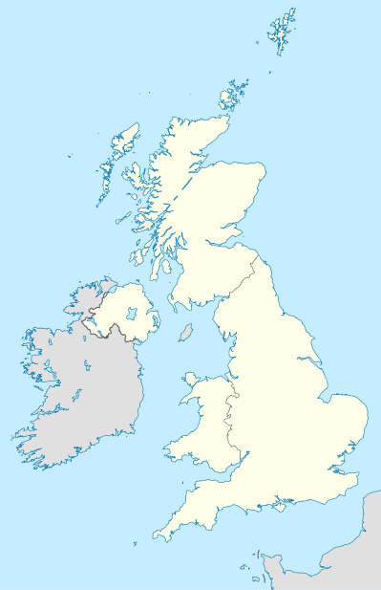

ABE (UK)
Cambridge Regional College
2. John Innes Centre, Norwich
3. Mid-Kent College
4. University of Herts
5. University of Hull
Notes:
We now have established sites in Cambridge, Norwich, MidKent, Hatfield and Hull.
Those of you who have browsed the Amgen Biotech Experience website, will know that we offer a set of practical opportunities developed to fit with the curriculum and health and safety requirements of the UK.
We do this in Herts (were the programme is managed and close to Amgen’s Uxbridge baae), Homerton College (Cambrdige) – Amgen also on Cambridge Science Park, and Norwich (thru TSN which runs an extensive kit loan programme to schools from its base on the Norwich Research Park)

Slide 9
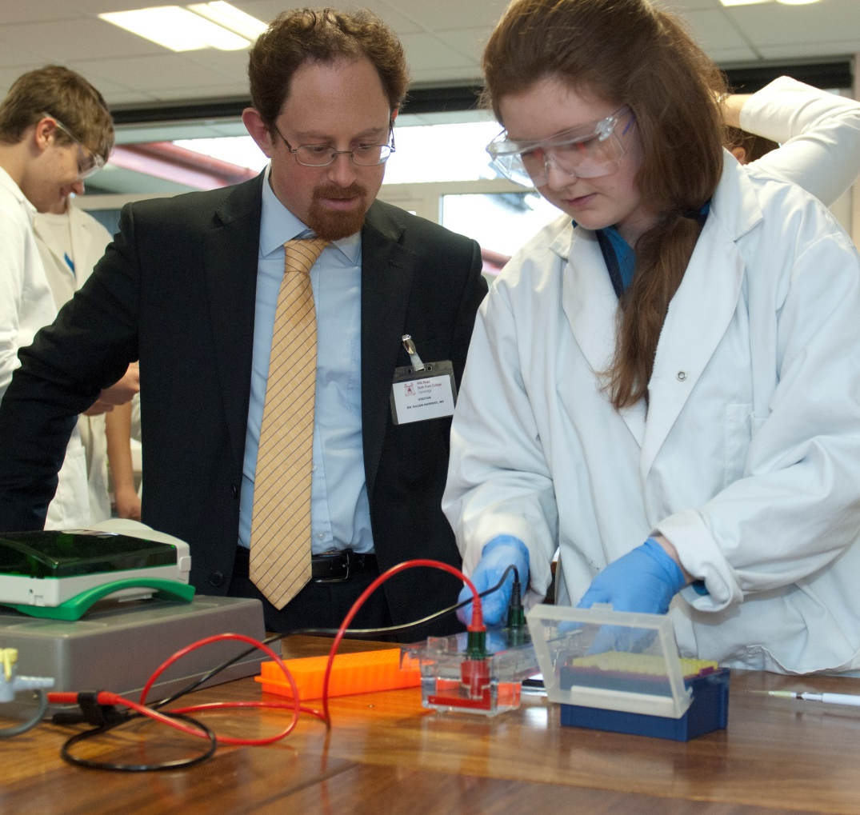
Opportunities (PR)
“It is always a pleasure to learn more about how local businesses such as Amgen are supporting our community.” …”we need to ensure that we are encouraging more young students to be passionate about science…”
“Impressed by the quality of science”
Notes:
In 2013 we had a visit from Julian Huppert, Lib Dem MP for Cambridge whilst the Amgen Biotech Experience was running at Hills Road Sixth Form College. He was impressed by the quality of science performed by students at sixth form. Opportunity for raising school’s profile

Slide 10
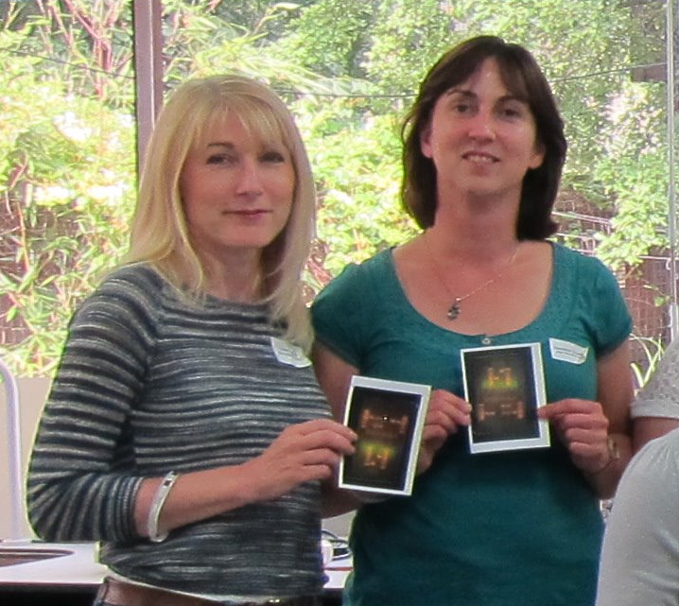
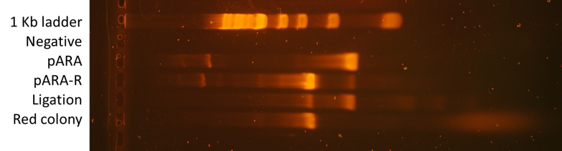
Opportunities (Profile)
pARA PCR product = 662 bp
pARA-R PCR product = 1092 bp
2.0 Kb
1.0 Kb
1.5 Kb
0.5 Kb
Notes:
In 2013 we had a visit from Julian Huppert, Lib Dem MP for Cambridge whilst the Amgen Biotech Experience was running at Hills Road Sixth Form College. He was impressed by the quality of science performed by students at sixth form. Opportunity for raising school’s profile

Slide 11

Technicians = vital link
Hub
technician
Technicians
Teachers at school

Slide 12
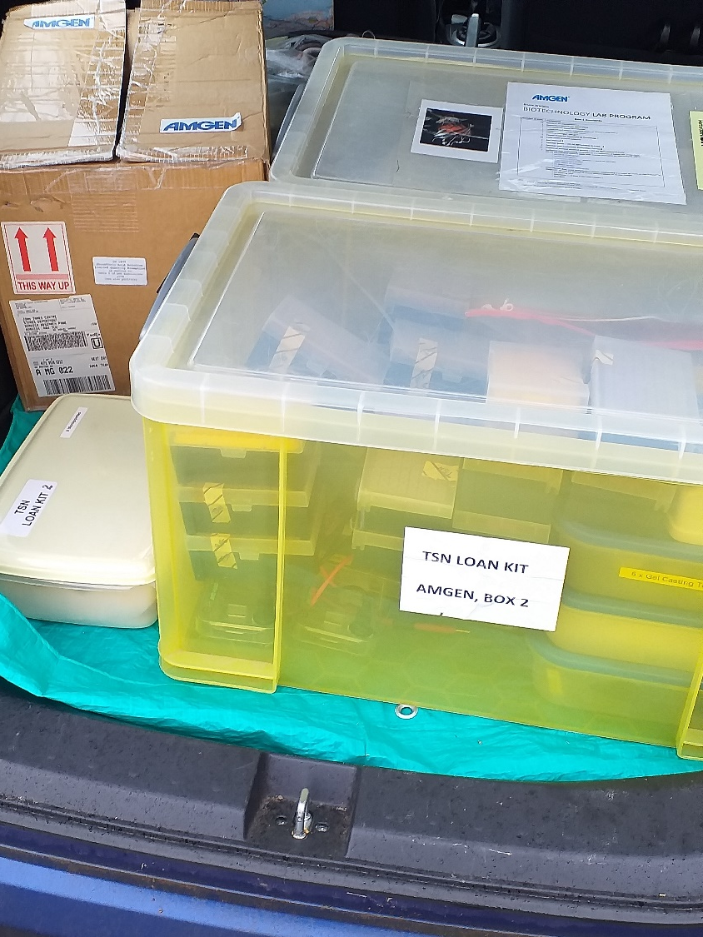
Kit comes in boxes
You will receive all the hardware to run the labs you are trained in today
In addition, you will need
Fridge & Freezer Access (-20ºC)
Water Bath @ 37ºC & 70ºC
Digital BALANCE
MICROWAVE
LARGE QUANTITIES of Elga grade H₂O
Notes:
In the evaluation and at courses every year we receive requests for the kit loan slots to be longer, more flexible and to fit every participating schools desired timetabling.
Unfortunately, while we sympathise with schools requests, the Amgen Foundation want each kit to reach as many schools, teachers, technicians and students as possible in a year. Kit loan time is therefore always going to be limited because of the desire to reach as many students as possible.
We do try very hard to accommodate schools requests for the time of year that they borrow the kit.
This year in Cambridge we are trialling a new, more flexible approach to booking. This is in recognition of the fact that some schools use it in off-timetable days, and some use it with very large numbers of students during lessons over an extended period. Rather than divide the school year up prior to the courses and kit slot choices, we are trialling a more flexible approach in which:
1 – schools have more time to consider how they will use the kit during courses
2 – all schools on the original course are guaranteed the kit in schools for 2 weeks
3 – all schools on other courses can opt to have the kit for up to 3 weeks (or longer if the lengths of terms / other kit booking requests allow it)
Ali McCree will be sorting out the kit bookings, as before.

Slide 13
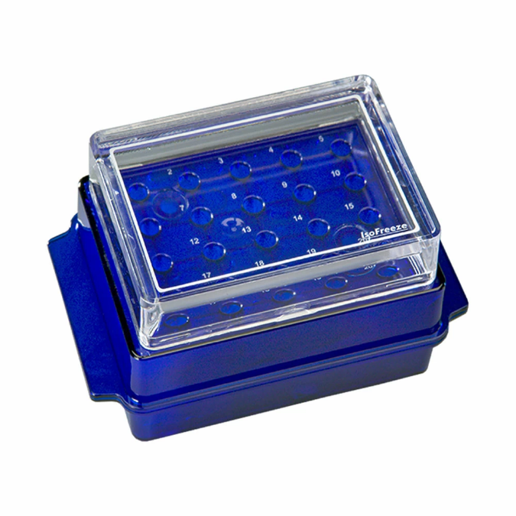
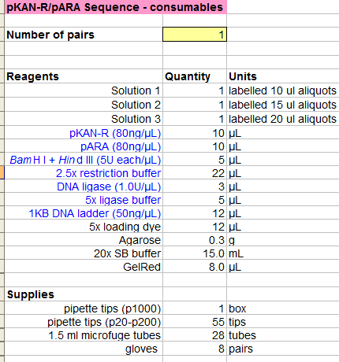
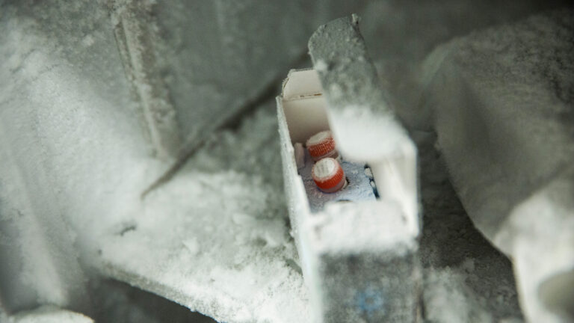
Sample Storage
Blue = store @ -20°C (in freezer)
Black = store at room temperature

Slide 14
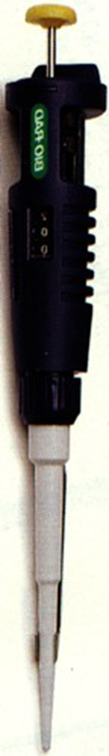
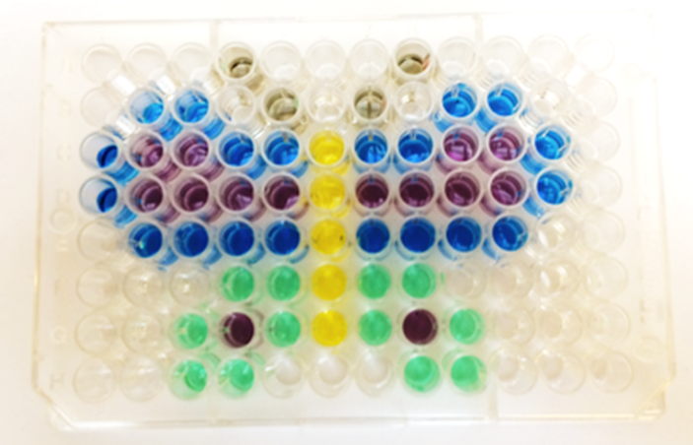
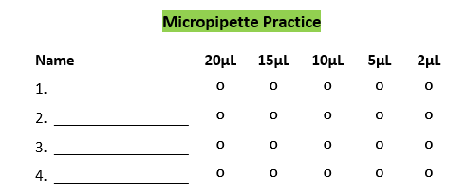
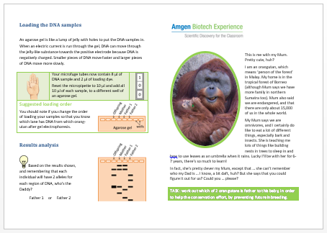
Aims and NC fit
Key Stage 3: Genetics and evolution; Inheritance, chromosomes, DNA and genes
heredity as the process by which genetic information is transmitted from one generation to the next
the variation between individuals within a species
use appropriate techniques during laboratory work, paying attention to health and safety
interpret observations and data, including identifying patterns and using data to draw conclusions
Notes:
As all A level teachers are undoubtedly all too well aware there are changes to the A level specifications from September and so we undertook a review to see how well the ABE programme fitted with the new requirements.

Slide 15
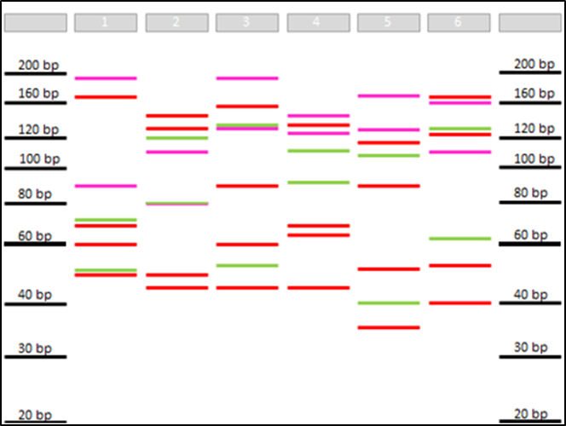
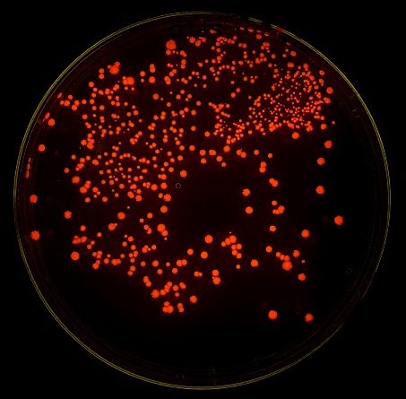
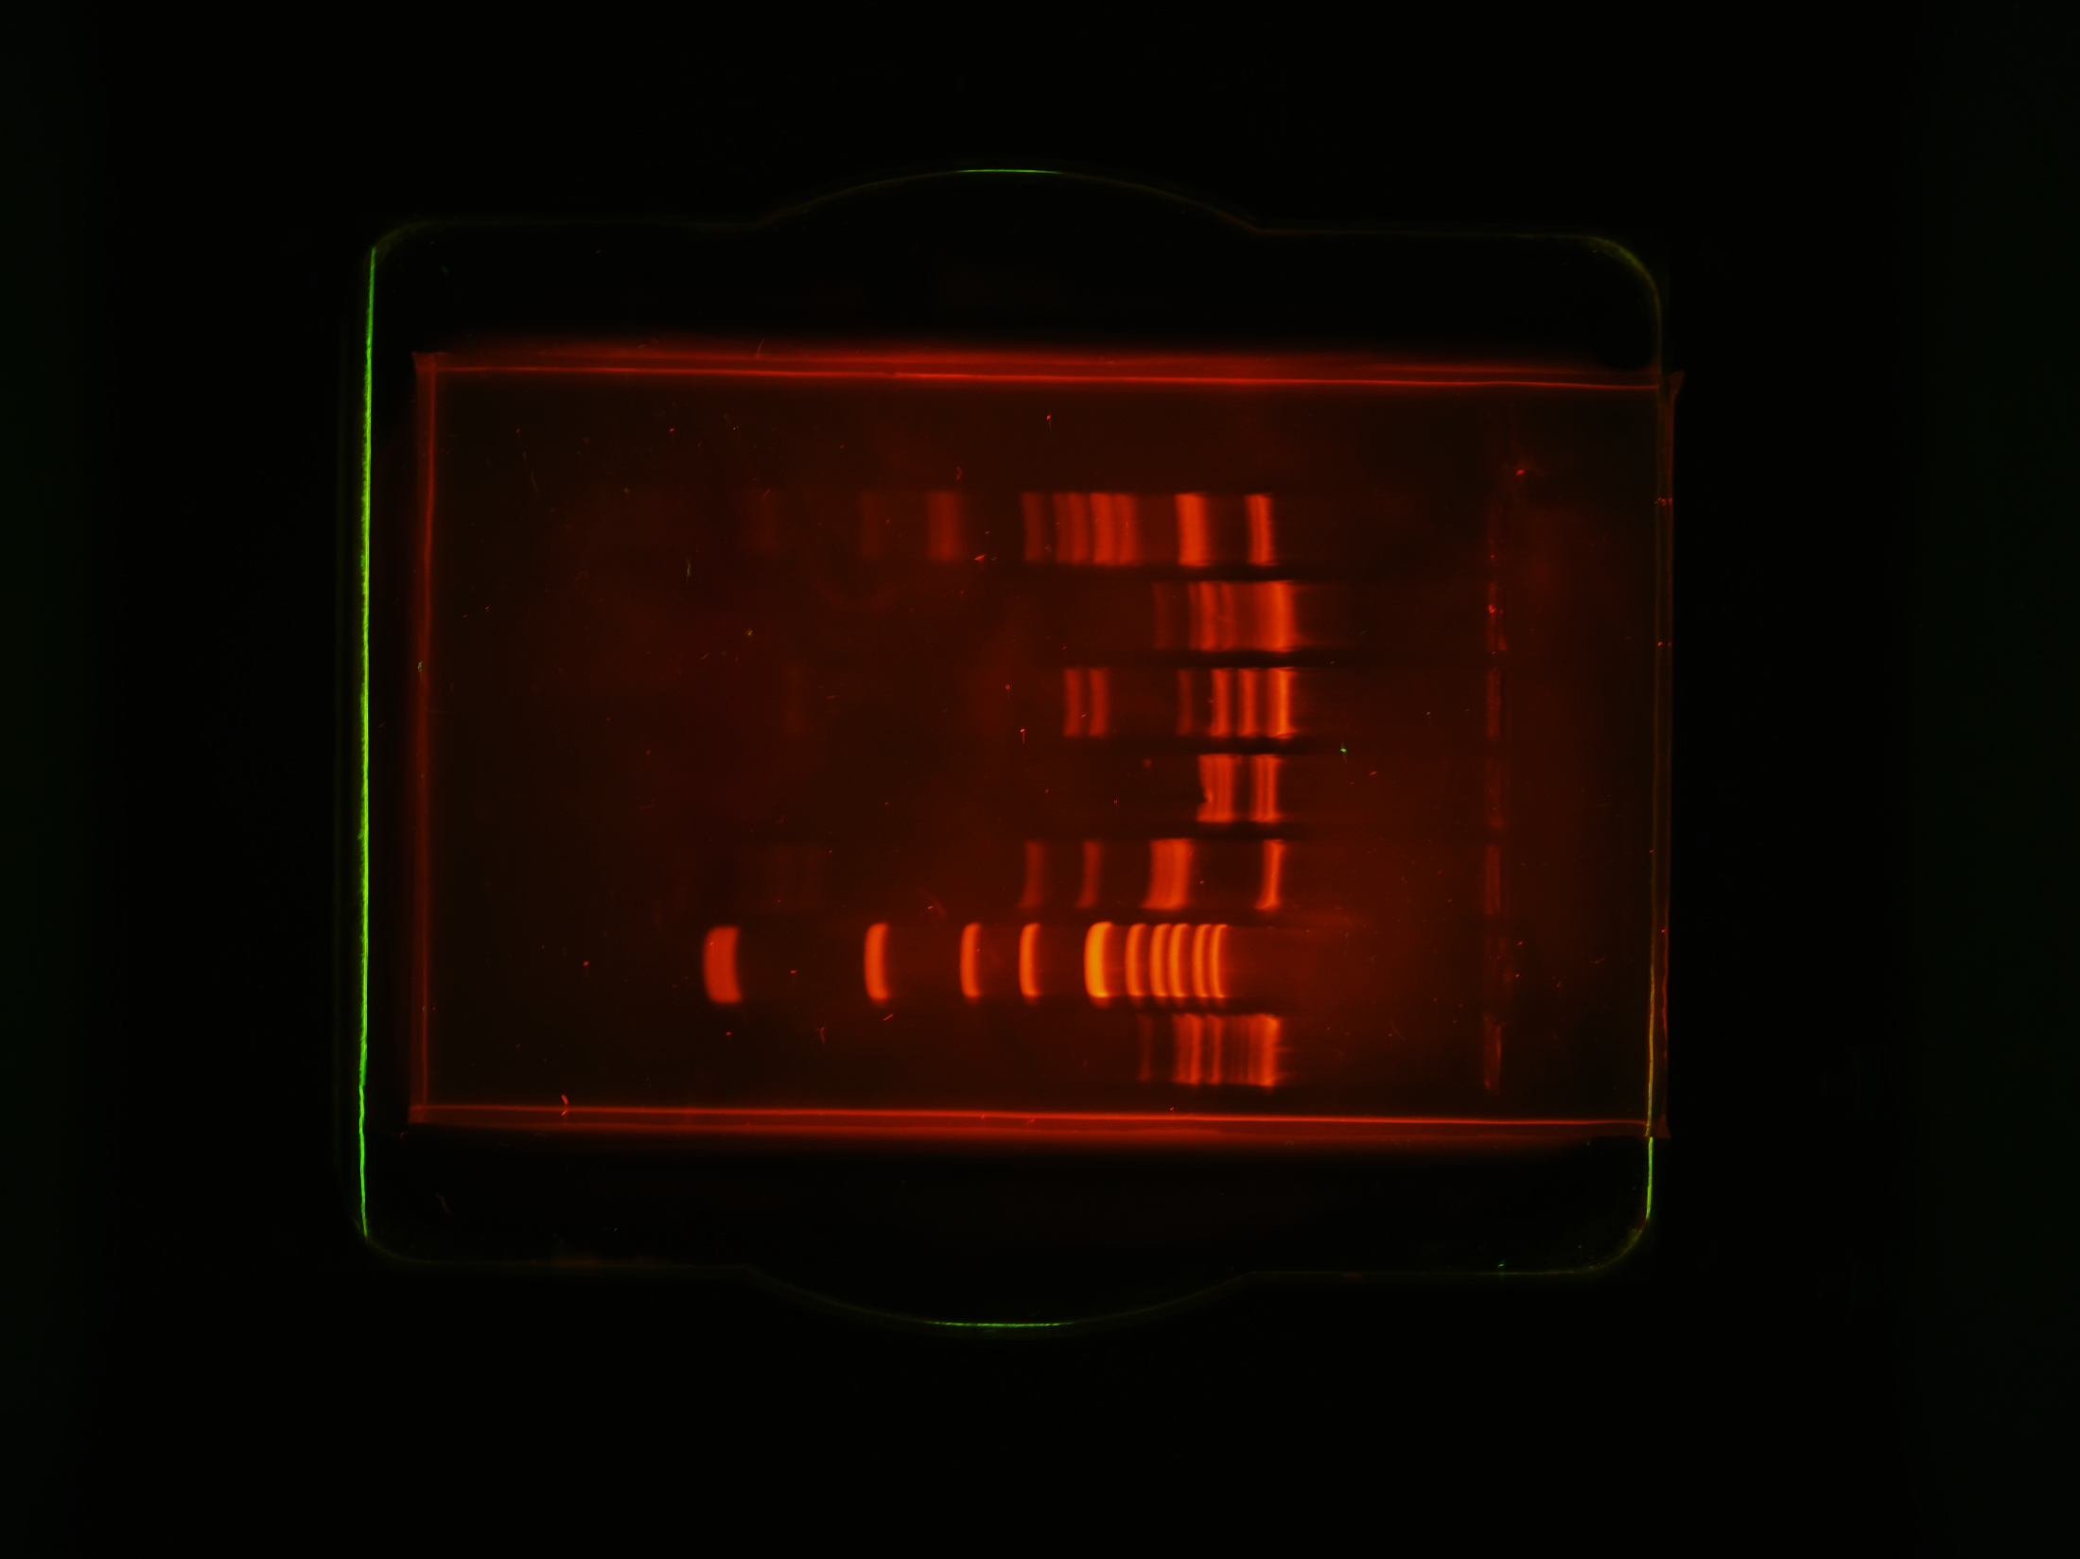
Aims and NC fit
Key Stage 4: Evolution, Inheritance and Variation
the genome as the entire genetic material of an organism
genetic variation in populations of a species
the uses of modern biotechnology including gene technology; some of the practical and ethical considerations of modern biotechnology

Slide 16
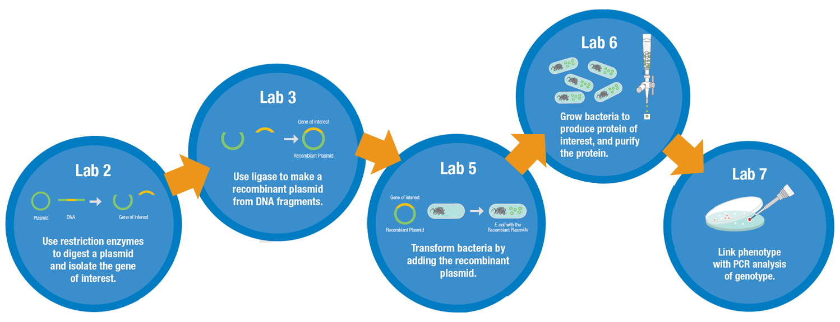
Aims and NC fit
Key Stage 5: Genetics and evolution
gene technologies allow study and alteration of gene function in order to better understand organism function and to design new industrial and medical processes

Slide 17
Required Practicals
Practical techniques to be completed by candidates:
• use laboratory glassware apparatus for a variety of experimental techniques to include serial dilutions
• separate biological compounds using thin layer/paper chromatography or electrophoresis
• use microbiological aseptic techniques, including the use of agar plates and broth
• use ICT such as computer modelling, or data logger to collect data, or use software to process data
From the ‘GCE AS and A level subject content for biology, chemistry, physics and psychology’ document issued by the Department for Education in April 2014,
Appendix 5c – Use of apparatus and techniques – biology
Notes:
One major change to the new exam specifications is the addition of a practical endorsement to the examined content, which will be given as pass/ fail.
In the core / required practicals specified by the Department for Education in their document, ‘GCE AS and A level subject content for biology, chemistry, physics and psychology’ published in April 2014 , one is that students should ‘separate biological compounds using thin layer/paper chromatography or electrophoresis’. Electrophoresis is obviously one practical component where the ABE program can support teachers and students in the new A level practical endorsement requirements.
There are other areas of the practical endorsment, where kit loans and consumable supplies from the ABE program can be used to help schools. Shown in slide – cover.

Slide 18
ABE (UK) Organisation
DNA profiling (lab 9)
Microvolumetrics and pipetting (lab 1)
Restriction digest: pARA and pKAN-R (lab 2)
Restriction digest: pARA-R (lab 2a)
Ligation (lab 3)
PCR (lab 4)
PCR (lab 4a)
Agarose gel electrophoresis:
verification product size(s) (lab 5)
Agarose gel electrophoresis:
verification product size(s) (lab 5a)
Transformation with ligation products (lab 6)
Transformation with pARA-R (lab 6a)
Colony PCR and gel electrophoresis (lab 7)
Colony PCR and gel electrophoresis (lab 7a)
Notes:
This gives an overview of the course structure.
The original course, which participants must attend first allows hands-on experience of Micropipetting, restriction digestion, ligation and gel electrophoresis.
The extension course extends this to include using the ‘a’ series and completing bacterial transformation.
The advanced course introduces PCR from cheek cells and DNA profiling
The additional course then links to PCR options for use through the ABE series of experiments

Slide 19
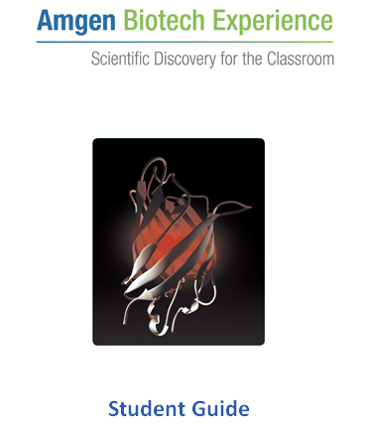

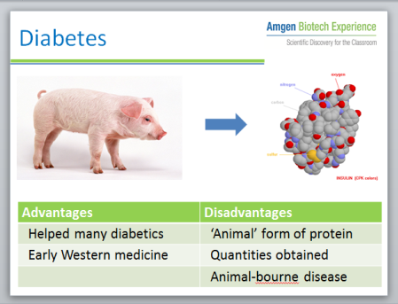
Resources
Student guide
Teacher and technician guide
Video resources
Powerpoints available

Slide 20
Student guides
Introduction
Learning objectives
Aims
Materials
Health and safety
Methods
Questions

Slide 21
Teacher & technician guides
Overview
Preparation
Health and safety
Learning objectives
Prior knowledge and skills
Expected question responses
Additional resources
Notes:
Teacher and technician guides give preparation details
Both teacher and technician and student guides give health and safety information

Slide 22

ABE requirements
ABE grant in place until 2026
… we (& you!!) want it to continue !!

Slide 23
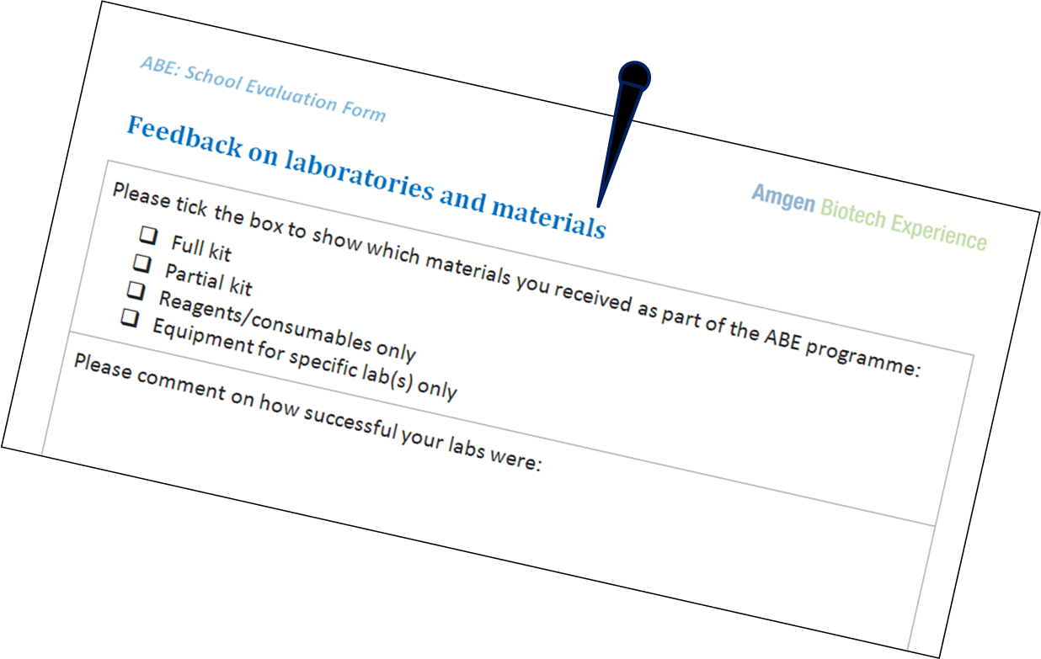
ABE requirements
On-line feedback form for CPD course
School ‘contract’ – planning form
Survey Monkey for box evaluation
Notes:
FEEDBACK is essential. Feedback forms for kit borrowing is longer, but we need to reapply for the next 2 years of grant funding to continue this year and without feedback forms we will be unlikely to be successful as collecting and collating feedback is a requirement of the grant
PLEASE: we know that this form is longer and you have it at a time when you have been and are busy doing extra above and beyond the normal crazy busyness, but please, we need these filled in if we wish to continue to run the ABE programme in the UK
Schools are required to sign a contract before borrowing the kit which essentially says….
CPD courses are being assessed as aprt of the ABE evaluation, on-line form to fill in at the end fo the day.

Slide 24
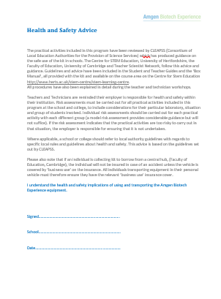
Health and safety
Electrophoresis buffer
Gel Red / Gel Green
Microorganisms
(Course 2)

Slide 25
Notes:
Any questions so far?

Slide 26
Drug development
Drug discovery
Research and development
Manufacturing
Protein targeted
Legal issues
Patient use
Regulatory affairs
Clinical affairs
Notes:
If you remember I said as part of the ‘development of the programme' that the ABE programme had 3 major aims:
To motivate students by getting them to perform current biotechnology experiments
To use industry standard equipment and reagents, and
To interest students by linking the techniques they performed to real examples from industry
Now I will try to put these Biotechnology experiments in an industrial context for you, as you might want to do for your students
This slide shows a common pathway for drug development. (I know that the writing’s quite small, because it wouldn’t fit on otherwise, so I’ll just read along the different stages.) READ BLUE BUBBLES. This isn’t really linear, lots will be happening in parallel stages. Contrast with COVID vaccine development where many steps were at advanced stages – hence it was speeded up!
The part from manufacturing to patient use is common to all drug development companies.
The part that makes Biotechnology unique and so interesting is that in the Research and Development phase it targets a protein. So instead of working with a bank of chemicals to screen and modify, it is working with and manipulating materials from living organisms.
At both GSCE and A level students are expected to know the example of insulin.
Insulin was the first protein therapeutic approved for human use to treat diabetes. Initially produced from animals (cow / ox / pig) from as early as the 1920s to treat diabetics, insulin was the first recombinant / synthetic medicine ever made in 1964. By the 1980’s most diabetic patients were being treated with synthetic insulin. This has many advantages in terms of; large quantities required, protein compatibility, correct protein folding and structure.

Slide 27
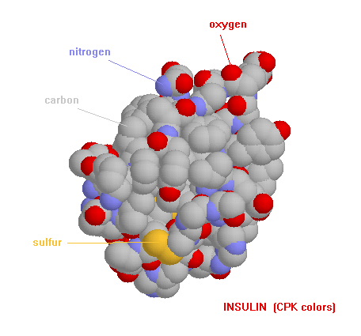
Diabetes
Problem:
absent protein (insulin)
Solution:
manufacture protein and deliver
(into blood)
Notes:
Turns out quite a lot of diseases are caused by absent or malformed proteins.
Common example, frequently encountered is diabetes.
Diabetes gives a simple genetic model of disease, caused by the absence of a single gene product.
The absence of the protein insulin is detected by a blood test (since insulin is a hormone that circulates in the blood).
Scientists and health professionals need to manufacture and deliver replacement insulin into the blood.

Slide 28
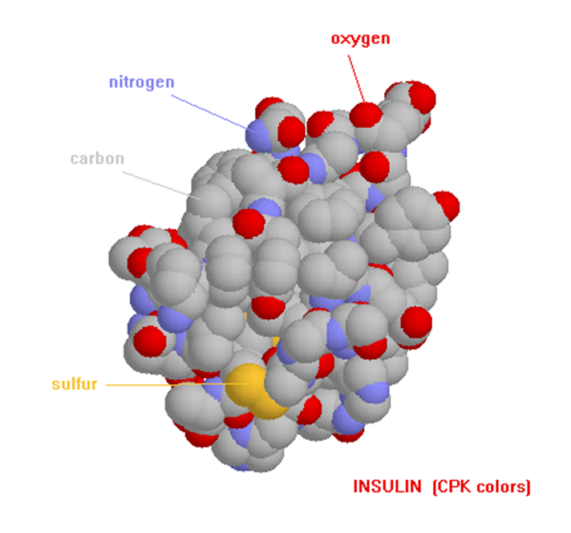
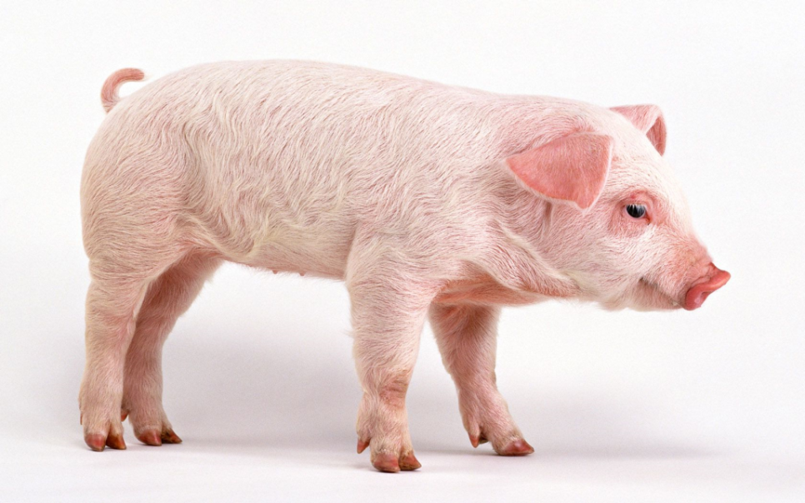
Diabetes
Advantages | Disadvantages
Helped many diabetics | ‘Animal’ form of protein
Early Western medicine | Quantities obtained
 | Animal-borne disease
Notes:
In the 1920s, insulin was not manufactured, but purified from animals’ (cow / ox / pig) pancreases and used to treat diabetics.
The process involved:
Killing the animal
Removing the pancreas
Purifying the protein
Consuming the purified protein
Advantages and disadvantages

Slide 29
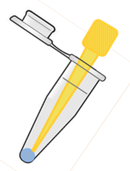
Diabetes
Advantages | Disadvantages
‘Human’ form of protein | Time-consuming to develop
Greater quantities | Uses GMOs
No animal-bourne disease
Notes:
In 1964, insulin was the first recombinant medicine ever made (that is one made by recombining human DNA with bacterial DNA to manufacture the protein missing in a genetic condition). It was also the first protein therapeutic approved for human use.
By the 1980’s most diabetic patients were being treated with synthetic insulin. This has many advantages in terms of; large quantities required, protein compatibility, correct protein folding and structure.
So how is synthetic insulin made?

Slide 30
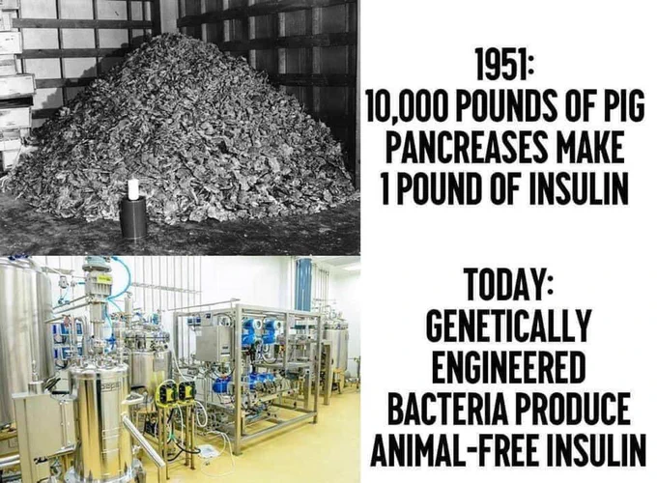
Diabetes
Notes:
A recent poster on Twitter!

Slide 31
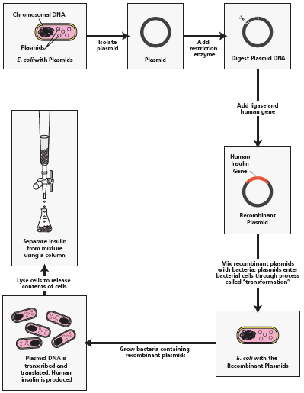
Making protein therapeutics
chromosome
plasmids
E. coli
Notes:
More in depth view of making protein therapeutics
Clone the gene of interest into a vector
One commonly used vector is a plasmid, a circle of DNA incapable of independent replication, but which will be transcribed and translated alongside the chromosome in a bacterium, producing the cloned gene’s product. Once a foreign gene is cloned into a plasmid using restriction digestion and ligation, it is known as a recombinant plasmid.
Transform a bacterium with the recombinant plasmid
Channels in the bacterial membrane are created using chemicals or electricity, then the recombinant plasmid is forced into the bacterium, often using a ‘heat shock’. Bacteria that have been successfully transformed with the recombinant plasmid are often detected by means of an antibiotic resistance gene, also carried on the recombinant plasmid.
Grow lots of transformed bacteria
When bacteria containing the recombinant plasmid have been identified they are grown in flasks to identify optimum conditions for growth. This is then scaled up and multiple large vats of bacterial culture are grown, within which the bacteria will all be making the protein of interest.
Purify the expressed protein
A small-scale method for purification of the protein of interest will be devised, using its characteristics (hydrophilic/hydrophobic, size, charge etc). Again this then needs to be scaled up to purify large quantities of the protein of interest.

Slide 32
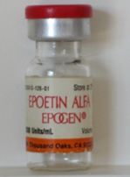
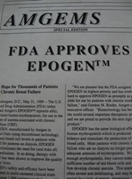
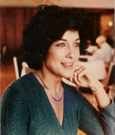
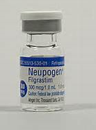


Protein therapeutics
Notes:
2 more recent examples of protein therapeutics could come from AMGen.
AMGen is one of the companies that have patents on recombinant molecule medicines; Epogen and Neupogen
They have been manufactured, gone through legal issues, clinical trials, regulatory affairs and are being used by patients. In fact these are 2 people whose lives have been saved by the drugs.
EPOGEN®
Mimics erythropoetin
Helps your body produce red blood cells
Is used to treat anaemia caused by chronic kidney disease in patients on dialysis
NEUPOGEN
Mimics granulocyte-colony stimulating factor
Stimulates the growth of white blood cells in your body
Is used to treat neutropenia, a lack of certain white blood cells caused by cancer, bone marrow transplant or chemotherapy.
As you can imagine it is very rewarding to be working on drugs like these that save lives.
The laboratory skills used are also very relevant to local employers;
Cambridge Science Park has companies working on recombinant protein technology; including AMGen
So does the bioincubator at Babraham
One of the global giants GSK has Research and Development centres in Stevenage and in Harlow
The same skills in biotechnology can be used in the academic, government and charity sector. For example at the University of Cambridge, Addenbrookes, or at the Sanger Institute is 10 miles down the road in Hinxton.
I think this goes some way to demonstrating the relevance of Biotechnology techniques for your students.
So we now need to hone in and find out what these common techniques involved in recombinant DNA technology are and how the Amgen Biotech Experience has translated them into a series of laboratory experiments appropriate for schools.

Slide 33
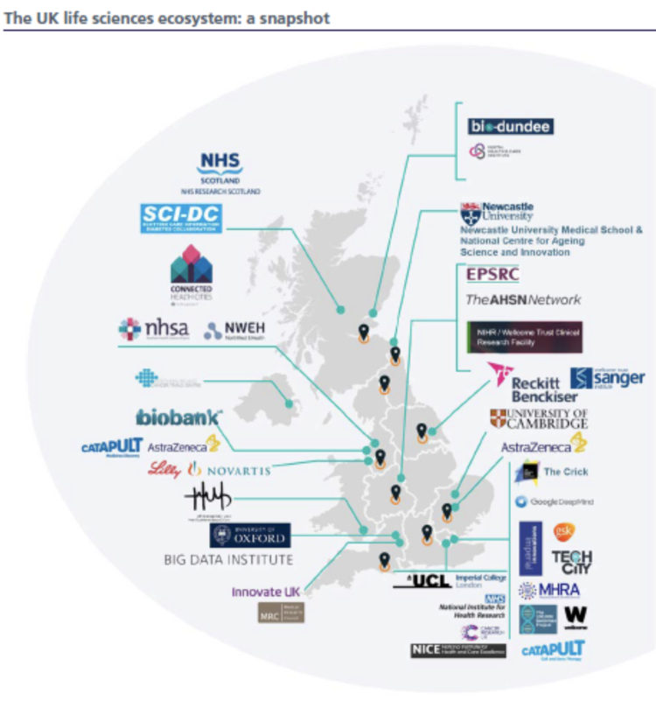
UK Biotech hubs
UK biotechs raised £2.8 billion in 2020
UK-wide but some clusters

Slide 34

Making protein therapeutics
chromosome
gene of interest
plasmids
E. coli
plasmid
digest plasmid
Lab 2
recombinant plasmid
Lab 3
protein produced
Notes:
This slide about making protein therapeutic, basically describes the experimental steps that you will take in school to create a bacteria that expresses, not a protein therapeutic, but instead an easily visible red fluorescent protein.
Clone the gene of interest into a vector
One commonly used vector is a plasmid, a circle of DNA incapable of independent replication, but which will be transcribed and translated alongside the chromosome in a bacterium, producing the cloned gene’s product. Once a foreign gene is cloned into a plasmid using restriction digestion and ligation, it is known as a recombinant plasmid.

Slide 35



ABE labs
Lab 2 Restriction digestion
Lab 3 Ligation
Lab 5 Electrophoresis
Notes:
Lab 1 is an introduction to materials and methods for students. You can choose how much you teach of this lab. And tomorrow they’ll be some suggestions for the technicians about different ways to do this introductory practical.
Labs 2, 3 and 5 go through the techniques of restriction digestion, ligation and checking the recombinant DNA using gel electrophoresis, which equate to the first part of R&D ‘generate and verify recombinant DNA’
Other labs are available that allow you to do transformation, PCR and DNA profiling: I’m happy to talk to you about other options…

Slide 36
Notes:
Any questions so far?

