Slide 1
What’s Different and the Same this Academic year?
ABE RI
Doreen Osgood, MS, Ph.D. , PI And Director

Slide 2
RI ABE Site Office
Doreen Osgood
Alden Gustafson
Kim Basa
Aiden Orodenker

Slide 3
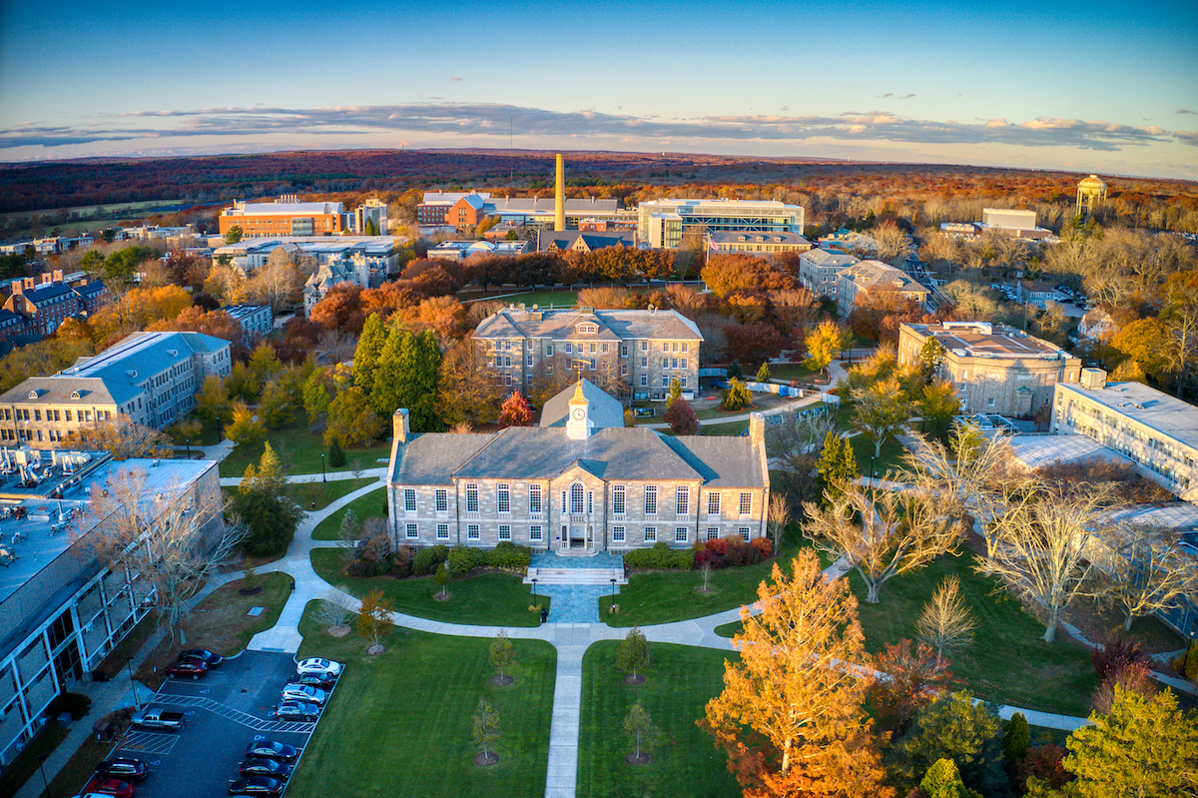
We are Moving! Kingston Campus
TBD

Slide 4

https://youtu.be/K9y_SVfNNIE

Slide 5
ABE Resources
LabXchange
https://www.amgenbiotechexperience.com/
M3rlot!
ABE offers lab-based, classroom-based (non-lab), and web-based investigations in biotechnology, and provides professional learning opportunities and resources to support teachers and students in the use of ABE materials.

Slide 6
ABE RI Resources
ABE RI website https://amgenbiotechexperience.net/rhodeisland/node/511
  Access directly or though the Amgen Biotech Experience Website (register)
ABE RI website
  Resources for each lab: 1, 2a, 4a, 5 and 6 and Colony PCR
  Quick guides for Gel making and resource binder information
  Videos to be coming ( we hope)

Slide 7

ABE lab Manual
M3rlot!
Doreen Osgood, ms,pHd.
ABE RI PI and Director

Slide 8
View the entire Foundations of Biotech package of materials (all of the below sequences are included):
Teacher Guide [7 MB] (password protected) | La Guía del profesor—todas secuencias (protección por contraseña)
Student Guide [6 MB] | La Guía del estudiante—todas secuencias
SEQUENCE OPTIONS
Abridged Genetic Engineering Sequence (16–18 class sessions)
The Abridged Genetic Engineering Sequence is identical to the Complete Genetic Engineering Sequence except that students are provided with the recombinant plasmid rather than creating it themselves.
Teacher Guide (password protected) M3rlot!
Student Guide
Related Resources
List of Laboratory Reagents
Abridged Genetic Engineering Pathway PowerPoint
List of Laboratory Reagents
Colony PCR (1–2 class sessions)
The Colony PCR lab is designed to be used as part of Foundations of Biotech. In this lab, students sample a colony from one of their plates and perform PCR on it to confirm the presence of the desired plasmid.
Teacher Guide (password protected) | Guía para el profesor (protección por contraseña)
Student Guide | Guía para el estudiante

Slide 9

LAB Guides: Current 2019
Manuals/Guides
  All sequences available online for print
    Website; curriculum; teacher/student guides
    Teacher guide password protected:
      M3rlot!
If using 2015; Begin at Tab C

Slide 10
2015 Teacher LAB Manual/Guide
TAB A
  Amgen biotech Experience & Program introduction
  Chapter 1: Tools of the trade
TAB B – Complete sequence
  Chapter 2: How do you begin to clone a gene?
  Chapter 3: Building a recombinant plasmid
  Chapter 4: Making sure you’ve got a recombinant plasmid
  Chapter 5: Getting recombinant plasmids in bacteria
TAB C – Abridged sequence
  All above EXCEPT Chapter 3
TAB E: Getting what we need
Abridged Genetic Engineering Sequence (16–18 sessions) | Tab A | Introduction: Students read about the biotechnology and biopharmaceutical industries. | 2
 |  | Lab 1: Students learn how to use two basic biotechnology lab tools: micropipettes and gel electrophoresis | 2–3
 | Tab C | Lab 2A: Students learn how plasmids are made. In the lab, students use restriction enzymes to create DNA fragments that contain the rfp gene. | 3–4
 |  | Lab 4A: Students verify that they have the correct recombinant plasmid. | 3
 |  | Lab 5A: Students transform the bacteria using the recombinant plasmid, then grow the transformed bacteria. | 3
 | Tab E | Lab 6 (optional): Students extract and purify the protein made within the bacteria by the rfp gene. | 3

Slide 11
STUDENTS 2015 manual/Guide
Start at Tab A
  Everyone does
  About the Amgen Biotech Experience – important! (A-1)
    Please relay to students HOW they are getting to use this kit
  Then program introduction & tools of the trade (A-3 & A-15)

Slide 12
Program
Expectations

Slide 13
Policies for ABE school sites – from P.O.
New teachers need to be trained at an ABE PDI before they can sign up to borrow ABE materials and equipment
Do not supply materials and equipment to labs where the teacher has not yet been trained
Annually, each teacher who participates in the ABE program should submit a signed copy of the Amgen Biotech Experience
Expectations and Policies Form prior to or when picking up their ABE materials

Slide 14
Program Expectations
Contact Coordinator ( Alden) to confirm date scheduling
Pick kit up and return on the dates agreed upon
Return kit as it was received
Notify Coordinator with any broken equipment
Any items not returned are reported to the EDC. School that do not return all items will not be able to borrow any future kits.

Slide 15
Required Documents: Dates to be Determined
Expectations and policies form: Each teacher!
Teacher information form : To be filled out by each teacher.
Kit request form: To be filled out by the Lead Teacher. Must list all teachers utilizing any portion of the kits.
Must list all participating teachers and contact information
New! After Rotation Survey

Slide 16
Kit ScheduLIng

Slide 17
Kit Contents
How to unpack: Put refrigerator and freezer items away ASAP.
Equipment and supplied checklist: Check that you receive what is indicated on the list.
Resource Binder
How to store: Keep track of kit contents.
How to pack: Try to put items back in appropriate labeled bin
All plastic ware, dyes, equipment, columns and reagents must be returned. Even empty bottles!

Slide 18
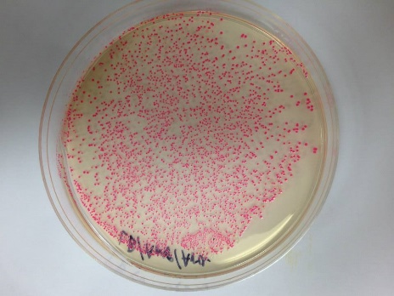
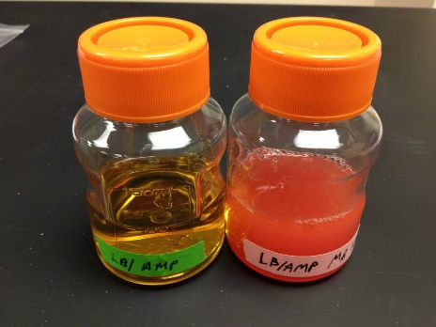
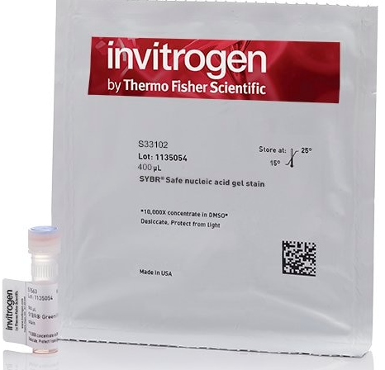
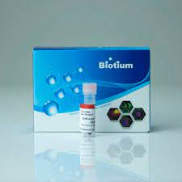
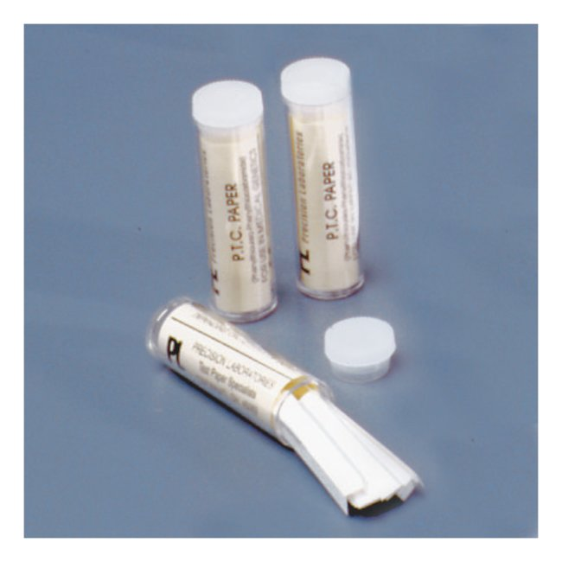
The Additional Labs CHANGES
4A: Post Stain: We will no longer provide a Bottle of 1xSB with Sybersafe
  4A/Colony PCR: SyberSafe will be replaced with Gel Green. Same dilution. Still light sensitive
6A – Protein purification preparation. Only will give out “transomed cells’ if requested.
Postponed: PTC PCR-using Single-nucleotide Polymorphism to predict bitter-tasting ability.
The Amgen Biotech Experience (ABE) offers lab-based, classroom-based (non-lab), and Web-based investigations in biotechnology.

Slide 19
The Additional Labs CHANGES
ABE’s classroom-based Exploring Precision Medicine mirrors the lab-based method but is designed for classroom use.
check out our classroom-based version.
The module explores the connections between genes and traits. Students learn how slight genetic differences can impact how well a patient responds to certain medications.
Working with classmates and using online resources, students examine how variations in a gene influence individuals’ abilities to taste the bitter compound “PTC,” and then consider how tiny differences in individuals' DNA might be responsible for variations in drug metabolism

Slide 20
What we OFFER and hope to offer again?
Biotech student award (electronic certificate)
Amgen visits (teachers)
Bring your students to URI day
Albert Kausch
  CMB 190: Issues in Biotechnology
  available to High School (HS)
  3 college credits for a fee

Slide 21
THANK YOU!

