Slide 1
Making sure you’ve got a recombinant plasmid
Laboratory 4A
Lab 4/4A video

Slide 2
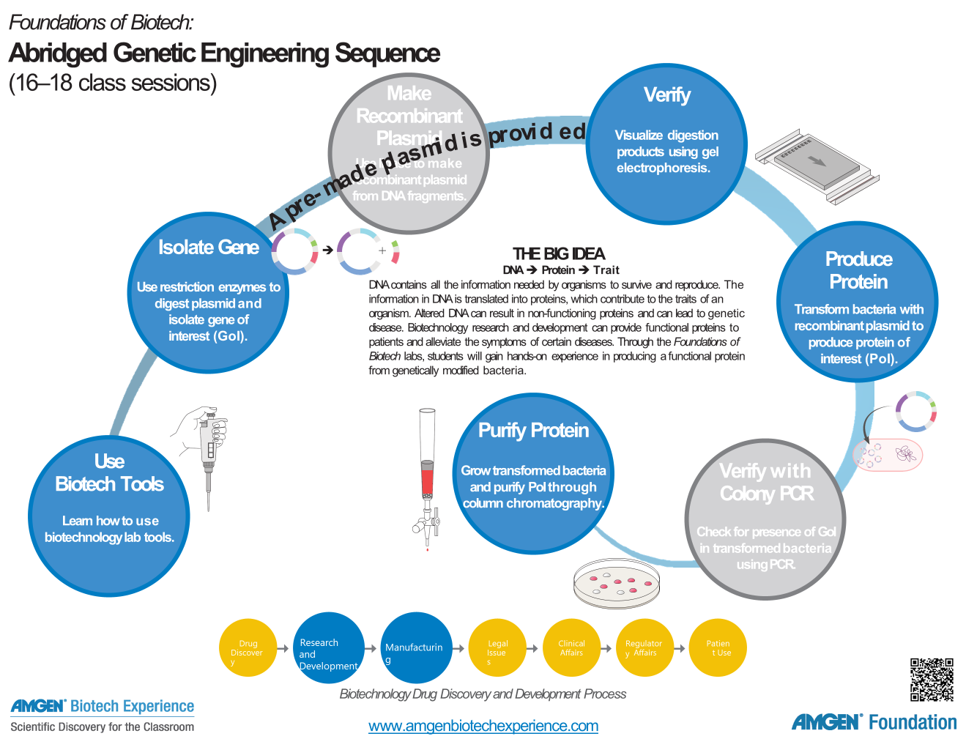
We are here

Slide 3
2019 guides
Student Guide: Starts on page 51
Teacher Guide: pg 87

Slide 4
2015 Student guides
Tab C - abridged sequence
Starts on page C-23 (Teacher guide does as well!)
Student
  Introduction
  Reading - Verification
  Laboratory 4a: Verification of the recombinant plasmid using gel electrophoresis
  Questions
  Glossary

Slide 5
Chapter 4A Goals
Previous knowledge the same
Learning goals:
  Describe why it is important to verify products created in the genetic engineering process
  Predict the relative speed of DNA restriction fragments and plasmids through gel electrophoresis
  Separate and identify DNA restriction fragments and plasmids using gel electrophoresis

Slide 6
Proposed Sequence of Activities
Session 1
  Review Intro and Goals – 5 minutes
  Have students answer the What do you already know questions – 10 minutes
  Have students read Verification and answer the CONSIDER questions – 15 minutes
  Lead a discussion on student answers – 5 minutes
  Have students prep for Laboratory 4A – 10 minutes
Session 2
  Have students complete laboratory 4A – 45 minutes
Session 3
  Have students discuss Chapter 4A questions and lead a discussion on answers – 45 minutes

Slide 7
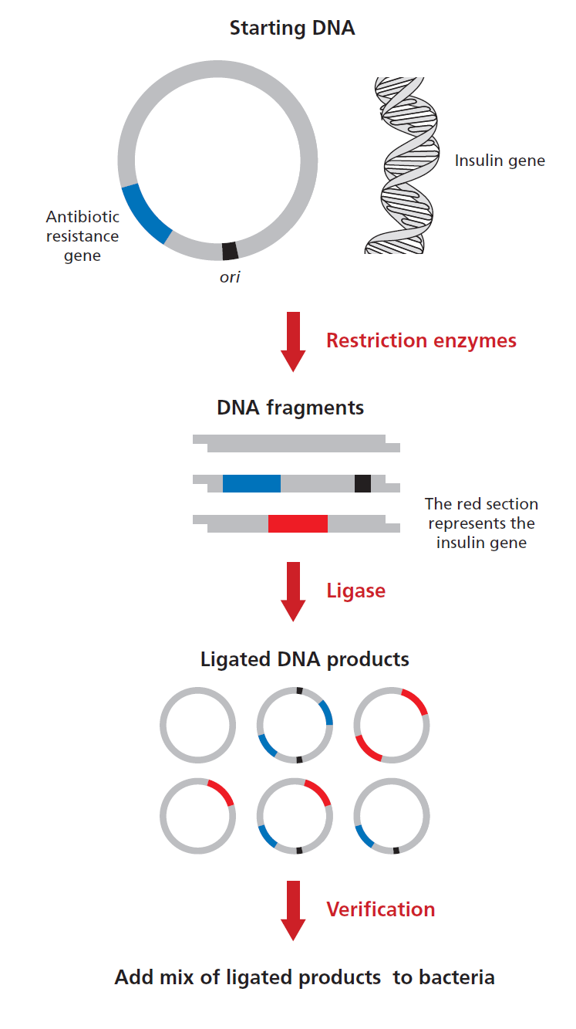
Verification
Why do scientists have to verify what they have done in lab?
  Many sources of potential error
  Ligation of DNA sometimes results in different combinations
  Confirmation that you made the recombinant plasmid that is needed
    Restriction digest & ligation procedure was successful
Biotech companies
  QC

Slide 8
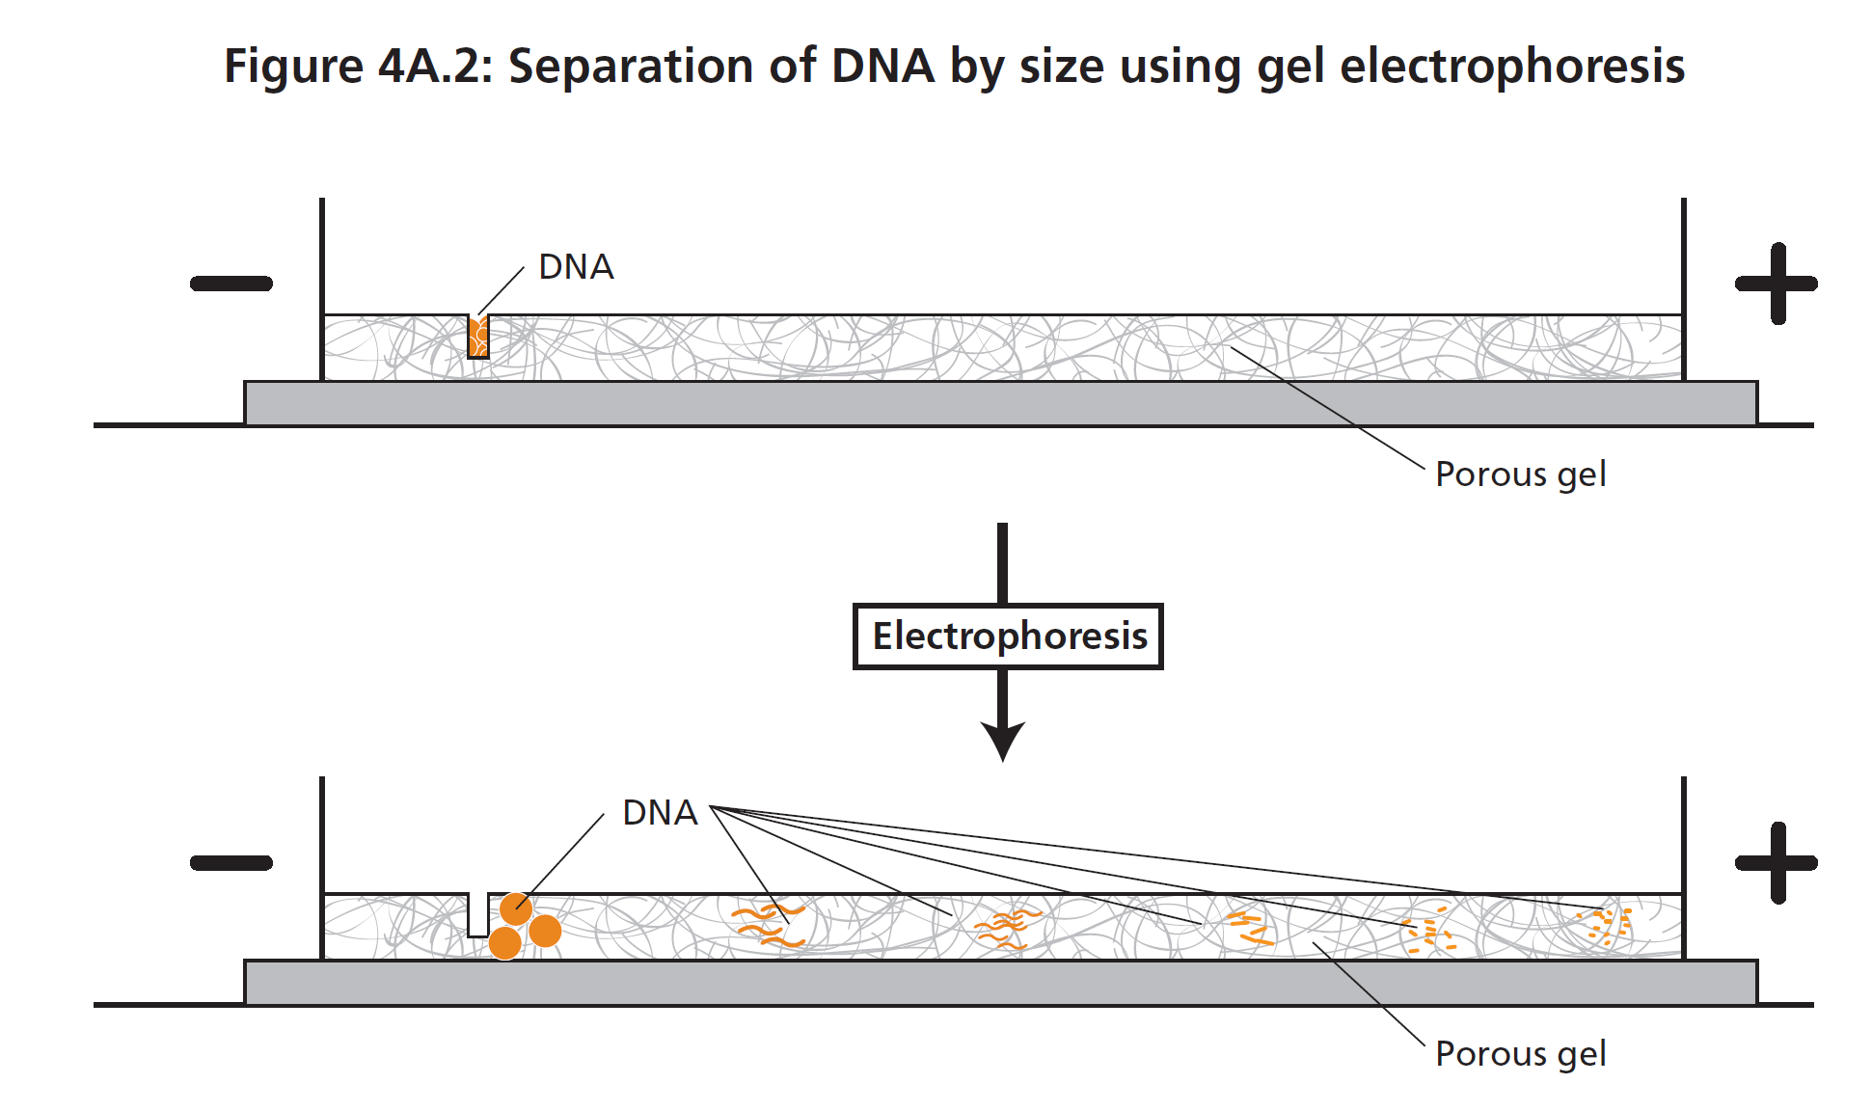
Gel Electrophoresis
Used in DNA verification and purification
Separation technique
  According to molecular size – number of base pairs
    Smaller will move faster!!
  DNA negatively charged
    Due to phosphate groups
    Will move away from negative (black) electrode
    Will move towards the positive (red) electrode

Slide 9
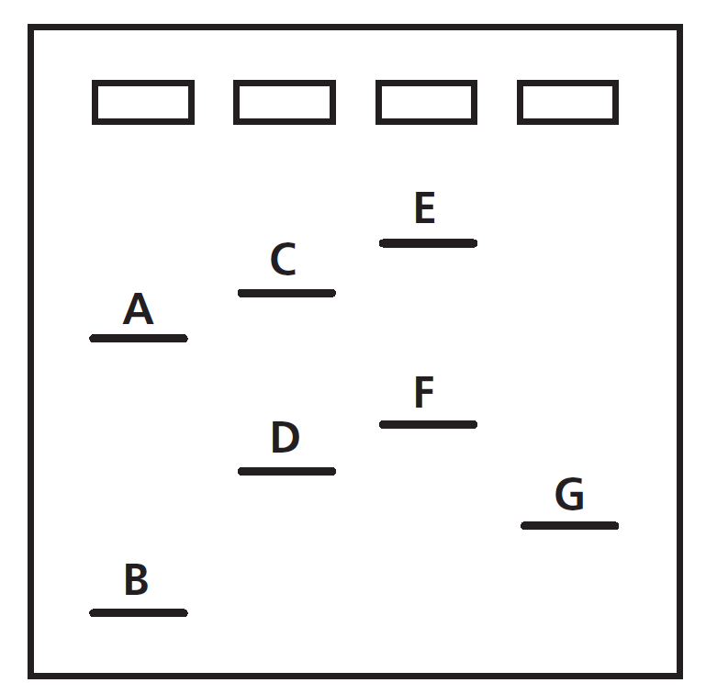
What is the order of fragments from smallest to largest?

Slide 10
What is the order of fragments from smallest to largest?
B, G, D, F, A, C, & E

Slide 11
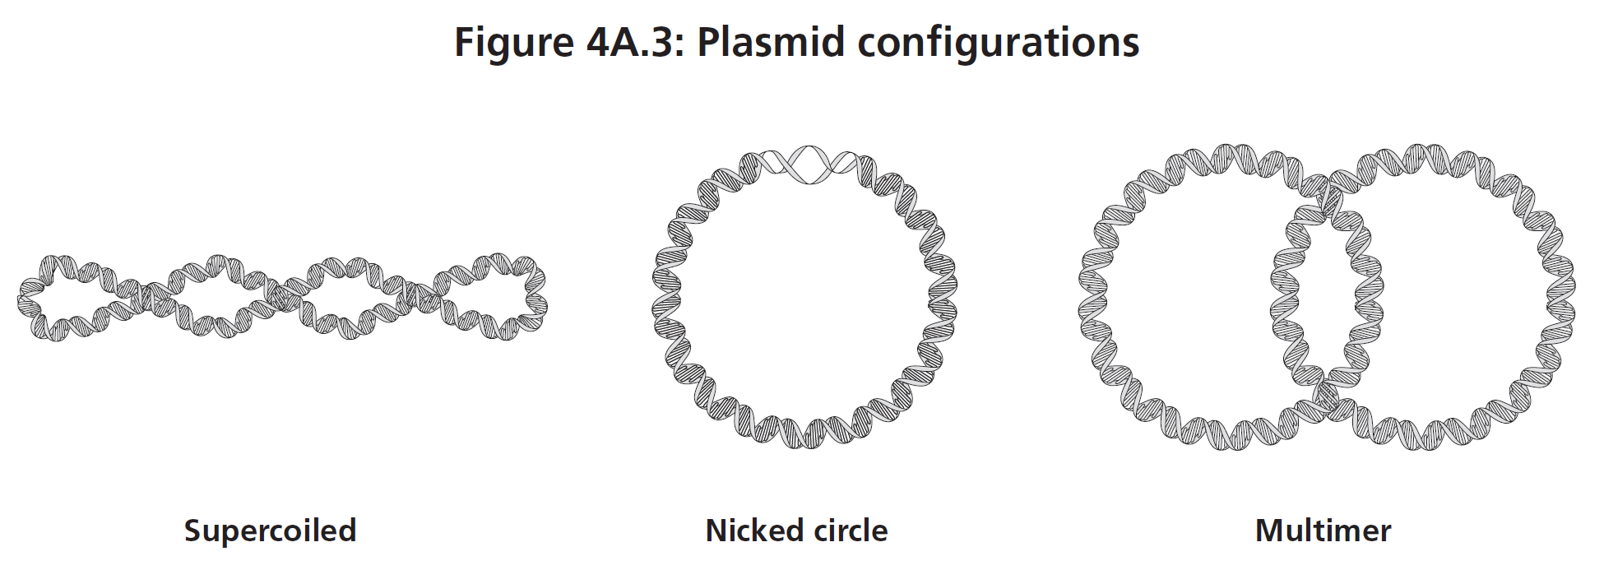
Plasmid conformations
Will affect movement through gel
Exist in different configurations
  Supercoiled
  Nicked circle
  Multidimer
  Linear

Slide 12
Plasmid conformations - supercoiled
Most common configuration
Twisted rubber band
Twisting results in compact molecule
Move through gel quickly
Result of an enzyme in bacteria – only seen in replicated bacteria
Default configuration in bacteria

Slide 13
Plasmid conformations – nicked circle
Floppy circle
Has a break in one of the covalent bonds
Does not move through gel easily

Slide 14
Plasmid conformations - multimer
Think “magic” rings
Plasmid replicated so fast they remain attached to each other
Twice as large as single plasmid = moves slowest through gel

Slide 15
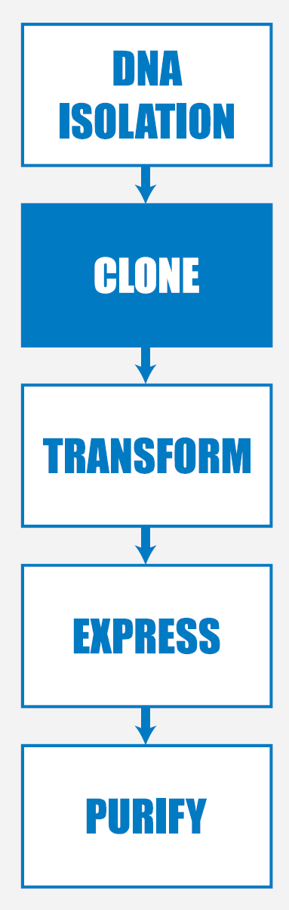
Laboratory 4A
Verification of the recombinant plasmid using gel electrophoresis

Slide 16
purpose
Use gels electrophoresis to examine products from restriction digest of pARA-R
  From laboratory 2A
  By BamHI and HindIII
Understand the use of a DNA ladder
  Mixture of DNA fragments with known sizes
Loading dye
  Set of dyes added to DNA
  Move farther than sample = time to stop running the gel

Slide 17
Take digested and undigested plasmid samples (R- & R+)
  Undigested = control (R-)
  Digested = R+
  2-3 bands may appear

Slide 18
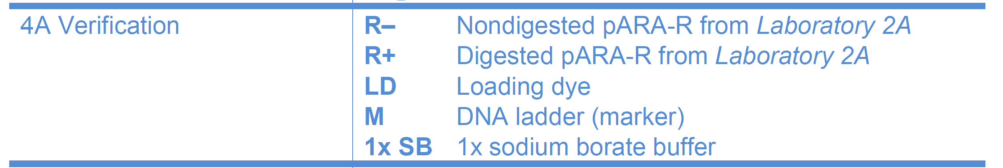
Teacher preparation
Page C-25 through C-29 2015 manual
  Make agarose gels
  Aliquot reagents for lab
  Gather remainder materials

Slide 19
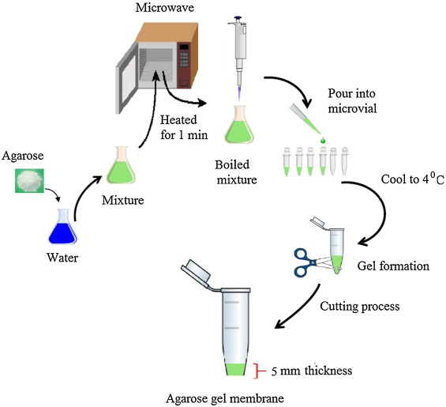
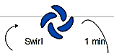
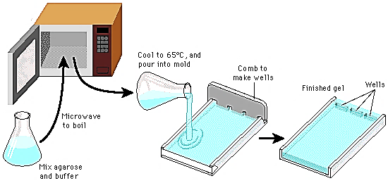

Making Agarose Gels
Lab 1.2: no SyberSafe®
Lab 4A and Colony PCR: add SyberSafe®
Lab 1.2: Step A 0.8% gels
Lab 4A and Colony: Step A 0.8 % gels
Add 15µL SyberSafe® to 150mL of 1X SB or 1µL to 10mL of 1X SB
Gently swirl
Lab 4A, Colony PCR
Step B
1.2g
Back in microwave
Lab 4A/Colony PCR: Step C
150mL
1X Sodium Borate buffer
Lab 1.2:
Step B
Let the solution cool down to about 60 °C at room temperature.
Running Buffer for all labs: 1X Sodium Borate;
ie:10 mL 20X SB to 190 mL dH₂0
(30mLs of agarose per plate; ~ 5 gels per flask for lab 1.2 and 4A and Colony PCR.

Slide 20
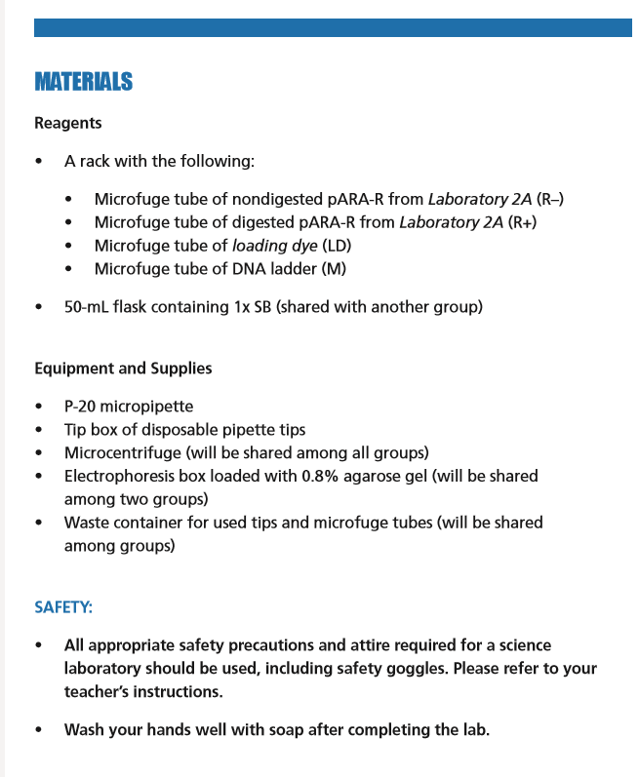
Materials - Students

Slide 21
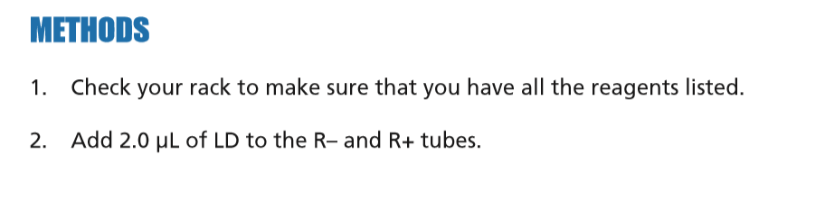
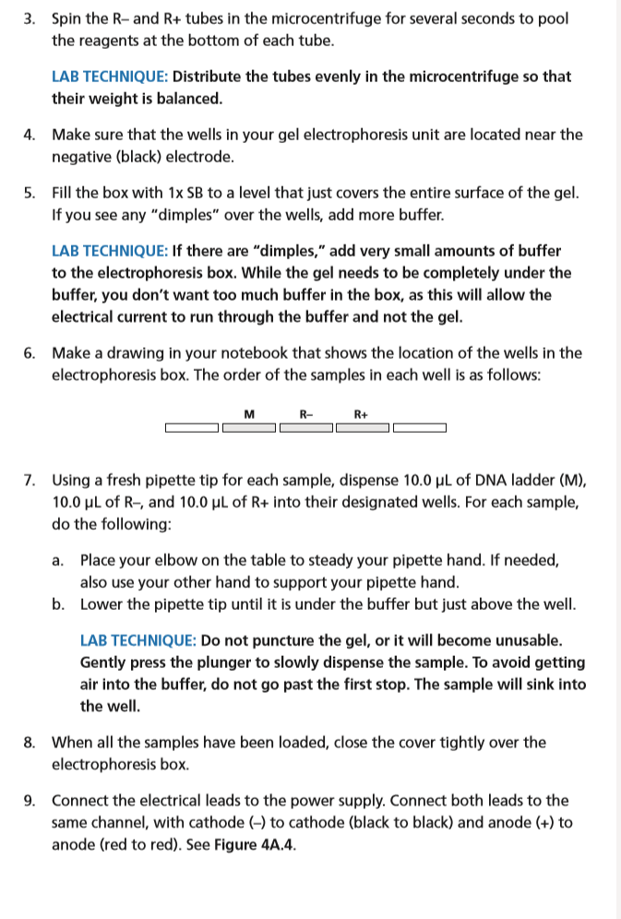
methods- Students

Slide 22
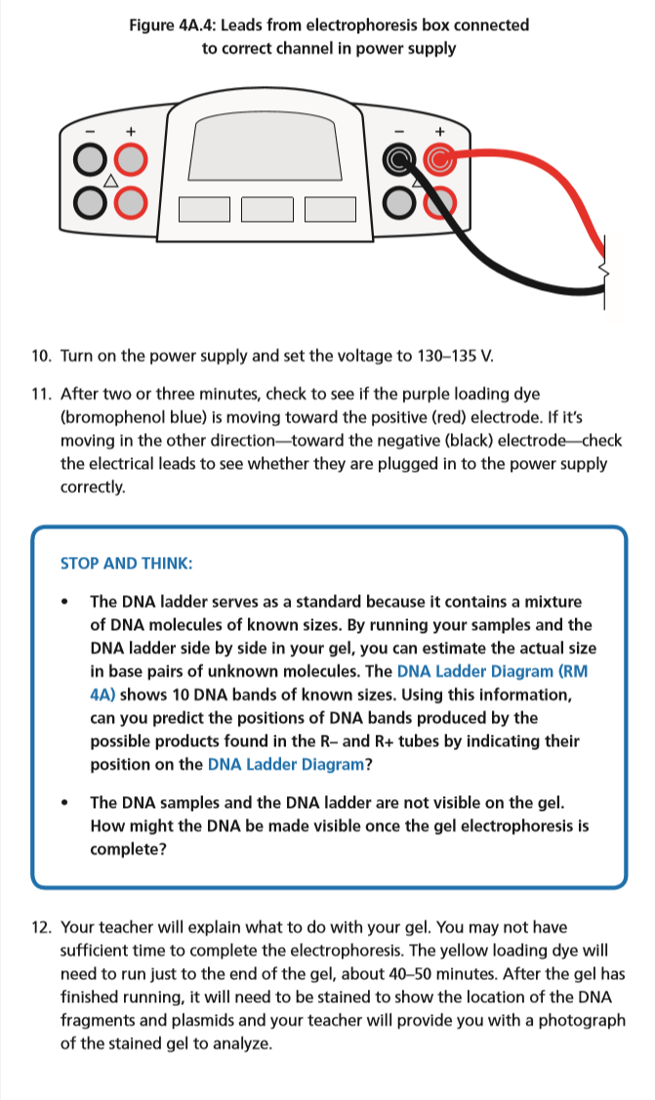
Methods - Students

Slide 23
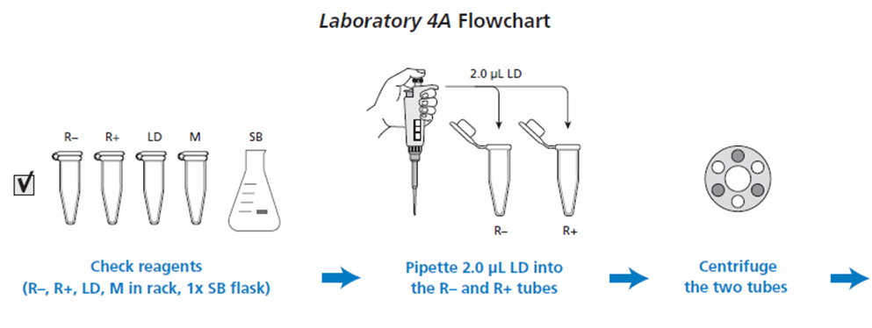
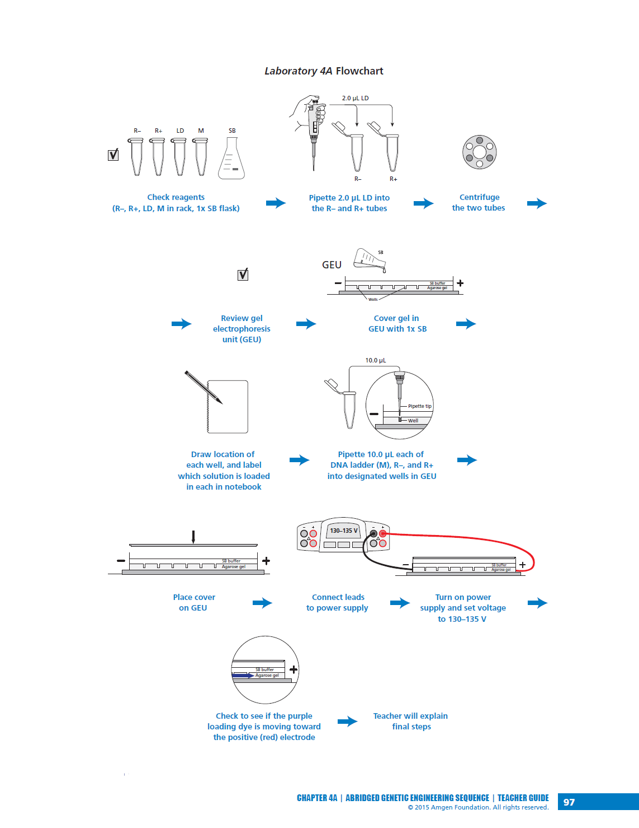
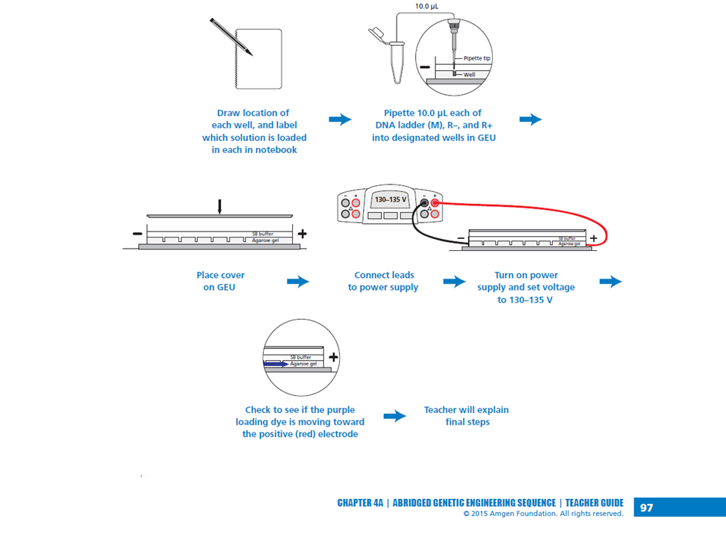

Laboratory 4A - Flow Chart

Slide 24
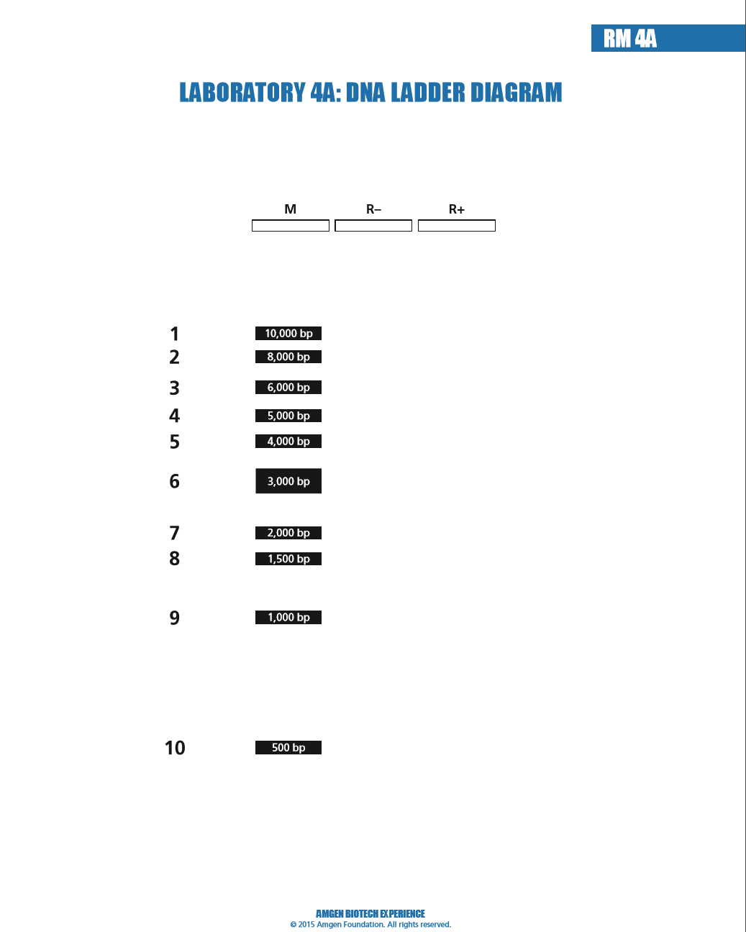
DNA ladder diagram
10 bands of known sizes
Ask students to predict the positions of the DNA bands produced by possible products
  R-
  R+
  Indicate their position on the diagram

Slide 25
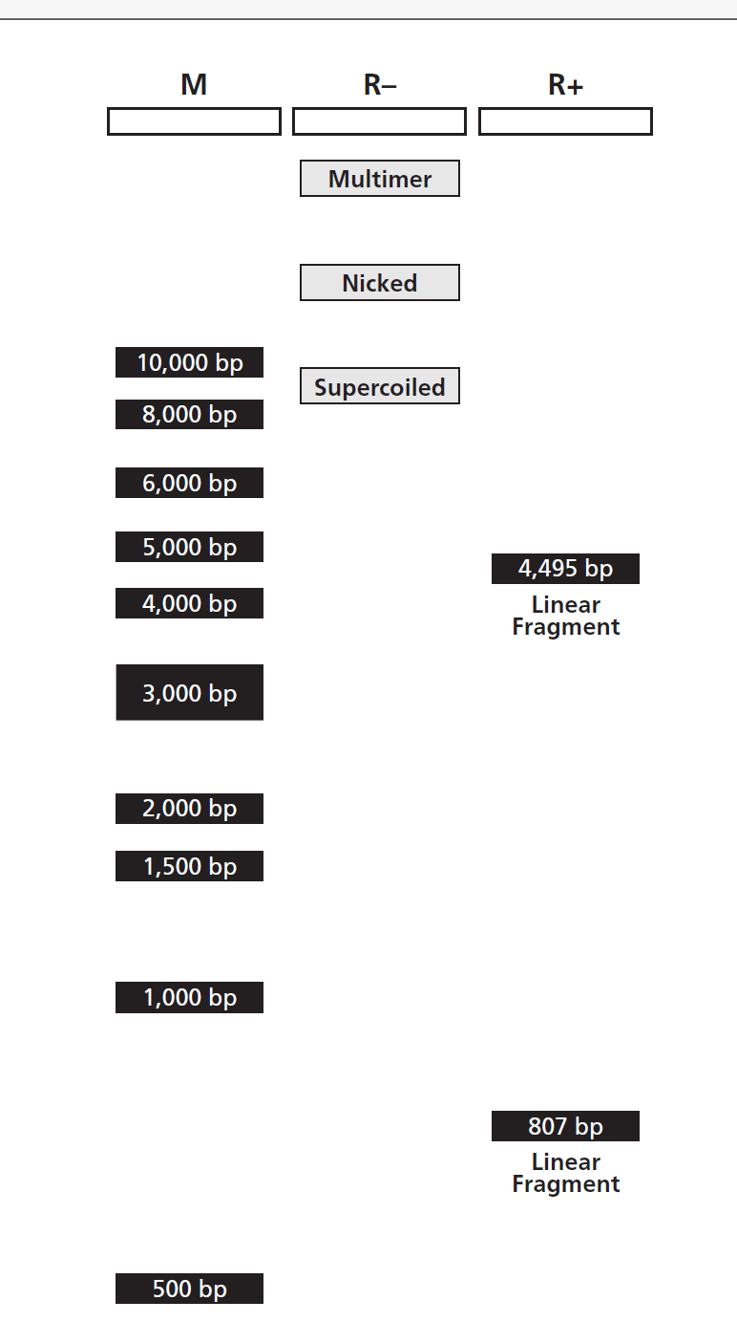

Slide 26
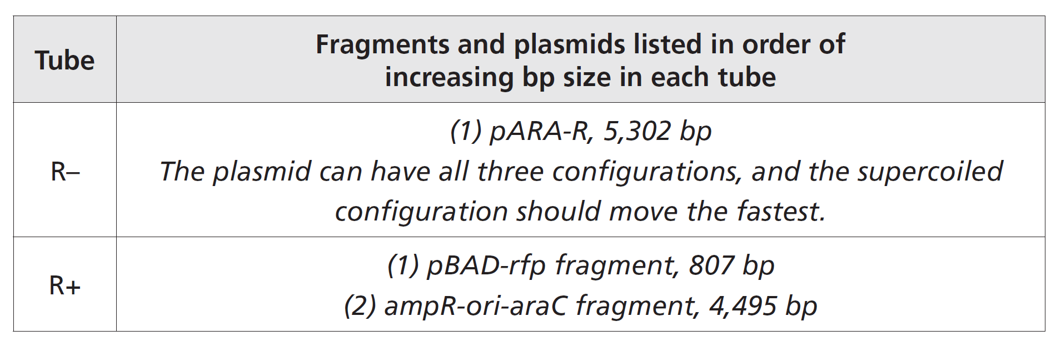

Slide 27
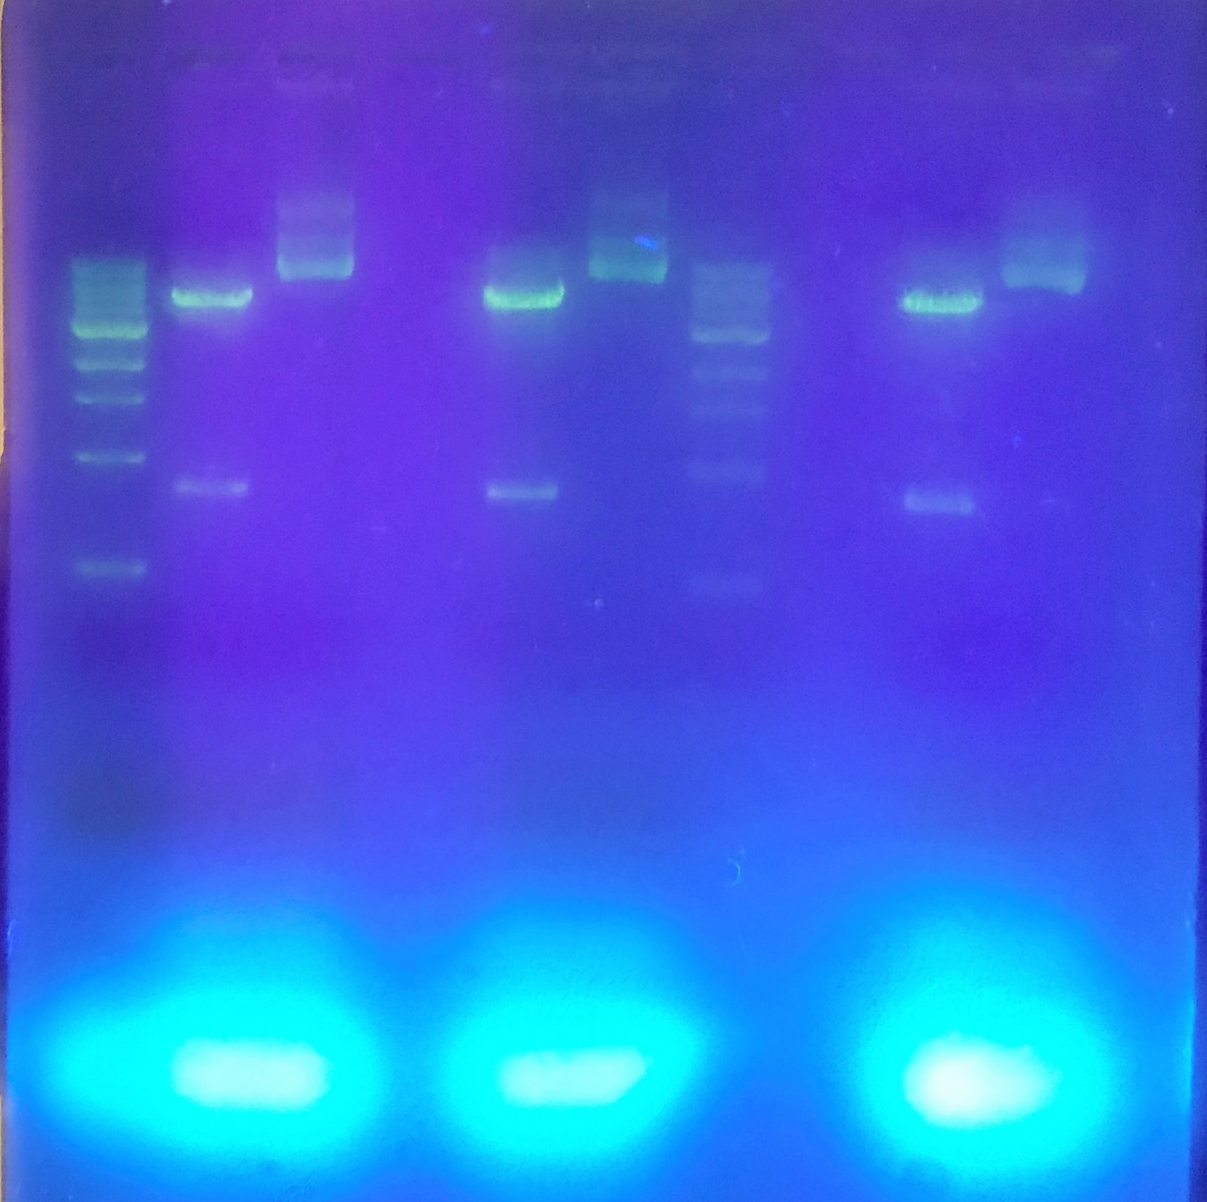
What should they get?
R+
R-
R+
R-
R+
R-
5,302 bp, pARA-R
4,495bp
1000bp
807bp
500bp
3ul of Sybrsafe to 30 ml of (melted) 0.8% agarose gel in 1X Sodium Borate Buffer

Slide 28
Now onto lab!

